Slide 1

Your Leadership Style
Discover Your Leadership Talents and How to Manage Differences
Notes:
Case Studies: Digital Advice & Intergenerational Wealth Transfer
Organizational Transformation
Big Data

Slide 2

Signals for Enhancing Your Leadership
Rate How Effectively You Lead Others?
Do you operate with a high-level of self-knowledge and manage your blind-spots?
Do you know how to identify and manage the right diversity of talents for the team?
Are you maintaining a balance between achieving results and building relationships?
Are you comfortable to hold the team accountable?
Do you clearly communicate the strategy and what is expected?
Are you being personally transparent, authentic and trustworthy?

Slide 3

Read Discover Your True North
Become an Authentic Leader
Stay on track toward the purpose of your leadership by:
Cultivating your level of self-awareness
Defining your values
Finding the “sweet spot” of your motivated capabilities
Building your support team and leading an integrated life
Making the journey from “I” to “We” as an empowering leader
Becoming a global leader

Slide 4

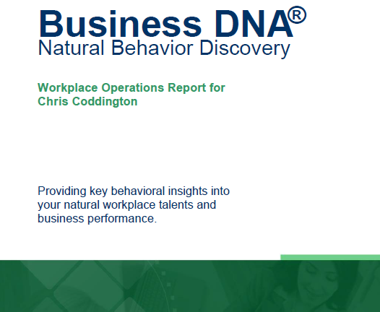

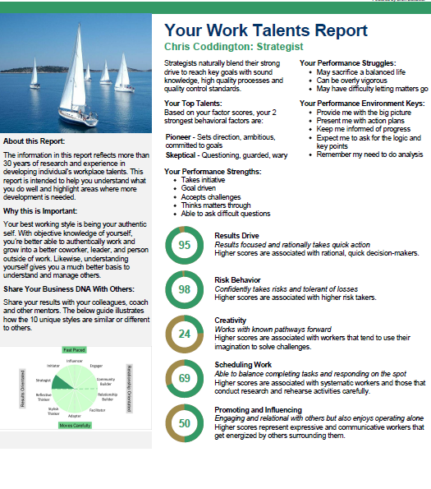
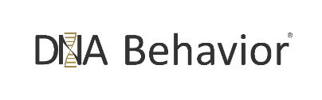
Discover Your DNA Behavior Style – A Quick & 91% More Reliable Method
DNA Natural Behavior Discovery (10 to 12 Mins)
Completed by each individual
leader and team-mate
Universally Applicable Insights
LEARNED SITUATIONAL BEHAVIOR
NATURAL BEHAVIOR
Automatic
Behavior Biases
Communication Style
Talents
Learning Style
Leadership Style
Decision-Making
Risk-Taking

Slide 5
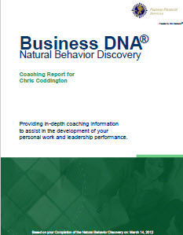

Business DNA Natural Behavior Discovery
Coaching Report for Talent Management and Foundational Insights to Discovering Your Leadership Talents
Business DNA Coaching Report
Detailed Analysis of 8 Primary Factors and 24 Sub-Factors
Strengths and Struggles
Keys to Building Your Leadership Performance
Customized Powerful Questions Based on Strongest Factors
10 Unique Natural Workplace Styles based on 8 Primary Factors and 24 Sub-factors

Slide 6
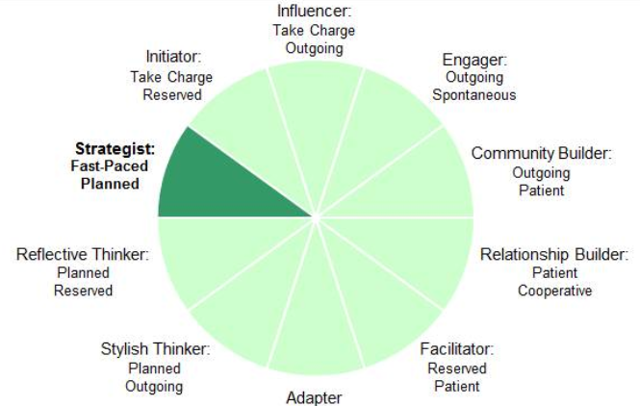
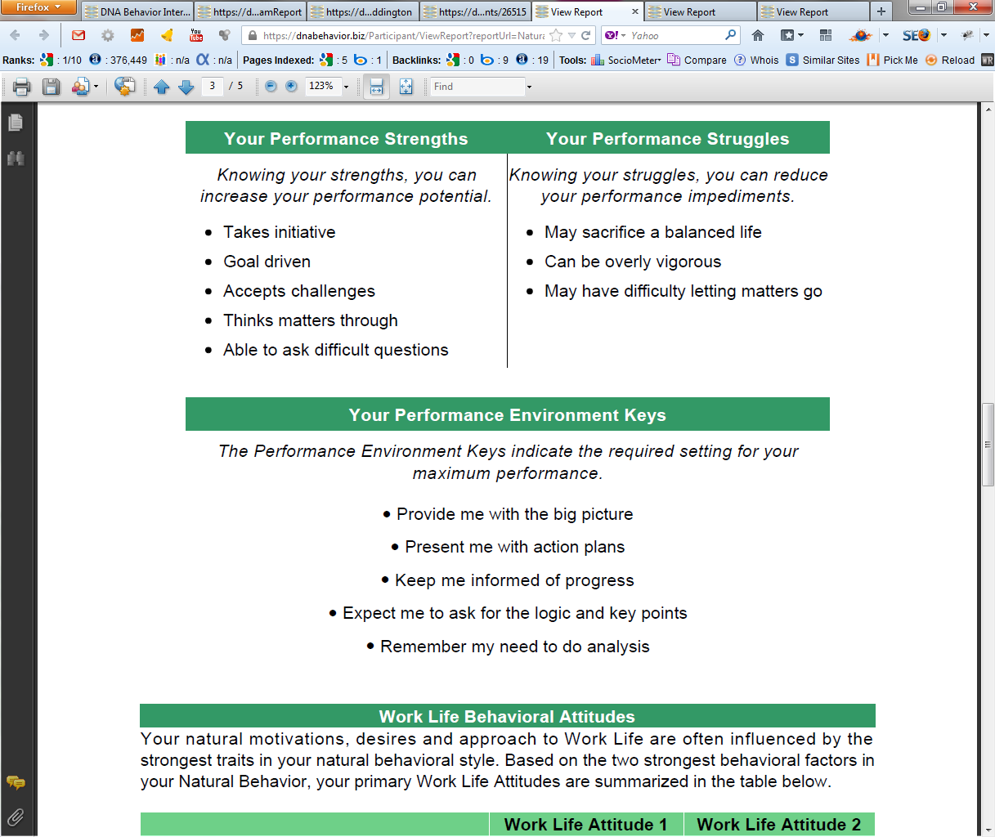
Practical Analysis of the Key Talents & Values
Driving Your Productivity and Relationships
10 Unique Natural Workplace Styles based on 8 Primary Factors and 24 Sub-factors
Customized DNA Ultimate Performance Guide

Slide 7
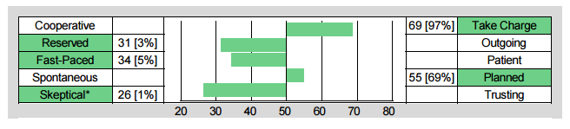
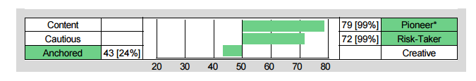
Building Your Own Level of Self-Awareness
Understand Your Talents, Strengths and Struggles – They Are Key to Your Leadership
Chris Coddington - Strategist
Skeptical Strength:
Questioning and guarded
Skeptical Struggle:
Too doubting and wary
Pioneering Strength:
Goal orientated and ambitious
Pioneering Struggle:
Too driven and success focused

Slide 8
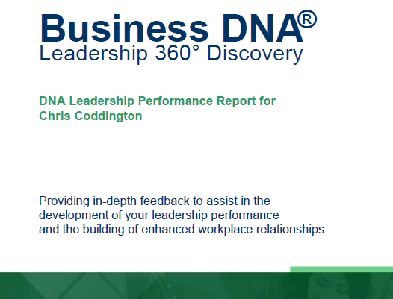
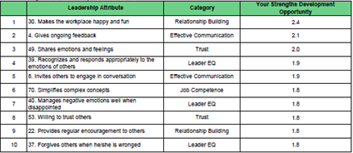
Enhanced Leadership Performance Development
Coaching for Developing Leadership EQ and Growth
The Leadership 360° Discovery Process provides objective measurement of how a leader is actually performing versus how they should perform based on their natural DNA style.
The DNA Leadership Performance Report highlights the leader’s top 10 leadership strengths and struggles, uncovering 75 items relating to their leadership performance in 7 distinct areas:
Communication
Results
Relationships
Trust
Emotional Intelligence
Values
Competence

Slide 9
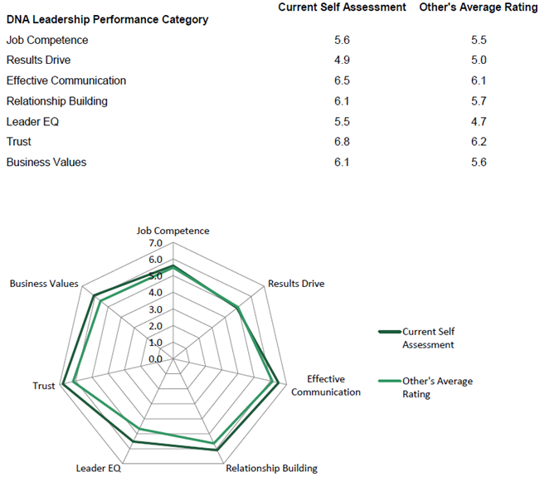
DNA Leadership Performance Report
The Gaps Highlighting Development Opportunities

Slide 10
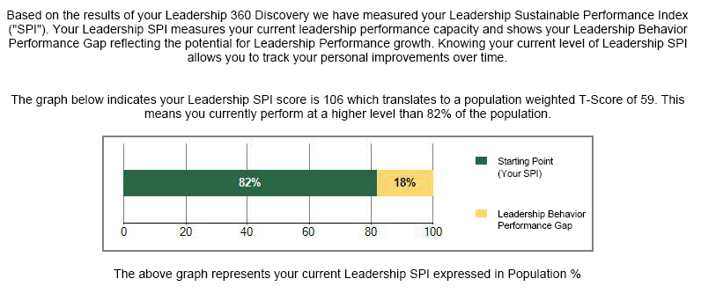
Measuring Performance
Your Leadership Sustainable Performance Index

Slide 11




Identifying Your Natural DNA Behavior
and Leadership Performance
Enhancing Your Leadership Effectiveness
Managing Behavioral Differences
Programs available from DNA Behavior to Improve Personal and Business Performance
Unifying the Team

Slide 12


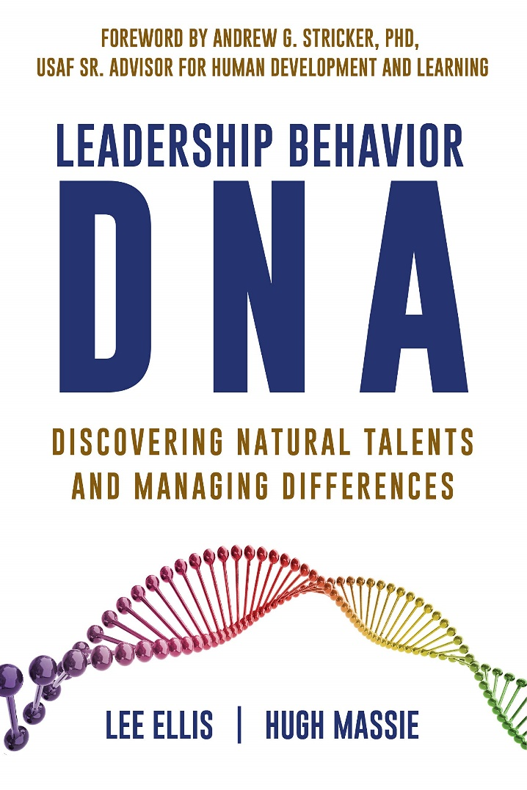
Hugh Massie, along with Lee Ellis literally wrote the book on discovering Natural Talents and Managing Differences.
Now available on Amazon.com
DNA Behavior
Unlocking the Science of Natural Behavior In Yourself and Others
dnabehavior.com

