Slide 1

Sales Management
Building a Scalable Sales Process
Notes:
Case Studies: Digital Advice & Intergenerational Wealth Transfer
Organizational Transformation
Big Data

Slide 2

Signals Your Business Has Strong Sales Process
Rate How Your Business Is Geared to be Sales Focused
Do you consider your business is a sales machine?
Are you routinely meeting your sales growth goals?
How easily are you generating qualified sales leads?
Is your sales conversion process effective?
Do you have the right sales team?

Slide 3
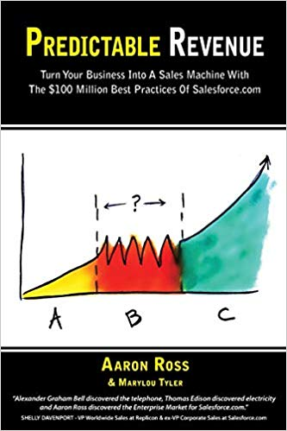
Read Predictable Revenue
Turn Your Business Into an Outbound Sales Machine
Learn how to design an outbound sales process based on the following:
Generating leads without cold calls and a large marketing budget
Making outbound selling friendly, helpful and enjoyable
Developing self-managing sales teams
Re-defining sales tasks to keep sales focus
Cultivating sales talent

Slide 4
Identifying the Talents for a Sales Team
Understand the Talents Required For Building the Sales Team
DNA Behavior Factor | Talents - Activity | Outside Sales | Inside Sales | Customer Service
Take Charge | Visionary/Decisive | >55
Cooperative | Listens/Collaborates |  | <50 | <50
Outgoing | Networks/ Communicates | >55 | >55 | >45
Reserved | Task Focused/ Researches
Patient | Friendly/Supportive |  | >45 | >50
Fast Paced | Handles Objections/ Rejection | <45
Planned | Detailed/ Structured |  |  | >50
Spontaneous | Flexible | <45 | <50
Trust | Receptive |  | >50 | >45
Skeptical | Asks Questions | <45
Pioneer | Goal Driven | >55 | >50
Content | Balanced |  |  | <50
Risk Taker | Takes Bold Action | >55 | >45
Cautious | Manages Risk |  |  | <50
Creative | Problem Solves
Anchored | Implements/ Executes | <50 | <50 | <45

Slide 5
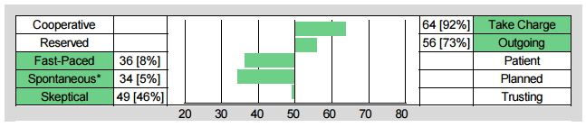
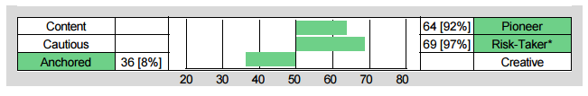
Identifying the Talents for Sales
Understand the Talents Required For Outside Sales Performance
Dave Michaelson – Influencer
Take Charge:
Will direct the client
Outgoing
Will network to prospect for clients
Fast-Paced:
Will handle rejection
Pioneer:
Will be competitive and follow through
Risk-Taking
Will take chances to open new sales channels
Anchored:
Will follow processes and procedures consistently

Slide 6


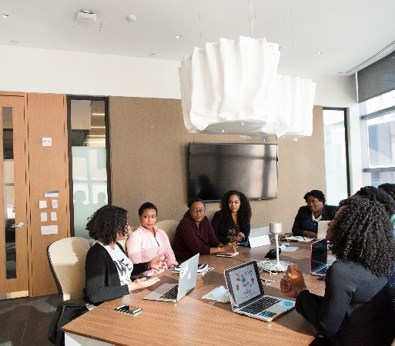

Identifying and Managing Sale
Team Behaviors
Building a Scalable Sales Process
Sales Model Review
Programs available from DNA Behavior to Improve Personal and Business Performance
Re-Defining a Scalable Sales Model

Slide 7


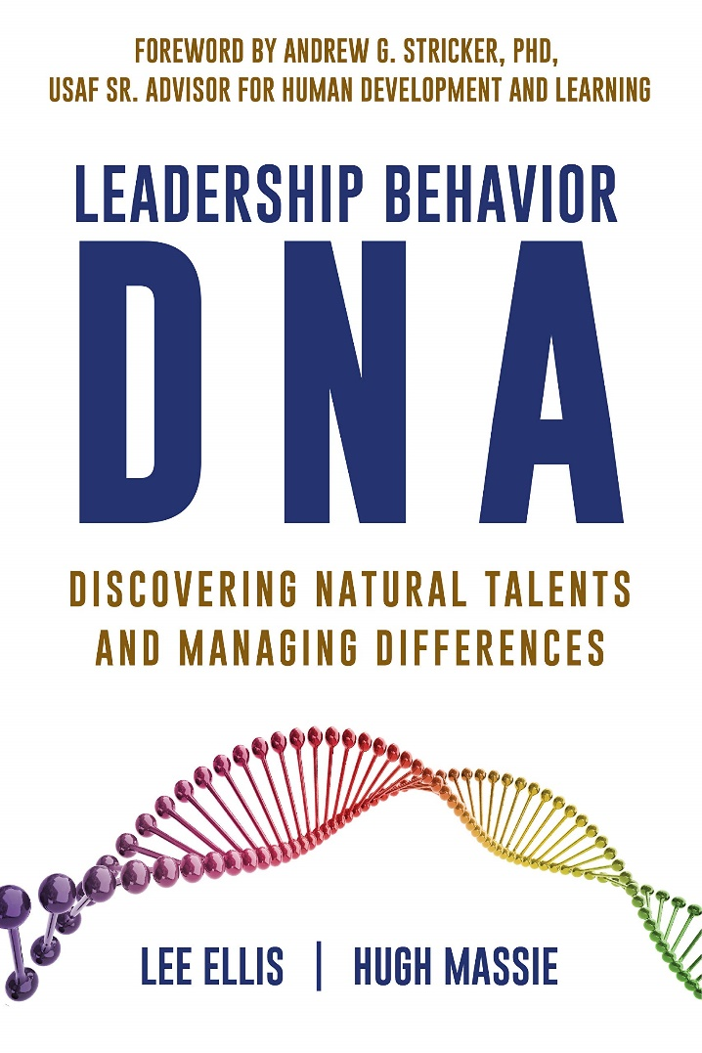

Hugh Massie, along with Lee Ellis literally wrote the book on discovering Natural Talents and Managing Differences.
Now available on Amazon.com
DNA Behavior
Unlocking the Science of Natural Behavior In Yourself and Others
dnabehavior.com

