Slide 1

Quality Life Discovery
Finding and Living with Purpose
Notes:
Case Studies: Digital Advice & Intergenerational Wealth Transfer
Organizational Transformation
Big Data

Slide 2

Signals of a Quality Life
How Would You Rate Your Life Quality in these key areas:
,
You are able to articulate your purpose?
You feel balance in key areas of your life?
You are living with purpose and intention?
4. You have attended to your wants and needs?
5. You have a plan for giving back to the community?

Slide 3

Read Man’s Search for Meaning
Learn:
That we cannot avoid suffering but we can choose how to cope with it.
That in difficult times you can find meaning and move forward with renewed purpose.
A key objective of life is discovery and pursuit of what you personally find meaningful.
How imagining your future can affect longevity and happiness.

Slide 4
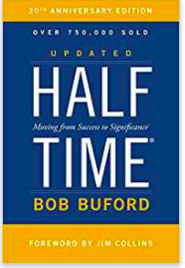
Read Half Time
Moving from Success to Significance
Learn:
The importance of the second half of your life.
That time is needed to figure out what you want to do with the rest of your life.
That this is a season of revitalization and for catching a new vision.
The questions to consider and reflect upon in the transition from the first to the second half of your life.

Slide 5
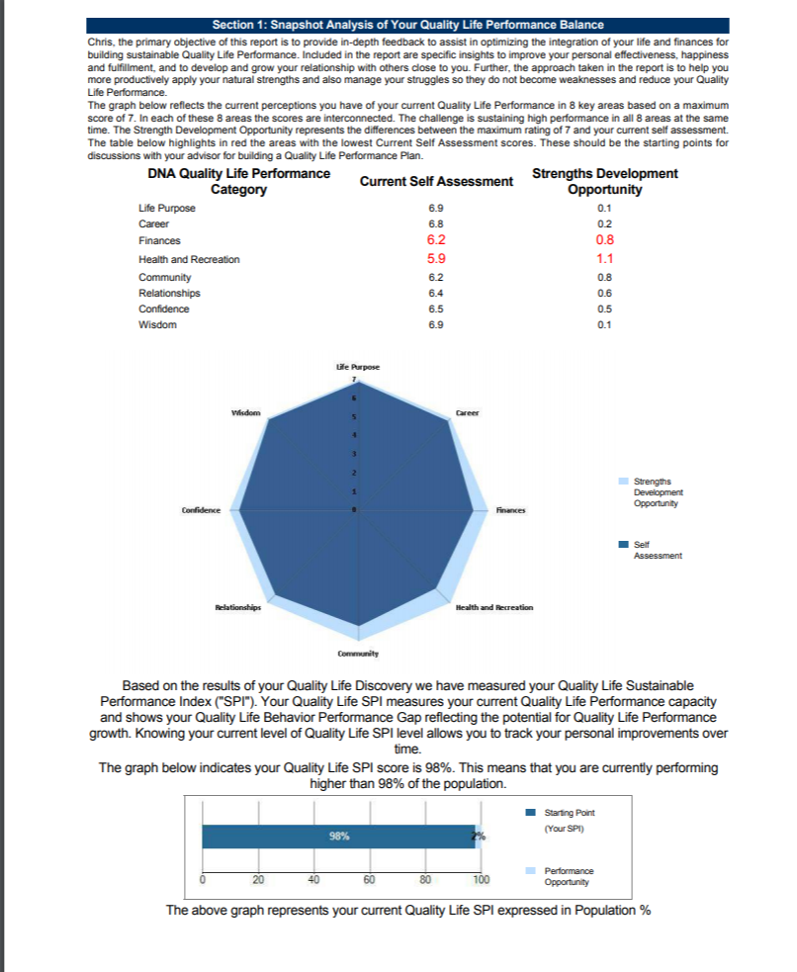
Identifying Your Quality Life Balance
Understand where your greatest strengths and opportunities exist
Rate Life Performance Categories:
Life Purpose
Career
Finance
Health and Recreation
Community
Relationships
Confidence
Wisdom
Review with a Coach:
What is working well?
Where do you want to see improvement?
How are you using your unique talents in building a quality life?

Slide 6
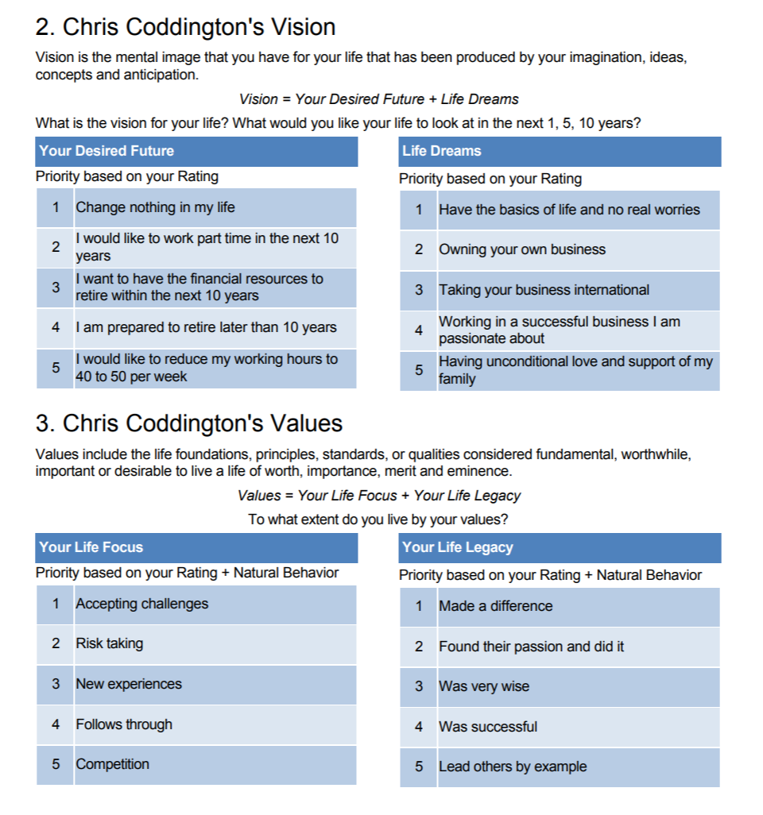
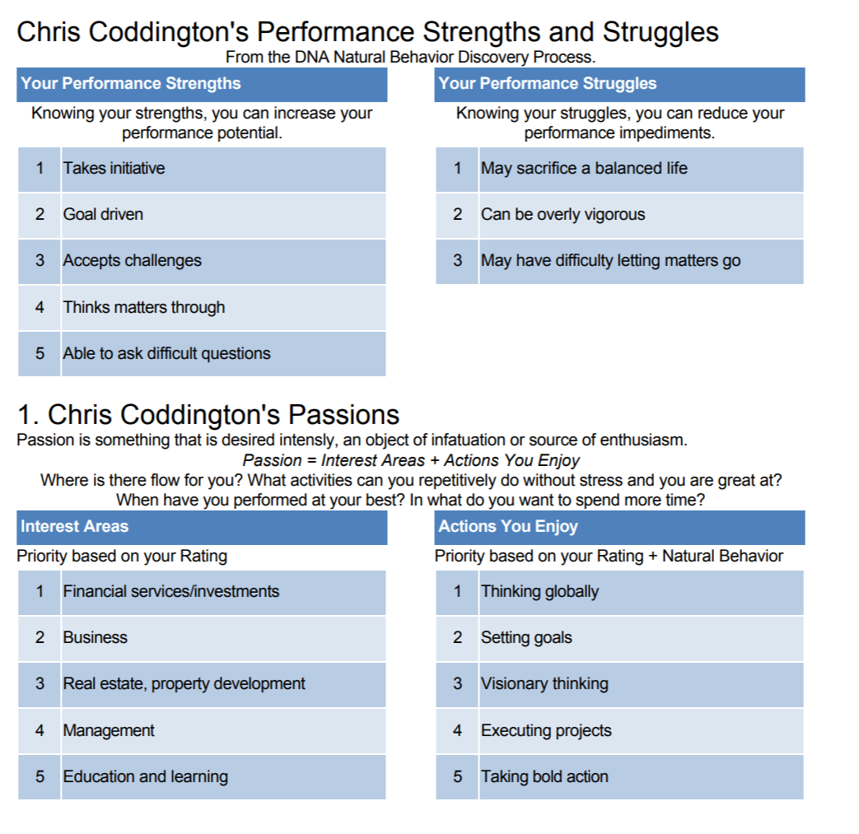
Discovering Your Life Purpose
Review Quality Life Planning
Explore your Talents, Passion, Vision and Values to define and articulate your life purpose.

Slide 7




Plan Your Quality Life
Quality Life Discovery
Measure Where You Are
Programs available from DNA Behavior to Improve Personal and Business Performance
Define and Live Your Life Purpose

Slide 8


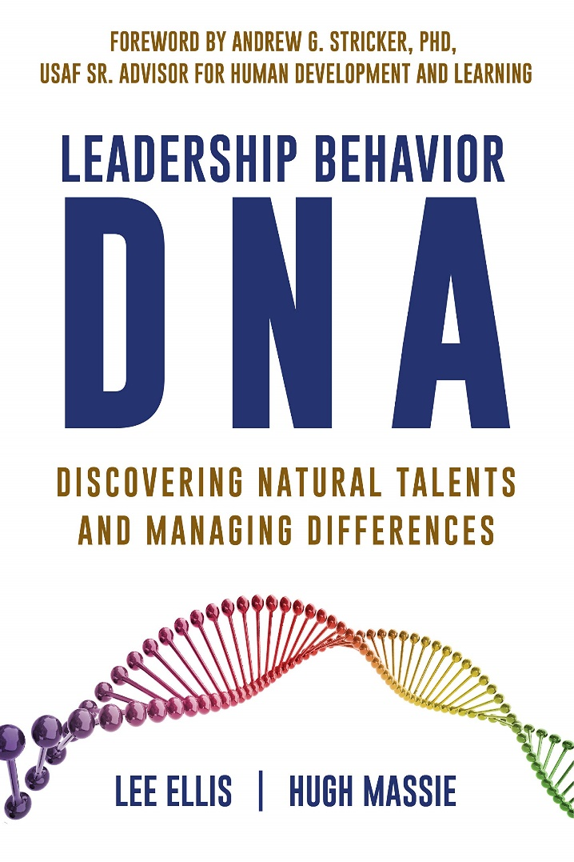
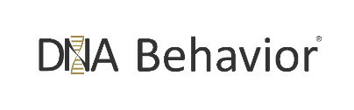
Hugh Massie, along with Lee Ellis literally wrote the book on discovering Natural Talents and Managing Differences.
Now available on Amazon.com
DNA Behavior
Unlocking the Science of Natural Behavior In Yourself and Others
dnabehavior.com

