Slide 1
DNA Behavior®
Behaviorally Smart™ Mentor Training Program
Learn to Know, Engage and Grow Every Person in Your Community
Notes:
Today, you have an introverted former CPA and wealth manager who was a life guard is a cricket fanatic talking to you about human behavior . You might ask why did I leave Sydney Australia to live in America to build a business in the field of human behavior focused on behavioral finance? [Life event – transition triggered by being asked “Hugh, what are you passionate about] It also says some thing about my own financial personality and risk taking. Certainly, a driver of everything I do is a desire to understand people to unlock their human potential for building a Quality Life and to Live with Meaning. Money helps unlock potential but can also be a barrier. A person’s relationship with money is very closely related to who they are and themselves. Further, by knowing this information, I want to put a tailor made suit on each person.
This leads me to the key message - I want you to grow as a behaviorally smart advisor which means you must become more behaviorally aware. If you are behaviorally aware your clients can become behaviorally aware and make smarter decisions.
Who wants to engage their clients more deeply? Who thinks compliance is in the way? What I want to do is show you a process to meet both objectives of increased engagement and compliance. Today, the big issue that you face is suitability of recommendations. Knowing the risk profile of the client is not enough - the paradigm needs to be moved to knowing all of the clients behavioral biases – their financial personality.

Slide 2
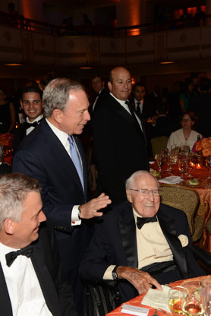
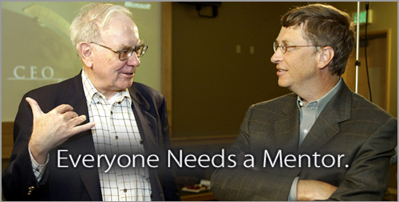
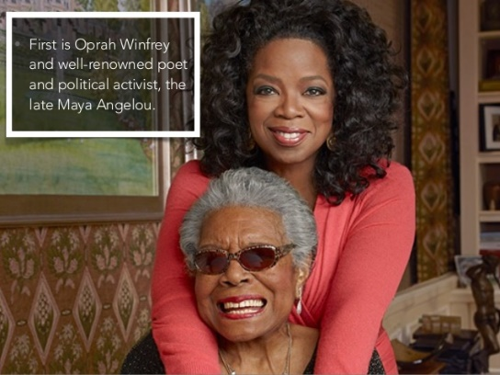

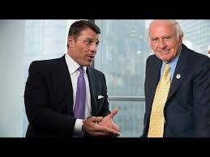
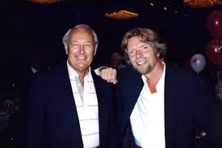

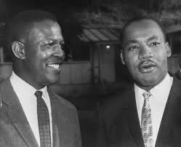
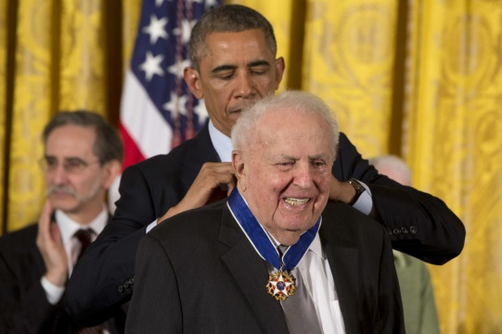
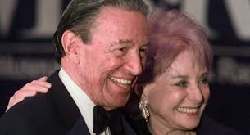

Everyone Needs a Mentor
Many successful people credit one or more mentors through their life who made a difference in helping them achieve their success

Slide 3
Statistics – why have a Mentor
1 out of every 5 women does not have a mentor.
75% of millennials want a mentor, and 58% of them turn to baby boomers first for advice.
80% of CEOs polled have stated they have had mentors.
83% of professionals would like to be involved in a mentoring program, yet only 29% are in workplaces that offer them.
Companies with low engagement had an average operating margin that was 32.7% lower than companies with engaged employees.
Mentoring fills your leadership pipeline: Employees who received mentoring were promoted 5 times more often than those who did not. Mentors were 6 times more likely to be promote.
Mentoring helps keep valuable employees.
Mentoring increases learning retention: productivity increased by 88% versus 24% with training alone.
People are 77% more likely to stay in a job if they are in a mentoring relationship—particularly younger generations.
35% of employees who do not receive regular mentoring look for another job within 12 months.
When peer mentoring is done well the average engagement capital can increase by 66%.
See Handbook for sources

Slide 4
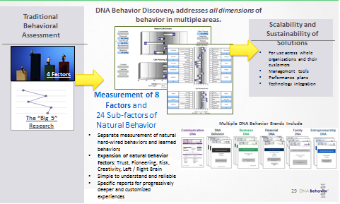
What Is Mentoring and What are its Benefits?
Behaviorally Smart Mentoring is a relational process that involves guiding mentees with wisdom to self-discover who they are, their uniqueness and their priorities for a Quality Life through a mutual sharing of their life journey.

Slide 5
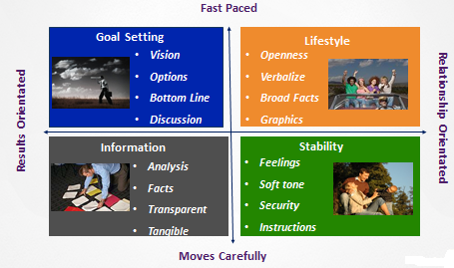
Understanding Communication Unlocks Conversations
DNA Behavior recognizes that Mentoring is relationship oriented and requires each party to be fully cognizant of their communication style and personalities. This insight ensures that the partnership begins from a platform of mutual understanding and respect.

Slide 6
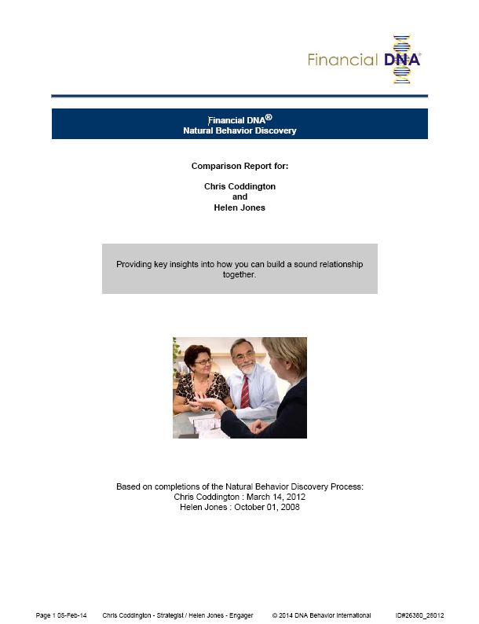
With our Unique approach DNA Behavior can produce a Comparison Report to match Mentor to Mentee
The Comparison Report overlays both profiles
It highlights and reviews closest similarities for similar strengths and blind spots
It sets out and reviews the greatest differences for different strengths and struggles
It provides insight into the the impact of strengths and struggles on each other?
Before addressing the Mentor/Mentee relationship this Natural Behavior Discovery approach will help build greater understanding, acceptance and respect of each other through knowing their natural behavior styles.

Slide 7
The 6 Steps to Discovering the Mentees Life Purpose
Identify Dominant Talents (Strengths) from each of the Strongest Natural Behavior Factors
With the use of the DNA Behavior Natural Discovery Process – Relationship will be built
Identify Their Passion
Identify Their Unique Gift
Get them to Dream Their Vision and Set the Mission
Encourage them to Identify Their Values
Ask them to Articulate Their Life Purpose

Slide 8
As a Mentor the Qualities Needed are: -
Wise Counsel (ability to ask questions to unlock conversations)
Sounding Board (empathetic listener; hear what is being said)
Wisdom Transferor (advice that encourages and sets the mentee up for success)
Collaborator (guide decision-making through a deeper more comprehensive understanding of the mentee and their life goals )
Understanding that Every Person is Unique (one size does not fit all)
Harvard Business Review makes this observation about the role of mentoring in companies; the same is true of any form of mentoring – it can have significant impact on both mentor and mentee. One of the most critical elements in retaining great people is effective mentoring. To attract and retain great people, several things need to coalesce. From the extrinsic reward of a salary to the more nuanced (and more important) intrinsic reward of people feeling that they have a meaningful role, it requires thought and a proactive approach to keep talent once you’ve got it. https://hbr.org/2011/08/keeping-great-people-with-thre.html

Slide 9

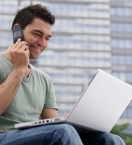
What's in it for the Mentee?
Gaining a positive role model
A safe space to try out ideas
An opportunity for personal reflective space
An opportunity to be stretched and challenged
Access to networks and other learning sources
A way to take more responsibility for one’s own development
Increased confidence and self-esteem
Increased motivation and sense of achievement
A sense of personal growth and development
Make a friend / future professional contact in a mentor

Slide 10
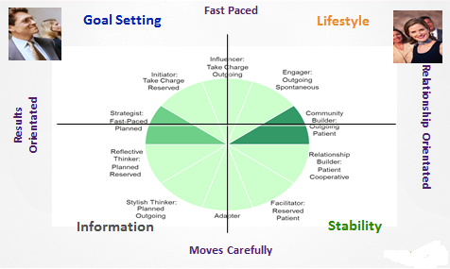
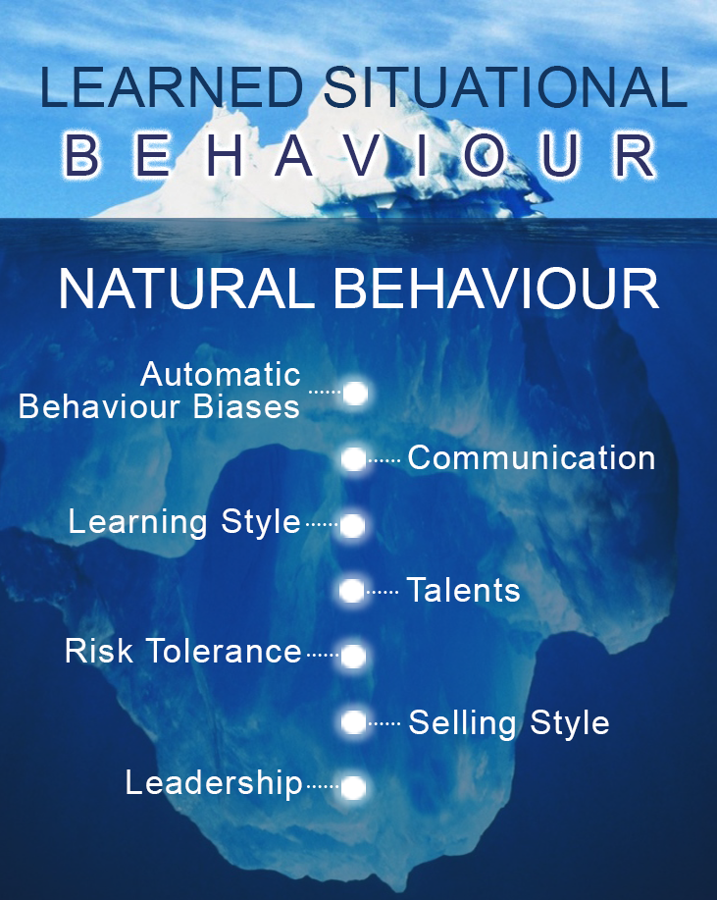
Personality has Many Layers
Everyone is Unique
How do you get below the surface

Slide 11
The ‘Johari’ Window
Known to
Self
Unknown to Self
Known to Others
Open:
Parts of ourselves known to ourselves and others
Blind:
Parts others can see but we cannot
Success Formula:
Develop the ‘Knowing Me, Knowing You’ foundation.
Unknown
to Others
Hidden:
Parts we know about but we hide from others
Unknown:
Hidden from ourselves and from others
© Joseph Luft and Harry Ingham

Slide 12
The Goal: Knowing Me Knowing You
Known to
Self
Unknown to Self
Goal:
Mentoring begins with showing empathy by being open.
Open
Blind
Known
to Others
DNA Behavior®
widens these windows
of knowledge through mutual sharing of self and reports.
Unknown
Hidden
Unknown
to Others
© Joseph Luft and Harry Ingham

Slide 13
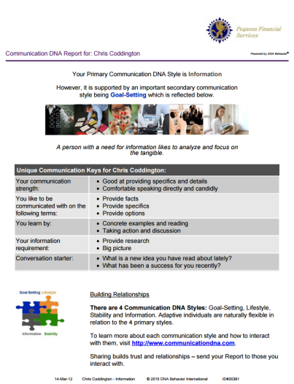
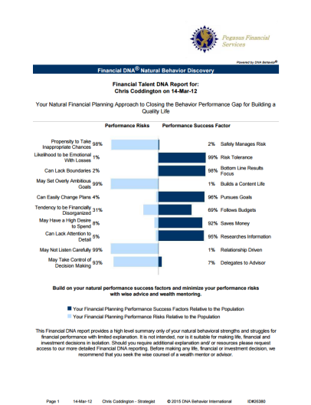
The DNA Communication Discovery Process
Uncovers your natural preferences of how you wish to be communicated with
Going Deeper to Reveal Personality (example)

Slide 14
Discovery Connection Questions to open Conversations
Recommended Starting Point
How do you feel about your report? [or What did you think...]
What was the most accurate part of the report?
What aspects do you agree with and disagree with?
What parts of the report do you not understand?
What is something new the report has said about you?
Has the report identified differences with others?
What is your greatest behavioral strength for making decisions?
What is your greatest struggle for making decisions?
How do you adapt your behavior in making financial decisions?
Have you showed your spouse? If so, what do they think?

Slide 15
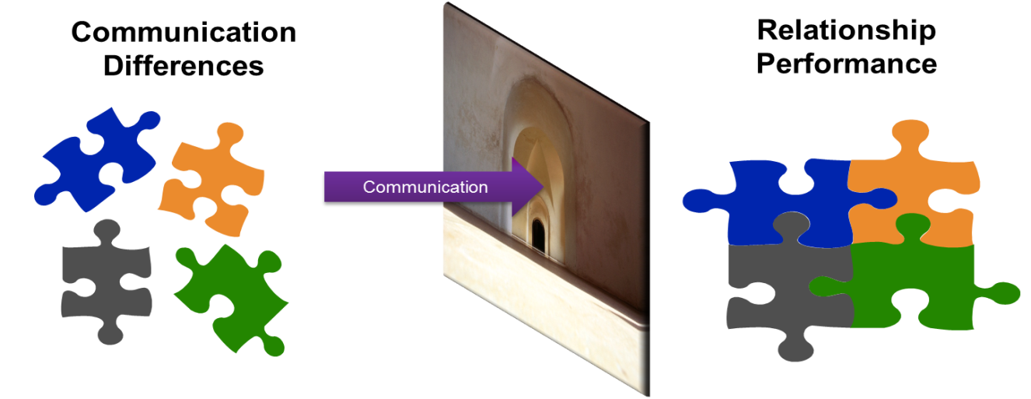
Communication Drives Relationships
Poor Communication
Stress and Discomfort
Misunderstanding
Blockages
Poor Execution
Lack of Trust
Positive Communication
Situations Flow
Clarity
Decisions Get Made
Tasks Get Completed
Engagement

Slide 16
A Behaviorally Smart Approach to Mentoring through Matching
Mentoring With Lack of Behavioral Insight
Behavioral Discovery to Know, Engage and the Mentor/Mentee Relationship
Matching Mentor to Mentee for 4 in 4 Engagement
Goal Setting: Provide Discussion and Opportunities
?
Life Style: Provide Fun, Openness and Graphics
?
?
?
Stability: Provide Security, Feelings and Instructions
Information: Provide Analysis, Research and Details
Default Styles =1 in 4 Engagement
23% Revenue Uplift

Slide 17
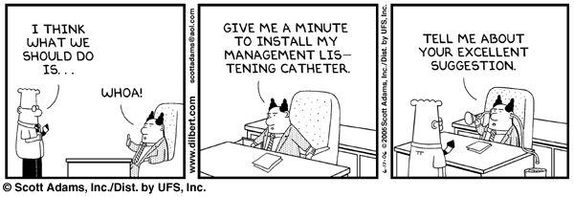
To be a GREAT Mentor….
You Need To Listen
I am listening - what did you say? http://www.youtube.com/watch?v=bO-a-Yz4xA8&list=PL058A82A702A180CF&index=11

Slide 18

The Power of Listening
NOTE: DON’T EVER, EVER, EVER ASK A QUESTION THAT YOU DON’T CARE ABOUT HEARING THE ANSWER TO.
When we ask two or three more questions, we unlock the unseen from behind the seen. MESSAGE: Sometimes we have to go beyond our “comfort zone” and ask questions that allow others to talk out their feelings. We get uncomfortable to allow them to get comfortable. In the end, it’s the right thing to do AND it’s always a win-win in terms of building authentic relationships.
DRILL BELOW THE SURFACE

Slide 19

What Level of Listener Are You?
Become a Level 5 Listener
EMPATHETIC
ACTIVE
SELECTIVE
Five Levels of Listening
PRETENDING
IGNORING
Notes:
NOTE: THIS MODEL AND CONTENT ARE ORIGINAL CONTENT CREATED BY JOE COLAVITO based upon idea of Level 5 Executive from “Good to Great” reference Jim Collins concept and then bring into new context.
After Andrea’s Story ask them what were the three questions that I asked myself when I entered the house … the clue is on the flipchart written before I started. Observation and listening are prerequisite to connecting with people. Also ask if anyone noticed change in slide --- “Familiarity is the enemy of curiosity” is timed to come in 45 seconds after slide is shown while I’m telling story.
Script: We started by asking if you can fake caring. Here is where the rubber meets the road message. We MUST not just listen. We must hear what is being said – probe for underlying emotions and needs. Reminder: Never ask a question you don’t want to hear the answer to. LISTEN FOR FACTS AND FEELINGS.
DON’T WASTE MENTAL BANDWIDTH THINKING ABOUT YOUR RESPONSE. See page 139 in Trust-Based Selling for more background information and read select sentences to audience.
TIPS:
Be transparent as you listen. Rephrase what you hear.
Think out loud. What does it feel like? What am I missing?
DON’T try to solve the problem yet. You haven’t earned the right yet.
Don’t be afraid to admit you don’t have an answer.

Slide 20


Mentoring Requires Active Listening
Active listening takes focus. To be a Mentor you need to understand how to listen actively.
Mentors and mentees spend much of their relationship talking and listening to one another. Active listening is critical for both parties.

Slide 21
A Behaviorally Smart Mentor…
Should:
  Listen and encourage the Mentee to formulate their own solutions
  Focus on guiding the Mentee with powerful behavioral questions and let them come up with the answers
  Offer suggestions but accept that the Mentee may not be ready or willing to take them up
  Make recommendations for reading, education or networking introductions
  Offer acceptance and a non-judgemental atmosphere
  Slow down when you see resistance in the Mentee
Should not:
  Make assumptions or impose solutions on the Mentee
  Analyze the Mentees family background or mental / psychological state
  Offer counseling which is going too far into the past
  Push a Mentee too quickly to a place they are not emotionally ready go even though you think it is right
  Always refer back to the to their profile

Slide 22

Engaging Mentees with Mentoring DNA Discovery
How Will You Begin the Behaviorally Smart Mentoring Relationship
  Ask your mentees the following questions:
  How do you wish to be communicated with in the mentoring process?
  Are you interested in discovering the behavioral strengths and blind-spots which influence your life and the decisions you make?
  What does a Quality Life look like for you?
  Do you have the clarity to confidently choose between the many options in building your Quality Life?
  Do you have a road map for the next stage of your life journey?
  Do you have objective clarity of your level of risk tolerance for making career choices and business?
Notes:
22

Slide 23

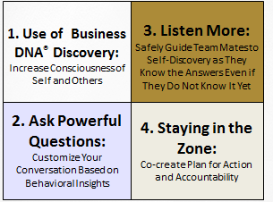
The Conversation Model
DNA Behavior has a significant library of powerful behaviorally focused questions and processes to unlock conversations

Slide 24
Mentoring – The Process
Mentoring is a relational process that involves guiding people with wisdom to self-discover who they are and their priorities for a Quality Life through a mutual sharing of their life journey.
The first steps of the mentoring process — identifying needs, setting goals and establishing an agreement — are vital to the future success of the mentoring relationship.
Building rapport, trust and empathy is the foundation for all successful mentoring relationships.

Slide 25
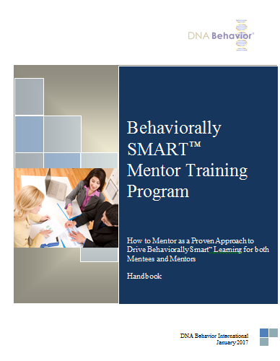
Sustainable Mentoring & Planning Performance
The complete process for building a Quality Life Performance plan starts with completion of (Insert name of the profile to be used).
Fundamental to the whole process is discovering your life purpose. The process is uniquely structured process for discovering your life purpose which starts with understanding your talents and then your passions.
Then we integrate your values.
The strength of this structured approach is that it ensures you quickly get clarity and do not get lost in the process.
Discovering your life purpose is foundational to setting your goals. Each step of the process is documented in the Quality Life Performance Plan Mentoring workbook.
The documentation process gives you a track to know where you have come from, to write down your plans and have a review mechanism.

Slide 26
Sustainable Mentoring & Planning Performance Building a Life Purpose Centred Plan
DNA Discovery
Facilitation of Discovery
Setting Quality Life Goals
Documentation & Accountability
Values
Career
Life Planning Performance
Behavioral
Talents
Environment
Experience
Relationships
Natural
DNA®
Discovery
Life Purpose
Health
Recreation
Passions &
Vision
Knowledge
Aptitudes
Community
Finances
Business DNA Discovery Process

Slide 27
The Mentee…
Should:
  Be prepared to be open and honest
  Be prepared to explore causes and effects of issues
  Be able to take responsibility for his or her own growth, development and education
  Be willing to work on issues until they are resolved
  Take responsibility for his or her own actions and outcomes
  Be prepared to establish accountability practices for outcomes
Should not:
  Expect the Mentor to hand solutions to them
  Expect the Mentor to help them with issues they are not prepared to discuss
  Expect that issues will be solved without work, and a positive attitude to behavioral change
  Abdicate responsibility for success to the Mentor
  Avoid accountability

Slide 28
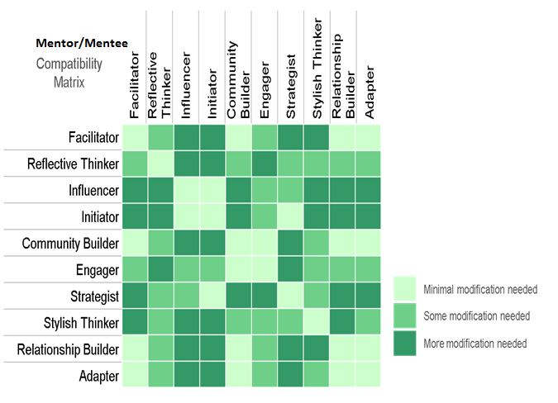
Modifying Communication Styles
Mentee
Mentor

Slide 29
Core Work Life Drivers
Results and Relationships
COOPERATIVE
1. Commanding
TAKE CHARGE
Practical
Hesitant
Diplomatic
Visionary
Decisive
Blunt
RESERVED
OUTGOING
2. People
Expressive
Recognized
Talkative
Reflective
Focused
Withdrawn
FAST PACED
3. Patience
PATIENT
Logical
Challenging
Critical
Understanding
Tolerant
Lenient
SPONTANEOUS
Instinctive
Flexible
Unfocused
4. Structure
PLANNED
Systematic
Particular
Rigid
SKEPTICAL
5. Trust
TRUSTING
Questioning
Guarded
Wary
Receptive
Believing
Forgiving
20
40
50
60
80
Traits intensify as you move
left and right from center
Notes:
As you move left or right from the mean score of 50, the left and right side traits grow more intense. For example, as the Commanding score moves right, the associated behavior goes from Assertive to Decisive, and can be Controlling at the extreme. Moving to the intense left of the Commanding score of 50 could see the traits revealed as Overly Polite and Careful, Uncertain, Tentative and Timid.
Learning point: interpreting and understanding the intensity of these traits will provide invaluable insight into how to manage clients. Always look for the 2 most significant scores whether to the right or left as these are traits to focus on.

Slide 30
Work Life Planning Drivers Workplace Direction and Drive
CONTENT
PIONEER
Satisfied
Balanced
Easy-going
6. Pioneering
Goal Orientated
Ambitious
Driven
CAUTIOUS
RISK TAKER
Calculated
Conservative
Needs Certainty
7. Risk
Daring
Courageous
Over Confident
ANCHORED
CREATIVE
Consistent
Experience Driven
Tied To Old Ways
8. Creativity
Original
Imaginative
Abstract
20
40
50
60
80
Traits intensify as you move
left and right from center
Notes:
These 3 traits will deliver useful insight into how a client might approach decision making around finances. For example: if the score on the right side of each of these factors was 70+ this should signal a warning flag that the client could be audacious and reckless in their decision making.
Learning point: these graphs offer very credible indicators of behavioral traits; understanding clients traits both on the right and left side will signpost you to how balanced or unbalanced they are likely to be in their decision making. This will need to be managed.

Slide 31
Unlocking Questions to Open Conversation
Using the Highest Factors Left and Right
Questions | Left Factor | FACTOR | Right Factor | Questions
1. Tell me about what you are currently doing really well. 2. Tell me about the steps you are taking to achieve what it is you are doing well. 3. What are you not doing well that is preventing you from getting there? 4. What will you do differently tomorrow to meet those challenges? 5. How can I help / where do you need the most help? | Cooperative Diplomatic. Practical. Acquiescent. Prefers to follow with the set agenda. Wants to fit in. Can be unassertive and timid; may not speak up. Communication Key: Encourage input | COMMANDING | Take Charge Needs to be in control. Requires options if you are looking for them to make a decision. Results focused. Stay on topic. Only needs key points. May be uncomfortable taking instruction from others. Communication Key: Provide Options | 1. Where do you want to be a year from now? 2. Can you achieve your objectives with your current skill set? If not what skills do you want to acquire to achieve results. 3. What are your personal weaknesses? What character traits do you want to develop? 4. Why are you trying to achieve those objectives and are they consistent with your life plan. 5. How can I help / where do you need the most help?

Slide 32
Unlocking Questions to Open Conversation
Using the Highest Factors Left and Right
Questions | Left Factor | FACTOR | Right Factor | Questions
Tell me about a new idea you have recently been working on. What skills or knowledge do you need to build your career and life plan. Have you shared your new ideas with others and if not why not. What does success look like to you. How can I help / where do you need the most help? | Reserved Reservation about new ideas Propensity to think/reflect Considers/analyzes/questions Withdrawn Guardedness Can be unassertive and timid; may not speak up. May appear withdrawn and distant Drained by too much interaction with others Communication Key: Allow reflection time | PEOPLE | Outgoing Enthusiasm for ideas Propensity to express view Ask questions People, networking approach Openness Strong need for approval from others Communication Key: Tell me who is involved | What professional organizations are you associated with and in what ways? Who else are you talking to about your life plans. Tell me about a recent success in your life. What new ideas are you currently thinking about being involved in and why. How can I help / where do you need the most help?

Slide 33
Unlocking Questions to Open Conversation
Using the Highest Factors Left and Right
Questions | Left Factor | FACTOR | Right Factor | Questions
Describe your life plan and vision and tell me how you are planning to deliver it. What will tell you that you have achieved success. Are you reaching out to others to be a part of your journey. If not, why not. What is your expectation of this Mentor/Mentee relationship. How can I help / where do you need the most help? | Fast Paced Anticipate my immediate responses and quick fixes Speak/move at a quick pace Use summaries, bullets and key points May lack Patience May be abrupt or interrupting Communication Key: Bottom line results and speak/move at a quick pace | PATIENCE | Patient Remember my need to avoid conflict Soften your tone of communication Present me with information plus feelings May compromise too much Can be resistant to change Communication Key: Safety and soften the communication | What motivates you. Tell me about a time when you held back from getting involved in something which you later regretted What's been the toughest challenge you have ever faced and what did you learn from it. Tell me about someone who has played a significant role in your life so far. How can I help / where do you need the most help?

Slide 34
Unlocking Questions to Open Conversation
Using the Highest Factors Left and Right
Questions | Left Factor | FACTOR | Right Factor | Questions
Tell me about your goals that you want to achieve over the next year. Do you think your expectations of the outcomes are realistic. If not what are you willing to compromise. What characteristics or skills set you apart from others and how do you plan to use them. Tell me about a recent decision you made that you now regret. What did you do to undo the decision, or did you. How can I help / where do you need the most help? | Spontaneous Free-flowing High level approach Improvisation Wing it approach Low-complexity Instinctive approach Can be too quick to decide Communication Key: Provide broad facts | STRUCTURE | Planned Provide details, research Budgets and structure Ambiguity aversion Written advice Task Focus Analytical approach Tends to be inflexible or too fixed Communication Key: Present specifics – facts, figures, data | Tell me about a time when you wish you had jumped in to an opportunity, but left it too late. How did you feel about that. Tell me about a recent success. How did you arrive at the decisions you made to achieve this success. Tell me about a time when you made an irrational ill-thought out decision and it was successful. How can I help / where do you need the most help?

Slide 35
Unlocking Questions to Open Conversation
Using the Highest Factors Left and Right
Questions | Left Factor | FACTOR | Right Factor | Questions
1. What keeps you up at night. Are you over thinking the subject. 2. How often do you say ‘‘this won’t work’ and how do others react. 3. Does you need to withhold judgment until relevant evidence is examined, regardless of previous experiences cause frustration to others. Explain their reaction. 4. Tell me about a time when you trusted another person blindly and they let you down. What did you learn from that experience. 5. How can I help / where do you need the most help? | Skeptical Thinks matters through Able to ask difficult questions Watchful of important tasks May have difficulty letting matters go May not be easily forgiving Communication Key: Provide logic and key points | TRUST | Trusting Allows open dialogue Approachable Transparent May not set boundaries Can be overly impressionable Communication Key: Present feelings/emotions | Tell me about a time when you continued to trust long past a time when you should have responded. Describe a time when you realised you were not trusting but being gullible. Explain what you believe are the differences. Tell me about some ways in which you could check yourself if you felt you were being too trusting. Give me 3 examples of the criteria you apply when deciding whether or not to trust someone. 5. How can I help / where do you need the most help?

Slide 36
Unlocking Questions to Open Conversation
Using the Highest Factors Left and Right
Questions | Left Factor | FACTOR | Right Factor | Questions
1. Describe a time when you wanted to be adventurous but persuaded yourself not to get involved. How did that feel. 2. What is it that you see others doing that you would really want to be and do? 3. What would you have to do differently tomorrow to meet those challenges? 4. In what ways do you believe your experience and knowledge could determine your life plan. 5. How can I help / where do you need the most help? | Content Uncomplaining Not envious Satisfied Does not worry Thankful Comfortable Prone to be complacent Communication Key: Focus on life balance | PIONEERING | Pioneer Sets direction Committed Ambitious Follows through Trailblazer Driven May sacrifice a balanced life Communication Key: Provide the big picture | What has been your most successful accomplishment. Tell me about the sacrifices you have had to make when pioneering a new idea. Tell me about a time when your plans didn’t work out. What did you learn from that experience. Tell me about a time when everyone said it wouldn’t work and you proved them wrong. How did that feel. How can I help / where do you need the most help?

Slide 37
Unlocking Questions to Open Conversation
Using the Highest Factors Left and Right
Questions | Left Factor | FACTOR | Right Factor | Questions
1. If you avoid risk taking, you will never see the large gains you desire in your life. Do you agree. 2. Tell me about a time when you took a calculated risk and failed. How did that feel. 3. How do you approach a risky opportunity – what steps do you take to determine whether to go ahead or back out. 4. Risk is avoided when large goals are broken down into smaller goals. Do you agree. 5. How can I help / where do you need the most help? | Cautious Looks for ways to minimize risks Allow me time to survey the situation Remember my need for safety May miss opportunities May be too hesitant Communication Key: Minimize Risks | RISK | Risk Taker Present me with risk/return Present me with opportunities Keep the discussion positive May take unnecessary Risks May not see dangers Communication Key: Present Risk /return | Tell me how you prepared yourself before you venture into a risky situation. How do you determine the outcome you need to have when taking a risk. Describe time when you took a risk and failed. How did that make you feel and what did you learn. Tell me about a time when took a risk against advice and it was successful. How did that make you feel and what did you learn about yourself. How can I help / where do you need the most help?

Slide 38
Unlocking Questions to Open Conversation
Using the Highest Factors Left and Right
Questions | Left Factor | FACTOR | Right Factor | Questions
How do you react to Innovative individuals who think every idea is feasible. Tell me how you would respond to a creative colleague who responded to a decision you made by thinking it was still open to discussion. How important is it for you to have your need for evidence, proven methods etc to be validated. Describe to me your thought pattern in determining which ideas and suggestions to follow. How can I help / where do you need the most help? | Anchored Proven methods Solution driven Evidence – facts, figures Experience preference Execution focus Provide the steps Can be hesitant to act on new ideas Communication Key: Keep it tangible and provide the logical steps | CREATIVITY | Creative New methods Ideas driven Connect “dots” Explores possibilities Brainstorming process Innovative Difficulty with following set procedures Communication Key: Encourage brainstorming | How do you keep account of all the creative ides you have and how do you decide which to invest your time in to. What frustrates you the most when others try to box you in when you are on a creative thinking roll. How do you respond when superiors won’t let you follow through on what you consider is a great idea. Tell me about a time when an out of the box thought resolved a situation. How did you and others react. How can I help / where do you need the most help?

Slide 39


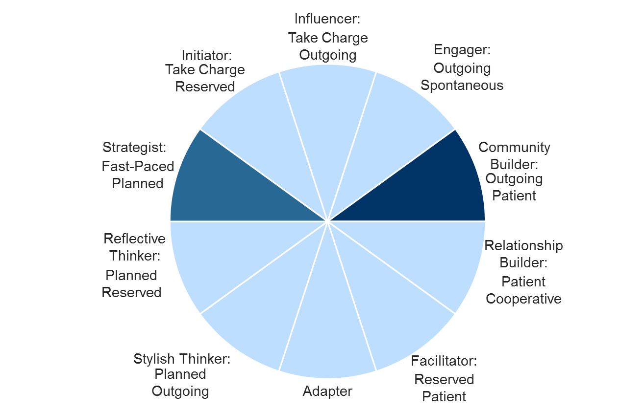
Decision-Making Style Connected to Natural Behavior
Fast Paced
Risk Taker/ Goal Setting
Spender/ Lifestyle
Results
Orientated
Relationship Orientated
Saver/ Information
Cautious/ Stability
Moves Carefully

Slide 40
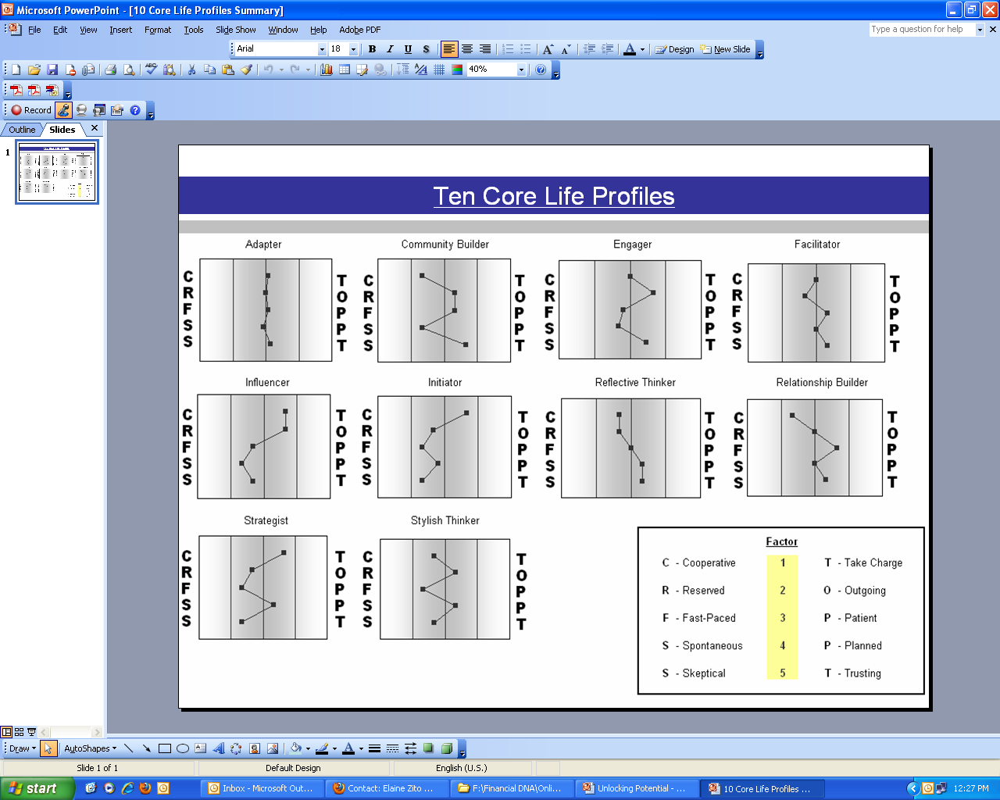



Mentoring an Initiator
Description
Results-driven | Logical | Determined
Initiators like to take bold, aggressive actions and create the rules. They will prefer to lead decision-making, setting the agenda for others to follow, and monitoring the timely completion of tasks. They are goal-driven people who like their expectations managed and not to get caught up in unnecessary details. Their decision-making will typically be fast-paced and rational. They will not be afraid to take on challenging assignments or to accept a lot of risks to realize their ambition.
Wants - Workplace
Being able to set the agenda, define goals, and assume authority.
Wants – Team Mates
Direct communication.
Fears
Too many details and routines.
What Alienates Me
Decision Making Style
Very bold, confident and goal-driven.
Anything that stops them from reaching their goals.
Being given independence, challenges, variety, problems to overcome and a minimum of details to deal with.
Progress and results being achieved with a high degree of accountability.
Losing control and not owning their projects.
Being confined and taken advantage of.
Quick and definite and responsive to new challenges.
Unable to control their work environment, especially the direction, purpose, and goals.
Relating to Them:
Remember their need to be in control, set the agenda, and initiate action. Move quickly to the bottom line. Offer them options so they can decide. Speak/ move at a quick pace. Use summaries, bullets and key points. Use graphic and verbal communications—don’t swamp them with detail.
To Help Them
Perform:
Encourage them to think through the steps required to realize their goals, and help them establish realistic expectations with others.
To Help Them Maximize
Their Potential:
Support them with detail and analysis
so they can concentrate on setting
goals and agendas.

Slide 41


Mentoring an Influencer
Description
Ringleader | Assertive | Visionary
Influencers usually have a unique blend of confidence, initiative and people skills. They are typically able to see the larger vision and then use their superior communication skills to influence others towards accomplishing it. They will wholeheartedly invest time and effort into developing others and their personal performance towards goals, particularly strategies that they see hold significant potential.
Wants – Workplace
Opportunities to lead, influence, impact, train and motivate others.
Wants – Teammates
Direct and engaging communica-tion.
Fears
Being given the runaround or having their time wasted on issues that are not relevant to them.
What Alienates Me
Decision-Making Style
Very confident, quick and definite, and will favor whatever will achieve their goals most quickly.
Loss of control and influence in the work setting and not having an input.
Roles that require them to use their natural skills to understand the larger vision and then energize others to get the result they need.
A place for generating ideas and verbalizing them.
Not too much detail—just the relevant facts.
Recognition, acknowledge-ment and encouraging feedback.
Loss of respect or reputation.
Having to analyze or research too much detailed information.
Confining routines, over commitment of time and lack of access to people.
Relating to Them:
Remember their need to be in control, engage with people, be recognized, initiate action, have freedom. Give direct answers, get to the bottom line quickly. Remember their need for fun/excitement. Use summaries, bullets and key points. Use graphics and verbal communications—don’t swamp them with details.
To Help Them
Perform:
Work with them in developing multiple projects that are diverse and require a high level of energy. Encourage them to communicate their ideas and influence others in order to succeed.
To Help Them Maximize
Their Potential:
Work with them in understanding the goals they set, and help them to be realistic in their optimism and expectations.

Slide 42



Mentoring a Strategist
Description
Evolutionary | Visionary | Structured
Strategists excel by blending their strong drive to reach key goals with sound knowledge, high quality processes and quality control standards. As a result, they are equipped to be strategic players in situations where achieving results is a priority. They have an ability to achieve ambitious goals and concentrate on matter-of-fact, practical issues. They also have a rational, impartial approach that enhances their ability to make difficult decisions.
Wants – Workplace
Opportunity to meet their goals with desire for precision, accuracy and quality.
Wants – Teammates
A high degree of reliability in performance so that goals can be met.
Fears
Having their time wasted on issues they feel are not relevant to them.
What Alienates Me
Decision-Making Style
They are capable of making quick and confident decisions if the risks are minimized through superior planning and analysis and they are aware of the options.
Making poor decisions that will hinder them from reaching their goals.
To be able to lead in situations where achieving results in a challenging environment is a priority.
Organized and focused on the tasks at hand, and available for collaboration to achieve goals.
Losing control of their working environment.
Having the solution to a problem without the authority to implement it.
Being given solutions based on gut instincts without research.
Being persuaded to commit to solutions and plans that do not meet their goals and criteria.
Relating to Them:
Remember their need to be in control, retreat and think. Move, speak and act quickly, be accurate with details. Give direct answers, get to the point. Provide plenty of detail so they can analyze it for themselves. Give them choices so they can make the final decision. Honor their need for structure, schedules, rules.
To Help Them Perform:
Talk with them about engaging others in delivering their plans, and encourage them to delegate responsibility so others are empowered to help them reach their goals.
To Help Them Maximize
Their Potential:
Encourage them to share their expertise across a number of business areas and develop strategies that involve a mixture of solution development and new transactions.

Slide 43
Mentoring a Reflective Thinker
Description
Analytical | Logical | Philosophical
Reflective Thinkers are analytical, thorough and philosophical in their search for meaning, truth and purpose in all they do. They are particularly adept at drawing incisive conclusions from data and research. Their accuracy and precision is valuable in any group setting, and they bring objectivity to decision-making processes. Typically, they will prefer to follow guidelines in completing tasks and will expect cooperation to be given.
Wants – Workplace
Ample time to think, reason, analyze and organize details into logical and creative solutions.
Wants – Teammates
Focused discussions.
Fears
Being rushed or forced into a decision without time to research their options.
What Alienates Me
Decision-Making Style
Rational, fact-based decision-making.
Appearing incompetent in front of others.
Time and space to produce top-quality work.
Reduce small talk and unnecessary interruptions.
Time to reflect before making a decision.
Insufficient time to prepare adequately.
Will research thoroughly, be sceptical and generally take their time to make a decision.
Lack of organization, focus or loyalty.
Unwanted attention.
Relating to Them:
Remember their need to fit in, retreat and think, be accurate and detailed. Create a relaxed environment. Encourage their input. Present the facts, minimize emotions. Look for ways to minimize risks. Remember their need to analyze.
To Help Them
Perform:
Agree deadlines for delivery of work and discuss the level of accuracy required for each activity to be delivered.
To Help Them Maximize
Their Potential:
Give them time to prepare and think in-depth so that they can present logical, quality work.

Slide 44

Mentoring a Stylish Thinker
Description
Sharp | Cutting-edge | Demanding
Those with the Stylish Thinker DNA Natural Behavior Style enjoy interacting with others and getting the most out of any situation. In making decisions they require precision, technical information and the latest trends that will fully inform them that they are getting the best solution or outcome available. They also like to be able to test ideas in discussions with other people. They will usually be strong in following through on their goals but may need some help in developing their personal vision.
Wants – Workplace
Relating to people and using their natural ability to influence others and create impressions.
Wants – Teammates
A high energy and enthusiasm for new projects and researching new ideas.
Fears
Extended periods of working alone, along with having sole responsibility for completing major projects.
What Alienates Me
Decision-Making Style
They will make a decision after conducting their own research and listening to the opinions of those they respect.
Being perceived as being irrelevant.
An environment for generating and promoting creative new ideas.
Activity interspersed with periods of methodical research and preparation.
Cooperative rather than confrontational relationships but will become contentious if challenged.
Strong verbal skills.
Being restrained from opportunities to engage groups of people or being rejected by an audience or group.
Overcommit-ment to multiple projects and not having an input into decisions.
Dampening their enthusiasm
Relating to Them:
Remember their need to engage and be publicly recognized, fit in, be accurate with details. Encourage their input and be an active listener. Remember their need for fun/excitement. Invest time in building the relationship. Present specific facts, figures, plans. Anticipate their immediate responses and quick fixes.
To Help Them Perform:
Work with them in a project with social mobility that requires them to generate ideas using their flare, creativity and innovation.
To Help Them Maximize
Their Potential:
Support them, and give them opportunities to present their ideas and gain recognition and respect.

Slide 45

Mentoring a Facilitator
Description
Balanced | Discerning | Harmonious
Facilitators combine the ability to guide people with feelings together with the determination to reach goals and accomplish tasks. This blend of behavioral strengths makes them well suited for situations where setting the agenda and recognizing the needs of other people are required. Further, consistency, reliability and persistence are important. They flourish in an environment where there is plenty of stability, group decision-making is needed, and where they are recognized for the contribution they make.
Wants – Workplace
Cooperation, stability, teamwork and trust.
Wants – Teammates
Loyalty.
Fears
Being rushed or forced into
a decision.
What Alienates Me
Decision-Making Style
Reasonably emotional, although quite goal-driven.
Impediments to achieving their goals or the inability to produce consistent progress at work.
Opportunity to pursue their goals on their own terms.
Friendly environment.
Space to get on with their work.
Conflict in the workplace.
They may make decisions based on what “feels right.”
Lack of cooperation, punctuality or loyalty.
Relating to Them:
Remember their need to retreat and avoid conflict. Allow them to have control, choices, options. Get to the point, minimize small talk. Present the facts, minimize emotions.
To Help Them
Perform:
Encourage them to be receptive to new alternatives and the ideas of others.
To Help Them Maximize
Their Potential:
Work with them and allow them to plan achieve, lead, define project goals and build team-oriented environments.

Slide 46


Mentoring a Relationship Builder
Description
Advocate | Dependable | Loyal
Relationship Builders will be comfortable and operate at their best when given the opportunity to work with and serve others. They are friendly, kind and empathetic to others they interact with and gain fulfillment by helping others to achieve their goals. Their preference is to live in a stable environment and make decisions based on history and security.
Wants - Workplace
A stable and consistent environment with not to much mobility and where there are daily routines.
Wants – Team Mates
They are more comfortable when someone else takes charge, provides the vision, and sets the goals and objectives for them.
Fears
Being asked for a decision before they have had time to process their thoughts and feelings.
What Alienates Me
Decision Making Style
Need to “feel” comfortable with the concept before making a decision.
Facing sudden surprises or constant change in their routines and responsibilities.
They get fulfillment from supporting the efforts of those in charge, helping others, and serving as peacemakers.
Teamwork, cooperation, and routines so that they can reliably complete their tasks.
Fear of hurting others, being disloyal.
They will tend to commit only to strategies that they know and understand.
Conflict situations, unexpected changes, a lack of appreciation, rudeness and chaotic or unpredictable work settings.
Relating to Them:
Remember their need to fit in, avoid conflict. Create a relaxed environment. Encourage their input and be an active listener. Slow down the pace and soften the tone of communication. Share your emotions along with information.
To Help Them
Perform:
Encourage them to share their ideas, take a stand and work with them to realize goals.
To Help Them Maximize
Their Potential:
Support them to build their decision-making confidence and to make a productive stand in resolving conflict rather than withdrawing from it.

Slide 47
Mentoring a Community Builder
Description
Easy Going | Promoter | Amiable
Community Builders excel at meeting people and promoting cooperation among groups of people. Their natural inclination is to help and support others to carry out an activity or transaction. They are attentive both to people and tasks and influence others through empathy and supportiveness. Once convinced of a course of action, they will encourage others, operate diligently and collaborate to achieve the goal. They seek supportive relationships that are appreciative and empathic towards one another.
Wants - Workplace
A strong relationship that will provide them with a safety net in order to do their job with enthusiasm.
Wants – Teammates
Encouragement and assurance that they fit in and a trusting relationship.
Fears
Being pushed to make a decision before they feel ready.
What Alienates Me
Decision Making Style
They may delay or avoid making decisions or wait for a consensus of opinion so relationships are not compromised.
Not meeting expectations.
Working with people in small groups or one-on-one situations in order to convey empathy and compassion and to respond to specific human needs.
Being able to support their teammates and help them in practical ways.
Being taken advantage of by helping too much.
Being in conflict and hostile situations, particularly where it may result in hurting a person.
They will do what “feels right.”
Being in an environment with unresolved conflicts, situations requiring them to be highly assertive and deadlines that cause them to compromise relationships.
Relating to Them:
Remember their need to fit in, build relationships, avoid conflict, be free from detail. Look for ways to minimize risks. Slow down the pace of communications. Use written policies, plans, procedures. Encourage their input. Invest time in building the relationship.
To Help Them
Perform:
Challenge them to clearly articulate goals and to commit to how they will realize their goals.
To Help Them Maximize
Their Potential:
Focus on developing a strong relationship with them. Support them in daily work by ensuring they are not overwhelmed by details.

Slide 48

Mentoring an Engager
Description
Resourceful | Inventive | Instinctive
Engagers enjoy meeting new people, situations and environments, and they enjoy being a promoter. They use their people skills to build relationships and interact with an ever-widening circle of contacts. Engagers enjoy using their verbal skills and will be very outgoing. They approach situations enthusiastically, especially when they are passionate about the outcomes, and enjoy new opportunities and starting (rather than finishing) new projects and goals.
Wants – Workplace
Fun and variety.
Wants – Teammates
Loyal supporters who can provide strong detailed back-up.
Fears
Not being provided with sufficient detailed background information to meet their goals.
What Alienates Me
Decision-Making Style
Sometimes rational, sometimes emotional.
Public visibility of failure to meet goals.
Opportunity to establish a wide circle of contacts with whom they can do business.
Can take undue risks without sufficient preparation, leading to panic.
Being excluded.
Relating to Them:
Remember their need to engage, be publicly recognized and be free from details. Give them center stage when needed. Expect/encourage their thinking out loud. Provide them with information using summaries, bullets, key points.
To Help Them
Perform:
Encourage them to focus on one goal at a time and define the key factors needed to attain it.
To Help Them Maximize
Their Potential:
Encourage them in making full use of their relationship skills and networking.

Slide 49
Mentoring an Adapter
Description
Flexible | Versatile | Courteous
Adapters are unique in that they have the unusual ability of being able to adapt to the needs of their environment and displaying whatever behaviors are necessary for success. They are very versatile and will generally partner and team well with others. They can generally perform many tasks well relating to achieving their goals and managing their performance, and they operate most effectively when they have very clearly defined expectations and boundaries.
Wants – Workplace
Variety in tasks and responsibilities to fully utilize their flexibility.
Wants – Teammates
Openness and responsiveness; professional and to-the-point responses.
Fears
Lack of courtesy and poor communication.
What Alienates Me
Decision-Making Style
Carefully considered after taking trusted advice.
Their broad general knowledge has to be strengthened by input from acknowledged experts.
A good balance between solitary tasks and working with people.
Working in a team environment where they support others and can be supported.
Being overloaded
with multiple expectations and no clear understanding of what the priorities are.
Inaccurate information.
Being caught in a situation where they have to take an uncompromising stand on issues.
Relating to Them:
Create a relaxed environment. Do not mistake their lack of response for inattention. Use written policies and procedures. Present specifics—facts, figures, data. Look for ways to minimize the risks. They are diplomatic and expect courtesy.
To Help Them
Perform:
Encourage them to make firm decisions on issues and clearly state their point of view.
To Help Them Maximize
Their Potential:
Encourage them in their goal setting and establishing priorities for their daily tasks.

Slide 50
Exercises
Mentor 1 Engager — The mentor has a good network that they have started introducing the mentee to, but is worried that the mentee is getting too good and might end up taking their job. They subconsciously try to ‘sabotage’ the mentee’s confidence in their own ability by being very critical of their performance.
Question – How would you resolve this approach to save the relationship
Mentor 2 Influencer— The mentor is generous with their time and very involved in the mentee’s development, but wants the mentee to be a ‘clone’ of themselves and expects the mentee to do everything exactly as they would do it.
Question – What action could you put in place to ensure this didn’t happen.
Mentor 3 Community Builder — The mentor is very friendly, caring and relaxed in their approach to being a mentor, but lacks organisational skills and sometimes forgets to attend the mentee’s matches.
Question – How would you resolve this issue of the Mentee challenged you about your organizational skills.
Mentor 4 Strategist— The mentor is very organised and has a clear vision but is a traditionalist, raised through the school of hard knocks, and believes the mentee needs to shape up and make a plan for their life and follow it.
Question – how should the Mentor who has been raised to be self sufficient approach mentoring.
Mentor 5 Initiator — The mentor is a high-level official and provides excellent technical advice, but is very busy and due to their commitments is only able to give limited time to the mentee.
Question – if this were your approach how would you expect the Mentee to react.
Instruction
Using the DNA Behavior profiles – record how you would answer the questions.

Slide 51
Case Studies
Case study 1 — There is conflict between the mentor and mentee because the mentor has heard from a third person that the mentee did not agree with their feedback at their last meeting.
Question - How should the mentor approach the next meeting?
Case study 2 — The mentee is really upset after an ‘ordinary’ Mentoring conversation where the Mentor seemed distracted.
Question - How should the mentee approach the feedback session?
Case study 3 — The mentee has just missed out on a business opportunity and wants to discuss what they need to do to get it next time.
Question - How should the mentor approach this conversation?
Case study 4 — The mentee has just verbally abused a colleague in front of their Mentor. The mentor needs to have a ‘tough’ conversation with them about this being unacceptable.
Question - How should the mentor approach this conversation?

Slide 52
In Summary
The role of the Mentor is to:
Listen
Question, to elicit facts
Give information, knowledge about organisation/occupation and informal network
Give advice on personal and career development
Offer different perspectives
Offer support and encouragement
Draw on own experience when appropriate
Confront and discuss current issues
Take the lead and make decisions – at least early on in the relationship
The Mentee should be encouraged to:
Listen
Clarify understanding
Share thinking
Review and reflect on oneself
Change assumptions
Consider different perspectives
Develop and manage a life and career plan
Take responsibility for their own development
Make decisions to maximise the outcomes of the mentoring relationship

Slide 53
Contact Us
For more information about the
Financial DNA Solutions and Training:
Contact:
DNA Behavior International
5901-A Peachtree Dunwoody Rd
Suite 375
Atlanta, GA 30328
1-866-791-8992
inquiries@dnabehavior.com
www.financialdna.com
`
Notes:
Make reference to:
Whitepapers and book
30 days trial – register on website

