Slide 1

Managing Family Continuity
Enhancing Family Communication for Enabling Family Continuity
Notes:
Case Studies: Digital Advice & Intergenerational Wealth Transfer
Organizational Transformation
Big Data

Slide 2

Signals Your Family’s Transition Preparation Is Strong
Rate How Well Prepared Your Family is for a Successful Transfer of its Wealth and Values ?
There has been total family involvement in the family wealth transition decisions?
All elements of the family wealth plan have been discussed?
There is a family mission statement (Family Continuity Plan) incorporating the purpose and values for the wealth?
There is consensus on the family member roles for managing the wealth?
The family members are equipped with the knowledge, skills and processes to manage the family wealth?

Slide 3
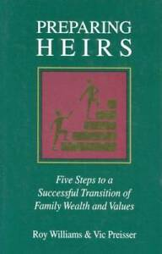
Read Preparing Heirs
A Powerful Process for the Successful Transition of Family Wealth and Values
Research on the reasons for successful and unsuccessful wealth transfers
Insights on planning for the transition of the family wealth and values
The need for preparing heirs so that wealth is a force for good in their lives, and not a burden
What should heirs be doing to prepare themselves for wealth and responsibility
Framework for the family to address the internal issues of trust, communication and planning that impede the wealth transition.

Slide 4

How an Independent Facilitator Can Guide Your Family?
An Objective and Unbiased Approach
Provide human capital, life, financial and business insights for each family member
Recognize the interplay of passing on wealth, values, virtues and memories
Closing the generational gaps
Succession planning
Mentoring family members
Facilitating family purpose and mission
Family Governance Council and processes
Aligned fee model and manage advisory team biases

Slide 5

The Family Continuity Model
Starts With Understanding Differences
C O M M U N I C A T I O N S
ALIGN
UNDERSTANDING
ACCEPTANCE
RESPECT
TRUST
^{Family Continuity}
ALIGN
C O M M I T M E N T
Different Behaviors
Family Cohesion:
From Diversity to Unity to Continuity

Slide 6




Customizing the Family Continuity Experience
How Do Family Members Wish To Be Communicated With?
Fast Paced
Vision
Openness
Option
Verbalize
Bottom Line
Broad Facts
Goal Setting
Discussion
Lifestyle
Graphics
Lifestyle
Results Orientated
Relationship Orientated
Analysis
Feelings
Facts
Feelings
Soft tone
Security
Instructions
Soft Tone
Transparent
Security
Information
Tangible
Stability
Instructions
Moves Carefully

Slide 7
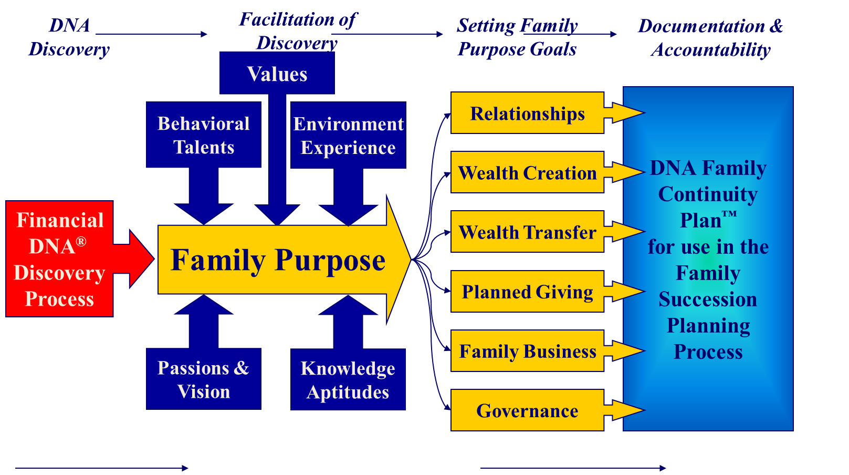
The DNA Continuity Planning Vision

Slide 8

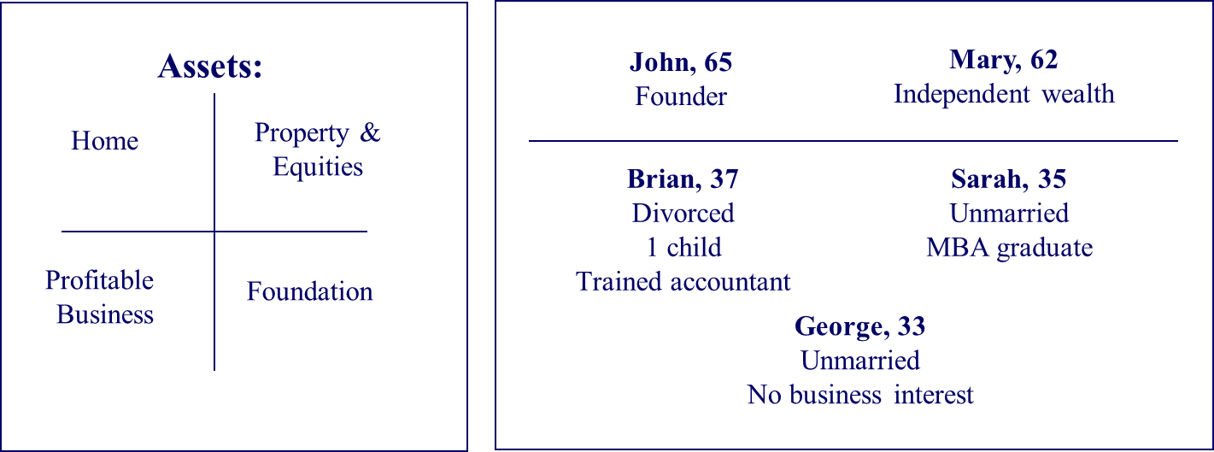
Facts: The Williams Family in Transition
Engaging them in Family Continuity Planning
The Family Status Quo:
Scenario: Father wants to retire:
Framework to address transition:
John Williams has a harmonious family life defined by the 4 “E’s”:
Entertainment
Excitement
Entitlement
Expectation
Both parents want to distribute family wealth, possessions and responsibilities equitably.
Communicate their values.
Seek common ground in family unit purpose and mission.
Relationship continuity (the priority)
Values continuity (the priority)
Business continuity
Financial continuity
Philanthropic continuity

Slide 9

Key Questions for the Family
What are your primary strengths and struggles for helping your family unit build a Quality Life together?
2. Identify the relationship dynamics between you and other family members. How would your strengths and struggles impact each other?
3. Based on your behavioral style, how will you adapt your communication with them?
4. Based on their strengths and struggles, what do you think their decision-making pattern is likely to be?
5. How will your decision-making pattern differ to theirs?

Slide 10
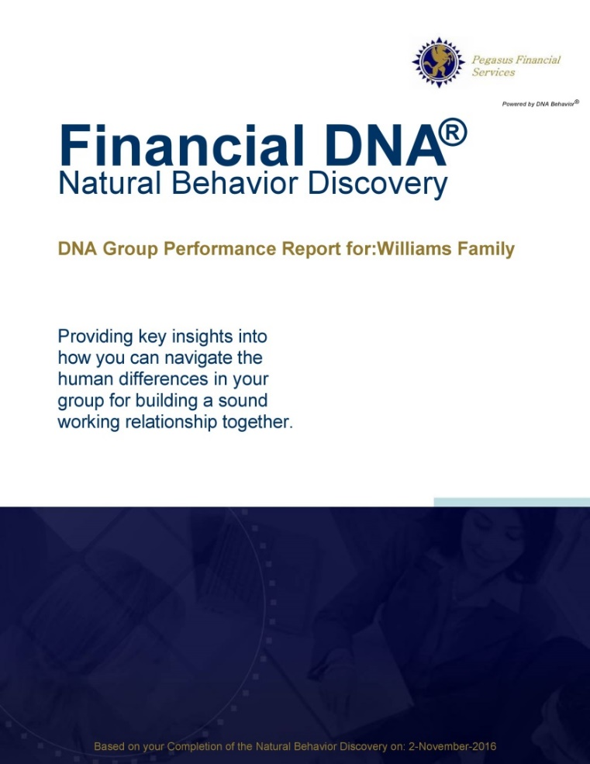
Financial DNA Group Report
Objectively Understanding Family Differences and Align the Advisory Team

Slide 11


Relationships
Results
Father
Fast Paced
Moves Carefully
Daughter
Son
Son
Mother
The Williams Family
Notes:
Measure behavior of each person
10 style groups for plotting: 4 quadrants
Detailed View in the Appendix – give you slides

Slide 12


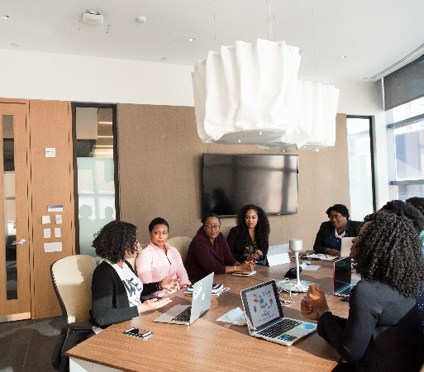

Identifying Family Member Behaviors
Managing Family Continuity
Navigating Family Differences
Programs available from DNA Behavior to Improve Personal and Business Performance
Building a Family Continuity Plan

Slide 13


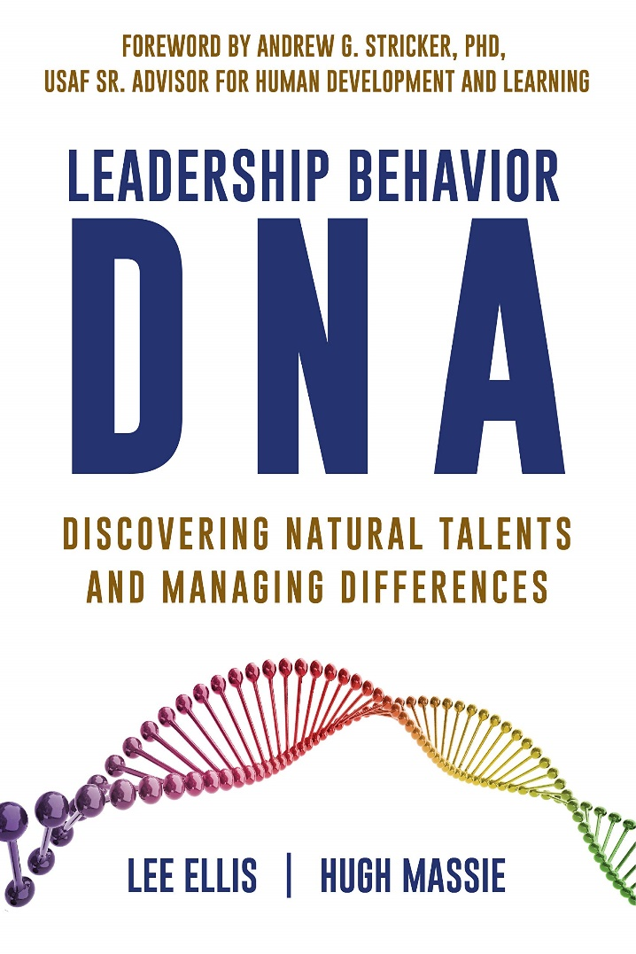
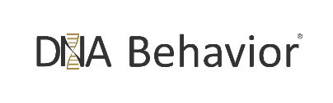
Hugh Massie, along with Lee Ellis literally wrote the book on discovering Natural Talents and Managing Differences.
Now available on Amazon.com
DNA Behavior
Unlocking the Science of Natural Behavior In Yourself and Others
dnabehavior.com

