Slide 1

Leadership Financial Behavior
Discover Your Financial Decision-Making Style as a Leader
Notes:
Case Studies: Digital Advice & Intergenerational Wealth Transfer
Organizational Transformation
Big Data

Slide 2

Signals for Enhancing Your Decision-Making
Rate How Effectively You Lead Others?
What hard-wired behavioral attitudes, habits, motivations and biases are impacting your decision-making?
What is your confidence level in making key decisions? Do you ever have feelings of regret?
Do you have a structured process for making key decisions?
Do you know the different perspectives of your team and stakeholders?
To what degree is your business decision-making conflicted by your remuneration package?

Slide 3
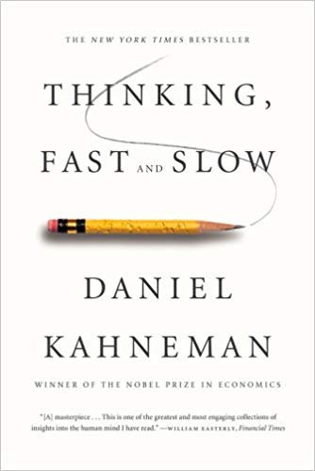
Read Thinking Fast and Slow
Improve the Rationality of Your Decision-Making Process
Learn to recognize:
The two systems that drive the way you think in making judgements and decisions
The impact of over confidence on corporate strategies
The effect of cognitive biases in decision-making
When to trust your intuition and tap into slow thinking
How to keep yourself out of trouble

Slide 4

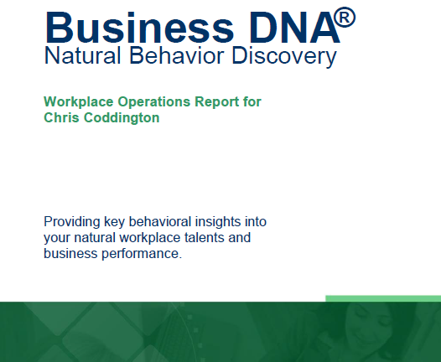

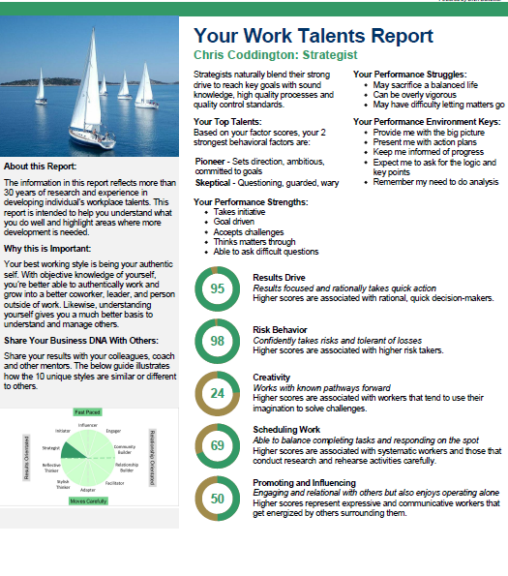

Discover Your DNA Behavior Style – A Quick & 91% More Reliable Method
DNA Natural Behavior Discovery (10 to 12 Mins)
Completed by each individual
leader and team-mate
Universally Applicable Insights
LEARNED SITUATIONAL BEHAVIOR
NATURAL BEHAVIOR
Automatic
Behavior Biases
Communication Style
Talents
Learning Style
Leadership Style
Decision-Making
Risk-Taking

Slide 5
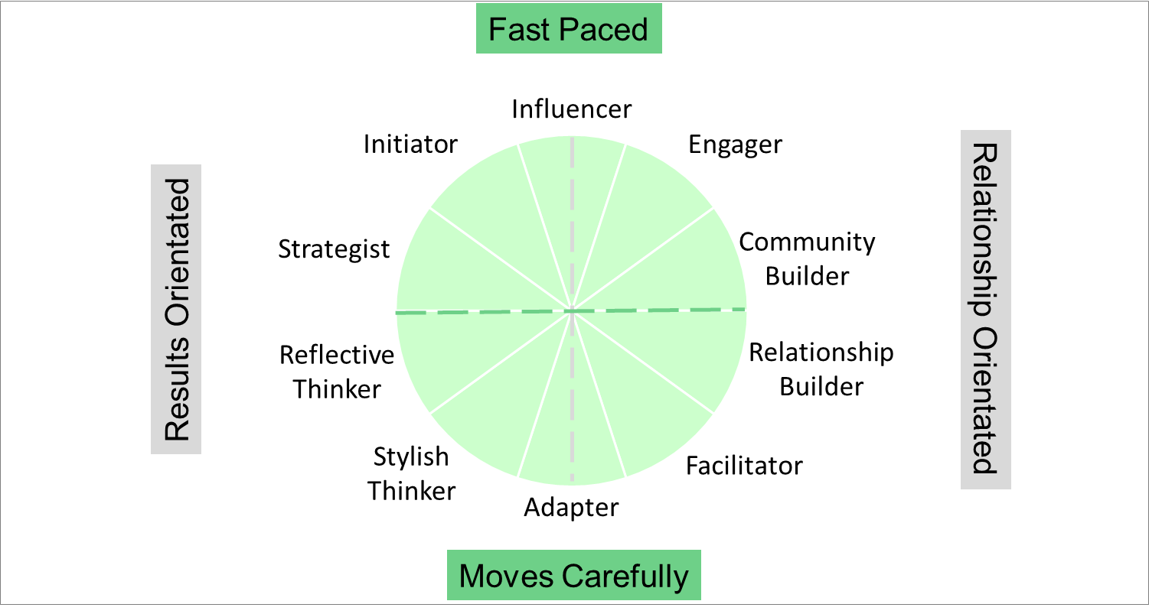

Natural Behavior Unique Style Matrix
Behavioral Biases Impacting Decision-Making
Consolidated View
Over Trading
Optimism Bias
Risk Taker
Fast Paced
Spender
Herd Follower
Instinctive
Status Quo
Results
Orientated
Relationship Orientated
Saver
Mental Accounting
Pattern Bias
Benchmark Focus
10 Unique Natural Workplace Styles based on 8 Primary Factors and 24 Sub-factors
Customized DNA Ultimate Performance Guide
Risk Aversion
Loss Aversion
Fear of Regret
Disposition Effect
Moves Carefully

Slide 6




Identifying Your Financial Behavior
For Making Business Decisions
Enhancing Your Leadership Decision-Making
Building a More Robust Decision-Making
Framework
Programs available from DNA Behavior to Improve Personal and Business Performance
Understanding the Different
Perspectives of Key Stakeholders

Slide 7


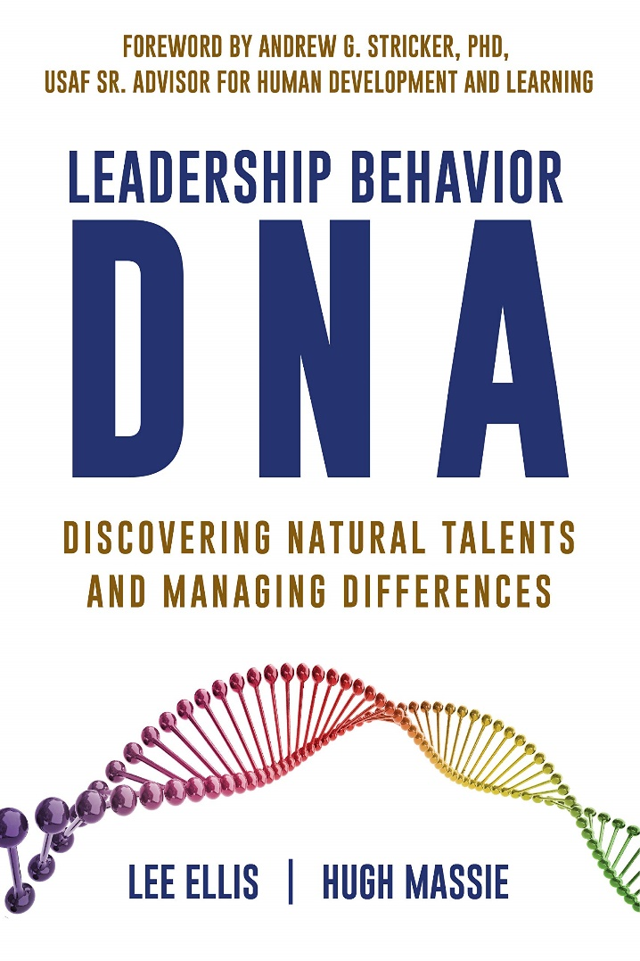
Hugh Massie, along with Lee Ellis literally wrote the book on discovering Natural Talents and Managing Differences.
Now available on Amazon.com
DNA Behavior
Unlocking the Science of Natural Behavior In Yourself and Others
dnabehavior.com

