Slide 1

Leadership Emotional Intelligence
Discover Your Hidden Drivers to Great Performance
Notes:
Case Studies: Digital Advice & Intergenerational Wealth Transfer
Organizational Transformation
Big Data

Slide 2

Signals for Enhancing Your Emotional Intelligence
Rate How Well You Manage Your Emotional Impact?
Do you respond appropriately to the emotions of others?
Are you comfortable to listen to feedback from others?
How well do you collaborate with others?
Are you able to positively influence others without manipulating them?
Do you manage your emotions well when disappointed?
Do you forgive others when you are wronged?
Do you demonstrate a willingness to compromise?

Slide 3

Read Primal Leadership
Become Emotionally Smart to Manage Your Emotional Impact
Build an action plan to grow your performance through:
Self-Awareness
Self-Management
Social Awareness
Relationship Management

Slide 4

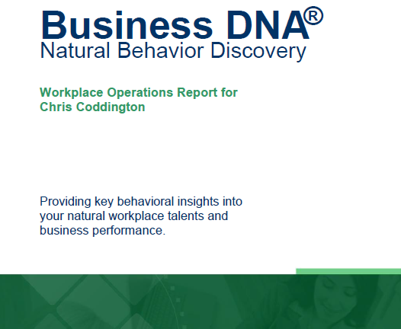

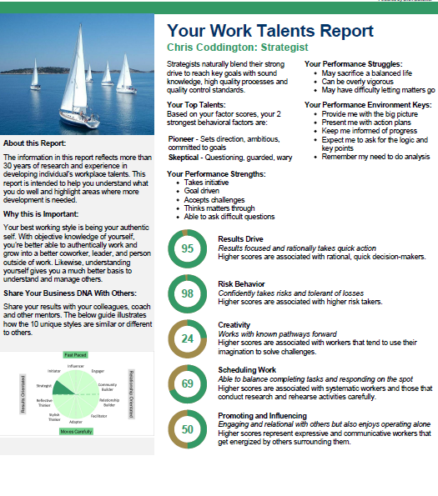

Discover Your DNA Behavior Style – A Quick & 91% More Reliable Method
DNA Natural Behavior Discovery (10 to 12 Mins)
Completed by each individual
leader and team-mate
Universally Applicable Insights
LEARNED SITUATIONAL BEHAVIOR
NATURAL BEHAVIOR
Automatic
Behavior Biases
Communication Style
Talents
Learning Style
Leadership Style
Decision-Making
Risk-Taking

Slide 5
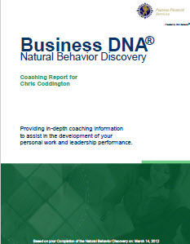

Business DNA Natural Behavior Discovery
Coaching Report for Self Management and Foundational Insights to Improving Your Emotional Intelligence
Business DNA Coaching Report
Detailed Analysis of 8 Primary Factors and 24 Sub-Factors
Strengths and Struggles
Keys to Building Your Emotional Intelligence
Customized Powerful Questions Based on Strongest Factors
10 Unique Natural Workplace Styles based on 8 Primary Factors and 24 Sub-factors

Slide 6
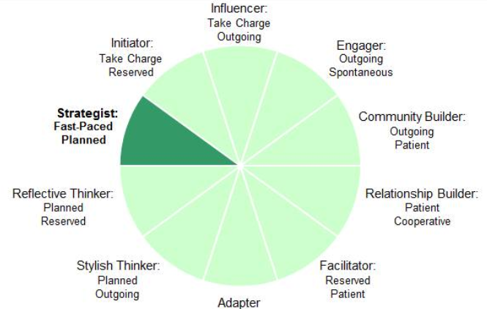
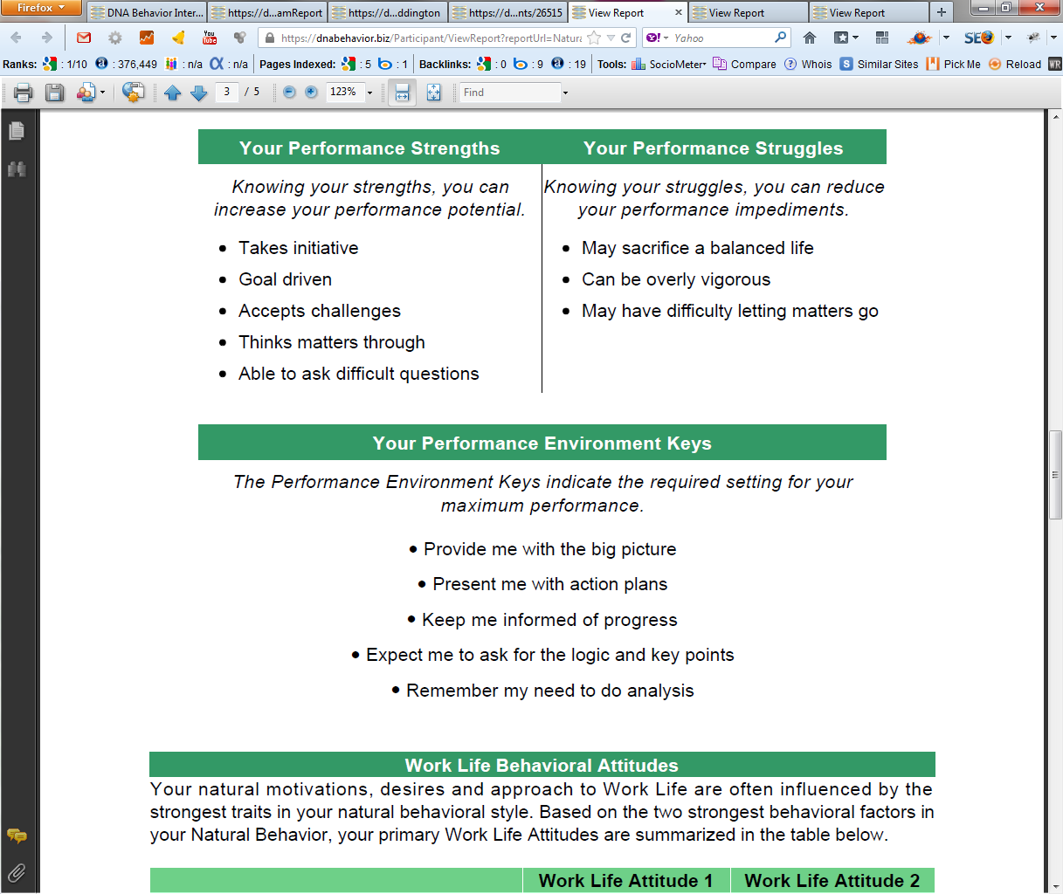
Practical Analysis of the Key Talents & Values
Driving Your Productivity and Relationships
10 Unique Natural Workplace Styles based on 8 Primary Factors and 24 Sub-factors
Customized DNA Ultimate Performance Guide

Slide 7
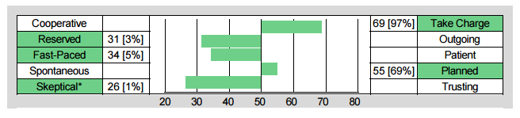
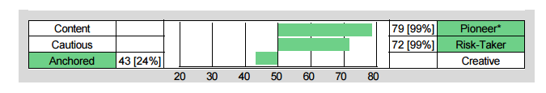
Building Your Own Level of Self-Awareness
Understand Your Talents, Strengths and Struggles – They Are Key to Your Leadership
Chris Coddington - Strategist
Skeptical Strength:
Questioning and guarded
Skeptical Struggle:
Too doubting and wary
Pioneering Strength:
Goal orientated and ambitious
Pioneering Struggle:
Too driven and success focused

Slide 8
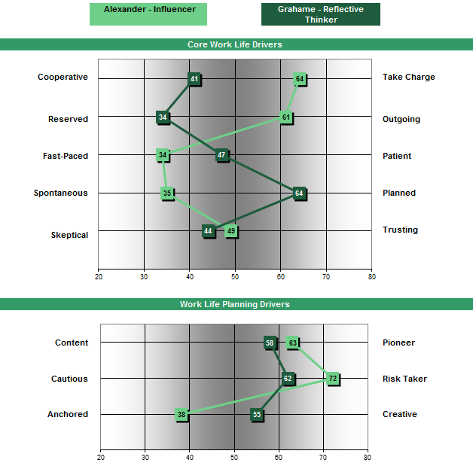
Building Awareness of Others
Managing Differences with a Comparison Report
Grahame needs to:
Speak up and be more direct with Alexander
Engage with Alexander in conversations
Not overwhelm Alexander with detail
Keep conversations with Alexander structured
Alexander needs to:
Include Grahame by being collaborative
Manage emotions with Grahame
Provide enough info to Grahame
Respect Grahame’s need to brainstorm

Slide 9
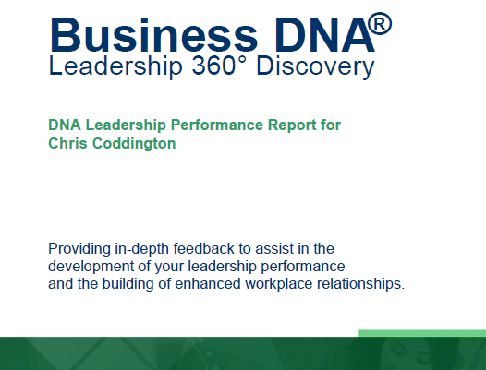
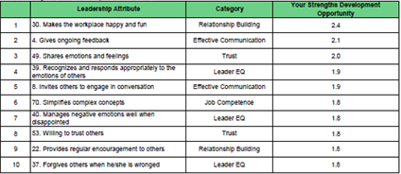
Enhanced Leadership Performance Development
Coaching for Developing Leadership EQ and Growth
The Leadership 360° Discovery Process provides objective measurement of how a leader is actually performing versus how they should perform based on their natural DNA style.
The DNA Leadership Performance Report highlights the leader’s top 10 leadership strengths and struggles, uncovering 75 items relating to their leadership performance in 7 distinct areas:
Communication
Results
Relationships
Trust
Emotional Intelligence
Values
Competence

Slide 10
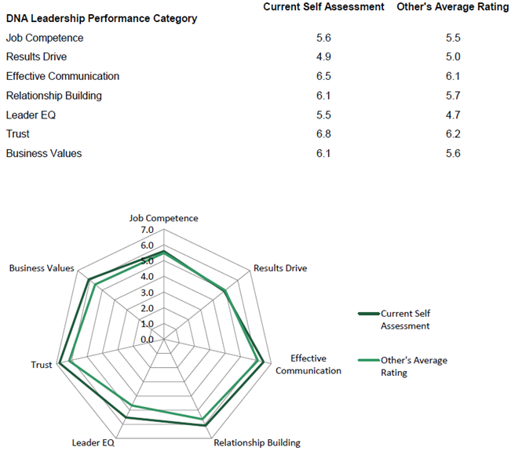
DNA Leadership Performance Report
The Gaps Highlighting Development Opportunities

Slide 11




Identifying Your Natural DNA Behavior
and Leader EQ
Improving Your Emotional Intelligence
Managing Self and Others
Programs available from DNA Behavior to Improve Personal and Business Performance
Being Smart in All Areas of Life

Slide 12


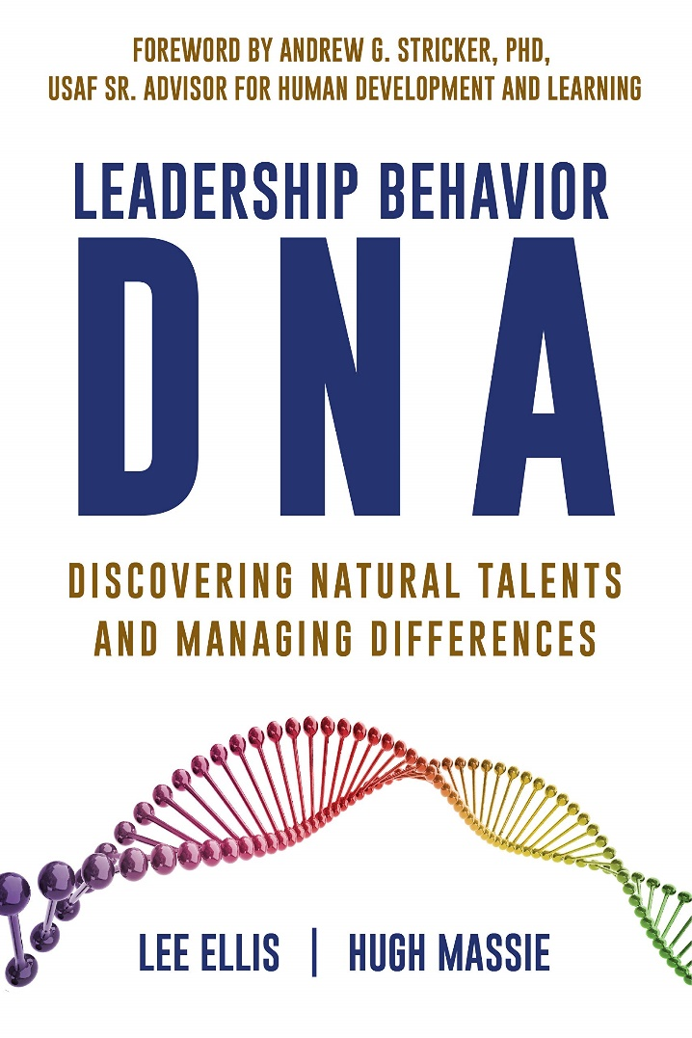
Hugh Massie, along with Lee Ellis literally wrote the book on discovering Natural Talents and Managing Differences.
Now available on Amazon.com
DNA Behavior
Unlocking the Science of Natural Behavior In Yourself and Others
dnabehavior.com

