Slide 1

Know Yourself
Discover Your Identity, Talents, Strengths and Struggles, Values and Purpose
Notes:
Case Studies: Digital Advice & Intergenerational Wealth Transfer
Organizational Transformation
Big Data

Slide 2


Signals for Maximizing Your Performance
Rate How Well You Know Yourself?
What is your stand-out talent that is unique to you for achieving maximum performance?
In what ways are you getting in your own way of performance?
What activities are you passionate about?
Do you have a purpose or calling which is guiding you?
What is the values set that you use to make key decisions?
In what situations are you most confident?
What behavioral changes are you going to make to realize your potential?

Slide 3

Read the Power of Identity to Find Your “Mojo”
A Powerful Developmental Framework for Making Behavioral Change
Change your thinking about yourself
Identify the source of your own self-worth – be proud of yourself
Get in touch with your key capabilities (including talents)
Choose who you will be
Focus on where you can have the most strategic impact and then evolve yourself

Slide 4

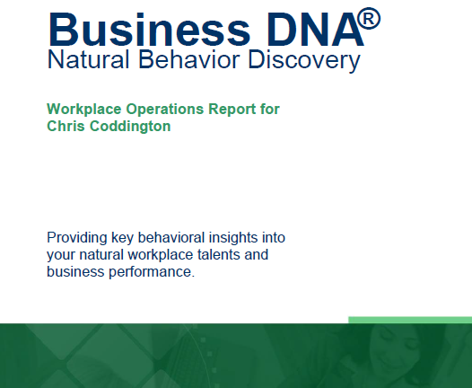

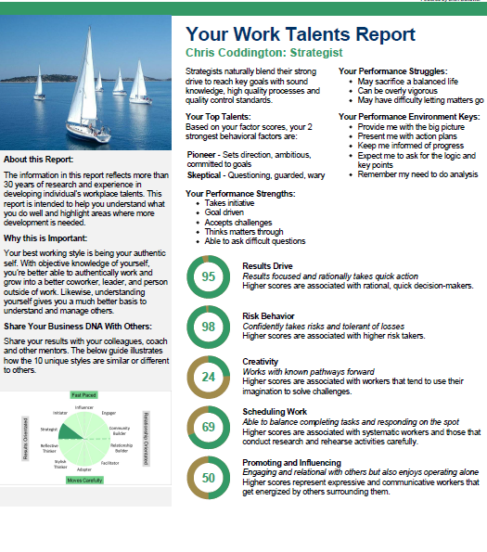
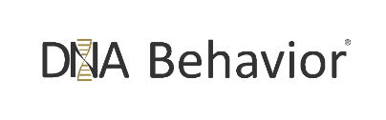
Discover Your DNA Behavior Style – A Quick & 91% More Reliable Method
DNA Natural Behavior Discovery (10 to 12 Mins)
Completed by each individual
leader and team-mate
Universally Applicable Insights
LEARNED SITUATIONAL BEHAVIOR
NATURAL BEHAVIOR
Automatic
Behavior Biases
Communication Style
Talents
Learning Style
Leadership Style
Decision-Making
Risk-Taking

Slide 5
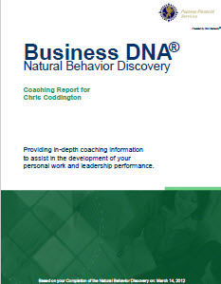

Business DNA Natural Behavior Discovery
Coaching Report for Talent Management and Foundational Insights to Discovering Your Identity
Business DNA Coaching Report
Detailed Analysis of 8 Primary Factors and 24 Sub-Factors
Strengths and Struggles
Keys to Building Your Personal and Business Performance
Customized Powerful Questions Based on Strongest Factors
10 Unique Natural Workplace Styles based on 8 Primary Factors and 24 Sub-factors

Slide 6
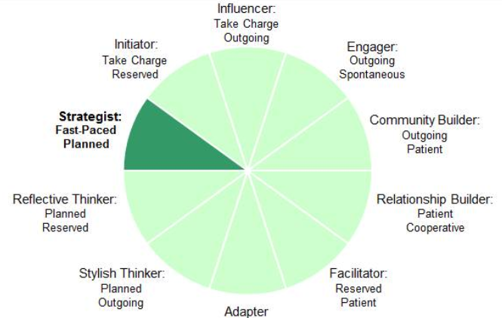
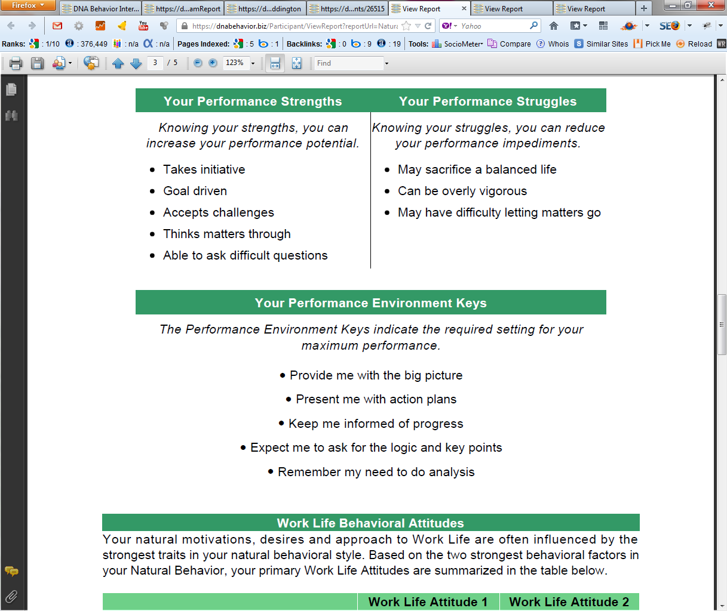
Practical Analysis of the Key Talents & Values
Driving Your Productivity and Relationships
10 Unique Natural Workplace Styles based on 8 Primary Factors and 24 Sub-factors
Customized DNA Ultimate Performance Guide

Slide 7
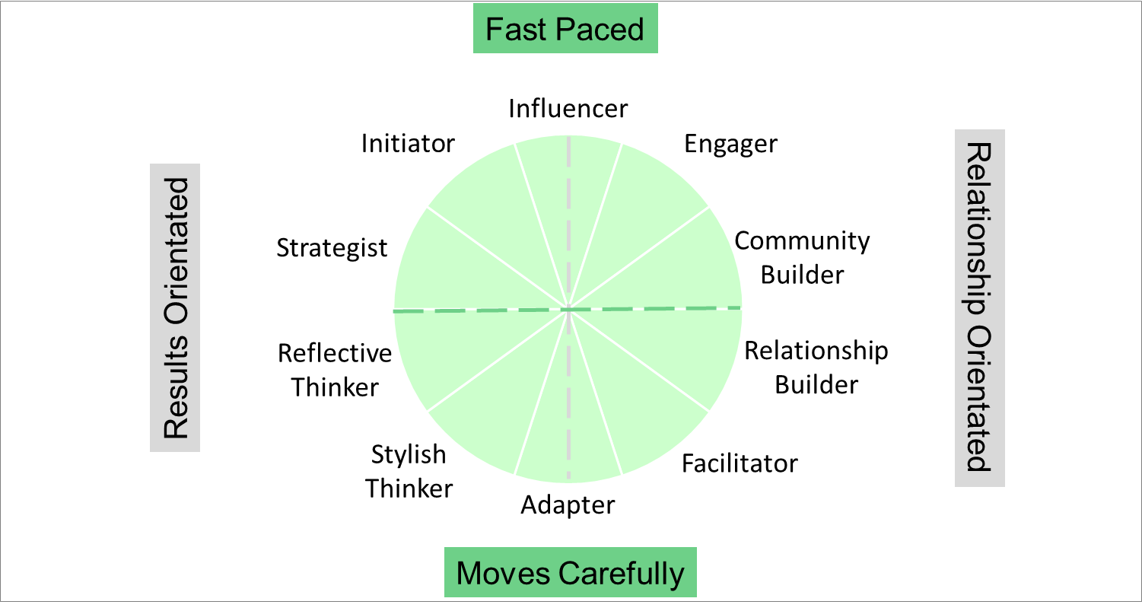
DNAB Natural Behavior Unique Style Matrix
Potential Behaviors Influencing Your Identity and Operating Style
Visionary and Determined
Heavy-handed and intimidating
Ambitious, cuts corners, greedy
Takes unnecessary risks
Open and Fun
Impulsive decision-maker
Loose with information
Sudden emotional outbursts
Analytical and Reliable
Resists change
Fails to initiate action
Lacks transparency
Relational and Inclusive
Buries problems
Passive aggressive
Covert sabotaging

Slide 8
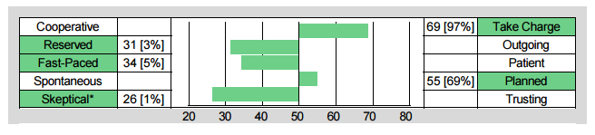
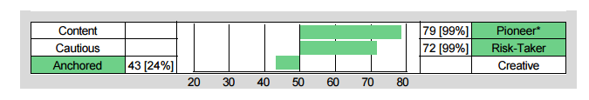
Building Your Own Level of Self-Awareness
Understand Your Talents, Strengths and Struggles – They Are Key to Your Identity
Chris Coddington - Strategist
Skeptical Strength:
Questioning and guarded
Skeptical Struggle:
Too doubting and wary
Pioneering Strength:
Goal orientated and ambitious
Pioneering Struggle:
Too driven and success focused

Slide 9
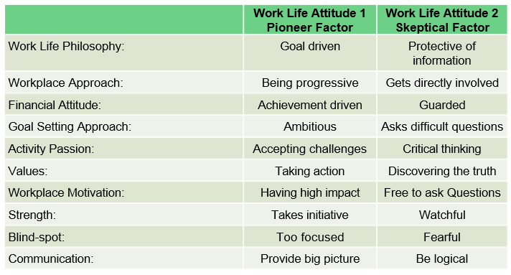
Work Life Behavioral Attitudes
Insights Into Your Values, Motivations and Approach
10 Unique Natural Workplace Styles based on 8 Primary Factors and 24 Sub-factors
Customized DNA Ultimate Performance Guide

Slide 10




Identifying Your Natural DNA Behavior
Know Yourself- For Making Behavioral Change
Productively Leveraging Your Talents
Programs available from DNA Behavior to Improve Personal and Business Performance
Maximizing Your Strategic Impact

Slide 11


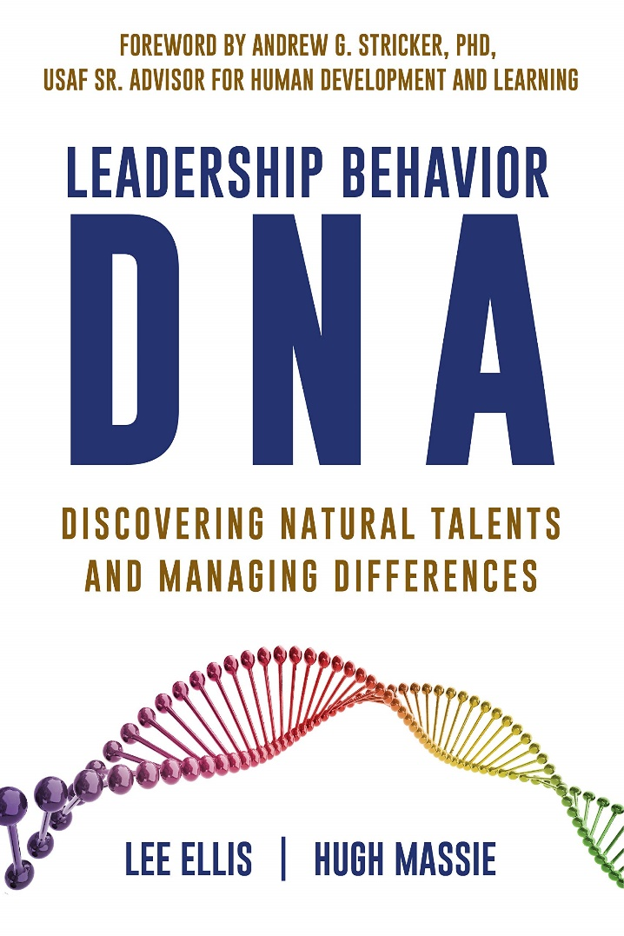
Hugh Massie, along with Lee Ellis literally wrote the book on discovering Natural Talents and Managing Differences.
Now available on Amazon.com
DNA Behavior
Unlocking the Science of Natural Behavior In Yourself and Others
dnabehavior.com

