Slide 1

Hiring Performance
Hire The Right People For Your Roles
Notes:
Case Studies: Digital Advice & Intergenerational Wealth Transfer
Organizational Transformation
Big Data

Slide 2

Signals Your Hiring Process Is Good
Rate How Your Hiring Process Measures Up In These Key Areas:
,
Hiring Managers follow a standard process with each candidate?
2. Job descriptions are written with specific behaviors/talents in mind?
3. Hiring managers understand the benchmark for an ideal candidate?
4. The hiring process has reduced turnover of hired candidates?
5. Leaders and new hires look for ways to maximize natural talent?

Slide 3
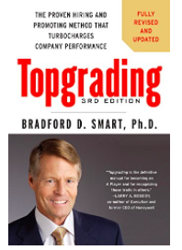
Read Top Grading
Get A Grip On Your Business
Learn:
That great companies, large and small, rise or fall because of their talent.
That the more high-performers on your team, the more successful your organization will be.
A new approach to hiring.
Interviewing techniques
The importance of developing talent.

Slide 4

Read Hire, Fire and The Walking Dead
A Leader’s Guide to Recruiting the Best
In this book learn how-to consistently:
Define the market and build a pipeline of high potential candidates; position the "product" (career opportunity) against the competition
Deliver the message with impact to potential candidates
Prospect for talent where competitors are not looking in the "hidden candidate market"
Rigorously qualify (screen) potential hires
Close the sale and deliver the star performer every time

Slide 5
Identifying Benchmarks for Hiring Success
What Talents are Required for your Role?
Building a Sales / Service Team
DNA Behavior Factor | Talents - Activity | Outside Sales | Inside Sales | Customer Service
Take Charge | Visionary/Decisive | >55
Cooperative | Listens/Collaborates |  | <50 | <50
Outgoing | Networks/ Communicates | >55 | >55 | >45
Reserved | Task Focused/ Researches
Patient | Friendly/Supportive |  | >45 | >50
Fast Paced | Handles Objections/ Rejection | <45
Planned | Detailed/ Structured |  |  | >50
Spontaneous | Flexible | <45 | <50
Trust | Receptive |  | >50 | >45
Skeptical | Asks Questions | <45
Pioneer | Goal Driven | >55 | >50
Content | Balanced |  |  | <50
Risk Taker | Takes Bold Action | >55 | >45
Cautious | Manages Risk |  |  | <50
Creative | Problem Solves
Anchored | Implements/ Executes | <50 | <50 | <45

Slide 6
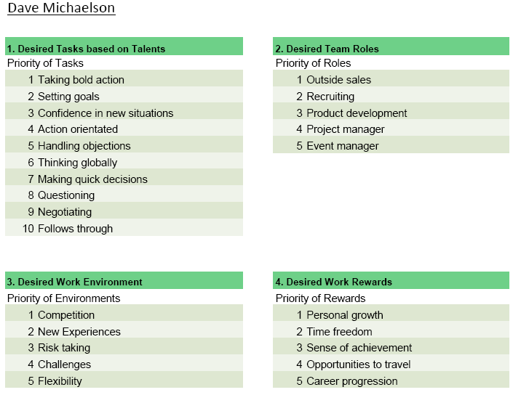
Review Ideal Environment for Hiring Success
What Tasks, Roles, Rewards and Environments are Key for your Candidate?
May be a good fit for Outside Sales Role
Probably bad fit for Tech Support

Slide 7




Identify Clear Job Description
Team Building - Hiring
Follow An Established Process
Programs available from DNA Behavior to Improve Hiring and Create Benchmarks for Roles
Hire and Onboard Great Candidates

Slide 8


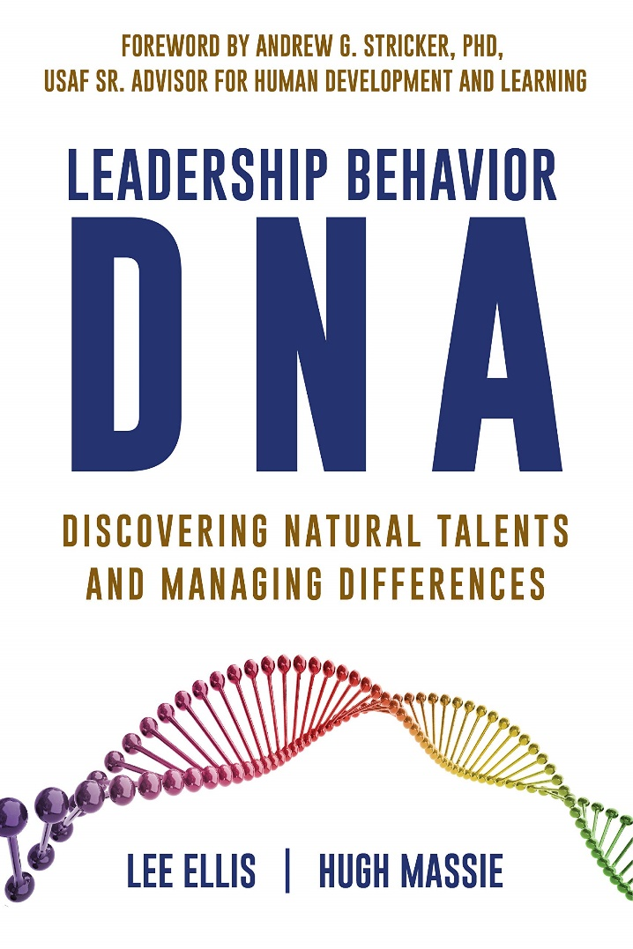

Hugh Massie, along with Lee Ellis literally wrote the book on discovering Natural Talents and Managing Differences.
Now available on Amazon.com
DNA Behavior
Unlocking the Science of Natural Behavior In Yourself and Others
dnabehavior.com

