Slide 1

Financial DNA®
DNA Personal Performance Plan
Self-Awareness
Confidence
& Wisdom
Emotional
Engagement
Based on the Philosophy of Behavior Drives Financial Planning Performance
Name:
Date:
DNA Behavior International
5901-A Peachtree Dunwoody Rd.
Suite 375
Atlanta GA 30328
Phone: 770 274 0311
www.dnabehavior.com

Slide 2

Natural Behavior Discovery
Your natural DNA behavior which is “hard-wired” by 3 years old is the first step to uncovering the core of your financial personality. This is the primary driver of:
How you instinctively respond to life and financial events
Your unique behavioral strengths, biases and risk taking
How you will consistently make decisions with the least stress, and where you will go to under pressure
Your communication style for providing and receiving information
Your talents, passions, values, life purpose and goals
The Financial DNA Natural Behavior Discovery Process measures natural “hard-wired” behavioral traits only
The report measures eight primary factors and 24-sub-factors of behavior
The reports do not identify baggage or mental health
The outcomes remain stable over time
There are no ‘good’ or ‘bad’ styles and they should not be used to put individuals in a ‘box’
No decision should be made solely on the report
The natural behavior styles are, age, gender and cultural neutral
Based on validation, the reports are right 90% of the time

Slide 3
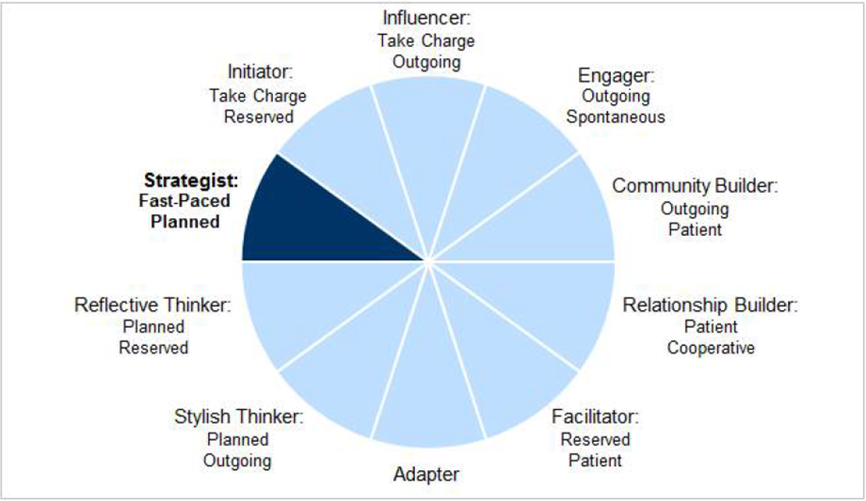
Financial DNA Summary Report Review
Exercise: Review your unique Natural Behavior Core Financial Life Style identified on page 2 of the Summary report (e.g. Strategist). To learn more, look up a description of your style in the DNA Unlocking Financial Planning Performance Guide.
Exercise: Review your top 2 behavioral factors identified in the report which influence your life and financial decision-making the most. The report analysis is based on these 2 factors. A summary of all the profile factors on the left hand and right hand sides is provided on the following pages, along with tables that show how these factors relate to your financial personality.
1
3. What are the 2 strongest factor scores from the above list:
1) 2)
4. What are 3 high level impressions you have about your life and financial decision-making style?

Slide 4
Profile Factors : Core Financial Life Drivers
COOPERATIVE Compliant
1. Commanding
TAKE CHARGE Visionary
Practical
Hesitant
Diplomatic
Visionary
Decisive
Blunt
RESERVED Reflector
OUTGOING People Connector
2. People
Expressive
Recognized
Talkative
Reflective
Focused
Withdrawn
FAST PACED Realist
PATIENT Stabilizer
3. Patience
Logical
Challenging
Critical
Understanding
Tolerant
Lenient
SPONTANEOUS Intuitive
PLANNED Analyzer
Instinctive
Flexible
Unfocused
4. Structured
Systematic
Particular
Rigid
SKEPTICAL Questioner
TRUSTING Believer
Questioning
Guarded
Wary
5. Natural Trust
Receptive
Believing
Forgiving
20
40
50
60
80
Traits intensify as you move
left and right from center
Notes:
As you move left or right from the mean score of 50, the left and right side traits grow more intense. For example, as the Directing score moves right, the associated behavior goes from Assertive to Decisive, and can be Controlling at the extreme.

Slide 5
Profile Factors: Financial Life Planning Drivers
CONTENT Balancer
6. Pioneering
PIONEER Goal Driver
Satisfied
Balanced
Easy-going
Goal Orientated
Ambitious
Driven
CAUTIOUS Conservative
7. Risk
RISK TAKER Venturer
Calculated
Conservative
Needs Certainty
Daring
Courageous
Over Confident
ANCHORED Implementer
8. Creativity
CREATIVE Idea Generator
Consistent
Past Experience Driven
Tied To Old Ways
Original
Imaginative
Abstract
20
40
50
60
80
Traits intensify as you move
left and right from center

Slide 6
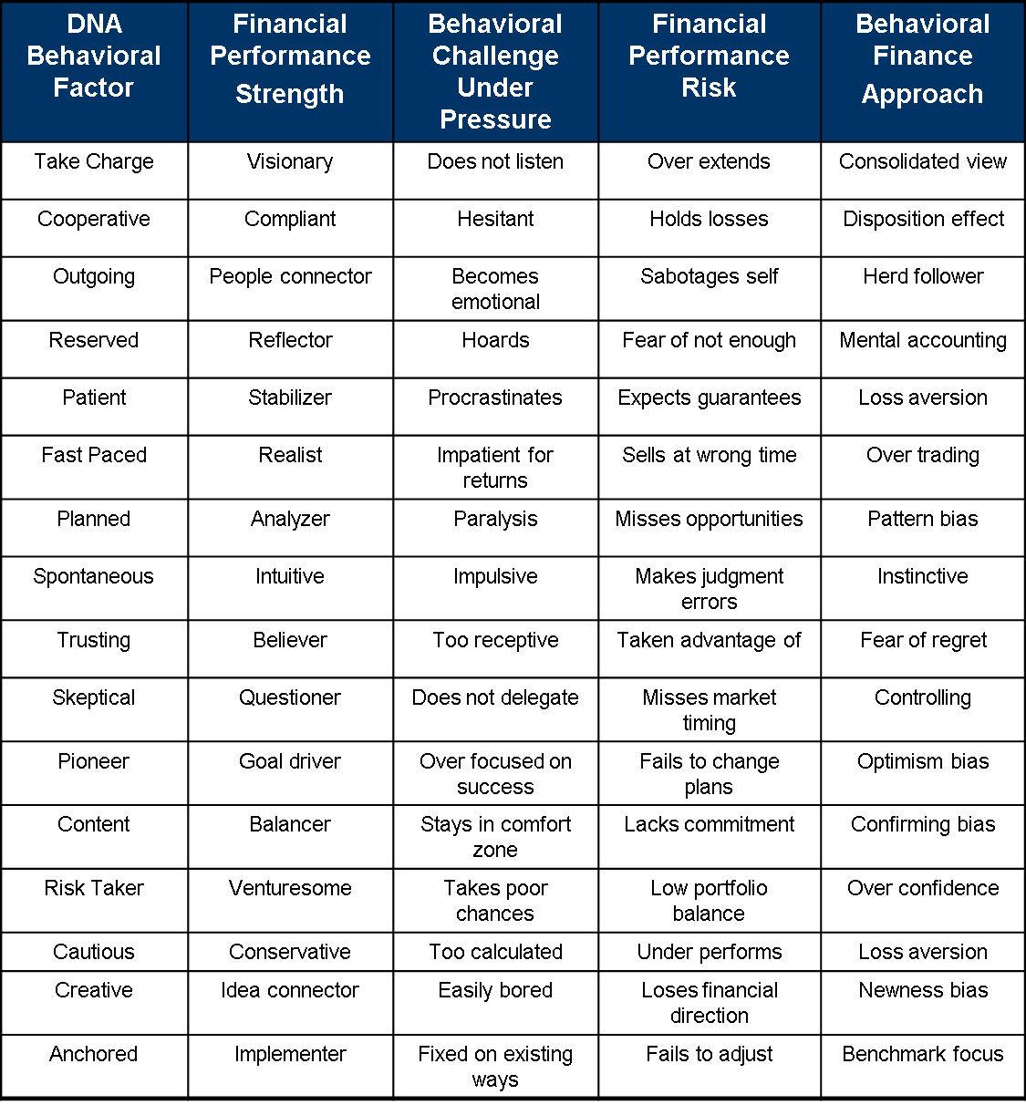
The Need for Financial Personality Awareness

Slide 7
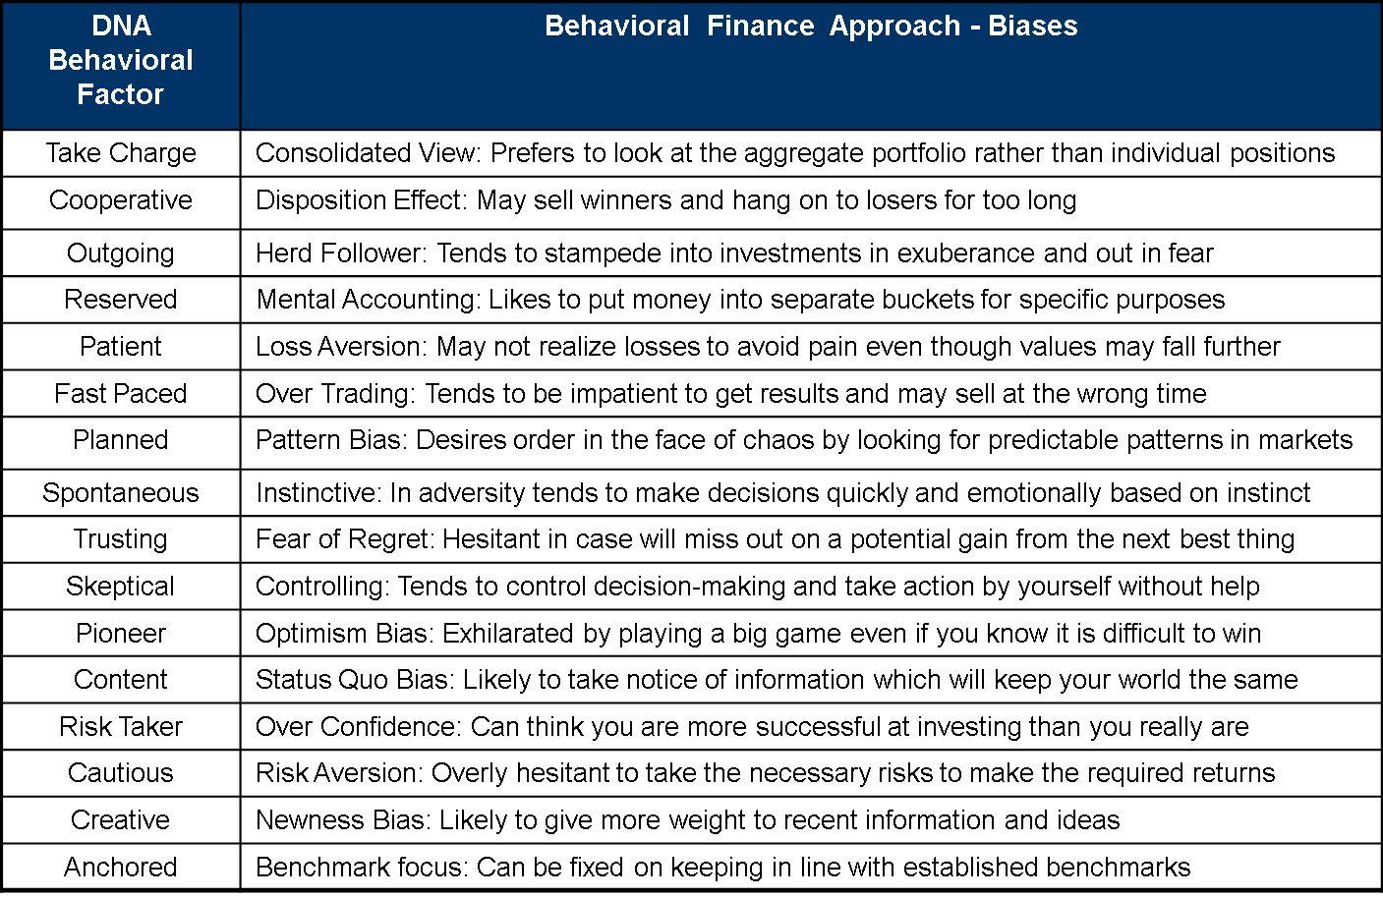
The Need for Financial Personality Awareness

Slide 8
Financial DNA Natural Behavior Summary Report Review
Exercise: Write a brief response to each of the questions below in the space provided
1. How did you feel about your Financial DNA Natural Behavior Summary Report?
2. Do you believe the Natural Behavior Report is accurate?
3. What aspects do you agree with / disagree with?
4. Are there any parts you do not understand?
5. Has the Natural Behavior Report told you something new about yourself?
Notes:
8

Slide 9
Financial DNA Natural Behavior Summary
Report Review
6. Has the Financial DNA Natural Behavior Summary Report identified differences you have with others?
7. What do you believe is your greatest behavioral talent (as reflected in your Financial DNA Natural Behavior strengths)?
8. From reviewing your Natural Behavior Summary Report, what part of your behavior do you struggle with most?
9. How have you learned to adapt your behavior in key areas of life (e.g. finances, career, family)?
10. Have you showed your spouse and family your Natural Behavior Summary Report? If so, what do they think?

Slide 10
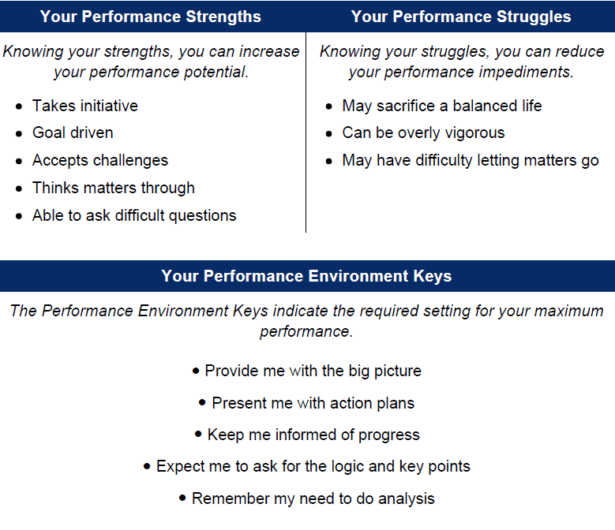
Taking Personal Performance to a New Level
Use your DNA Ultimate Performance Guide regularly.
Focus on your strengths as these are the dominant behaviors that will drive your decision-making.
Manage your struggles and their impact on others and your decision-making as they will be strengths overused and can get in the way of your success.
Self-trust will come from understanding and accepting your strengths and struggles and this will help you make improved decisions and build more open relationships.
Ensure you make decisions in an environment which is consistent with your unique style.

Slide 11
Natural Behavior Strengths and Struggles
Factor | Strength | Struggle | Factor | Strength | Struggle
Cooperative | Follows established agenda | Can be unassertive or timid | Take Charge | Takes the lead, wants to set the agenda | May be uncomfortable taking direction from others
 | Promotes stability through cooperation | Can underestimate own abilities |  | Sees the strategic / future vision | May over commit to what goals can be achieved
 | Speaks diplomatically | N/A |  | Speaks candidly | N/A
Reserved | Realistic and practical | May appear withdrawn and distant | Outgoing | Good at meeting people | Strong need for approval from others
 | Serious and modest | Drained by too much interaction with others |  | Likes to make a good impression on others | May be too transparent, too uninhibited
 | Not distracted by surroundings | N/A |  | Able to promote | N/A
Fast-Paced | Favors logic over feelings | May lack needed patience | Patient | Compassionate and warm, displays empathy | May compromise too much
 | Comfortable making difficult decisions | May be abrupt or interrupting |  | Listens well and receptive to others | Can be resistant to change
 | Prefers to take action | N/A |  | Likes to be stable and even paced | N/A
Spontaneous | Flexible, willing to adjust | May juggle too many ideas or tasks | Planned | Organized and orderly | Tends to be inflexible or too fixed
 | Works well with broad concepts | Can be too quick to decide |  | Good at following processes and procedures | Can be perfectionistic to avoid mistakes
 | Improvises or acts on the spot | N/A |  | Analyzes before deciding | N/A
Skeptical | Thinks matters through | May have difficulty letting matters go | Trusting | Allows open dialogue | May not set boundaries
 | Able to ask difficult questions | May not be easily forgiving |  | Approachable | Can be overly impressionable
 | Watchful of important tasks | N/A |  | Transparent | N/A

Slide 12
Natural Behavior Strengths and Struggles
Factor | Strength | Struggle | Factor | Strength | Struggle
Content | Satisfied with the status quo | Prone to be complacent | Pioneer | Takes initiative | May sacrifice a balanced life
 | Concentrates on balanced life | May stay in comfort zone |  | Goal driven | Can be overly vigorous
 | Creates a steady environment | N/A |  | Accepts challenges | N/A
Cautious | Plans initiatives carefully | May miss opportunities | Risk-Taker | Ventures into new areas | May take unnecessary risks
 | Sees potential dangers | May be too hesitant |  | Faces danger comfortably | May not see the dangers
 | Calculated decision-maker | N/A |  | Demonstrates courage | N/A
Anchored | Follows established procedures | Can be hesitant to act on new ideas | Creative | Open to unusual ideas | Difficulty with following set procedures
 | Operates using evidence | May overly rely on proven procedures |  | Imagines new possibilities | May fail to make ideas concrete
 | Handles tangible issues well | N/A |  | Highly curious | N/A

Slide 13
Natural Behavior Strengths and Struggles
Factor | Performance Environment Keys | Factor | Performance Environment Keys
Cooperative | Create a relaxed environment | Take Charge | Offer up options & recommendations for a decision
 | Allow me to collaborate and provide input |  | Give me direct answers, get to the point
 | Demonstrate that you are actively listening |  | Show the results and outcomes
Reserved | Honor my need to reflect and think | Outgoing | Remember my need for fun and/or excitement
 | Allow me time to process my response |  | Invest time in building our relationship
 | Present me with the facts, minimize your emotions |  | Tell me who is involved
Fast-Paced | Anticipate my immediate responses and quick fixes | Patient | Remember my need to avoid conflict
 | Speak/move at a quick pace |  | Soften your tone of communication
 | Use summaries, bullets, and key points |  | Present me with information, plus your feelings
Spontaneous | Allow me plenty of freedom | Planned | Consider my need for accuracy and detail
 | Use graphics and verbal communications |  | Honor my need for structure, schedules and rules
 | Resist the temptation to prematurely edit my ideas |  | Remember my need to be thorough and prepare
Skeptical | Expect me to ask for the logic and key points | Trusting | Remember my desire to be included
 | Remember my need to do analysis |  | Keep the conversation with me friendly
 | Allow me time to think matters through |  | Expect/encourage my thoughts out loud

Slide 14
Natural Behavior Strengths and Struggles
Factor | Performance Environment Keys | Factor | Performance Environment Keys
Content | Focus on my life balance needs | Pioneer | Provide me with the big picture
 | Keep the conversation easy-going |  | Present me with action plans
 | Give me the directions to move forward |  | Keep me informed of progress
Cautious | Look for ways to minimize the risks | Risk-Taker | Present me with opportunities
 | Allow me time to survey the situation |  | Present me with the risks and return
 | Remember my need for safety |  | Keep the discussion positive
Anchored | Show me the logical steps | Creative | Expect/encourage my out-of-the-box thinking
 | Tell me past experiences |  | Encourage me to brainstorm
 | Keep the ideas practical |  | Recognize my desire to investigate ideas

Slide 15
Summary Report - Quality Life Behavioral Attitudes
Exercise: Review the Quality Life Behavioral Attitudes in Your Financial DNA Natural Behavior Summary Report and answer the following questions.
1. How are you currently living out these key attitudes in your life?
2. Identify 3 ways these attitudes have impacted your life and financial decision-making to date.
1.
2.
3.
3. By having greater clarity of these attitudes, identify up to 3 changes you could make in your decision-making.
1.
2.
3.
Notes:
15

Slide 16
Summary Report - Financial Planning Insights
Exercise: Review the Financial Planning Insights dashboard in Your Financial DNA Natural Behavior Summary Report and answer the following questions. You can review the definitions on the next page.
1. What are 3 insights that you had from this Financial Planning Insights dashboard?
1.
2.
3.
2. Identify up to 3 ways you would like them handled in preparing and managing your financial plan.
1.
2.
3.
Notes:
16

Slide 17
Definitions of Financial Planning Insights
LOW |  | HIGH
Accepting, Agreeable, Relaxed, Calm | Sets the Agenda | Leads, Directs, Sets the Vision
Confrontational, Insensitive, Poor listener | Relationships | Patient, Caring, Inclusive, Harmonious
Over commits, Lose objectivity, Needs boundaries | Results | Outcomes focused, Price sensitive, Demanding
Conservative, Cautious, Safety first | Risk Propensity | Takes chances, Pioneering, Optimistic
Emotional with losses, Wants guarantees | Risk Tolerance | Rationalize losses, Lives with losses
Balanced Life, Cooperates, Steady | Setting Goals | Opportunistic, Ambitious goals, Drive to succeed
Changes plans, Flexible, Wavers | Pursuing Goals | Committed, Stays to plan, Focused
Procrastinates, Sensitivity, Stability | Comfort with Change | Resilient, Moves on, Fast Paced
Track record, Existing solutions, Realistic | New Idea Driven | Invest in new products and transactions, New ideas
Disorganized, Not Prepared, Disarray | Financially Organized | Orderly, Budgets, Structured
Fact sheets, Bullet points, Summaries | Need for Information | Investigative, Research, Analytical
Saver, Rational consumer, Selfish | Spender | Lifestyle, Emotional buyer, Generous
Collaborative, Team approach, Takes direction | Need for Control | Operate alone, Independent thinking, Liquidity

Slide 18
Summary Report – Investment Portfolio Parameters
Exercise: Review the Natural Behavior Investment Portfolio Parameter Grouping assigned to you based on your Risk Propensity and Risk Tolerance.
1. How do you feel your Natural Behavior Investment Portfolio Parameter Grouping compares to your current attitude to investment risk based on your:
Behavioral finance biases
Required returns needed to achieve your goals
Current financial capacity
Learned behaviors based on current perceptions of past experiences, knowledge of financial and investment markets
Confidence in financial and investment markets, and your own decision-making comfort
2. Indicate 3 reasons why you would like to take a higher or lower level of investment risk than your Natural Behavior Investment Portfolio Grouping.
1.
2.
3.
Notes:
18

Slide 19
Summary Report – Advisor Client Compatibility Matrix
Exercise: Using the DNA Ultimate Performance Guide and the Advisor/Client Compatibility Matrix in Your Financial DNA Natural Behavior Summary Report, address the following areas which will be foundational to the relationship with your Wealth Mentor.
How will you measure your relationship with your Wealth Mentor? (e.g. financial results, quality of the interaction, etc.)
How do you wish to be communicated with? (e.g. phone, email, detailed reports, etc.)
What is your goal setting style? (e.g. regular review and documentation, etc.)
What is the ideal pattern of your financial decision-making? (e.g. researching, taking risks, networking, etc.)
What will be the accountability process with your Wealth Mentor in relation to making decisions? (e.g. call before decisions are made, monthly, quarterly, or annual meetings, etc.)

Slide 20
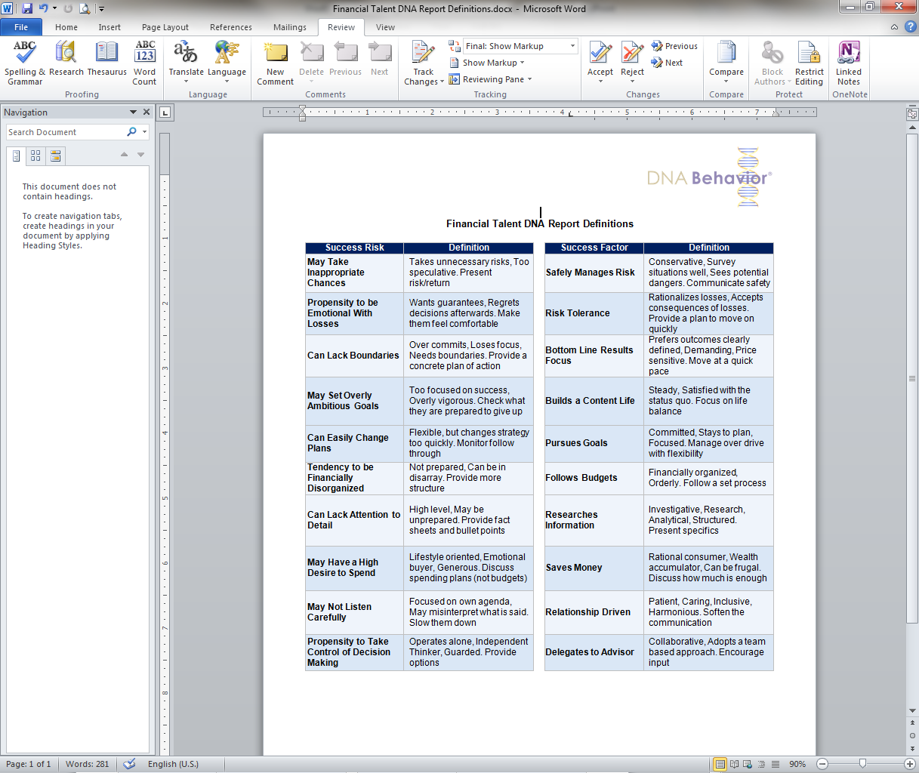
Financial Talent DNA Report Review
Exercise: After reviewing your Financial Talent DNA report circle 3 key items that you believe need the most discussion with your advisor in building your financial plan.
Notes:
20

Slide 21
Wealth Mentoring Report - Enhanced Personal Awareness
Exercise: Review Page 5 of your Financial DNA Natural Behavior Wealth Mentoring Report and identify your most significant strengths and struggles in each primary profile factor (or sub-factor within the factor) for making life and financial decisions. Focus on those strongest factors or sub-factors with scores over 60 and under 40.
Primary Factor: Strength: Struggle:
Commanding:
People:
Patience:
Structured:
Natural Trust:
Pioneering:
Risk:
Creativity:
Notes:
21

Slide 22
Your Immediate Action Steps
Exercise: In developing your DNA Personal Performance Plan, you need to identify the immediate action steps to achieve your top 5 Quality Life Goals.
This page will enable you to record your immediate action steps in a summary format. This is the starting place for you to achieve your longer term Quality Life Goals.
Top 5 Quality Life Goals |  | Quarterly / Monthly Activities |  | Weekly / Daily Action Steps
 | → |  | →
 | → |  | →
 | → |  | →
 | → |  | →
 | → |  | →

Slide 23
Disclaimer and Contact Information
Disclaimer
The purpose of the Financial DNA® profile products and related application tools is to assist in the identification of a person’s Financial DNA. The Financial DNA Natural Behavior Discovery, Financial Personality Discovery, and the Quality Life Discovery are not professional psychological instruments and should not be used to identify, diagnose or treat psychological, mental health, and/or medical problems. Additionally, if used to evaluate personnel, the user should seek adequate legal counsel to ensure compliance with applicable local, state and federal employment laws. The user assumes sole responsibility for any actions or decisions that are made as a result of using these aids to self-discovery. By using the Financial DNA Natural Behavior Discovery, Financial Personality Discovery, and the Quality Life Discovery, you expressly waive and relinquish any and all claims of any nature against DNA Behavior International, affiliated companies, and/or their employees, arising out of or in connection with the use of these products.
Copyright
All of the contents of this workbook and the Financial DNA Discovery Process and related application tools are the intellectual property of DNA Behavior International and its related companies. None of this intellectual property is to be copied or reproduced for any purpose, unless express written permission is applied for and given by DNA Behavior International.
Contact Us
For the complete range of Financial DNA® profiles, tools, training and consultation,
please contact DNA Behavior International:
in the United States
5901-A Peachtree Dunwoody Rd, Suite 375 Atlanta GA 30328
Telephone: 770 2740311 • inquiries@dnabehavior.com

