Slide 1
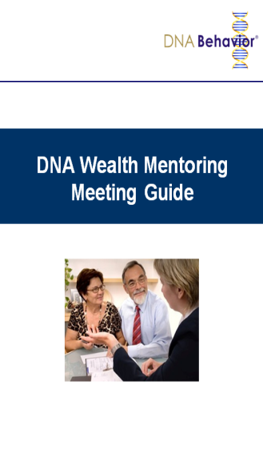
Client Engagement Letter
At the beginning of a relationship with a new client, Chris Coddington (the Advisor) sends an engagement letter that includes the following wording:
“Making the time we spend together more effective and helping you to reach your goals is very important to me. In order to provide you with the best service I can on a long-term basis, I would like to understand you better. I need to better be able to understand what drives your attitude to risk and financial decision-making and how best to communicate with you on your terms so that we can more quickly build the trust necessary to have a deeper conversation.
Building wealth is actually about first understanding your own rational and emotional zones and inherent aptitudes. I can help you to more consistently follow a pattern of decision-making that will lead you to success and fulfilling your dreams with a lot more comfort. This starts with understanding your unique financial personality.
For this reason, I ask my clients to complete the Financial DNA® Discovery Process to help you and me develop an objective understanding of your needs. Many of my clients have truly appreciated the clarity this process has brought from the uncovering of new information that helps their financial decision-making.
I will provide you with my Financial DNA® Discovery Report as well, so that you know I have also walked this path and to build my relationship with you.”

