Slide 1
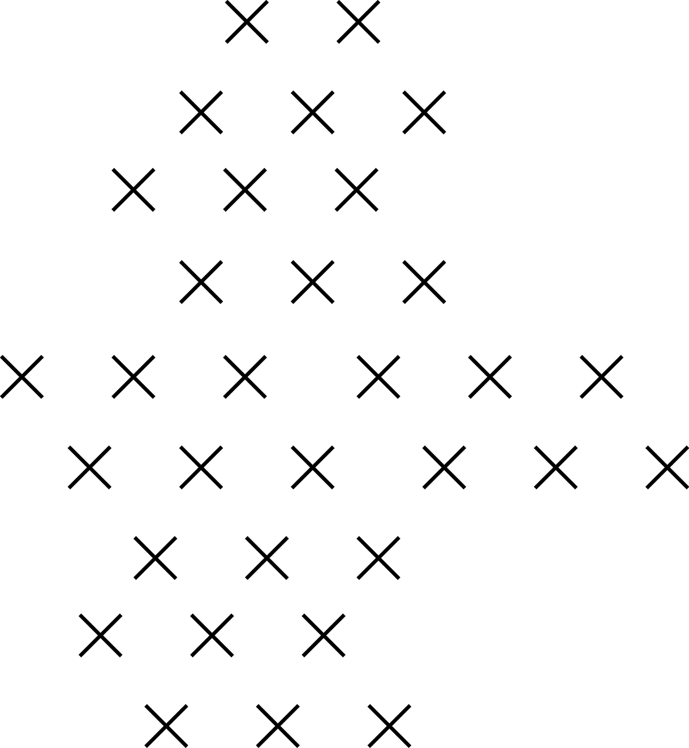

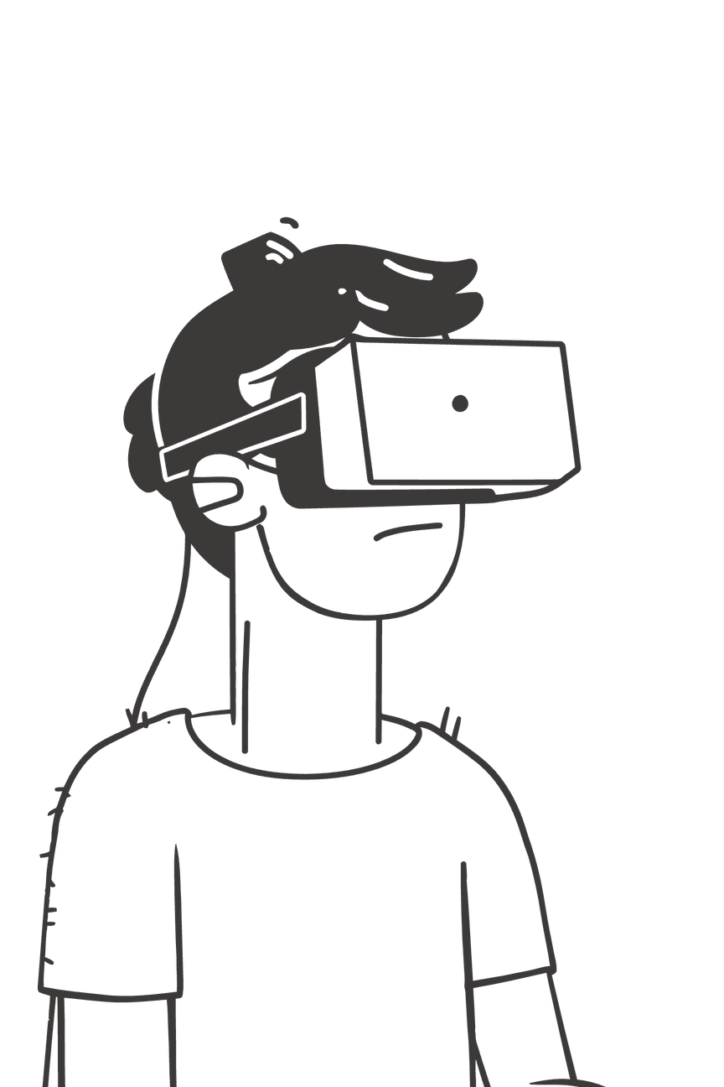

Big Unveiling
"The future of behavioral insights is here."
Notes:
1

Slide 2

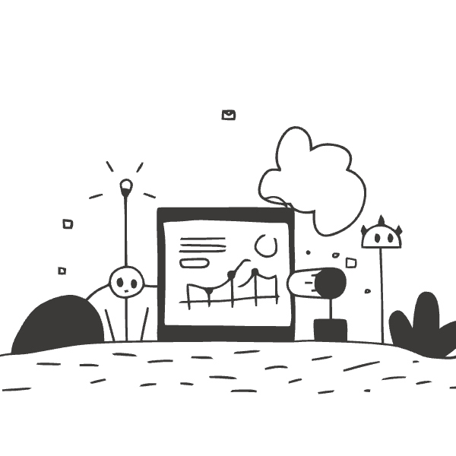

Key Updates
  Better insights, delivered faster
  Sharper outputs for more meaningful conversations
  Continuous improvements from our Research Team
  Built to keep raising the bar for clients and employees
Notes:
3

Slide 3




Introduction to Kenyatta Turner
CEO, Freedom Empire Consulting
Notes:
7

Slide 4


Case Study
"Digital Scan has revolutionized how I prep. I get to the core of my clients' needs faster, building trust and delivering measurable results almost immediately."
  Runs scans pre-coaching sessions for Behavioral SWOT Matrix Analysis
  Personalizes conversations with instant insights
  Faster prep without sacrificing depth
Impact: Clients feel understood quicker, building stronger trust. Sessions go deeper, faster, with measurable results.
Notes:
8

Slide 5
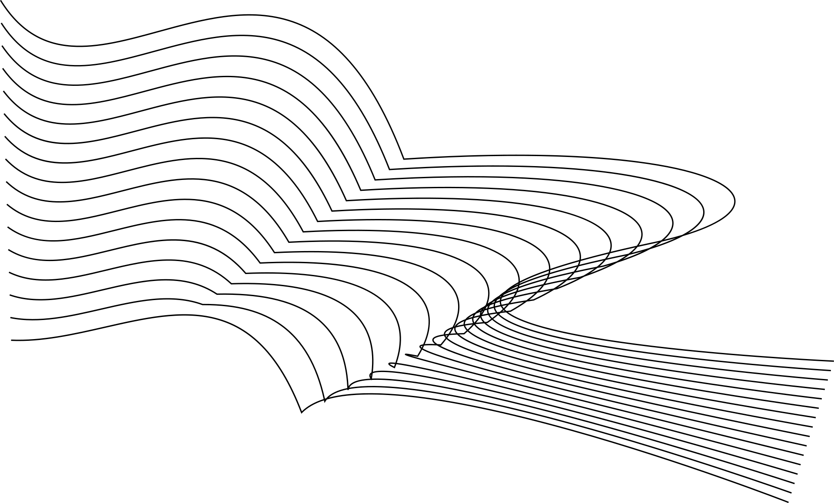



Digital Scan is Going Public
New Era
Client Access
Built In-House
Advanced insights for everyone
Available to all eligible clients
Streamlining your workflow
Notes:
2

Slide 6

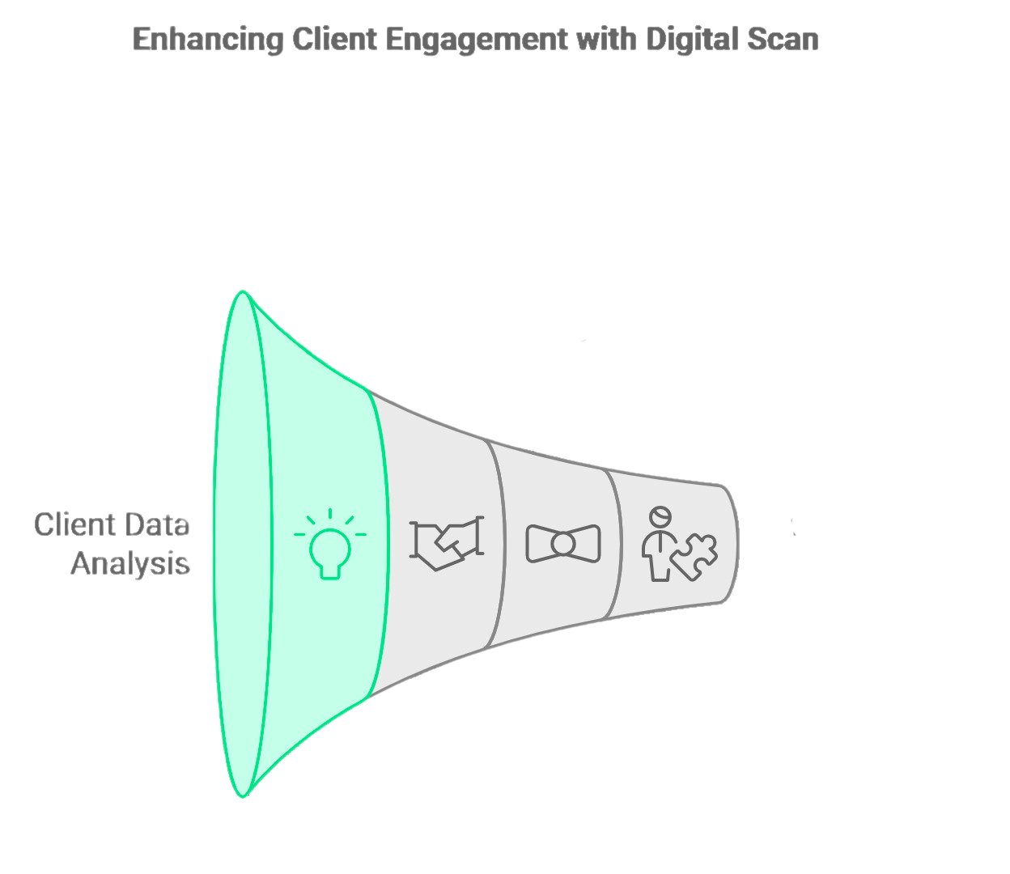



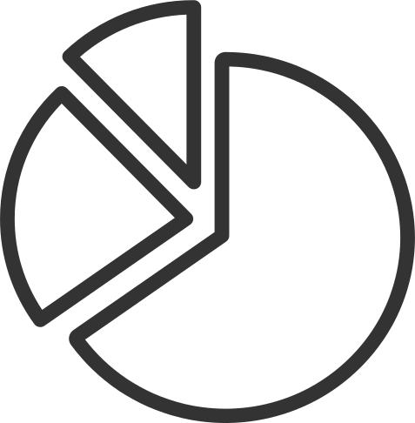



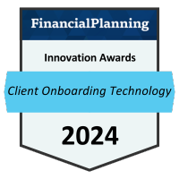
What is Digital Scan?
  Same deep insights as full profiles
  No lengthy questionnaires needed
Lead
Elevated Client Engagement
+
Increased Referrals
  Designed to simplify your work
  Onboarding
  Advisor - Client Matching
  Conference and Event Planning
Notes:
3

Slide 7


How It Works
01
02
Navigate to Users Page
Click "Scan" Button
Your central hub for client management.
Initiate the rapid analysis process.
03
04
Enter Client Info
Profile Appears
Quick data entry, minimal fuss.
Instant, comprehensive behavioral insights.
Notes:
4

Slide 8

Key Features
Instant Results
Full Insights
Meeting Prep
Equivalent to 46-question Discovery with Less Reliability
Insights in seconds, not hours.
Tailored insights for every interaction.
70-75% Accuracy
Plug-and-Play
Validated and highly reliable.
Seamlessly integrates into workflows.
Notes:
5

Slide 9
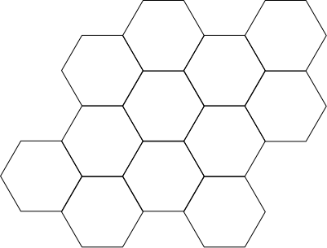

Benefits for Clients
Save Hours
Unlock Insights
Impactful Meetings
Maximize your productivity and focus on clients.
Deep behavioral understanding across your teams.
Data-driven conversations, every time.
Building Trust-Forward Relationship
Building Trust Forward Relationship using Digital Scan
Notes:
6

Slide 10




Availability & Packages
Digital Scan public access is available with:
Professional Package
Small Business Package
Enterprise Package
Ideal for established practices.
Tailored for growing enterprises.
Comprehensive solutions for large organizations.
Note: Not included in legacy or entry-level packages.
If you need to upgrade your current package you can contact us at DNACare
DNACare@dnabehavior.com
Notes:
9

Slide 11
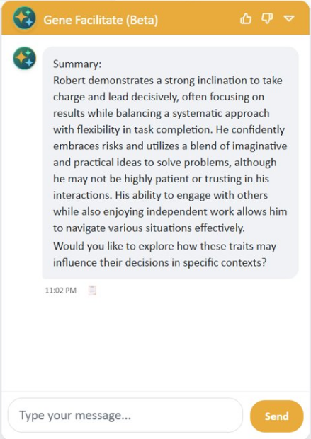
Gene Facilitate
  AI facilitator tool built for everyone
  Lets you ask questions and clarify reports/scores in real time
  Integrated across all reports for instant support
  Recently upgraded with stronger knowledge and better performance
We’d love your feedback: send to dnacare@dnabehavior.com

Slide 12


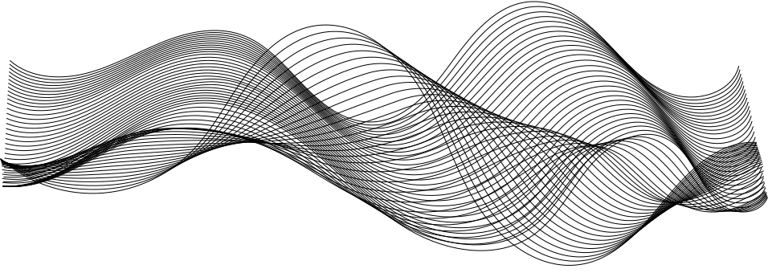



What's Next?
Available Now!
Roadmap Ahead
  Digital Scan for everyone
  Full profile-level insights in seconds
  Gene Facilitate for instant Q&A
  Visual dashboards and shareable reports
  Ongoing improvements to Digital Scan
  New features to make client initiatives easier and more effective
  Upcoming in-app experiences:
  Guided walkthroughs to help clients onboard faster
  Smart banners to notify clients of new features and updates
Notes:
10

Slide 13
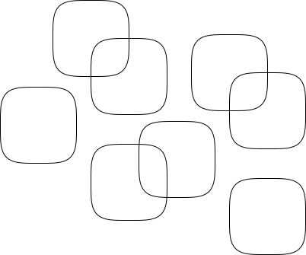


Q&A
Notes:
11

