Slide 1
DNA Behavior®
Team Productivity
Insert client logo

Slide 2
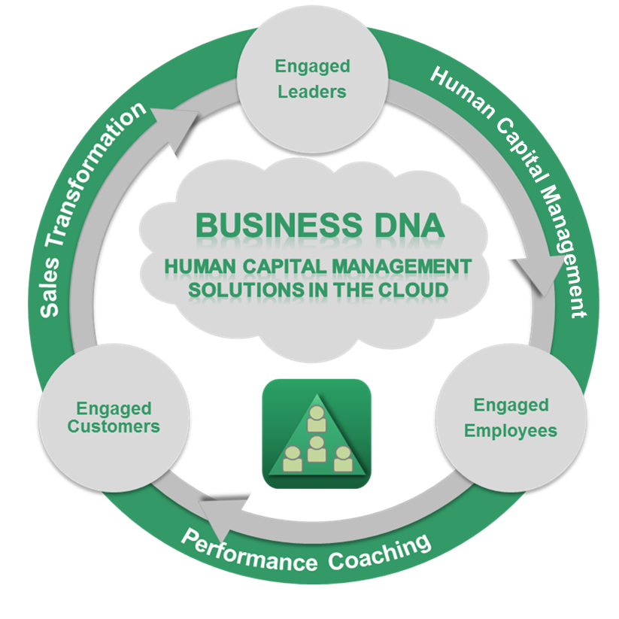
Business DNA® Delivering Employee Personality Insights Behavioralizing Teams
Know, Engage and Grow Every Employee Using our Talent Management Platform.
Since 2001, we have been delivering unique employee personality insights for leaders, employees and consultants to be Behaviorally SMART™ so they can build, coach and mentor their teams to achieve greater productivity and increased self-empowerment.
Behaviorally matching talents, role and teams is a proven way to build a high performance business.

Slide 3
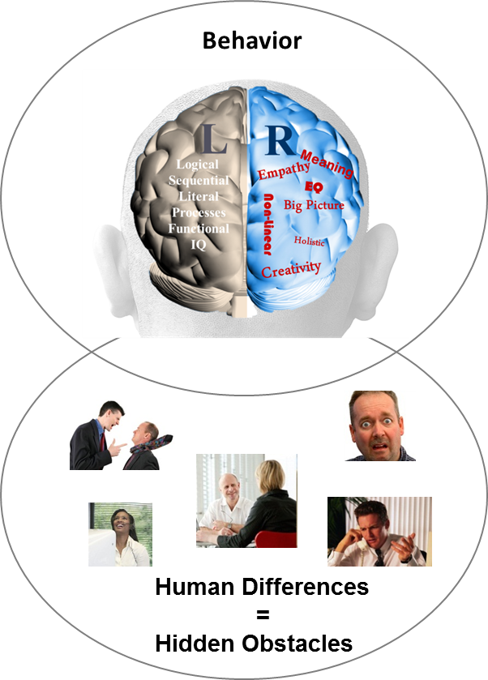
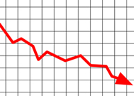
The Need to Reveal and Manage Hidden Team Differences
Behavior Causes Business Performance Challenges
Sales Conversion
?
Client Engagement
?
Employee Retention & Productivity
?
Operational Execution
?
87% of
measurable business issues are communication related
Business
Performance
Source: Harvard Business Review 2002

Slide 4
Outcome: A Behaviorally SMART™ Team
Built on Matching Talents to Roles, Teams and Customers
Team With Lack of Behavioral Insight
Behavioral Discovery to Know, Engage and Grow Employees and Customers
Matching Employees and Customers for 4 in 4 Engagement
Goal Setting: Provide Discussion and Opportunities
?
?
?
Life Style: Provide Fun, Openness and Graphics
?
Stability: Provide Security, Feelings and Instructions
Default Styles =1 in 4 Engagement
Information: Provide Analysis, Research and Details
70% Team Productivity Uplift
Source: Gallup Organization 2009 and DNA Behavior Research 2001-2014

Slide 5
The Connection Between Engagement and Results
What the Research Studies Say
Only 30% of Americans say they feel happy at work and 50% say they have “checked out
Gallup Research 2009
Gallup Research June 2013
Engaging BOTH employees and clients could increase the bottom line 2.4 times
18% say they are "actively disengaged," acting out their unhappiness and undermining co-workers
Fidelity Oct 2011
How you communicate is the single most important factor
Highly engaged employees exhibit 57% more effort and boost client engagement
Only 15% of clients are engaged and refer business
23% premium for engaged client in terms
of revenue over the average client.
UK Advisor Impact 2011

Slide 6
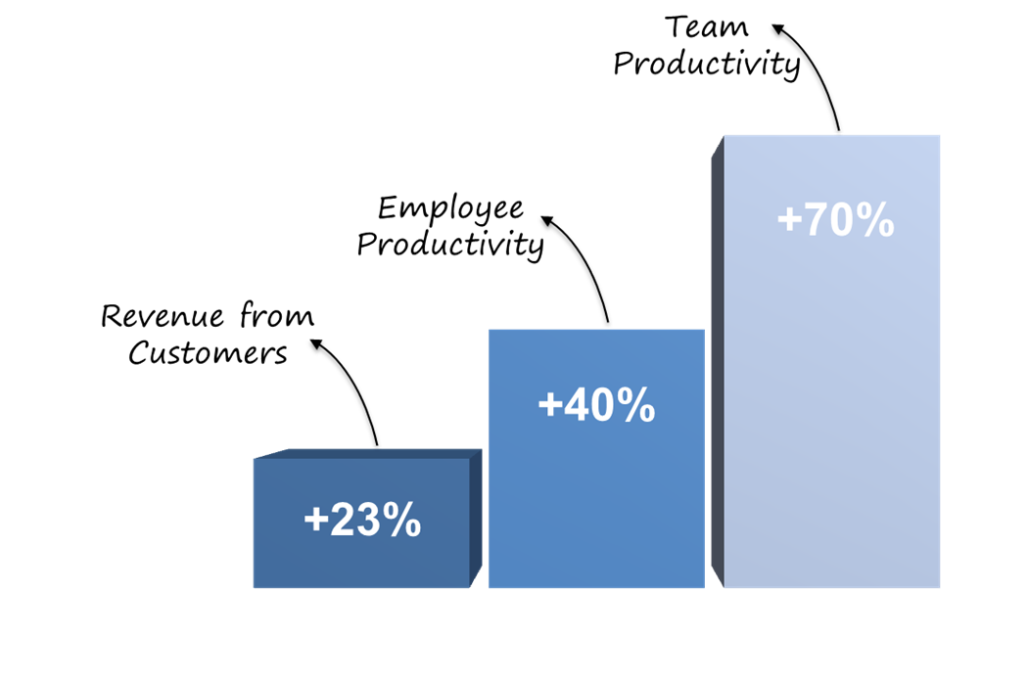
The Benefits of Implementing Business DNA
Substantial Productivity and Revenue Gains Unlocked
Some Indicators of Employee Engagement:
Turn up on time and are reliable
Feel understood by their manager
Want to work for their manager
Follow the company plan
Ask questions when they need help
A Proven Methodology
Our experience and independent research shows this approach leads to improved employee productivity by up to 40% and team productivity by 70% and sustainable revenue growth by more than 23% a year.

Slide 7
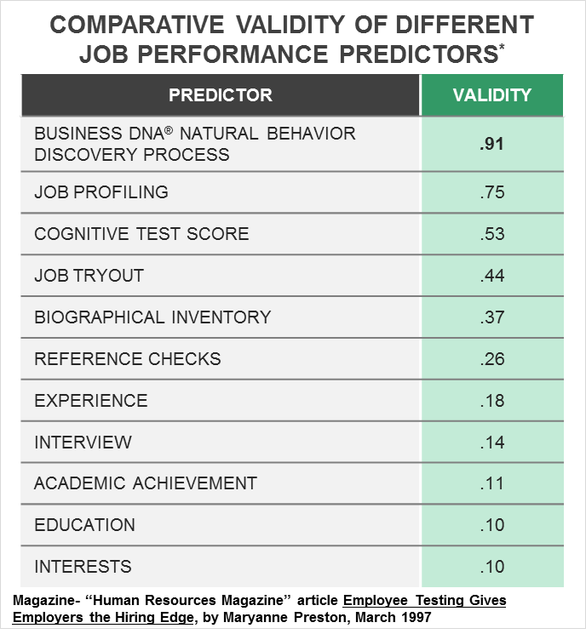
Business DNA as the Foundation of a
Robust Behavioral Hiring Process
Aptitude and Personality Assessments
Increase accuracy of a successful hire to 53%
Job Profiling
75% Accurate
Interview process alone
only 14% accurate
Studies by John Hunter, Ph.D., Michigan State University

Slide 8
Business DNA® = Talents for Performance
Multi-Dimensional Employee Personality Discovery
Fit for Role
Behavioral Talents
Fit to Manager and Team
Leadership EQ
Notes:
This graphic shows how financial personality is at the epicenter of discovery for the financial planning process .
A key area that we emphasize around investment risk is the differentiation between investment risk propensity (bold, taking risks) versus the risk tolerance (loss aversion).
Also, the right framework will enable the advisor to see the impact of their behavior.

Slide 9
The Traditional Personality Profiling Systems
Leave you in the Dark in Critical Areas
How to Adapt,
Performance Coaching,
Risk Management
Hard
Wired
Behavior
Team
Conflict,
Team Role Gaps, Performance Issues, Culture,
Leadership
Fit for Role

Slide 10
Business DNA Systems
The Science Behind the Swiss Watch DNA Systems
Powerful and Unique Behaviorally Intelligent Talent Management Solutions Delivered in 123+ Countries and 11 Languages
Forced Choice Assessment Measuring 64 Behavioral Traits
60+ Man Years of Development Investment Since 2001
Independent Validation by Team with 100+ Years of Experience

Slide 11
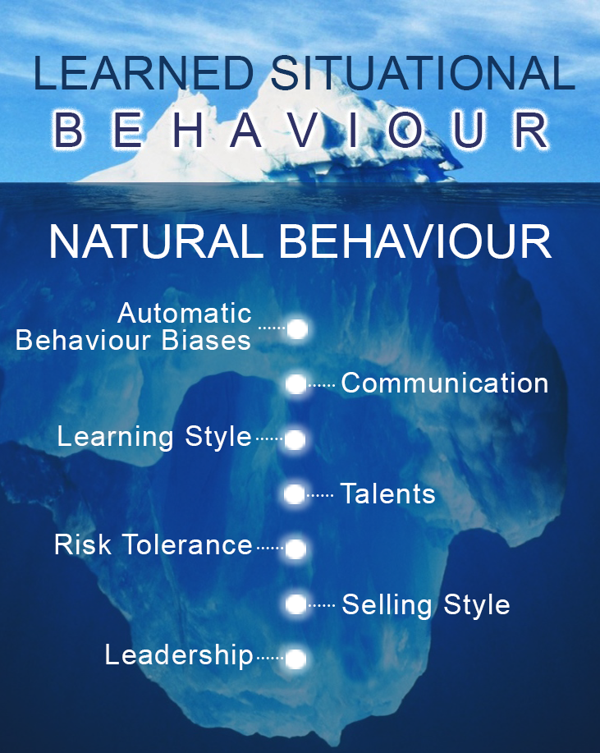
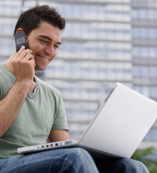
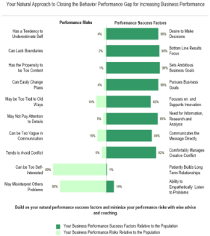
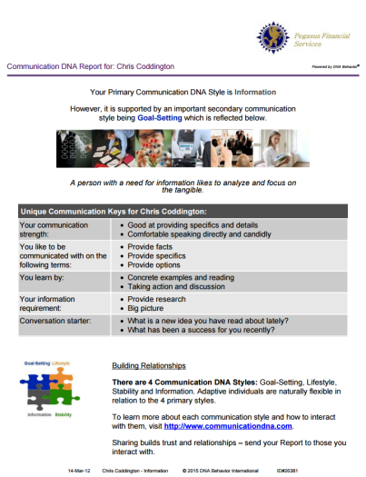
Quicker and 91% More Reliable Method to
Predict Reactions to Business / Life Events
BDNA – 46 Questions (10 to 12 Mins)
CDNA – 12 Questions (2 to 5 Mins)

Slide 12
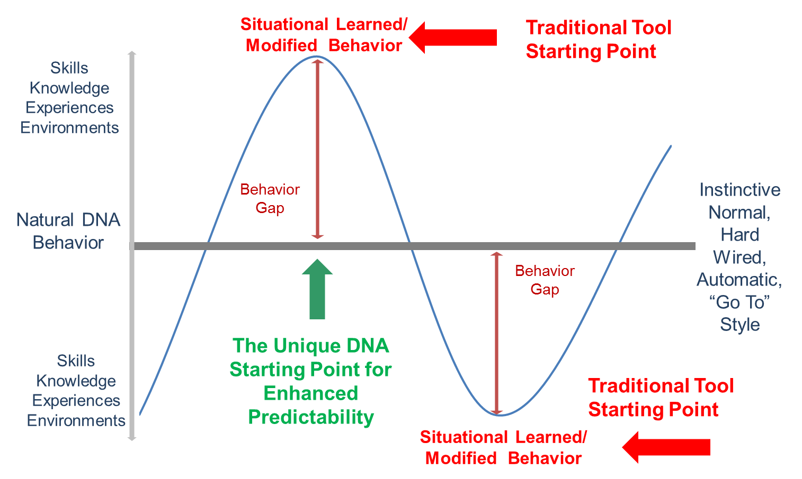
Re-Positioning the Starting Point to
Natural DNA Hard Wired Behavior

Slide 13

The Objectives of a DNA Team Productivity Program
Addressing Typical Team Performance Challenges
Understanding why different team members naturally do things differently.
Hiring the right talent to perform in the team.
Managing team members uniquely and aligning them to a common goal.
Identifying and unlocking the blockages to efficient execution.
Building open communication within the team and allowing creative conflict.
Building higher levels of team engagement leading to longer retention.
Matching team and customers for improved service and retention.

Slide 14
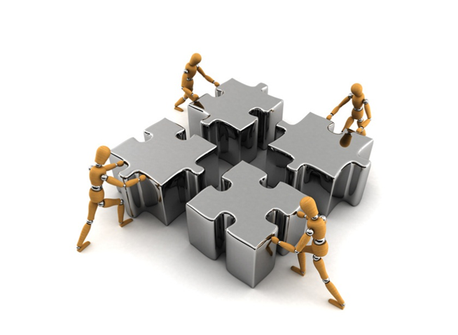
Team Intelligence Solutions
For Building Behaviorally SMART Team Productivity
Team Development Intelligence Solutions for leaders and coaches to enhance team productivity and adopt a more robust hiring role and team fit analysis based on knowing the employee’s natural “hard-wired” talents.
Hiring Intelligence Solutions
Business DNA Workplace Operations Report – deeper behavioral insights on the employees natural workplace and leadership approach
Business DNA Comparison Report – enabling deeper role fit and fit to manager analysis
Business DNA Team Report – Identify team differences and talents
Business DNA Factor Report – Identify specific measurement of behavioral factors for alignment to hiring metrics

Slide 15

Team Productivity Model
Leveraging Different Team Talents for Team Success
TRUST
D
I
F
F
E
R
E
N
T
C O M M U N I C A T I O N S
T
A
L
E
N
T
S
UNITY
ALIGN
Team Success
UNDERSTANDING
ACCEPTANCE
RESPECT
TRUST
ALIGN
C O M M I T M E N T
UNITY
TRUST
Team Development:
From Diversity to Unity to Success

Slide 16
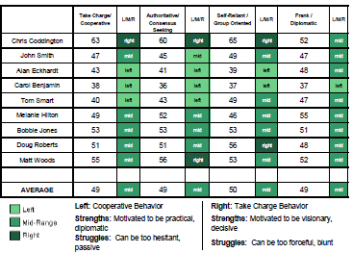
Identifying Team Differences for Building a Productive Team
The Business DNA Team Report makes understanding team dynamics easy by:
Identifying the different talents of team members
Providing graphical analysis of team differences
Summary of Results and Relationship drive differences
Identifies strengths and struggles of team members for role matching
Summary of how to communicate with each team members

Slide 17
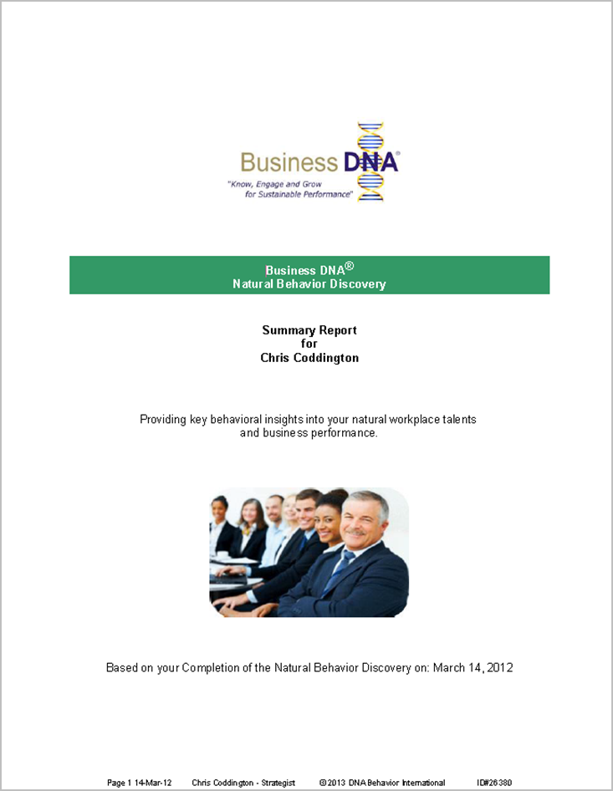
Talent Management for Employee Productivity
Summary of Workplace Talents
Business DNA Summary Report:
Natural Behavior Style
Business Risk Management Factors
Decision-Making Strengths and Struggles
Work Life Attitudes
Work Life Planning Drivers
Business Decision-Making Risk Grouping
Leader-Team Mate Compatibility
Powerful Questions

Slide 18
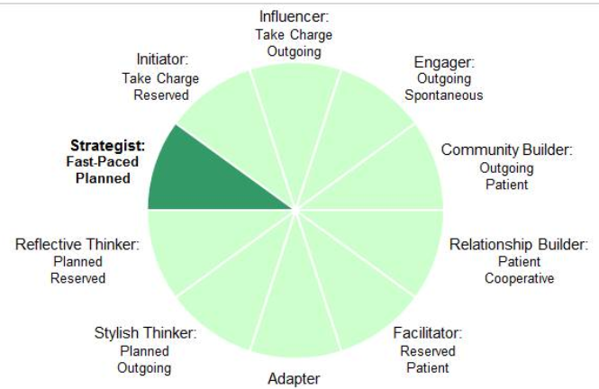
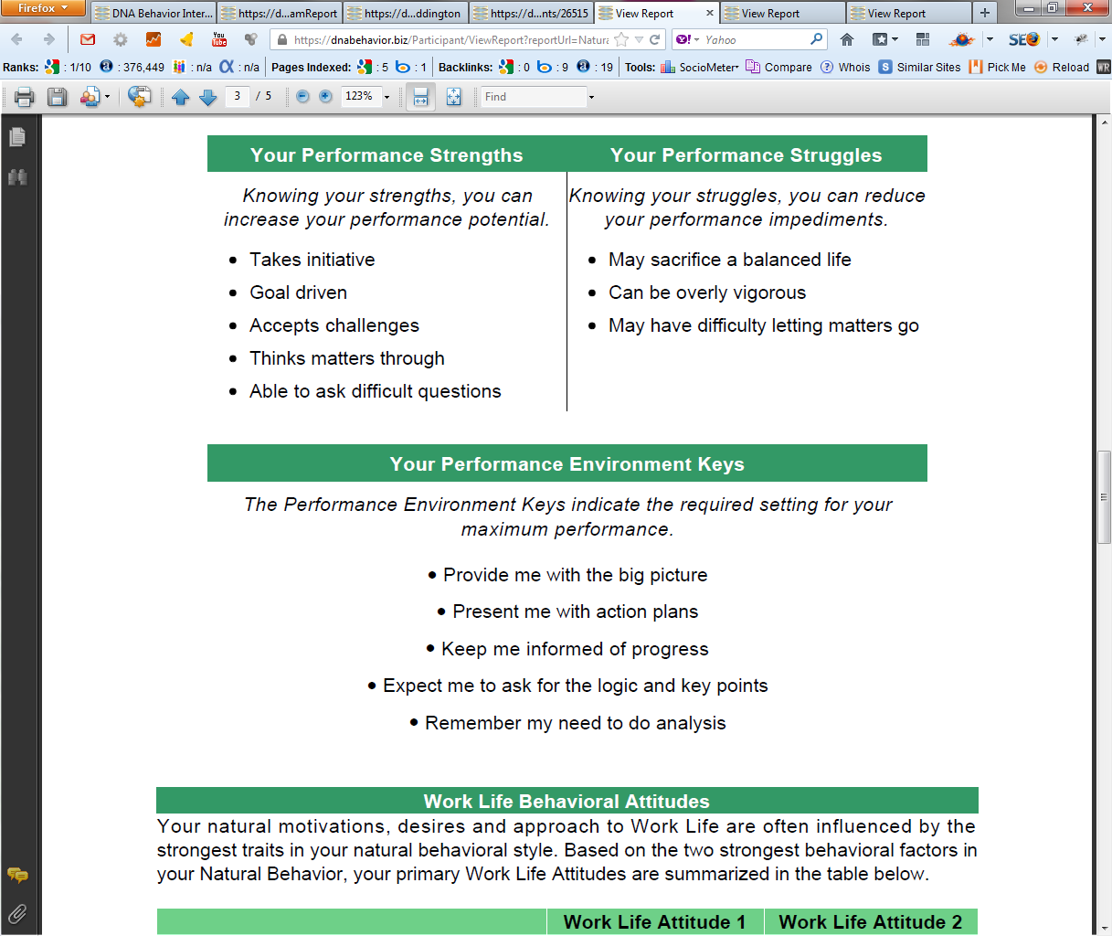
Practical Analysis of the Key Talents that Drive Employee and Team Performance
10 Unique Natural Workplace Styles based on 8 Primary Factors and 24 Sub-factors
Customized DNA Ultimate Performance Guide

Slide 19
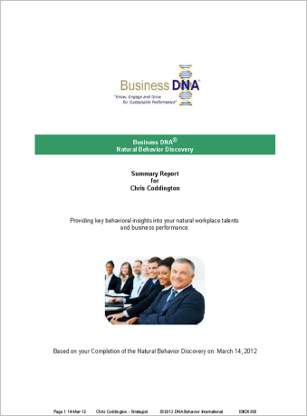
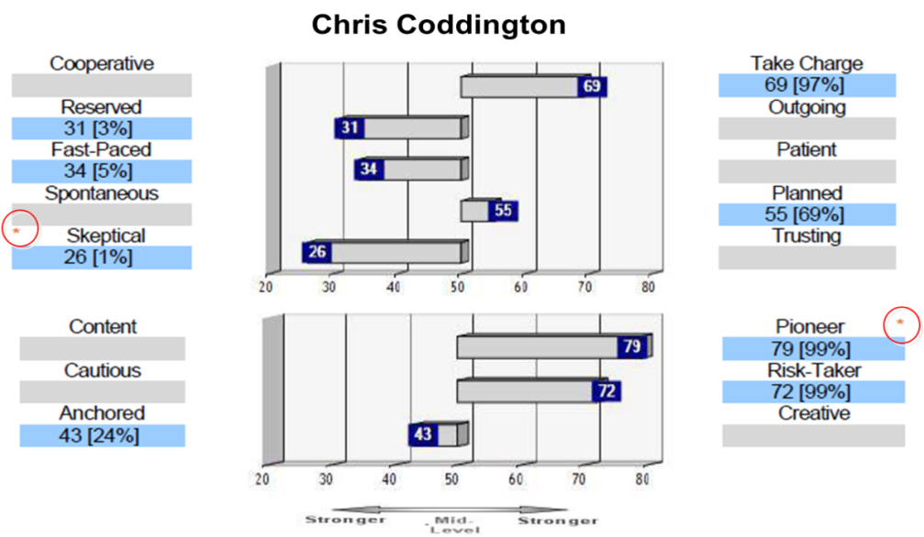
Workplace Operations Report for Deeper Insights
Business DNA Workplace Operations Report:
Business DNA Summary Report; and
More detailed reporting on Behavioral Factors for more specific analysis

Slide 20
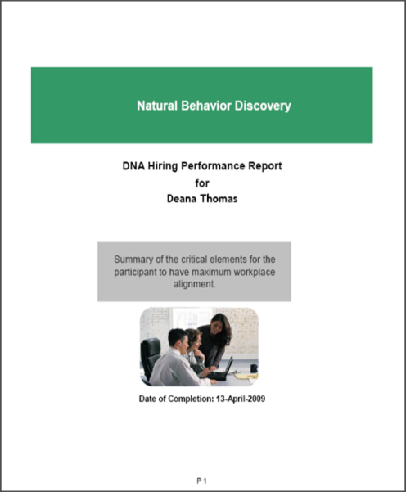
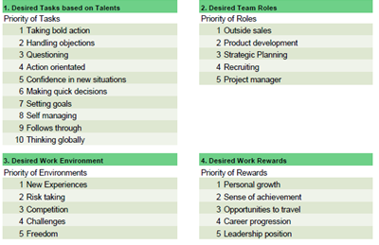
Hiring Based on Matching Talent to Role
Business DNA Hiring Performance Report
Provides insights in priority of importance based on the candidate’s natural behavioral traits:
10 Desired Tasks
5 Desired Team Roles
5 Desired Work Environment Traits
5 Desired Work Rewards

Slide 21
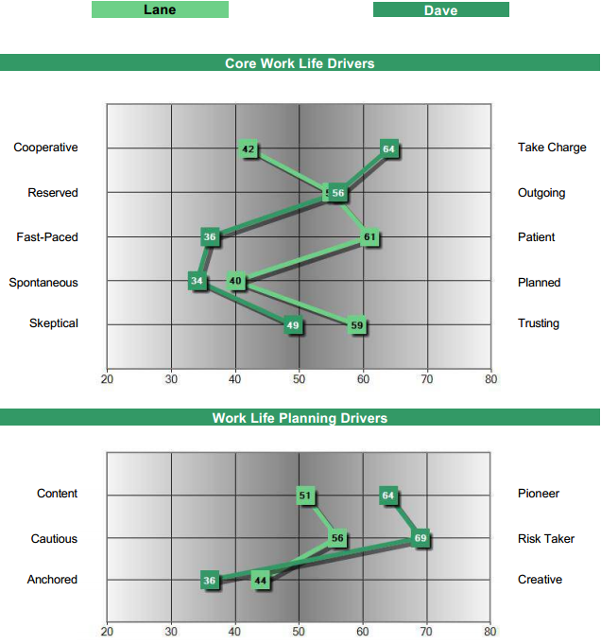
Benchmarks for Hiring Fit to Specific Role
Business DNA Benchmark Solution
Lane: Ideal Style for Relationship Management (“Farming”)
Dave: Ideal Style for New Business Development (“Hunting”)

Slide 22
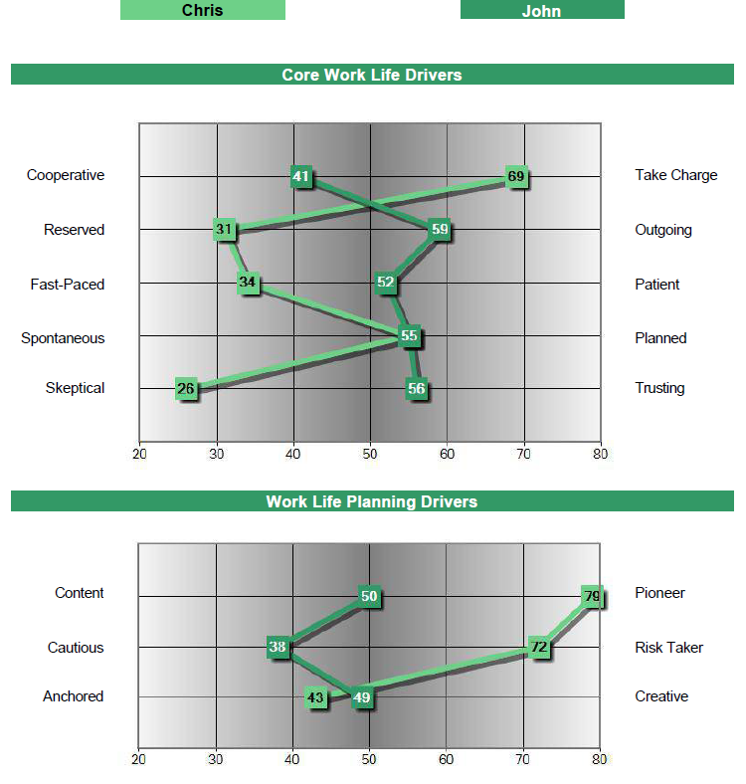
Hiring Fit to Manager
Business DNA Comparison Report
Strategist
Stylish Thinker
Identify and navigate
behavioral differences:
Chris may not provide John with the personal engagement he needs
John could be far more content and cautious than Chris’s pushy goal driven style

Slide 23

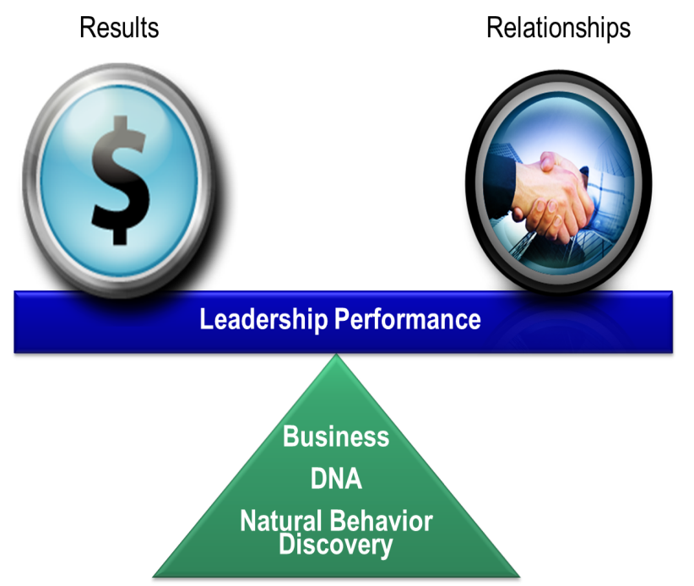
Organizational Intelligence Solutions
For Enhancing Behaviorally SMART Team Productivity
Organizational Intelligence Solutions for leaders and coaches wishing to expand the development of the entire organization, including the executive leaders, management and staff, by providing complete human capital development solutions. Additional reports include:
Team Development Intelligence Solutions
Business DNA Talent Report – snapshot on 10 key performance factors
Business DNA Coaching Report – enhanced behavioral insights for performance development
Business DNA Leadership or Advisor 360 Performance Report – feedback on actual leadership performance in 7 areas
Communication DNA Reports – insights on how to communicate with other employees and re-frame information

Slide 24
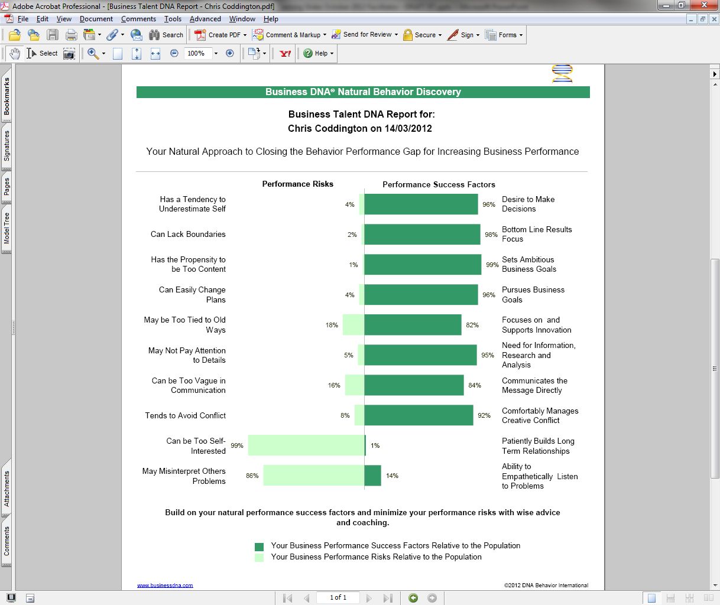
Business Performance Success and
Risk Factors Snapshot

Slide 25
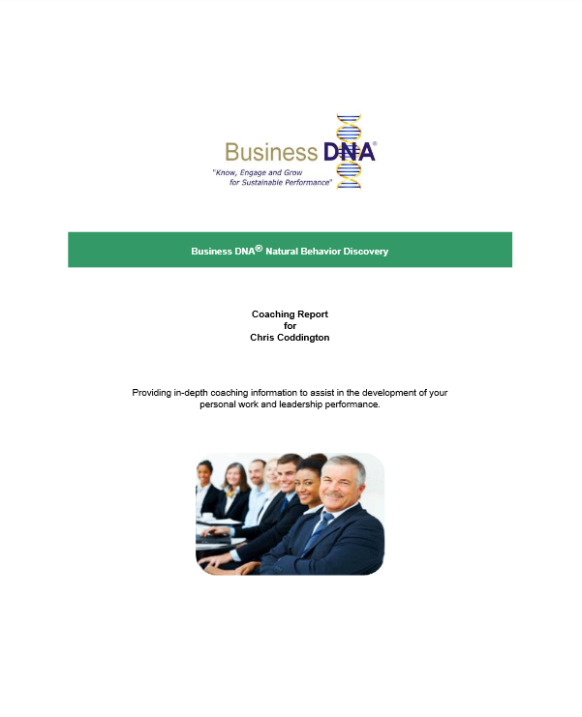
Enhanced Performance Development
Coaching for Sustainable Employee Productivity and Growth
Business DNA Coaching Report:
Detailed Analysis of 8 Primary Factors and 24 Sub-Factors
Strengths and Struggles
Keys to Building Your Personal Business Performance
Customized Powerful Questions Based on Strongest Factors

Slide 26
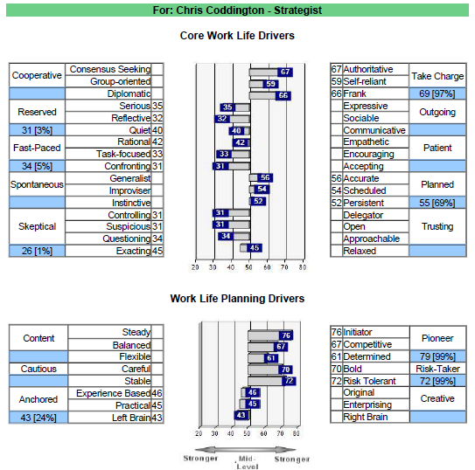
BDNA 1-Page Factor Report
For Detailed Factor Analysis
BDNA 1-Page Factor Report
The sub-factors are one dimension of the primary factor. Each sub-factor is independently measured. They do not average out to the Primary Factor score.

Slide 27
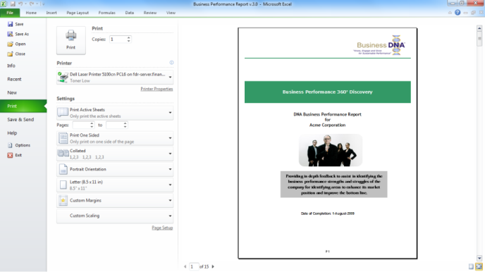
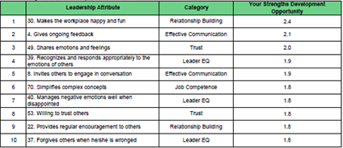
Enhanced Leadership Performance Development
Coaching for Developing Leadership EQ and Growth
The Leadership 360° Discovery Process provides objective measurement of how a leader is actually performing versus how they should perform based on their natural DNA style.
The DNA Leadership Performance Report highlights the leader’s top 10 leadership strengths and struggles, uncovering 75 items relating to their leadership performance in 7 distinct areas:
Communication
Results
Relationships
Trust
Emotional Intelligence
Values
Competence

Slide 28

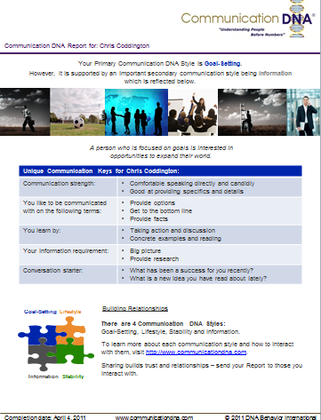
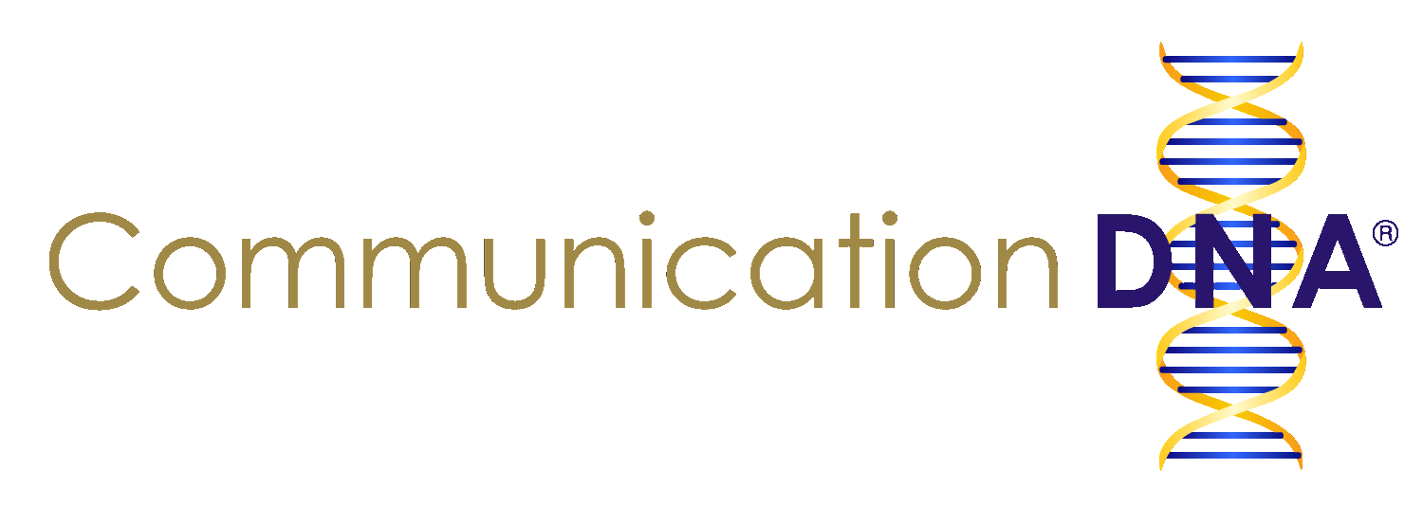
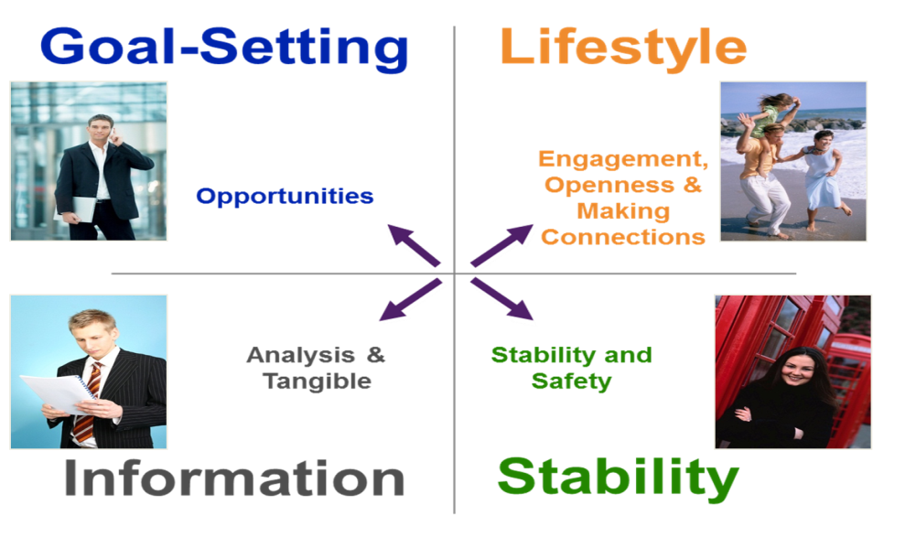
Communication DNA Discovery
Building Enhanced Team and Customer Engagement
Communication DNA Discovery uncovers the natural preferences for how employees and customers wish to be naturally communicated with by others across 4 primary styles. It takes 2 to 5 minutes to complete. This enables:
Different communication styles to be understood;
Communication with a person on their terms;
Relationships to be developed based on trust.
Communication DNA Report

Slide 29








How Can DNA Behavior Help Your Team?
Business DNA Talent Management Solutions
Matching Talents to Roles, Teams and Customers
Grow Engaged Teams and Customers
$
DNA Discovery Processes
DNA Training
Teams
DNA Knowledge Center
DNA Technology Systems
Customers
Behavior Drives Business Performance

Slide 30
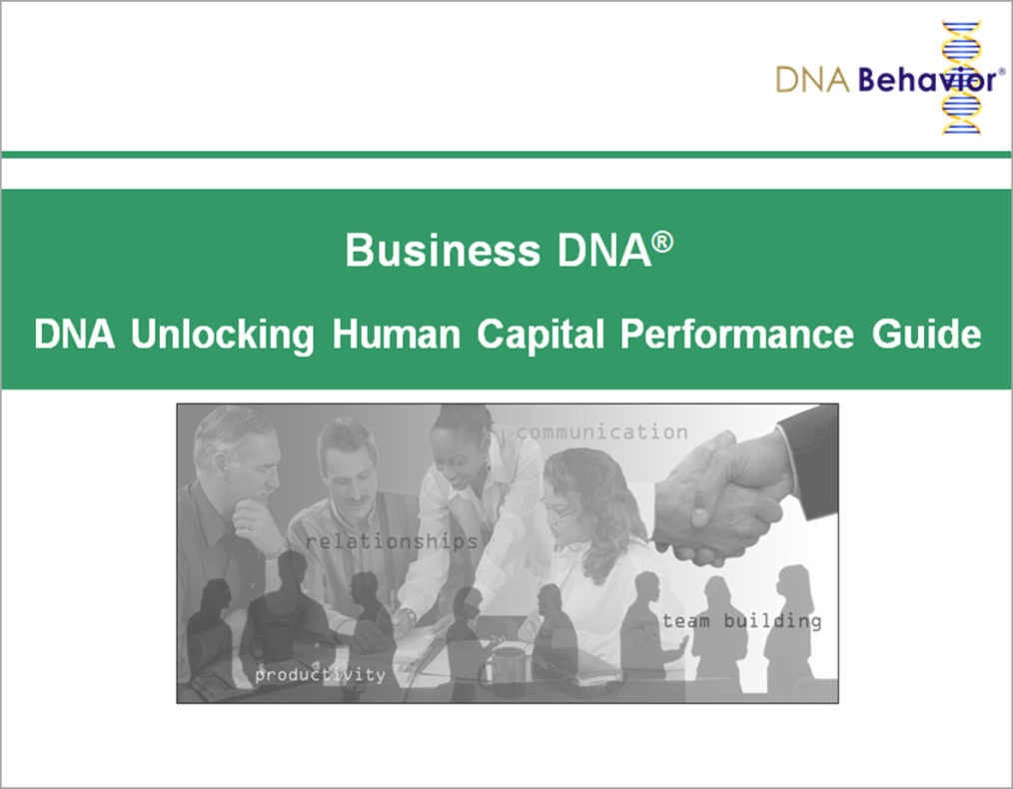
Contact Us
For more information about
Business DNA:
Contact:
DNA Behavior International
5901-A Peachtree Dunwoody Rd
Suite 375
Atlanta, GA 30328
(866) 791-8992
inquiries@dnabehavior.com
www.businessdna.com
`

