Slide 1
DNA Behavior®
Sales Engagement Program

Slide 2


Featured Host
DNA Behavior – Communication DNA
Leon Morales
  Chief Relationship Officer
  leon.morales@dnabehavior.com
  www.linkedin.com/in/leondna
Tripp Rockwell
  Chief Marketing Officer
  tripp.rockwell@dnabehavior.com
  www.linkedin.com/in/tripprockwell
Leon Morales
Tripp Rockwell

Slide 3
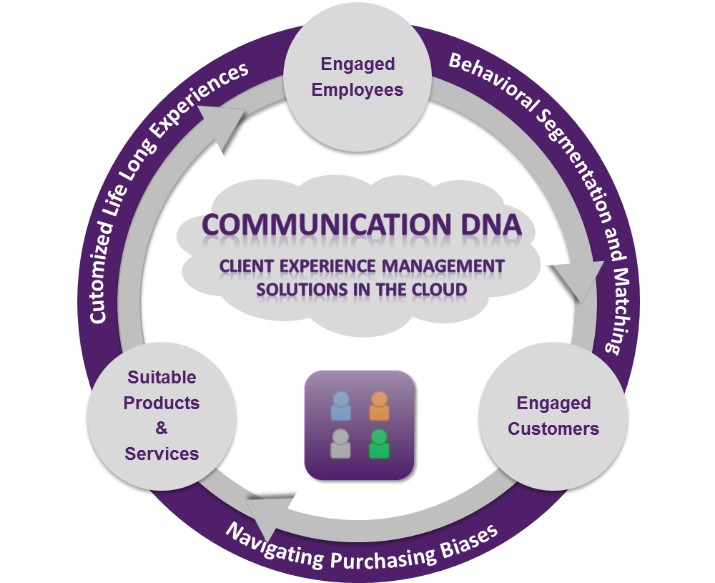
Communication DNA® Delivering Communication Insights
“Behavioralizing” Marketing and Sales
Know, Engage and Grow Every Client using our MarketingTech Platform.
Since 2001, we have been delivering unique communication insights for marketing and sales teams to be Behaviorally SMART™ so they can deliver customized life long experiences to every client and customer.
Behaviorally matching sales teams to clients and solutions is a proven way to build a client-centered business which out-performs.

Slide 4
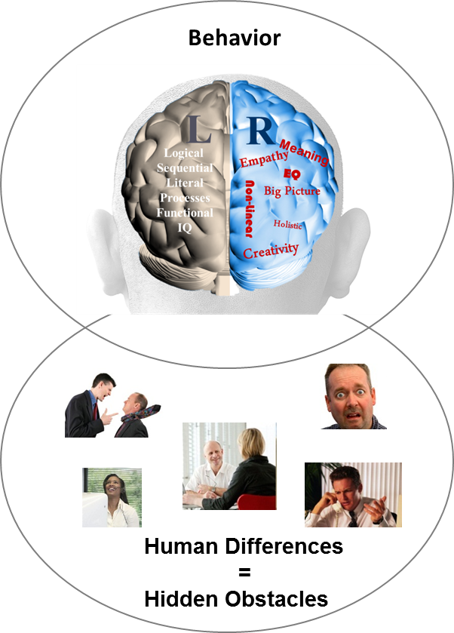
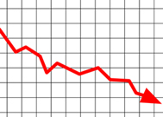
The Need to Reveal and Manage Hidden Communication Gaps
Behavior Causes Sales Performance Challenges
Sales Conversion
?
Client Engagement
?
Sales Team Productivity
?
Operational Execution
?
87% of
measurable business issues are communication related
Business
Performance
Source: Harvard Business Review 2002

Slide 5
The New Behavioral Economy Opportunity
Re-Framing Communication of Offerings to Remove Biases
Knowing Product Preferences Based on Quantitative Persona Models
Reframing Offering Message to Different Communication and Learning Styles
Highly Customized Life-Long Experiences (Offerings)
The opportunity is to reframe how the same solution is presented to people with different communication and learning styles.

Slide 6
Using DNA Discovery to Unlock Revenue Growth
The Power of Matching Sales Teams, Clients, Solutions
Tailored Communication and Solutions Matched to Client DNA Style Drives Confident Long Term Decision-Making
Hiring Advisory or Sales Teams Matched to Client DNA Style Drives Higher Engagement

Slide 7
Outcome: A Behaviorally SMART™ Sales Process
Built on Matching Talents to Roles, Teams and Customers
Sales Team With Lack of Behavioral Insight
Behavioral Discovery to Know, Engage and Grow Employees and Customers
Matching Employees and Clients for 4 in 4 Engagement
Goal Setting: Provide Discussion and Opportunities
?
?
?
Life Style: Provide Fun, Openness and Graphics
?
Stability: Provide Security, Feelings and Instructions
Default Styles =1 in 4 Engagement
Information: Provide Analysis, Research and Details
23% Revenue Uplift
Source: Gallup Organization 2009 and DNA Behavior Research 2001-2014

Slide 8
DNA Sales Engagement Programs Enhance Life Long Client Relationships
Client Engagement Development
Organizational Change Management
Service Delivery Execution
Sales Training
Solution Matching
Behavioral Marketing
Employee and Team Engagement
Leadership Messaging
Communication DNA Discovery Systems, Training, Tools

Slide 9
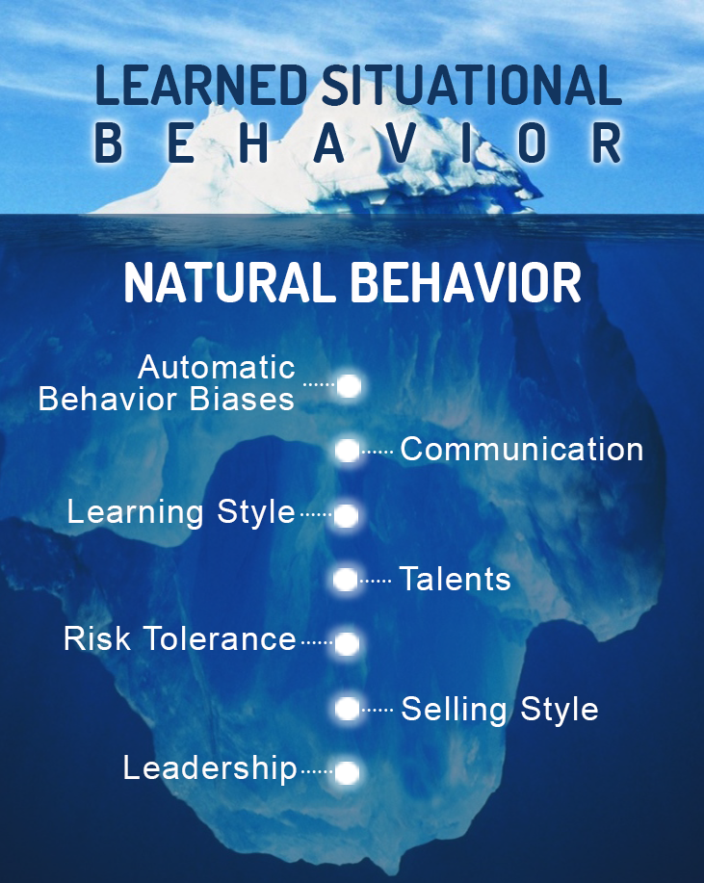
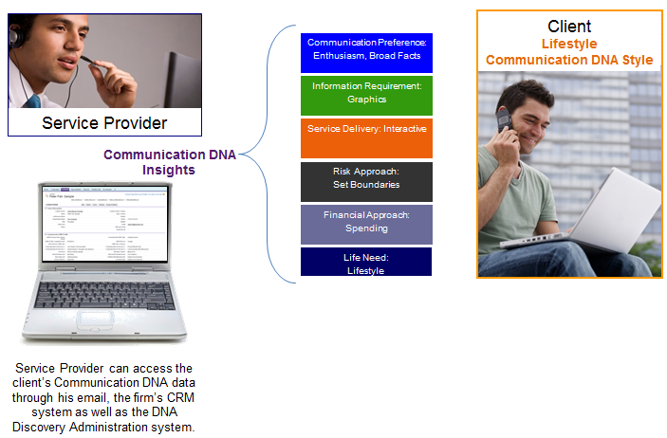
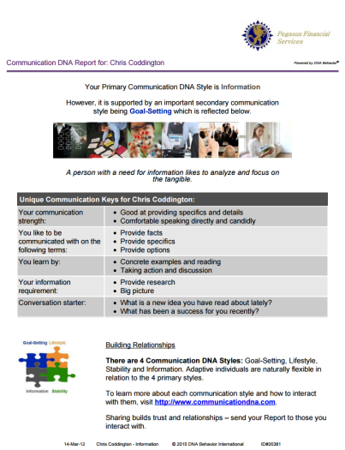
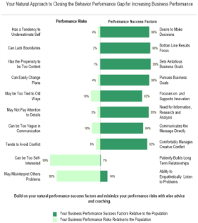
Quicker and 91% More Reliable Method to
Predict Reactions to Business / Life Events
CDNA – 12 Questions (2 to 5 Mins)
BDNA – 46 Questions (10 to 12 Mins)

Slide 10

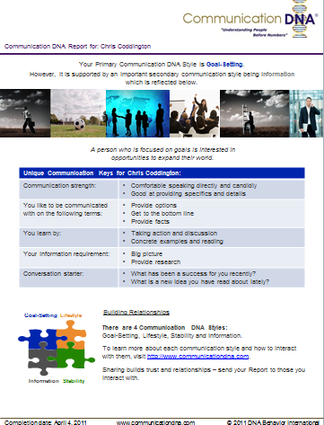
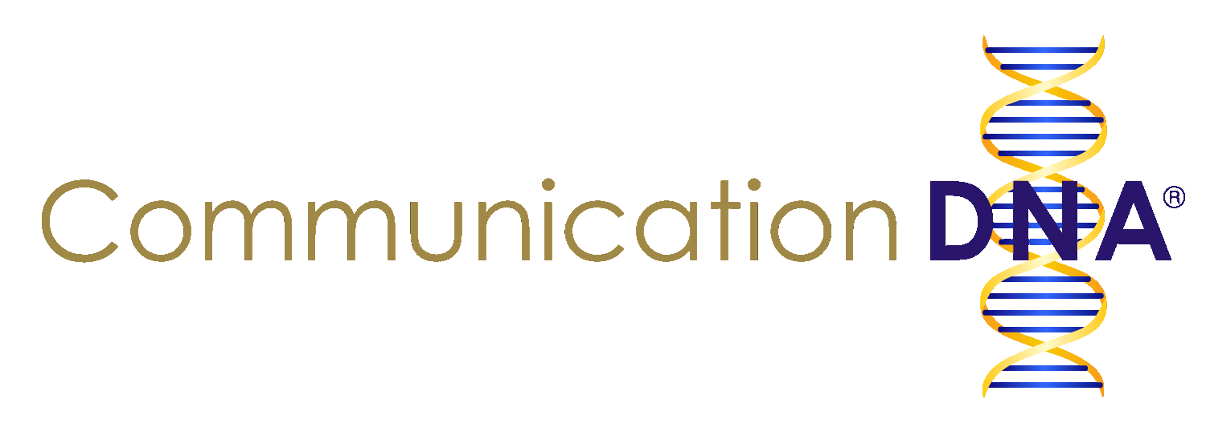
Communication DNA Discovery
Communication DNA Insights
Communication DNA Discovery uncovers the natural preferences for how sales people and clients wish to be communicated with by others. It takes 2 to 5 minutes to complete.
This enables:
Differences to be understood;
Communication with a person on their terms;
Relationships to be developed based on trust.
Communication DNA Insights Include:
Natural communication style
Preferences when communicating with others
Life needs
Information requirement
Communication DNA Report

Slide 11
Summary of 4 Primary Communication DNA Styles
Insights on How to Adapt
Communication Keys for Behaviorally Smart Conversations
Communication Style | Strengths | Struggles | What They Want
Goal-Setting (Allow Them to Discuss It) | Speaks Directly and Candidly | Could Be Too Forceful, Abrupt, Interrupting | Provide Options, Get to Bottom Line, Present Opportunities
Lifestyle (Allow Them to See It) | Open and Engaging | May Be Too Transparent and Uninhibited | Openly Express Views, Verbalize Provide Broad Facts
Stability (Allow Them to Feel It) | Shows Empathy and Warmth | May Compromise Too Much and Be Too Diplomatic | Keep it Relaxed, Speak Softly, Share Your Feelings
Information (Allow Them to Read It) | Provides Specifics and Details | May Be Too Serious, Modest, Not Interactive | Provide Facts, Provide Specifics, Demonstrate Transparency

Slide 12






Behavioral Discovery
Behavioral Discovery Leads to Higher Engagement
Our unique online behavioral discovery methodology leads to a more reliable prediction of an employee or client’s communication and learning style:
Reduces decision-making bias by re-framing of the same concept or message on their unique terms
Increased decision-making comfort from a higher level of personal alignment to the solution
Client feels higher level of connection by directly participating
Engaged Team
Engaged Clients
Behavior Drives Relationship Performance

Slide 13
DNA Behavior Discovery Systems
The Science Behind the DNA Behavior Discovery Systems
Powerful and Unique Client Centered Behavioral Solutions Delivered in 123+ Countries and 11 Languages
Forced Choice Assessment Measuring 64 Behavioral Traits
60+ Man Years of Development Investment Since 2001
Independent Validation by Team with 100+ Years of Experience

Slide 14
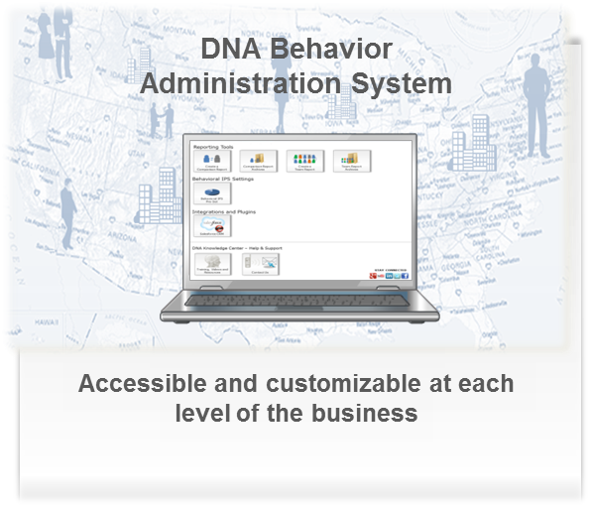
DNA Technology Transforms the Client Experience
Segment & Match Clients to Employees
Based on their communication style to customize sales, marketing and service activities
Solution Matching
Tailor Your Workflows
With specific guidelines based on their communication style & specific needs
Provide Customized Experiences
Based on their communication style & specific needs to make the offering more appealing
Match your client to the right solutions to speed up sales conversion
Customized Messaging
Send personalized
communications to increase connectivity of the message
Powerful Strength based Discovery Questions
Based on their communication style to unlock the interaction
Increased Revenues by Over 23% Per Year Through Creating Higher Levels of Sustainable Employee and Client Engagement

Slide 15


DNA Behavioral Marketing
More Than Traditional Marketing Approaches
“Left Brain” Persona Approach
Traditional Economics methodology using Quantitative Data Scraping Analysis to identify what the client has and does based on patterns of activities: Transaction Analysis Spending Patterns Income Demographics
“Right Brain” Personality approach
Psychograhic Methodology using Quantitative Behavioral Analysis based on Communication DNA Discovery to tailor the Solution and Relationship: Client, Employee and Solution Matching Emotional Engagement Customize Information Presentation to Different Communication and Learning Styles
DNA Marketing Automation program
23% revenue uplift Client Segmentation Targeted Resonance Marketing Personalized Solutions Client Service Relationship, Loyalty and Referrals
Source: Gallup Organization 2009 and DNA Behavior Research 2001-2015

Slide 16
Business DNA® = Talents for Performance
Multi-Dimensional Employee Personality Discovery
Fit for Role
Behavioral Talents
Fit to Manager and Team
Leadership and Sales EQ
Notes:
This graphic shows how financial personality is at the epicenter of discovery for the financial planning process .
A key area that we emphasize around investment risk is the differentiation between investment risk propensity (bold, taking risks) versus the risk tolerance (loss aversion).
Also, the right framework will enable the advisor to see the impact of their behavior.

Slide 17
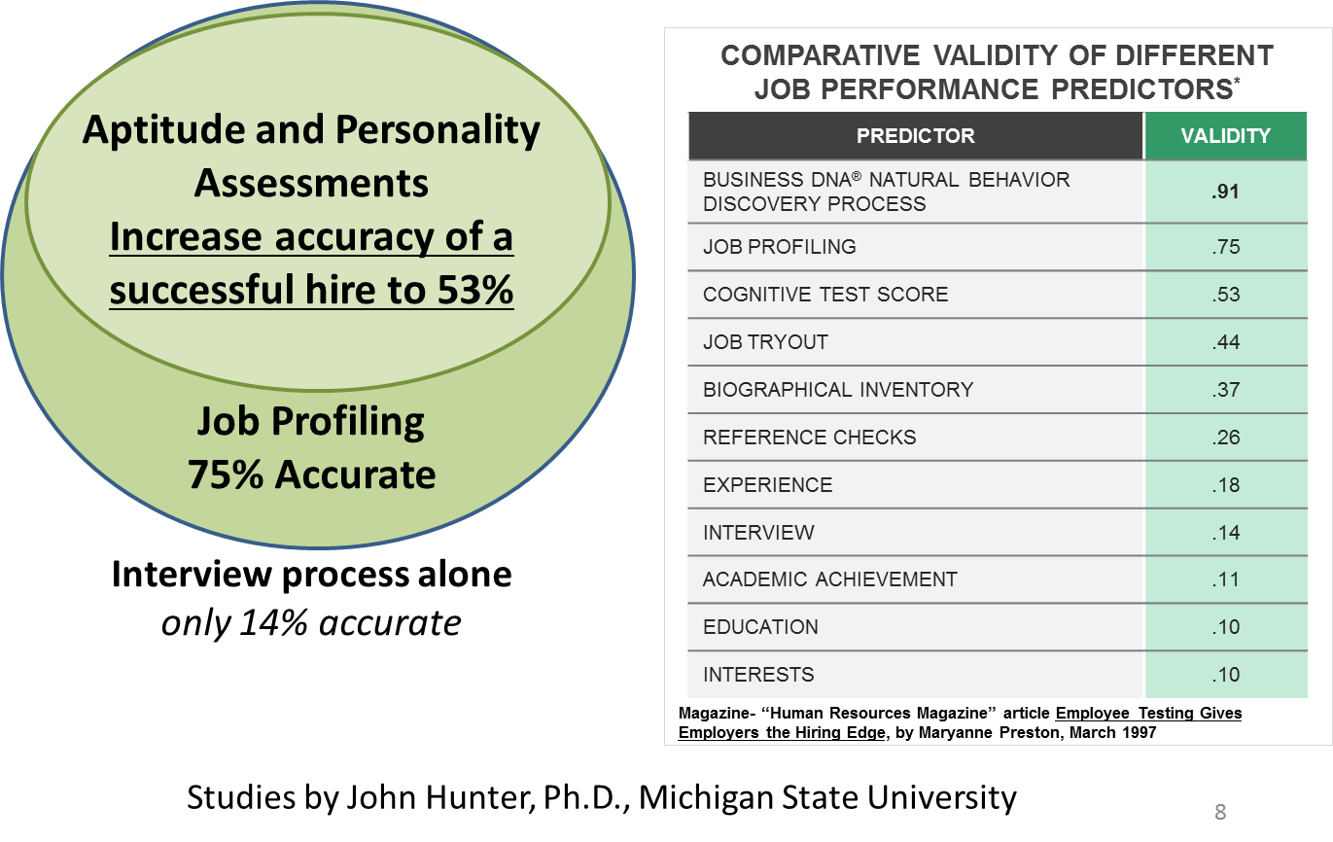
Business DNA as the Foundation of a
Robust Behavioral Hiring Process for Sales People

Slide 18
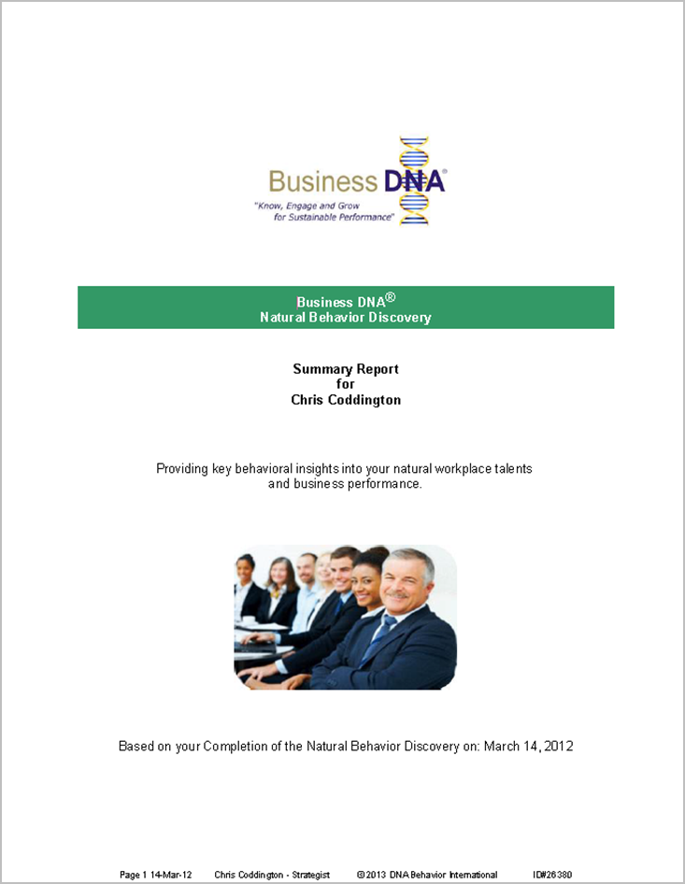
Workplace Talents
Summary of Workplace Talents
Business DNA Summary Report:
Natural Behavior Style
Business Risk Management Factors
Decision-Making Strengths and Struggles
Work Life Attitudes
Work Life Planning Drivers
Business Decision-Making Risk Grouping
Leader-Team Mate Compatibility
Powerful Questions

Slide 19
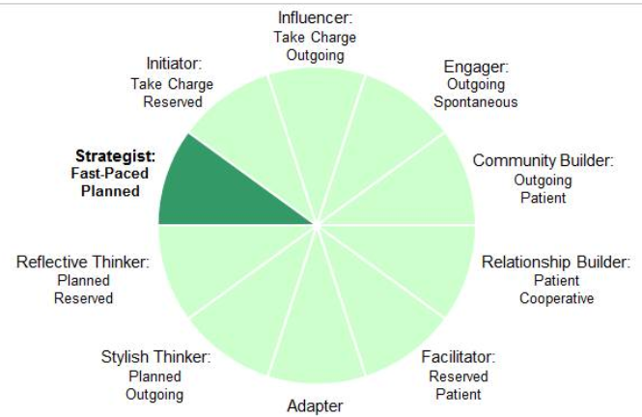
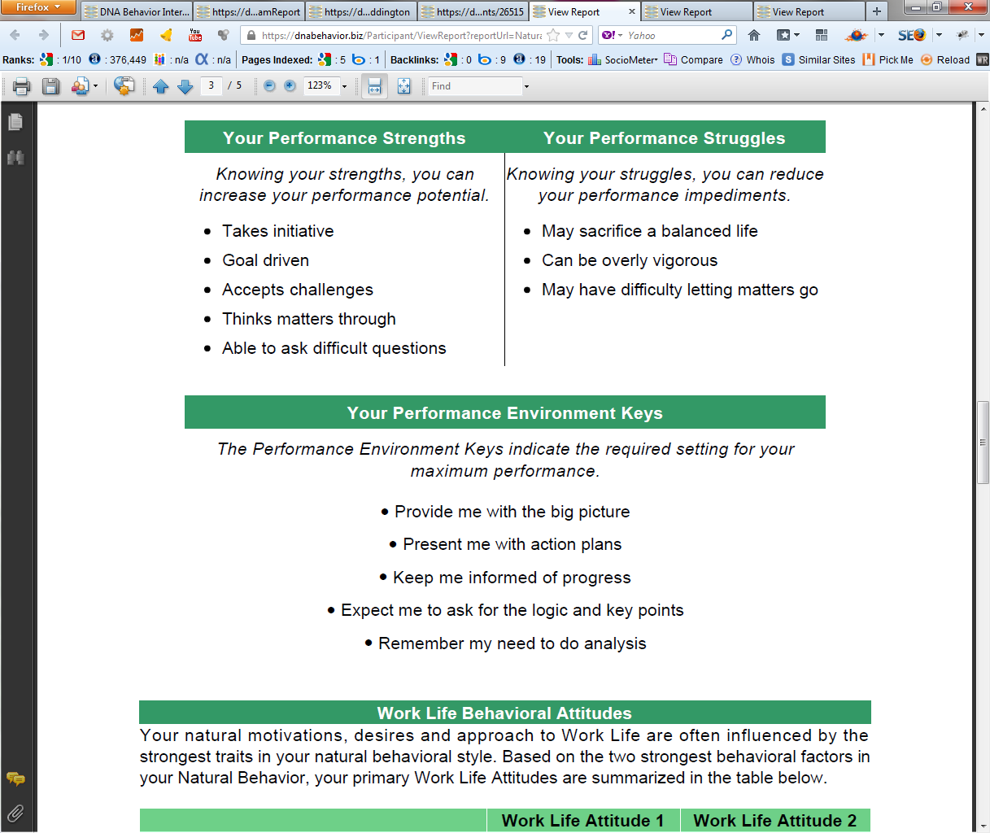
Practical Analysis of the Key Talents that Sales Drive Performance
10 Unique Natural Workplace Styles based on 8 Primary Factors and 24 Sub-factors
Customized DNA Ultimate Performance Guide

Slide 20
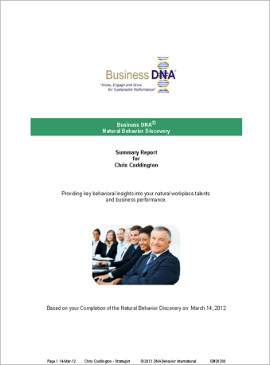
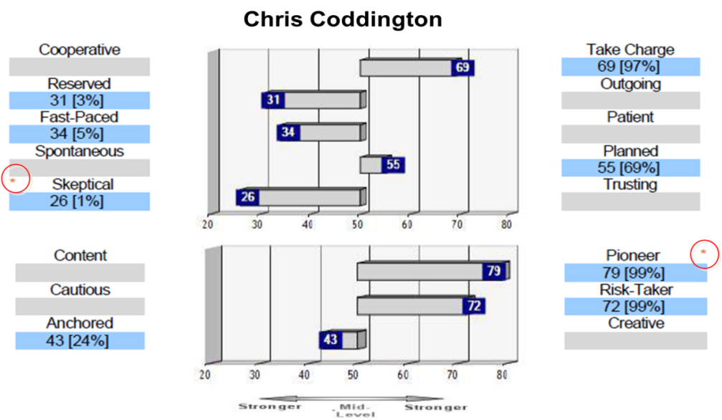
Workplace Operations Report for Deeper Insights
Business DNA Workplace Operations Report:
Business DNA Summary Report; and
More detailed reporting on Behavioral Factors for more specific analysis

Slide 21
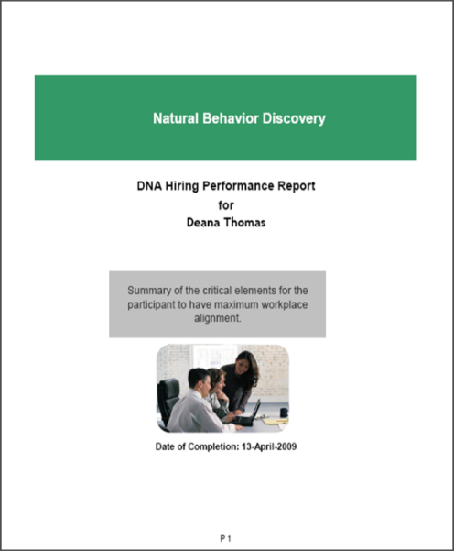
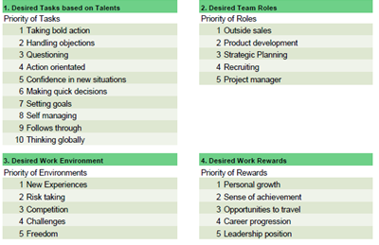
Hiring Based on Matching Talent to Sales Role
Business DNA Hiring Performance Report
Provides insights in priority of importance based on the candidate’s natural behavioral traits:
10 Desired Tasks
5 Desired Team Roles
5 Desired Work Environment Traits
5 Desired Work Rewards

Slide 22
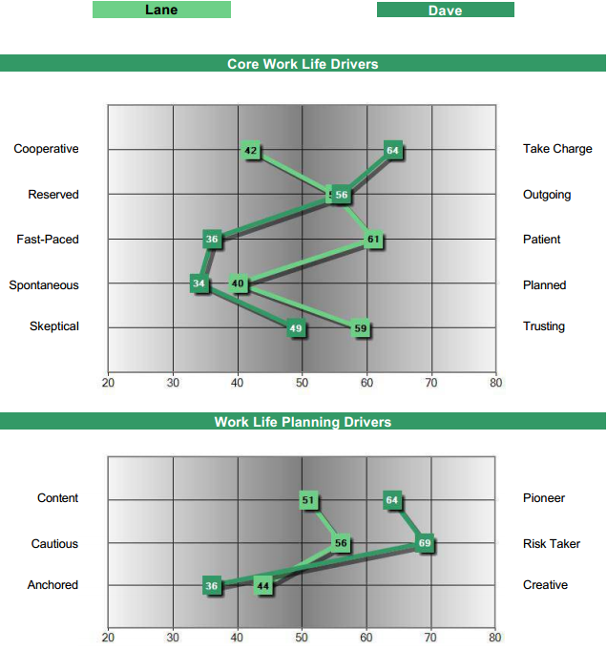
Benchmarks for Hiring Fit to Specific Role
Business DNA Benchmark Solution
Lane: Ideal Style for Relationship Management (“Farming”)
Dave: Ideal Style for New Business Development (“Hunting”)

Slide 23


How Can DNA Behavior Help Your Firm?
DNA Client Engagement and Talent Management
Systems
Matching Employees to Clients and Solutions Offered
Grow Engaged Clients and Employees
$
DNA Discovery Processes
DNA Training
Employees
DNA Knowledge Center
DNA Technology Systems
Clients
Communication Drives Business Relationship Performance

Slide 24

Contact Us
For more information about Communication DNA and Business DNA, and to complete a trial:
Contact:
DNA Behavior International
5901-A Peachtree Dunwoody Rd
Suite 375
Atlanta, GA 30328
1-866-791-8992
inquiries@dnabehavior.com
www.communicationdna.com
www.businessdna.com
www.dnabehavior.com
Read our Blog: http://blog.dnabehavior.com/
`

