Slide 1
DNA Behavior®
Advisor Performance Program for Financial Services Firms
Insert client logo

Slide 2
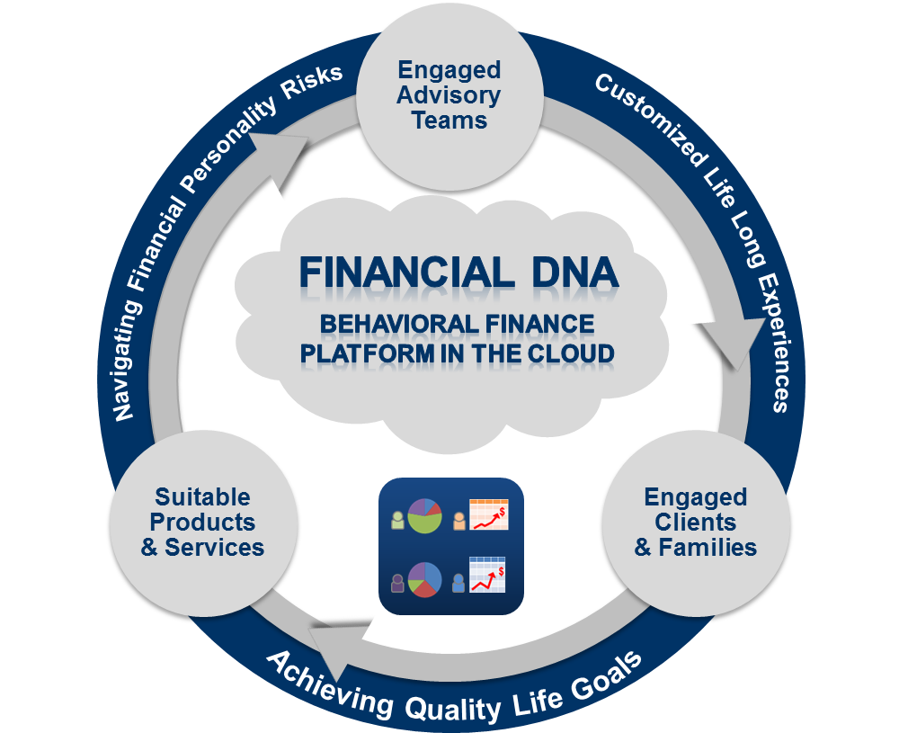
Financial DNA® Delivering Financial Personality Insights
“Behavioralizing” Financial Planning
Know, Engage and Grow Every Client Using our Behavioral Finance Platform.
Since 2001, we have been delivering unique financial personality insights for advisors to be Behaviorally SMART™ so they can Wealth Mentor™ their clients for achieving increased self-empowerment.
Behaviorally matching advisory teams, clients, goals and solutions is a proven way to build a client-centered business which is compliant and out-performs.

Slide 3
“The New World Culture” for Your Advisors
How They Will Put Clients at the Center of the Plan
Product Offerings Based on Persona Model Assumptions
Tailored Goals-Based Planning Using Financial Personality Insights
Customized Behavioral Coaching Powered by a FinTech Platform

Slide 4

What is Getting in the Way of Client-Centered Success?
Research: Lack of Behavioral Suitability From the First Interaction
Advisors can only engage 40% of their clients, leaving 60% under serviced
5% of advisors are potentially rogue costing 5% of revenue in losses/claims
Advisors are only 40% accurate in identifying the client risk profile
Investor emotions causing 7.45% per year portfolio under-performance
Advisor biases causing under-performance by 1% to 3% per year
Team differences and blockages cause productivity loss by up to 70% per year
Firm/advisor centered culture leads to fundamental biases in solutions offered – tied to old ways of operating

Slide 5

Building a Client-Centered Business
“Understanding People Before Numbers” Business Model
Client-centered businesses focus on these questions:
Who should be on the advisory team and what is their level of EQ?
Who are your ideal prospects and clients?
How do clients wish to be communicated with and served?
What are the clients goals and decision-making biases?
How will you manage clients in volatility?
Is your revenue model aligned to the client and is your firm delivering real value?
What compliance process do you have to demonstrate client interests have been put first?
Having an engaged team and engaged clients delivers a massive 23% uplift to your revenue.
Gallup Research 2009-2013

Slide 6
DNA Behavioralizes Money for Advisors and Clients
Predicting Planning Risks Triggered by Behavior
Financial Personality
Money
Behavioral Responses Driving Decision-Making
Emotions

Slide 7
Financial DNA Systems
The Science Behind the “Swiss Watch” DNA Systems
Powerful and Unique Client Centered Behavioral Solutions Delivered in 123+ Countries and11 Languages
Forced Choice Assessment Measuring 64 Behavioral Traits
60+ Man Years of Development Investment Since 2001
Independent Validation by Team with 100+ Years of Experience

Slide 8
Match Advisory Teams, Clients, Goals and Solutions
Turn Financial Personality into Performance
Advisor Client Communication
Financial
Personality
Risk Profile
Goals and Behavioral Biases
Notes:
This graphic shows how financial personality is at the epicenter of discovery for the financial planning process .
A key area that we emphasize around investment risk is the differentiation between investment risk propensity (bold, taking risks) versus the risk tolerance (loss aversion).
Also, the right framework will enable the advisor to see the impact of their behavior.

Slide 9
Financial Planning
Portfolio or Behavioral Management?
personality style
93.6%
of financial planning is
Behavioral Management
emotions
passions
excitement
listening
fear
optimism
reaction
anxiety
past experience
Investments
Communication preferences
speculation
confidence
opportunism
Source: The 93.6% Question of Financial Advisors, Meir Statman, 2000

Slide 10
A Client Centered Behavioral Approach
Value Proposition to Clients
Client Value:
150bps¹
per year on AUM
Firm ROI Value:
50x² ++ from increased referrals, retention and share of wallet
Sources:
(1)The Advisors Alpha: Putting a Value on Your Value, Vanguard 2015 (2) Modelling based on Schwab RIA Survey 2015, Advisor Impact UK Research 2012

Slide 11
Managing the Growing Regulatory Compliance Avalanche Behavioral Management Grows Relationships and Minimizes Risk
Client Protection, Engagement, Experience and Retention - 23% Revenue Uplift
Costly Complaints and Litigation – 99.75% Investor Suitability

Slide 12
The Power of Implementing Financial DNA
From 40% Advisor Accuracy to 99.75% Investor Suitability
91% Reliability from Financial DNA Measurement
8.75% Enhancement from Financial Planning Processes
99.75% Investor Suitability Performance Guarantee
Completion by Each Advisor + Team
Reduced Subjective Advisor Judgement
Completion by Each Client
Minimized Advisor + Client Emotions

Slide 13
The DNA Process For Firm Engagement and Compliance People Insights at All Stages of the Client-Centered Lifecycle
Real-Time Behavioral Management
Advisory Team Culture
Initial Connection & Meetings
Goals Based Planning & Reviews
Behavioral Monitoring & Coaching

Slide 14
Matching of Advisors to Prospects and Clients
Use Behavioral Insights to Unlock Hidden Differences
Advisory Team With Lack of Behavioral Insight
Communication Style Discovery to Know, Engage and Grow Advisors and Clients
Matching Advisors and Clients for 4 in 4 Engagement
Goal Setting: Provide Discussion and Opportunities
?
Life Style: Provide Fun, Openness and Graphics
?
?
?
Stability: Provide Security, Feelings and Instructions
Information: Provide Analysis, Research and Details
Default Styles =1 in 4 Engagement
23% Revenue Uplift
Source: Gallup Organization 2009 and DNA Behavior Research 2001-2015

Slide 15
Vision: Higher Levels of Advice Customization
Every Stage of the Client Lifecycle
Online Financial DNA Discovery uncovering financial personality insights for every client
Advice Solutions Customized to FDNA insights which are digitally delivered
Service Delivery with Firm Rep and workflow matched to Client based on FDNA Style
Active client participation boosts engagement and reliability of outcomes
Active behavioral management with a human touch boosts client confidence

Slide 16
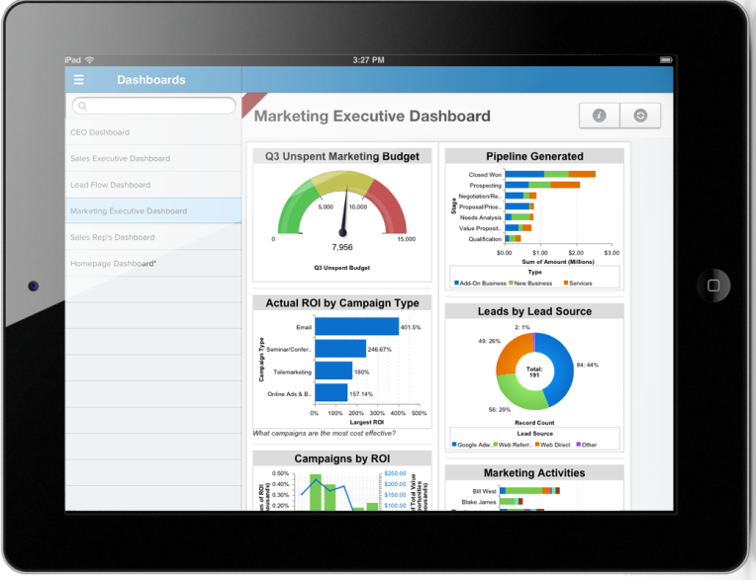
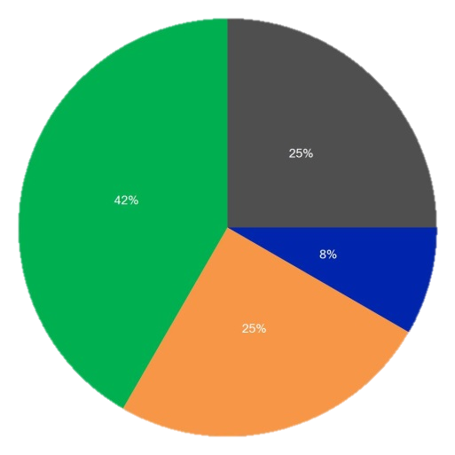
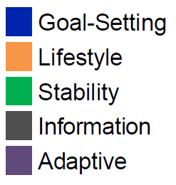
Powerful Tools for Applying Financial DNA Insights
Digitally Delivered On Scalable Technology
Client facing web portals enabling increased active client engagement through direct upfront and ongoing participation
Real-time system access, email and information flows enabling continuous active behavioral management of clients by advisors
Every human and electronic interaction customized to the style of the client with minimal preparation required
Enhanced monitoring of advisor and client behavioral risks with real time suitability compliance data
Powerful reporting to support enhanced client meeting and service experiences

Slide 17
Transforming Client Experiences
Digitalizing Touchpoints in Firm Workflow
FDNA Discovery Completion
Communication style
Behavioral Matching Algorithms
Advisor Rep to Client
Relationship Automation
Solutions to Client
Client meeting style and planning
Behavioral biases
Risk profile
Market Mood
Spending and savings pattern
Goals
Other service teams
Service flow
Client experience
Tailored portfolio and IPS
Event driven behavioral coaching
Customized communications and reporting
Service delivery and support
DNA data continuously integrated with client’s demographic and transaction data

Slide 18


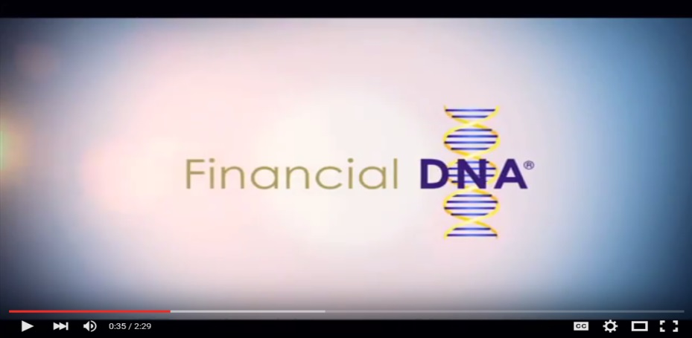
Example of JH Website
Marketing to Clients using Financial DNA
We use Financial DNA to better understand our client’s financial personality:
Click on the below button to start your 15-20 minute process to uncover your financial personality.
Client Communication style
Behavioral biases
Risk profile
Start
Financial DNA
www.financialdna.com/start

Slide 19
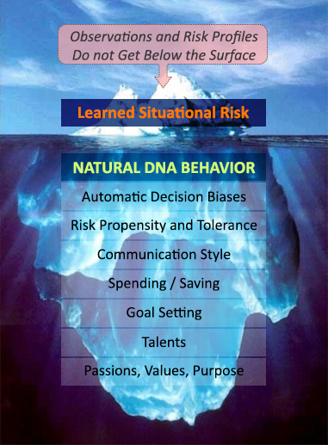
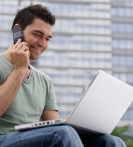
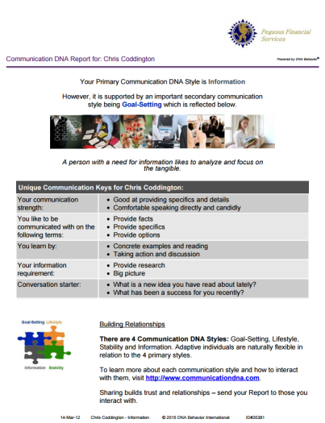
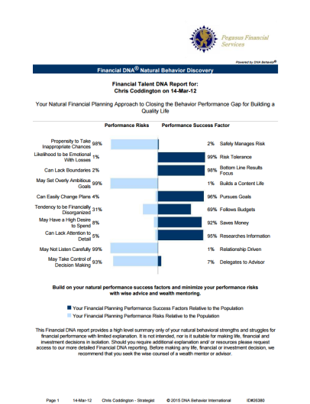
Quicker and 91% More Reliable Method to
Predict Reactions to Market / Life Events
CDNA – 12 Questions (2 to 5 Mins)
FDNA – 46 Questions (10 to 12 Mins)

Slide 20
Process for Advisors Using Financial DNA Insights
Impacting Every Phase of the Financial Planning Process
Financial DNA Discovery Process
Advisor EQ and Team Development
Advisor-Client Matching
Customized Communication
Tailored Portfolio Construction
Deeper and More Consistent Client Inquiry Process
Greater Disclosure of Client:
Goals
Interests
Priorities
Offering Client Centered Solutions Tailored to Style
Ongoing Behavioral Coaching
Compliance Monitoring
23% pa Revenue Uplift from Client Engagement
1.5% pa on Portfolio AUM Value

Slide 21
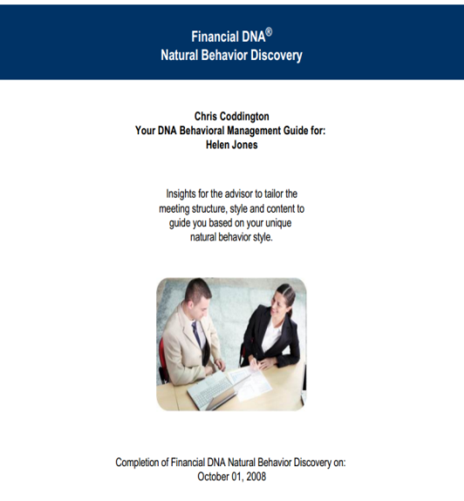
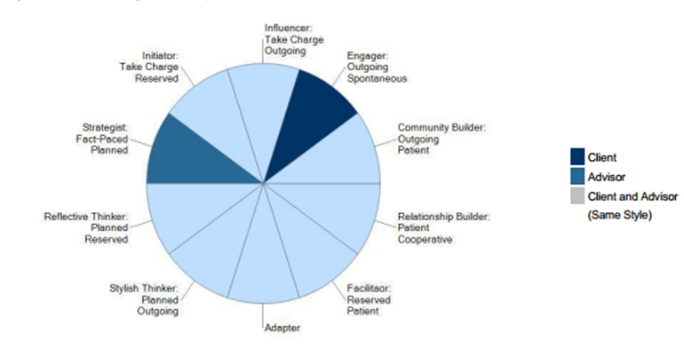
DNA Behavioral Management Guide Report
Helps Advisors Guide Clients to the Right Solutions
Report provides:
Behavioral differences between client and advisor
Guidance for the advisor to adapt their style to the client
Financial behavior biases and risk reporting
Client engagement meeting process and questions – relationship, financial and investment behaviors
Behavioral IPS – aligning goals, financial capacity and risk-taking behaviors

Slide 22
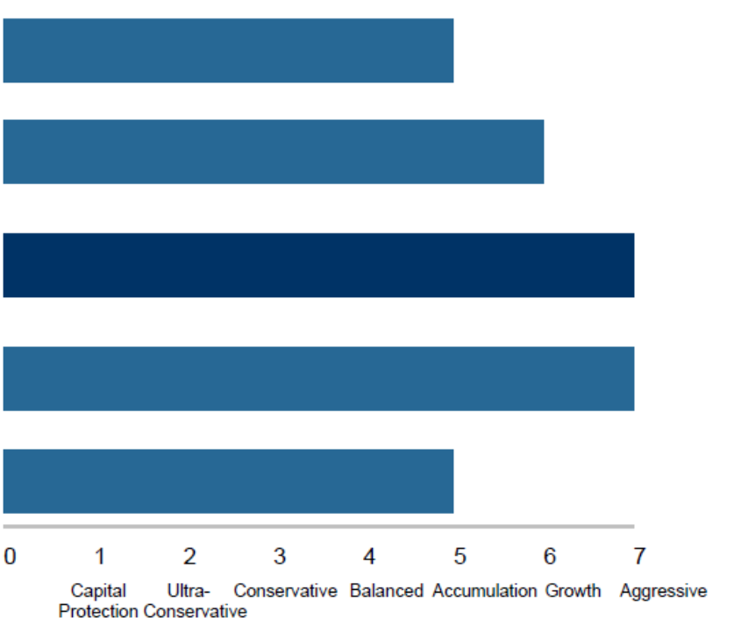
Building the Plan and IPS – Summary of Clients Selected Portfolio Risk Aligned to Goals, Capacity
Your Assessment of the Client’s Current Portfolio Risk Profile Group
Your Assessment of the Client’s Portfolio Risk Need Group to Achieve Goals
Your Assessment of the Client’s Portfolio Risk Group based on Current Financial Risk Capacity
Financial DNA Natural Behavior Portfolio Risk Group (based on Risk Propensity and Tolerance)
Financial DNA Learned Behavior Portfolio Risk Group (From Financial Personality Discovery or Advisor’s Assessment of the client)
Overall Selected Portfolio Risk Profile Group (Selected by Advisor and Client based on discussion of the aggregate of all scores)

Slide 23
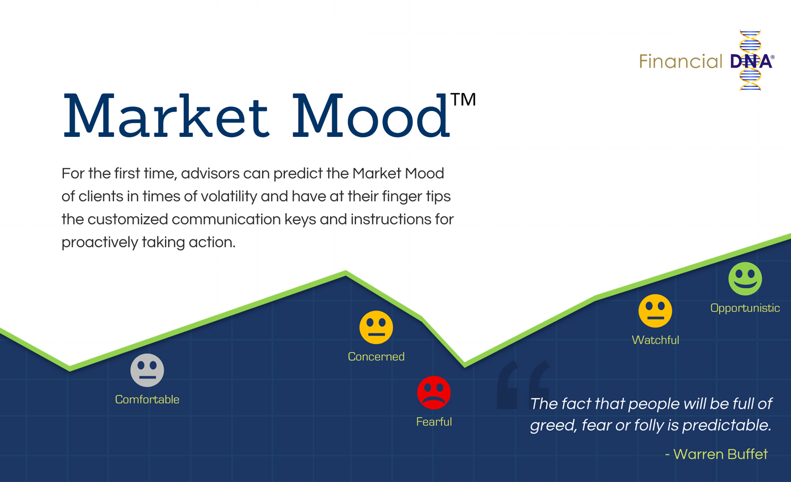
How Will You Manage Client Risk Composure (Emotions)?
In every Interaction, Annual Review and Market Volatility

Slide 24
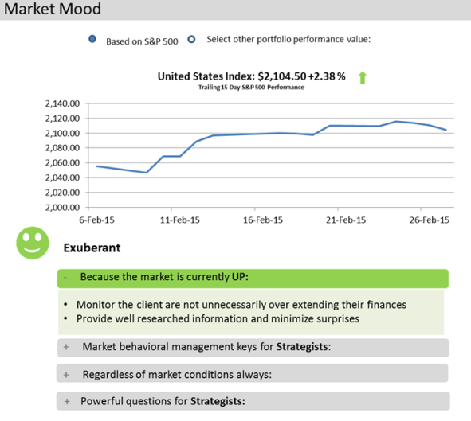



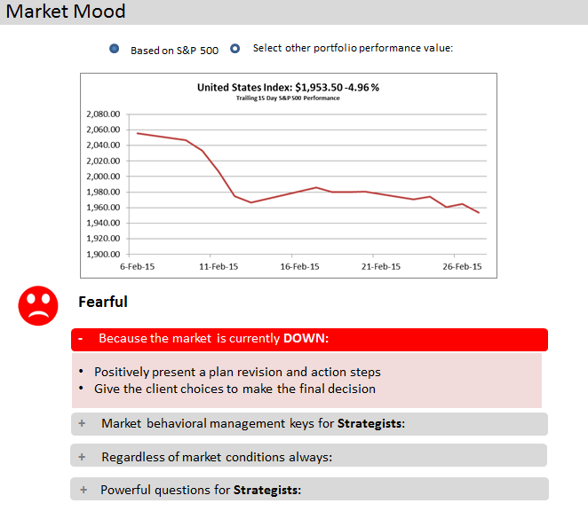

Power Real Time Client Behavioral Management Use the Market Mood™ to Simulate Risk Composure
Predict how clients are reacting to market events (in real time).
Exuberant: Grow the Portfolio
Comfortable: Regular meeting schedule
Watchful: Education opportunity
Fearful: Prevent client turnover

Slide 25
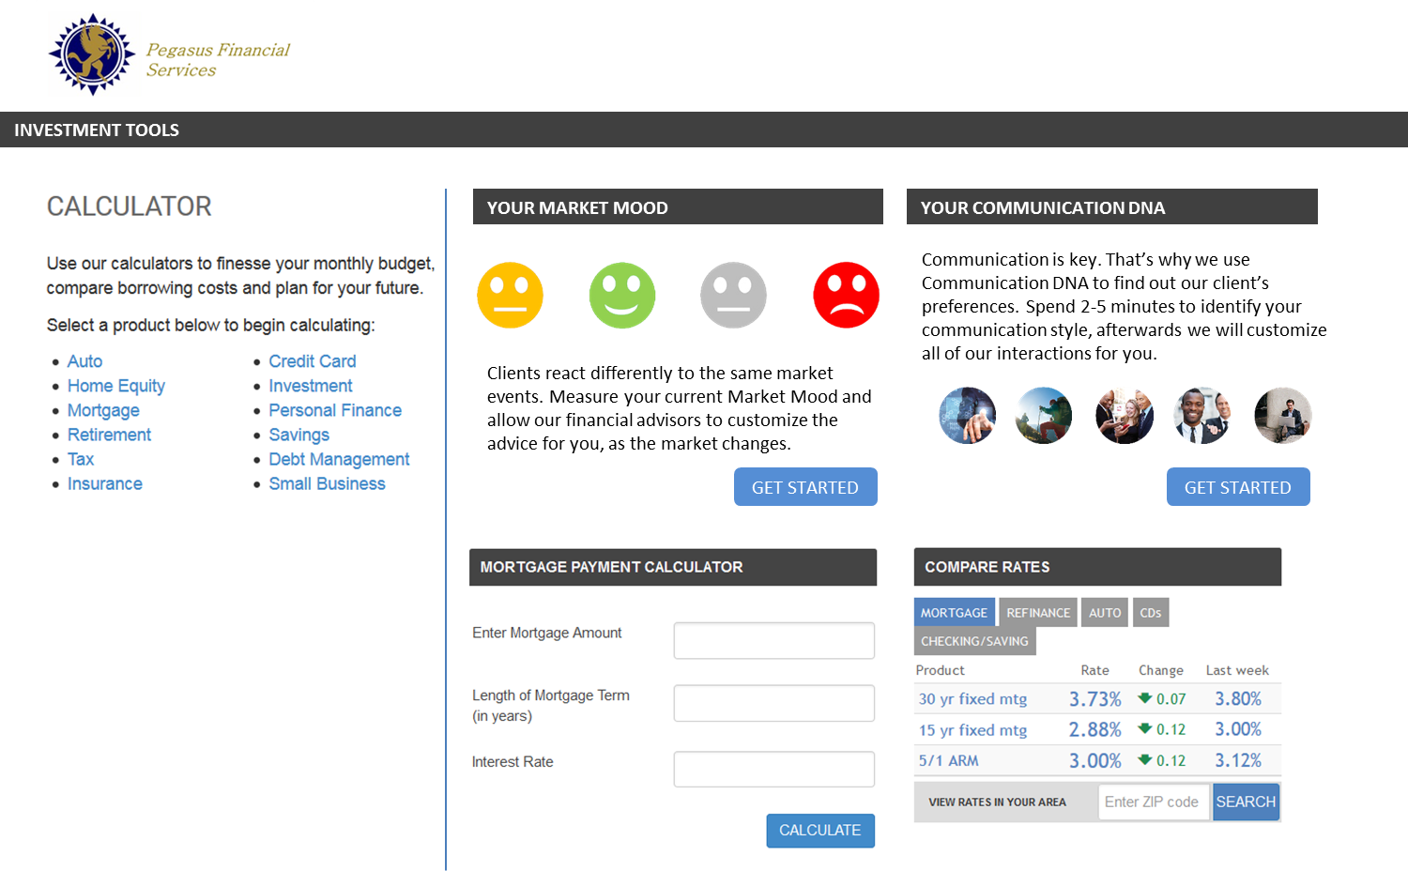
Positioning DNA Solutions In Your Firm’s Client Portal
Using API Data Transfers

Slide 26
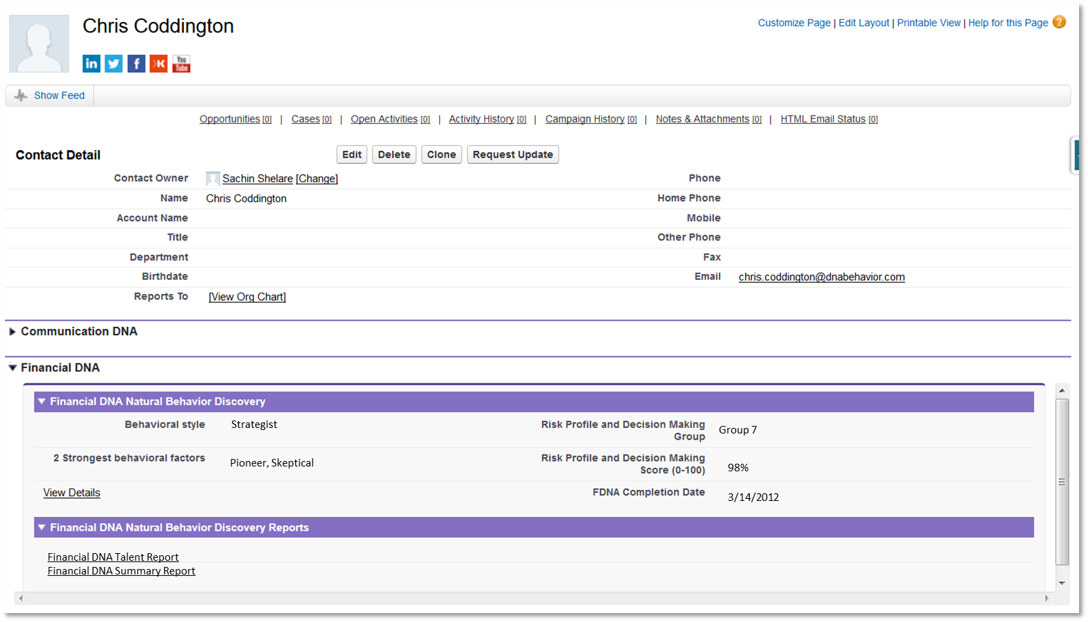
Financial DNA Insight Integration
Contact + Lead records

Slide 27
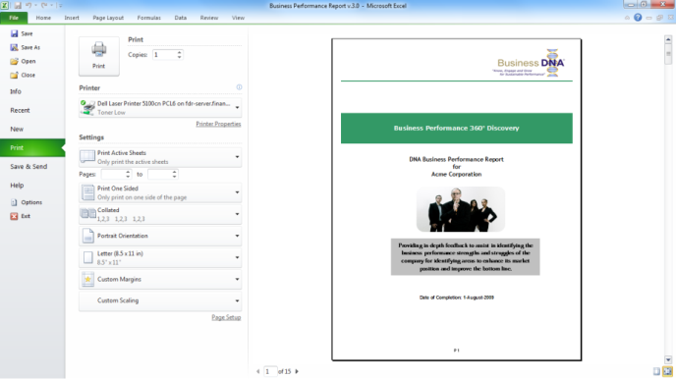
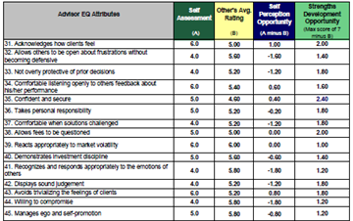
Enhanced Advisor Performance Development
Coaching for Developing Advisor EQ and Growth
The Advisor 360° Discovery Process provides in-depth feedback to assist in the development of your advisory performance and the building of client relationships. The process involves self-rating and then feedback from the leader, peers and clients. This process takes 15 to 30 minutes to complete 75 individual items across 7 key areas related to building advisor client relationships.
The DNA Advisor Performance Report highlights your top 10 advisory strengths and struggles, uncovering 75 items relating to your advisory performance in 7 distinct areas:
Communication
Results
Relationships
Emotional Intelligence
Trust
Values
Competence

Slide 28




Getting Started With Financial DNA
How Can DNA Behavior Help Your Firm?
Behavior Drives Performance
DNA Behavioral Intelligence Platform
Matching Advisory Teams to Clients and Solutions Offered
Grow Engaged Clients and Advisory Teams
$
DNA Discovery Processes
DNA Training
Advisory Teams
DNA Knowledge Center
DNA Technology Systems
Clients

Slide 29

Contact Us
For more information about DNA Behavior:
Contact:
DNA Behavior International
5901-A Peachtree Dunwoody Rd
Suite 375
Atlanta, GA 30328
(770) 274-0311
inquiries@dnabehavior.com
www.financialdna.com
www.dnabehavior.com
`

