Slide 1

Conflict Communication
Build The Confidence to Manage Conflict Communication Situations While Preserving the Relationship
Notes:
Case Studies: Digital Advice & Intergenerational Wealth Transfer
Organizational Transformation
Big Data

Slide 2
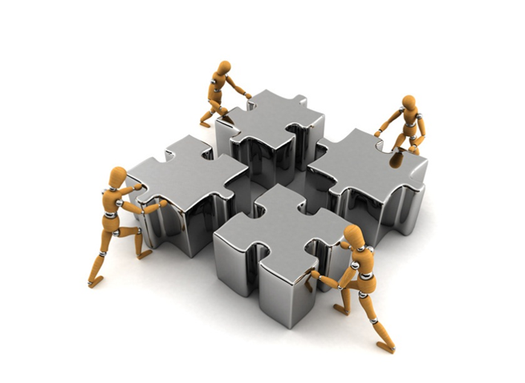
Signals You Can Communicate When It Matters
Rate How Well You Manage Conflict Communication Dialogue?
You are able to have real conversations with different styles of people when it is important?
You feel comfortable to communicate what needs to be said and preserve the relationship?
You are able to monitor how other people are reacting at key moments during an emotionally charged discussion?
The other person/people feel their concerns and needs have been heard?
You can safely discuss a difficult topic and achieve a higher level of win-win for everyone?

Slide 3
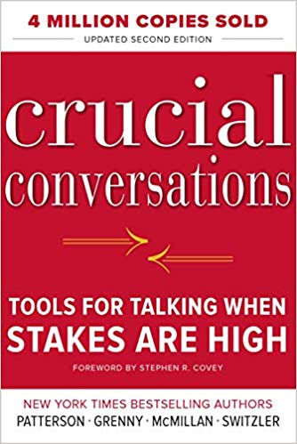
Read Crucial Conversations Tools
A Powerful Communication Framework for High Performance
Turn a doomed conversation into a healthy discussion
Learn the dialogue skills to face crucial conversations and handle them safely
Address controversial and emotional issues honestly and respectfully
Identify where you need to change your behavior between silence and violence in the conversation
Learn to create a higher middle ground by creating questions which combine what you want and do not want

Slide 4
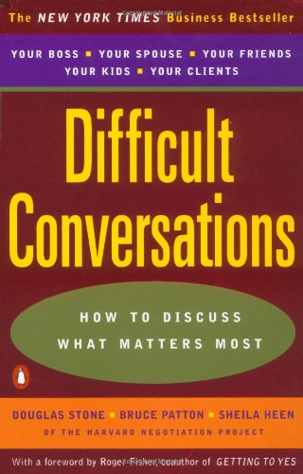
Read Difficult Conversations
A Powerful Communication Framework for Discussing What Matters Most in Difficult Situations
Decode the structure of Difficult Conversations
Learn the Three Conversation Framework -What Happened – whats the story, Feelings managing your emotions and Your Identity – what this says about you
Keeping your balance in difficult situations
Move towards a Learning Conversation

Slide 5
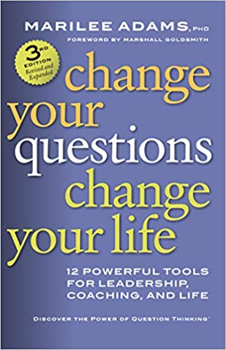
Read Change Your Questions Change Your Life
Discover the Power of Question Thinking
Learn how the right powerful questions can transform your life and relationships
Know what to ask and how at the right moments
Use a framework for learning and not judging
Gain the ability to shift your internal questions so you shift to your own positive thoughts
Learn to think productively and not reactively

Slide 6
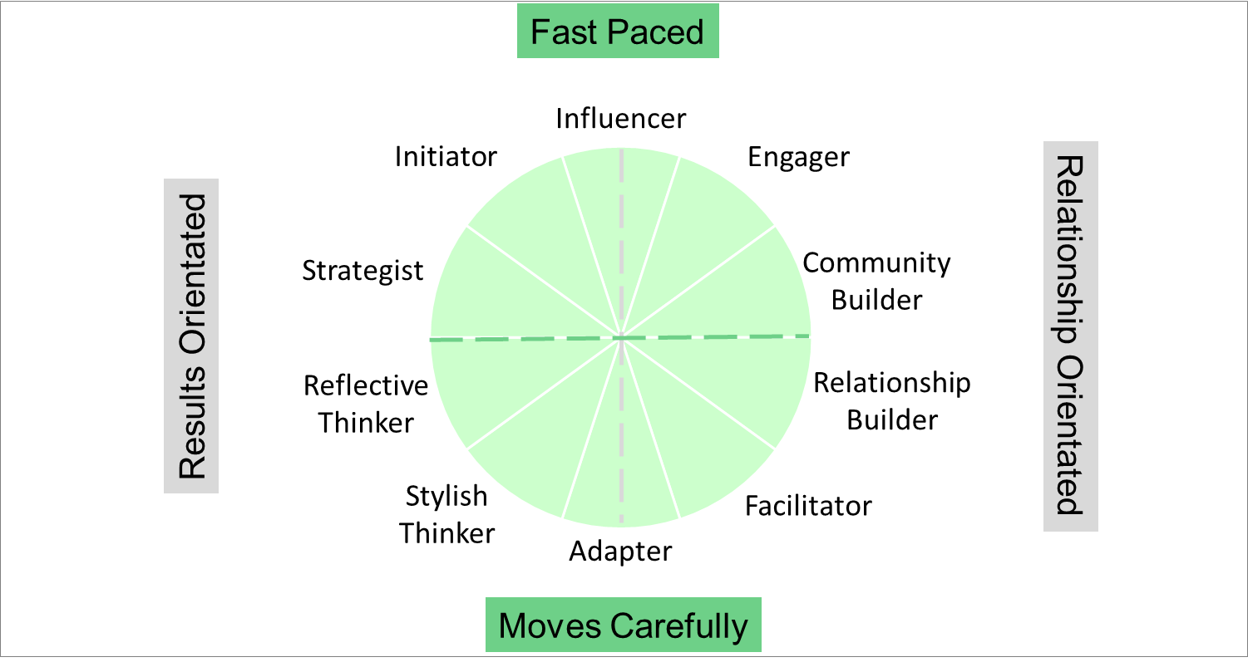

DNAB Natural Behavior Unique Style Matrix
Potential Behaviors Influencing How You Manage Conflict Communication
Will communicate directly
May seek to dominate and attack
Can fail to listen
You: Soften up with others
Others: Keep it bottom line
Will seek to engage
Could say things they regret
May be overly emotional
You: Tighten up with others
Others: Keep it open
Will respond to information
Could be too withdrawn
May lacks transparency
You: Loosen up with others
Others: Keep it factual
Will avoid conflict
May be too sensitive
Listens well
You: Toughen up with others
Others: Keep a soft tone

Slide 7
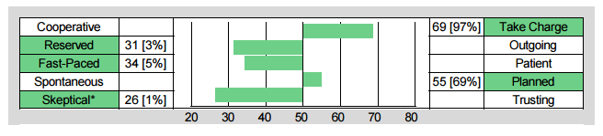
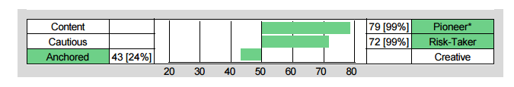
Building Your Own Level of Self-Awareness
Understand Your Strengths and Struggles for Conflict Communication
Chris Coddington - Strategist
Fast-Paced Strength:
Addresses conflict quickly
Fast-Paced Struggle:
Lacks empathy and safety in approach
Take Charge Strength:
Direct Communication
Take Charge Struggle:
May Not Listen
Skeptical Strength:
Seeks the truth
Skeptical Struggle:
Overly guarded and too questioning
Pioneering Strength:
Outcome focused
Pioneering Struggle:
Too driven to win

Slide 8




Identifying Your Natural Conflict Style
Managing Conflict Communication
Crucial Conversations for Performance
Programs available from DNA Behavior to Improve Personal and Business Performance
Handling Difficult Situations

Slide 9


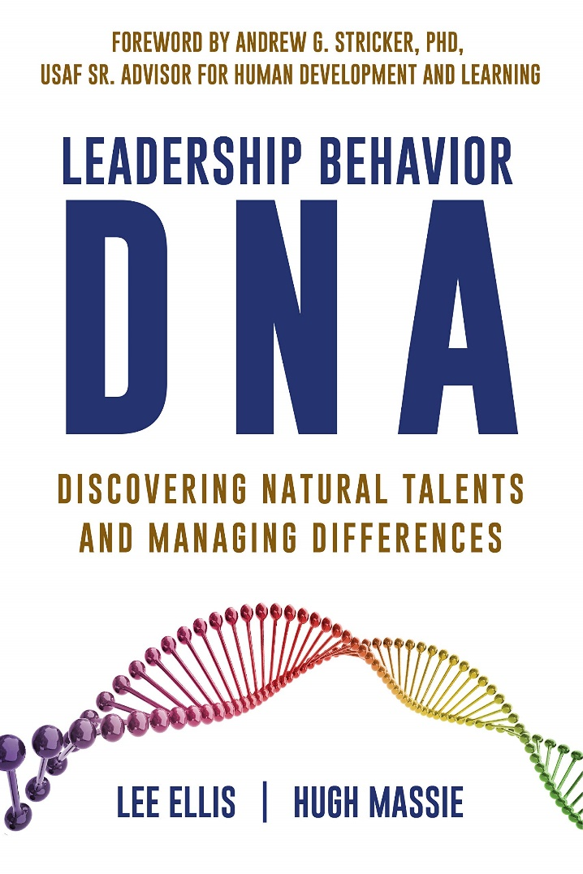

Hugh Massie, along with Lee Ellis literally wrote the book on discovering Natural Talents and Managing Differences.
Now available on Amazon.com
DNA Behavior
Unlocking the Science of Natural Behavior In Yourself and Others
dnabehavior.com

