Slide 1

Building Influence
Leading Without Direct Authority
Notes:
Case Studies: Digital Advice & Intergenerational Wealth Transfer
Organizational Transformation
Big Data

Slide 2

Signals of Influential Leadership
How Would You Rate Your Influence in these key areas:
,
You are able to find Win/Win solutions to issues frequently?
You often flex your style when working with others?
You are willing to give without a guarantee of reciprocation?
4. You inspire others to action?

Slide 3

Read Give and Take
Why Helping Others Drives Our Success
Learn:
What effective networking, collaboration, influence, negotiation and leadership skills have in common.
Surprising forces that shape why some people rise to top of the success ladder while others sink to the bottom.
Principles that drive effectiveness at every level of an organization and can immediately be put into action.

Slide 4

Read Getting To Yes
Negotiating Agreement Without Giving In
Getting to Yes tells you how to:
Separate the people from the problem
Focus on interests, not positions
Work together to create opinions that will satisfy both parties
Negotiate successfully with people who are more powerful, refuse to play by the rules, or resort to "dirty tricks"

Slide 5
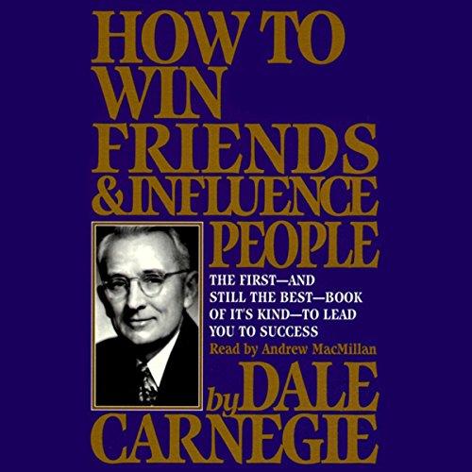
Read How To Win Friends & Influence People
Learn:
The six ways to make people like you.
The twelve ways to win people to your way of thinking
The nine ways to change people without arousing resentment

Slide 6
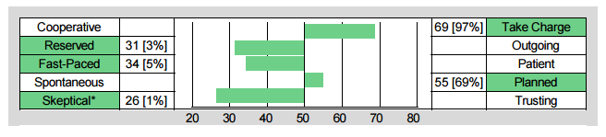
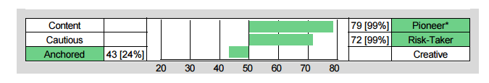
Identifying Your Natural Starting Place
Understand the Talents You Bring to Negotiation
Chris Coddington - Strategist
Influence Strengths
Pioneer:
Goal orientated and ambitious
Skeptical:
Able to ask difficult questions for better understanding
Influence Struggles
Reserved:
May appear too withdrawn, quiet
Fast-Paced:
May lack empathy or patience to connect with others

Slide 7
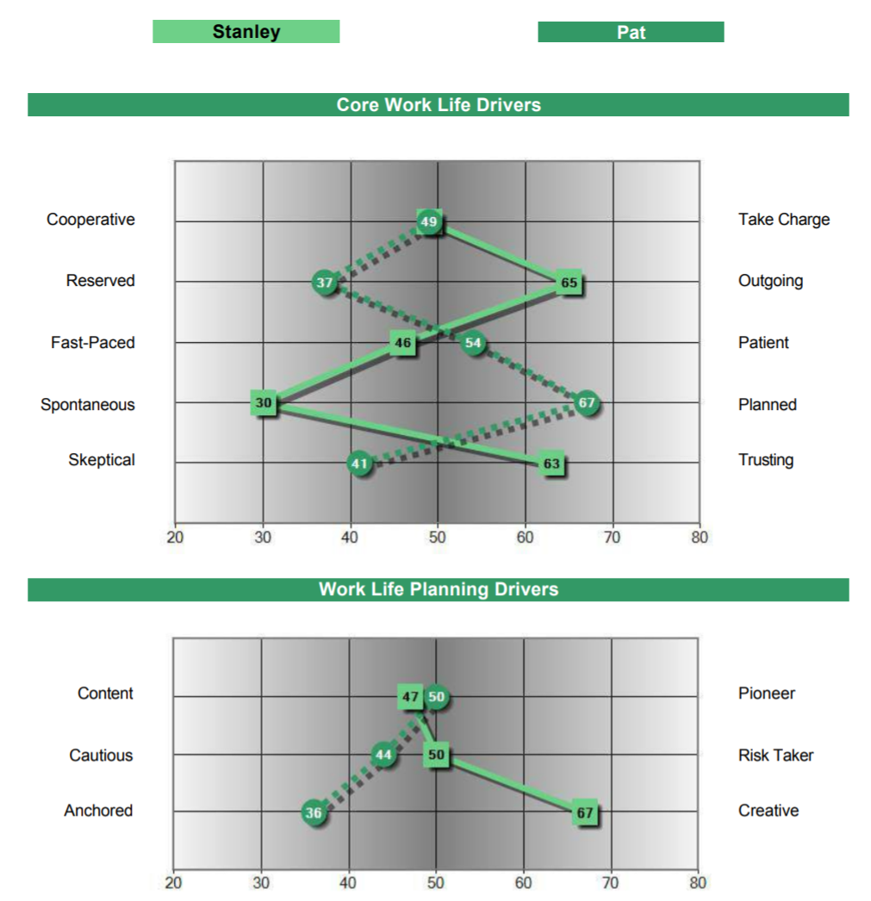
Working with Differences To Build Influence
Adaptable and Fixed Styles
Reflective Thinker – Very
Fixed:
Planned
Anchored
Engager – Highly Adaptable:
Spontaneous
Creative

Slide 8




Look for Win/Win
Building Influence
Be Aware Of Your Natural Style
Programs available from DNA Behavior to Improve Personal and Business Performance
Manage Differences to Create Results

Slide 9


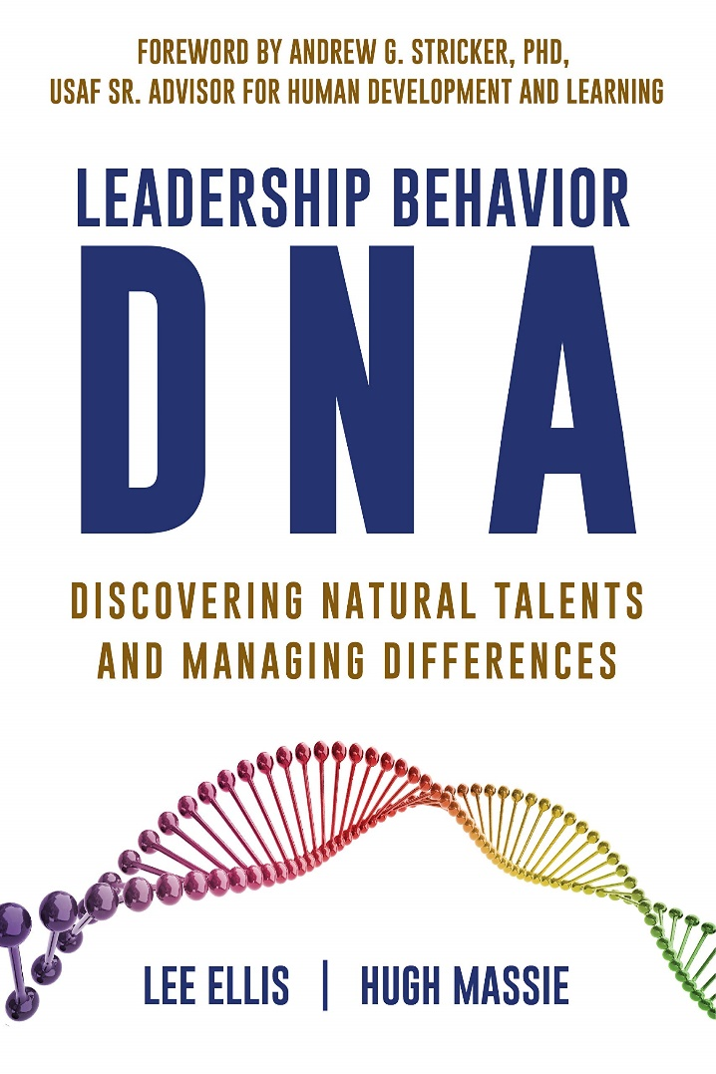

Hugh Massie, along with Lee Ellis literally wrote the book on discovering Natural Talents and Managing Differences.
Now available on Amazon.com
DNA Behavior
Unlocking the Science of Natural Behavior In Yourself and Others
dnabehavior.com

