Slide 1

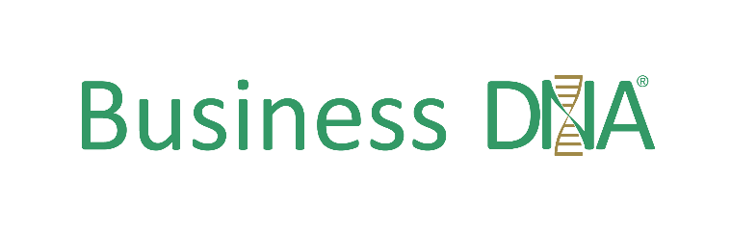
Optimizing Behavioral Intelligence

Slide 2


Hugh Massie
Hugh adopts
an “Understanding People Before Numbers” approach to business given 2002 Harvard research shows 87% of business issues are human behavior related.
CEO and Founder of DNA Behavior International
Behavioral Strategist
Business Leader and Board Advisor
Pioneer of Financial Personality Discovery
Author of Financial DNA®
Business DNA

Slide 3

DNA Behavior
DNA Behavior International is a behavioral sciences firm which adopts an Understanding People Before Numbers approach to business and life. By deploying powerful technology apps directly inside businesses we make validated behavioral data practical and usable to Know, Engage and Grow every employee, advisor,
and client online

Slide 4

Strict Rationality Kills Culture
A Straight Line Approach Does Not Work

Slide 5



The Business Performance Challenge
Closing the “Intention – Action” Gap
Human Emotions
Intention – Action Gap
Rational Business Management Processes

Slide 6

A Strong Culture Gets Results
Culture Needs to be Articulated, Seen and Lived

Slide 7





DNA Behavioralizes Culture for Organizations
Aligning Values, People and Engagement
Strong Values
Right People
Leadership Engagement
People Culture

Slide 8

People Culture In Action
Visible
Behavior
Demonstrated by Shared Patterns of Behaviors and Interactions
Perceptions
Not Visible
Attitudes
Values
Beliefs

Slide 9

Human Behavior Drives People Culture
Adopt an Understanding People Before Numbers Approach
Business Performance
87%
Sales Conversion
Client Engagement
87% of measurable business issues are people related
Employee Retention & Productivity
Operational Execution

Slide 10

The Connection Between Poor Engagement & Results
How you communicate is the single most important factor
30%
18%
15%
Only 30% of Americans say they feel happy at work and 50% say they have “checked
18% say they are "actively disengaged," acting out their unhappiness and undermining co-workers
Only 15% of clients are engaged and refer business
23%
57%
23% premium for engaged client in terms of revenue over the average client.
Highly engaged employees exhibit 57% more effort and boost client engagement
Engaging BOTH employees and clients could increase the bottom line 2.4 times

Slide 11

How Does Your Business Operate?
Defining Core Values
as the Bedrock of Culture

Slide 12

Inclusion & Diversity Are Fundamental
Build into the Culture and Core Values of Your Business

Slide 13

People Culture Impediments
The Wrong Motivations

Slide 14



Organizational Framework
for Sustaining a Strong Culture
How you communicate is the single most important factor
CEO/Leader
Culture Architect*
People Culture Manager
Daily Monitoring and Enforcement
Employees
Live and Breathe Culture

Slide 15


The Relationship Between Culture & Engagement
Adopt an Understanding People Before Numbers Approach
Hand-on management
Clear goals
Compensation
Mission &Purpose
Meaningful work
Recognition
Development & Career
Engagement
The way people feel about
the way things work
around here
Culture
The way things work around here
Risk & governance
Courage
Innovation
Inclusion
Trusted Leadership
Reward systems
The work environment

Slide 16
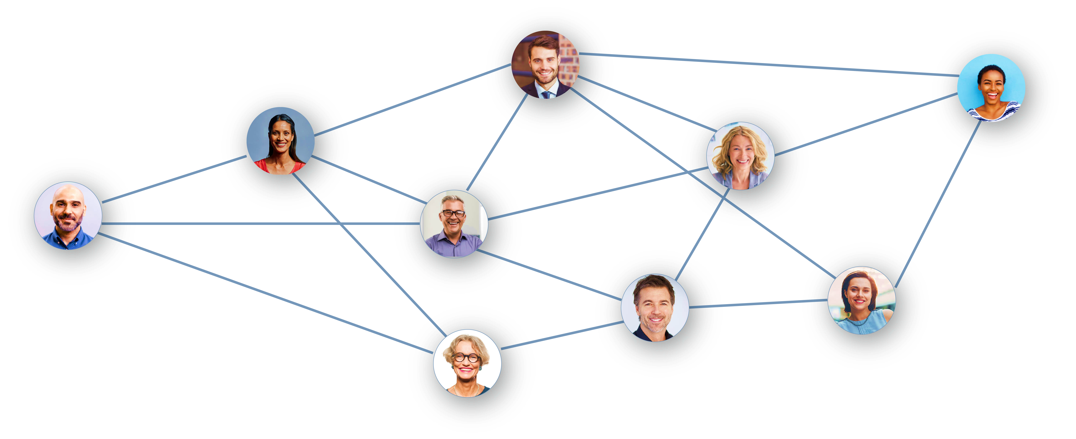
Improve Culture & Performance
With Tighter Controls
Adopt an Understanding People Before Numbers Approach
Is this a toxic combination of people in the team?

Slide 17




Manage Each Employee Uniquely
Capitalize On
Their Strengths (Talents)
Gallup Research: People prefer feedback than being ignored. If you notice one strength of an employee, then disengagement falls below 1%.

Slide 18

HOW TO BUILD A BEHAVIORALLY SMART PEOPLE CULTURE

Slide 19
Facilitating Building a Strong Culture
How Do You Want to Define Your Workplace Culture?
Review
01
Monitor
03
Design
02
M
Review
Identify Weak Culture Influencers
Employee/Team/Business Engagement Reviews
M
Monitor
Employee Values Alignment
Team Values Alignment
Employee/Team/Business Engagement Re-Reviews
D
Design
Founder/CEO Values
Company Values
Desired Workplace

Slide 20
Addressing a Weak Company Culture
What is Broken? It is No One Factor In Isolation
Negative Personality Traits
Inadequate Internal Controls + Monitoring
Superficial Hiring Process
Weak Org Design

Slide 21

Do You Know Who You Are Working With?
Recognize How Employee Differences Impact Your Culture

Slide 22
Business DNA Discovery
Provides an Objective View
Every Employee is Understood
Reality
Perceptions
Person A
Person B
Person C
STRENGTHS
STRUGGLES
STRENGTHS
BLIND SPOTS
BLIND SPOTS
STRUGGLES
STRENGTHS
STRUGGLES

Slide 23

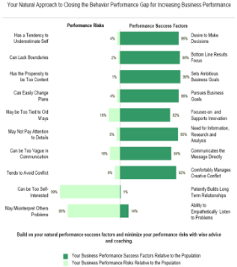
Business DNA: Quicker &
91% More Reliable Method
To Identify Strengths, Struggles, Reactions
LEARNED SITUATIONAL BEHAVIOR
NATURAL BEHAVIOR
Automatic
Behavior Biases
Communications
Learning Style
Talents
Risk Tolerance
Selling Style
Leadership

Slide 24
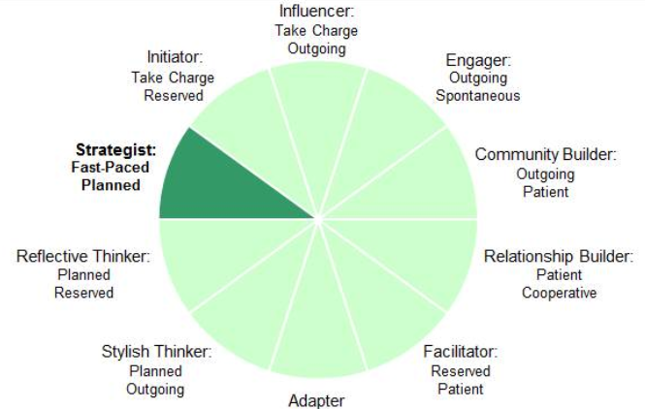
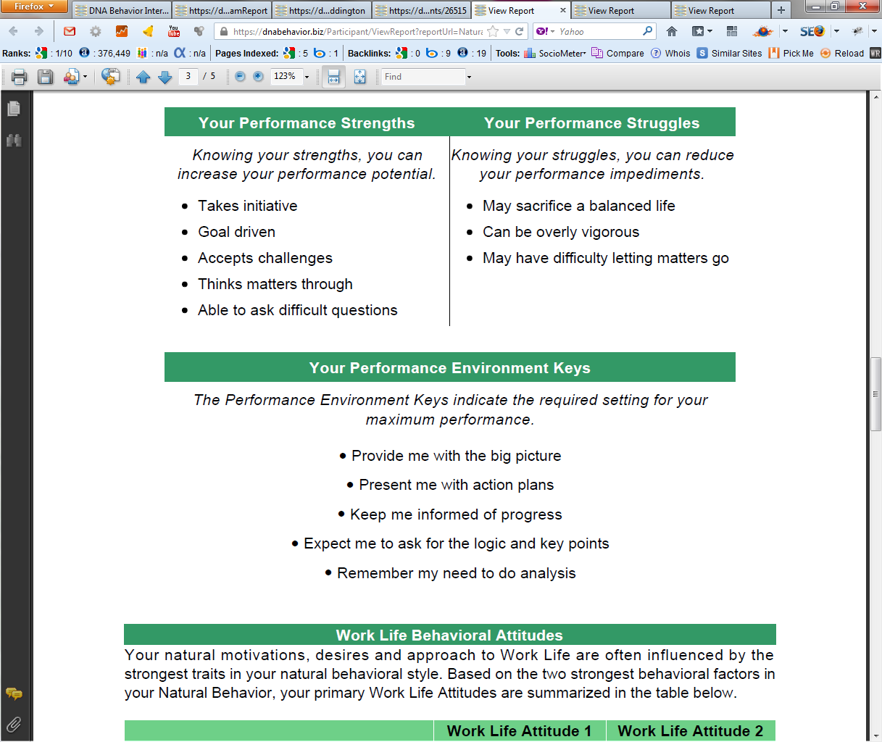
Practical Analysis of the Key Talents & Values
Driving Employee Productivity and People Culture
10 Unique Natural Workplace Styles based on 8 Primary Factors and 24 Sub-factors
Customized DNA Ultimate Performance Guide

Slide 25
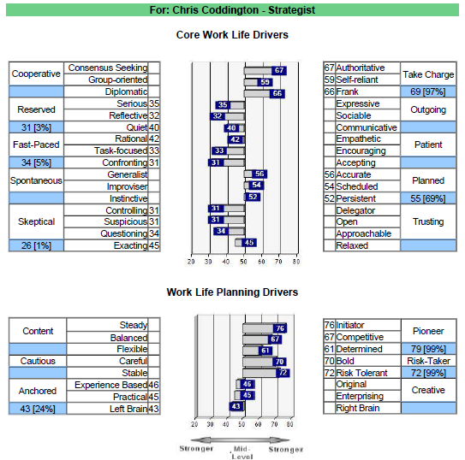
Identifying Culture Killers
1-Page Factor Report: 8 Factors; 24 Sub-Factors
Rationality – Culture Killer plus
Based on Research 3 Potential Rogue Behaviors:
1
Creative
2
Competitive (Ambition)
3
Reserved

Slide 26

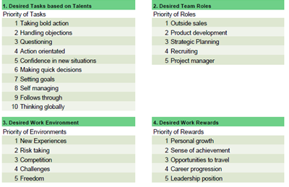
Hire the Right Talent and Retain Them
Getting Round Pegs in Round Holes and Values Alignment

Slide 27

How Well Is Your Team Aligned?
Behavioral Differences Need to be Understood

Slide 28
Build a Healthy Team Culture
DNA Team Performance Model
C O M M U N I C A T I O N S
ALIGN
UNDERSTANDING
ACCEPTANCE
RESPECT
TRUST
^{TEAM}
^{SUCCESS}
ALIGN
C O M M I T M E N T
Different Talents
Team Development:
From Diversity to Unity to Success

Slide 29
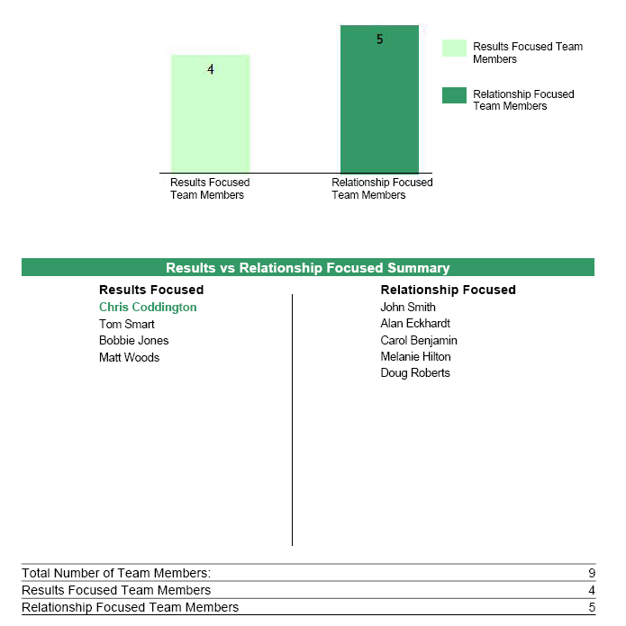
What is the Culture of Your Team?
The Different Team Personalities Will Influence It
The Business DNA Team Report makes understanding team culture easy by providing:
.
Graphical analysis of team differences
.
Summary of Results and Relationship drive
.
Analysis of blended team strengths and struggles
.
How to communicate with each team member

Slide 30
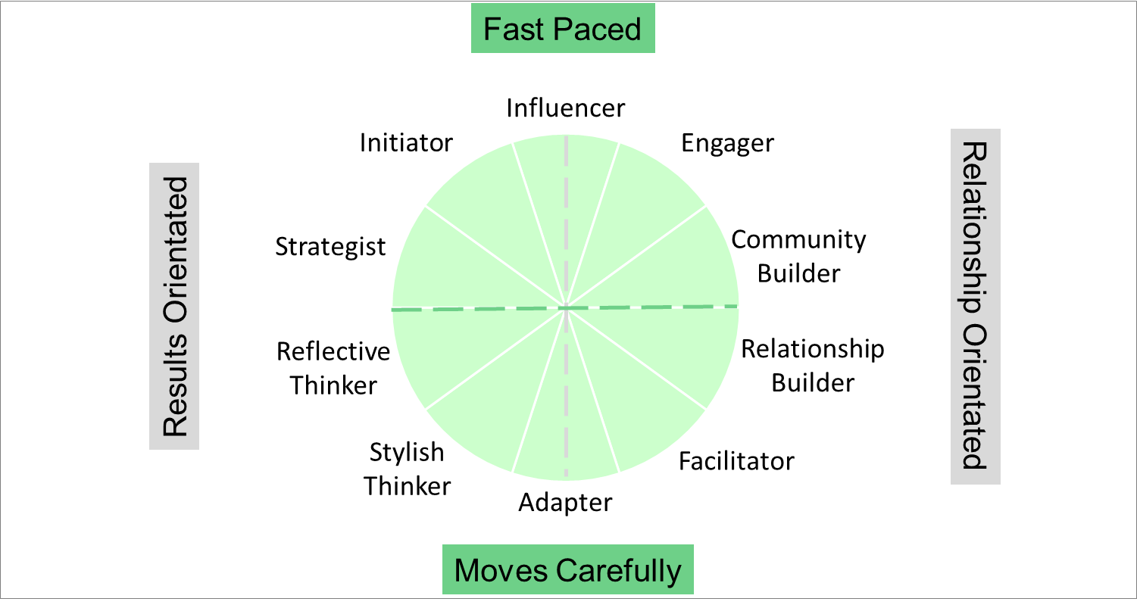
DNAB Natural Behavior Unique Style Matrix
Behaviors Influencing Culture
Visionary and Determined
Bullying and intimidation
Ambitious, cuts corners, greedy
Take unnecessary risks
Open and Fun
Impulsive decision-maker
Loose with information
Sudden emotional outbursts
Analytical and Reliable
Resists change
Fail to initiate action
Lack transparency
Relational and Inclusive
Bury problems
Passive aggressive
Covert sabotaging

Slide 31


What is Your Leadership Performance Balance?
Grow Your Leadership EQ
Results
Relationships
Leadership Performance
BDNA
Natural Behavior
Discovery and 360° Performance Review

Slide 32

The Importance
Of Communication
Making People Feel Understood, Accepted and Respected

Slide 33

Judge Each Other by the Quality of Work Done Not by the Hours Worked

Slide 34
CEO Flow
Empower Your Employees to Take Responsibility
CEO
CEO FLOW
CEO
“Turn Your Employees Into Mini-CEOs”

Slide 35
Outcome: A Behaviorally Smart Business
Built on Matching People to Roles, Team, Customers & Effective Communication
Team With Lack of Behavioral Insight
Behavioral Discovery to Know, Engage & Grow Employees & Clients
Matching Employees &
Clients for 4 in 4 Engagement
Goal Setting: Provide Discussion and Opportunities
?
?
?
Life Style: Provide Fun, Openness and Graphics
?
Stability: Provide Security, Feelings and Instructions
Default Styles =1 in 4 Engagement
Information: Provide Analysis, Research and Details
70% Team Productivity Uplift

Slide 36
Implementing Business DNA
Hire to Retire Talent Management Solutions
Values
I
Impediments
Values
Alignment
Leadership
L
Leadership EQ
Communication
Accountability
Right People
M
Managing Talent
Hiring and Onboarding
Team

Slide 37

Contact Us
For more information about Business DNA:
Contact:
DNA Behavior
5901 Peachtree Dunwoody Rd
Suite A375
Atlanta, GA 30328
(866) 791-8992
inquiries@dnabehavior.com
www.businessdna.com

