Slide 1
Behaviorally Smart Mentor and Mentee Matching Process
Optimizing Know, Engage and Grow in the Mentoring Relationship

Slide 2
The Mission
Introduce a transferable behavioral process to help you:
Match Mentor’s-Mentee’s Based on the Optimal Fit
  Objectively identify mentor-mentee compatibility
  Address the behavioral differences so that the strengths and struggles are identified and discussed
  Agree how each wishes to be communicated with
  Close gaps up-front between what you are expected to provide and what you will

Slide 3
The Outcome of a Poor Mentor-Mentee Relationship
Foundational to the breakdown of all relationships however caused is a lack of trust - the outcomes are:
Friction and tension
Mismanaged expectations
Loss of productive time in dealing with uncertainty and problems
Working around each other and failure to disclose enough information
Greater risk

Slide 4

Who Are You Best Suited To?
Not Everyone Is a Good Fit For You

Slide 5
Getting Started in the Selection Process
The Process Must be Mutual
Do you simply accept a person on referral?
Is there chemistry? Does it feel right?
Does the mentor have the appropriate knowledge, skills and experience (eg CPA, CFP, CEO etc)?
Is there shared values?
What are the behavioral differences – can they be managed to deliver value and maintain engagement?
How are fees being charged by the mentor? Can they be paid?
Is the mentee capable of being guided and becoming self-empowered?

Slide 6
Human Performance Attributes Discovering the Foundational Attributes for Mentoring
Typically mentors are referred mentee’s based on Integrity and Competencies, but the mentor or mentee is hired or fired for their Behavior
LEVEL C
Education, Training, Experience
KNOWLEDGE
SKILLS
COMPETENCIES
Business DNA Natural Behavior
LEVEL B
RELATIONSHIPS
RESULTS
NATURAL DNA BEHAVIORAL TALENTS
Heredity and Environment
LEVEL A
PURPOSE, CHARACTER and INTEGRITY
Trustworthy * Authentic * Emotionally Stable * Passion, Values,

Slide 7
Business DNA Talent Discovery
And the Whole Person
1
Natural Behavior
Natural hard-wired behavior, talents, strengths, stress behaviors, motivating needs, behavioral drivers
2
Learned Behavior
Values, passions, experience, beliefs, education and training, attitudes,
3
Cognitive Behavior
Not measured by DNA Discovery – includes IQ, aptitude, ability to acquire and work with knowledge, literacy, language skills, physical and health habits.

Slide 8
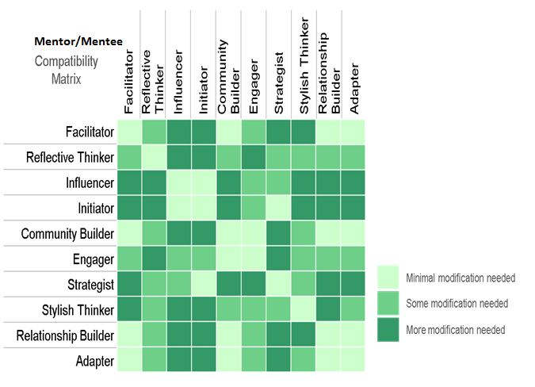
Compatibility Matrix
Identifying How Much Behavioral Modification Is Required

Slide 9
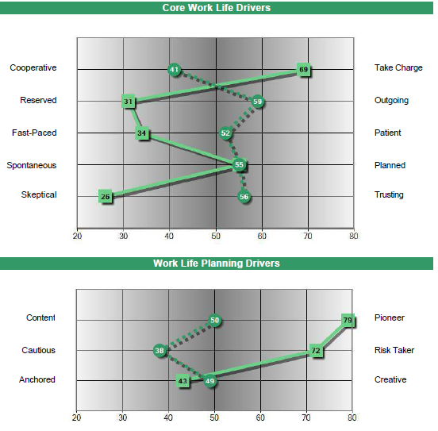
Comparison Graph
Chris Coddington & John Smith
Strategist
Stylish Thinker
Many Behavioral Differences to Navigate:
Chris may not provide John with the personal engagement he needs
John could be far more content and cautious than Chris’s pushy goal driven style

Slide 10
The DNA Performance Mentoring Coaching Model
Empowerment Through a Guided Self-Discovery Process
1. Use of Business DNA® Discovery:
Increase Consciousness of Self and Others
3. Listen More:
Safely Guide Mentee to Self-Discovery as They Know the Answers Even if They Do Not Know It Yet
2. Ask Powerful Questions:
Customize Your Conversation Based on Behavioral Insights
4. Staying in the Zone:
Co-create Plan for Action and Accountability

Slide 11
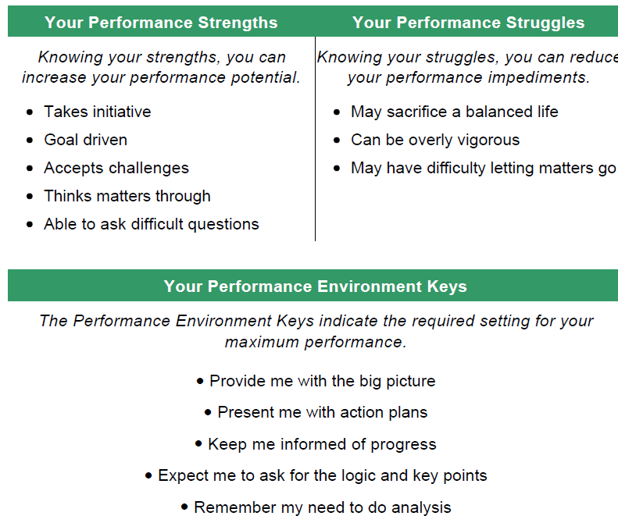
DNA Ultimate Performance Guide
The Behavioral Keys for Building the Relationship
Factor 1 (Pioneer) | Factor 2 (Skeptical)
3 Strengths | 2 Strengths
2 Struggles | 1 Struggle
3 Performance keys | 2 Performance Keys

Slide 12
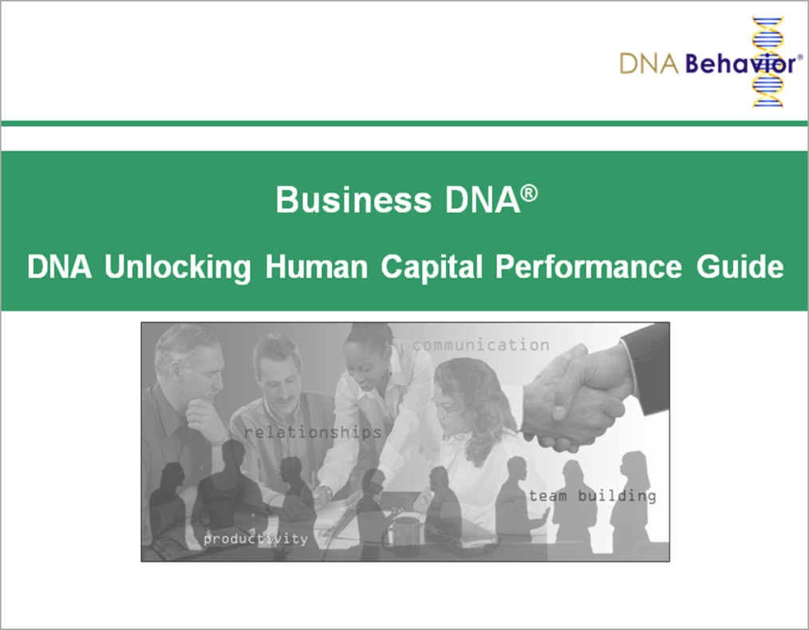
Contact Us
For more information about
Business DNA:
Contact:
DNA Behavior
3372 Peachtree Rd
Suite 115
Atlanta, GA 30326
(866) 791-8992
inquiries@dnabehavior.com
www.businessdna.com
`

