Slide 1

What is the No 1 Hurdle for Leaders to Cross?
Navigating Behavioral Differences In Every Team and Relationship
Different Perspectives is the elephant in the room.
Have you ever been in a team meeting for 1 hour discussing a critical topic and later you realize everyone has heard the discussion differently?
Why does that happen?
What is the consequence?

Slide 2
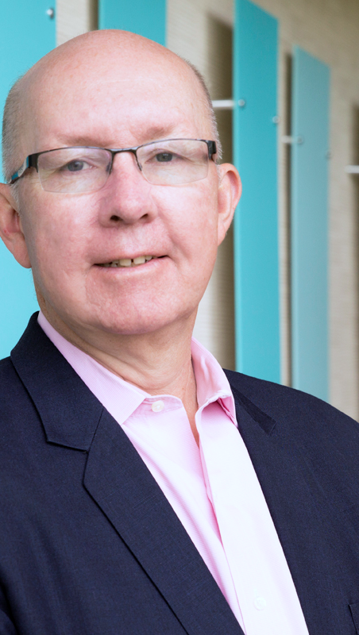
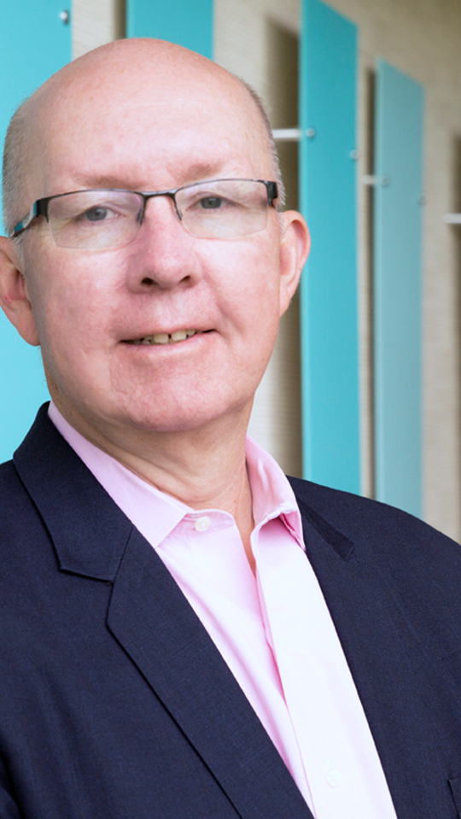
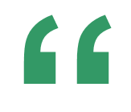
Hugh Massie
Hugh advocates 80% of human performance comes from managing human differences and the emotional aspects of decision-making
Founder and CEO of DNA Behavior International
Reformed Accountant
Behavioral Insights Pioneer
Business Strategist
Author of Leadership Behavior DNA® and Financial DNA®

Slide 3

A Hugh Massie Moment In Leadership
The Leadership Squeeze for Results Costing Relationships

Slide 4
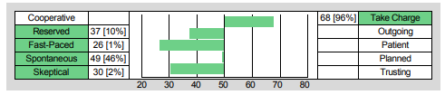

Hugh Massie’s DNA Hard Wiring for Performance
Results Driven Pioneer + Opportunist
Focused on Tasks and Results
Daring to Achieve Goals

Slide 5

Behaviorally SMART™ Leadership
Discovering Natural Talents and Managing Differences
Notes:
Case Studies: Digital Advice & Intergenerational Wealth Transfer
Organizational Transformation
Big Data

Slide 6
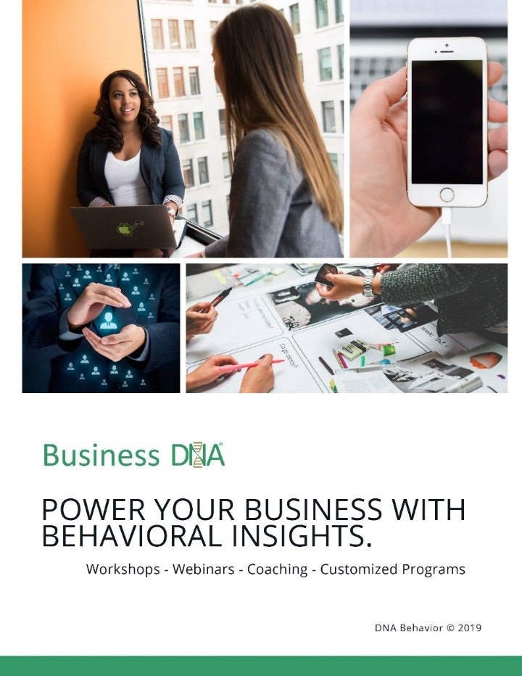


What DNA Behavior is as a Business
Delivering Customized Behavioral Experiences Since 2001
We deliver real-time behavioral management solutions through validated behavioral insights to connect, customize and power human performance.
The problem we solve:
De-railed performance due to intensified behaviors caused by unmanaged human differences, money attitudes, pressure and emotions.

Slide 7

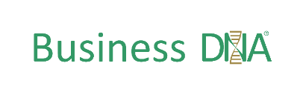
Most Business Issues Driven By Human Behavior
Adopt an Understanding People Before Numbers Approach
Business Performance Issues
87%
Sales Conversion
Client Engagement
Employee Retention & Productivity
Operational Execution
2002 Harvard Research: 87% of measurable business issues are communication related
Notes:
Sales conversion
Columbia Threadneedle & John Hancock

Slide 8

Todays Top 5 Requirements for All Leaders
How Do You Rate Your Performance In Demonstrating These Attributes?
Courage
Confidence
Character
Connection
Collaboration

Slide 9

3 Rules for Winning in a New World
Necessities for Building a High Performing Organization
Strategic Clarity – execute on the purpose
Operational Discipline – grow customer relationships based on reliability
High Performance Culture – high standards from motivated people

Slide 10

Top 3 Business Trends for All Leaders
How Is Your Business Addressing These Trends?
Mega Customization
Workforce Adaptability
Financial Wellbeing

Slide 11
The Hidden Competitive Advantage
Leverage Natural Behavior Insights to Know, Engage and Grow Every Employee and Client
Winning Strategy + Strong People Culture
Human Performance Acceleration for Improved Results
Behavioral Insights
(Talents, Communication, Biases, Beliefs, Values, Standards)

Slide 12

DNA Behavior presents easy to understand reports, dashboard analysis, tools and powerful questions to unlock leaders and employees to get out of their own way.
.
Behavioral Coaching of Leaders and Employees
dnabehavior.com
Notes:
*Leon
2001 – company built on UHNW family business consulting
Built tech for our own business
Saw need for industry so we started Financial DNA & CWM to provide tech to industry- CWMs worldwide
Brought in by firm, maintain relationship & AUM, third-party advisor
Father wants to retire
No clear successor, dysfunction
Children – no connection with the advisor
$260M

Slide 13
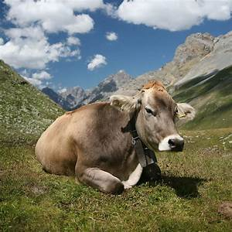
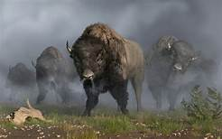
The Mentality of How Ultra Performers Respond
Are You a Cow or a Buffalo?

Slide 14
The Formula for Performance Acceleration
Capitalize on Strengths and Manage Struggles
Capitalize on Strengths
Manage Struggles
Manage Differences
A 100% Strengths Only mind-set and approach will naturally lead to under- performance.
The flip-side of strengths are struggles.
The over-use of strengths inherently means that there will be blind-spots which get in the way of performance.
Use your strengths 80% of the time and manage the impact of the related struggles on you and others.

Slide 15
Leadership Attributes
Natural Talents Play a Foundational Role

Slide 16


What is Your Leadership Performance Balance?
Grow Your Leadership EQ
Results
Relationships
Leadership Performance
DNA Behavior
Style
Natural Strengths and Struggles

Slide 17
Managing Your Leadership Performance Balance
Results:
Setting Goals
Task Focused
Processes
Accountability
Decisive
Opportunistic
Relationships:
Listening
Transparent
Approachable
Nurturing
Empathetic
Vulnerable

Slide 18
Confidence is the Foundation of Performance
What is Getting In the Way of Your Leadership Success?

Slide 19

Knowing Yourself
You can never have real success till you meet the real person… You.

Slide 20





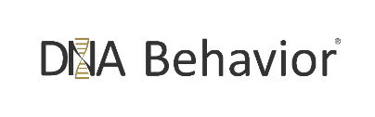
Your Workplace Personality Brain
Natural Impulses = Primary Driver of Performance and Imperfect Decision-Making
95% Natural DNA Behavior (Level 1 – Instinctive, Intuitive Automatic, Hard-wired)
5% Learned Behavior
(Level 2 – Conscious thinking based on experiences, education)
Behavioral + Cognitive Biases (Driven Harder by Emotions)
Imperfect Decision-Making and Sub-Optimal Performance
Reading: Thinking, Fast and Slow Daniel Kahneman
Emotional Stimuli
(Fear, Anxiety, Greed, Excitement)
Triggered by Money and Relationships

Slide 21

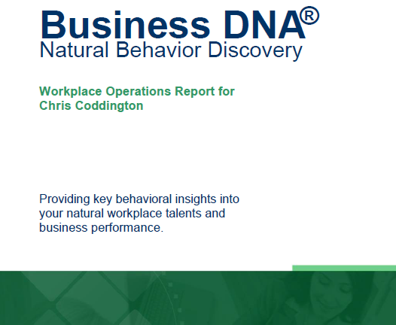

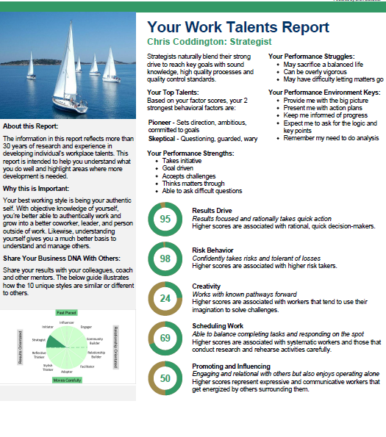
DNA Behavior is Quicker & 91% More Reliable Method
DNA Natural Behavior Discovery (10 to 12 Mins)
Completed by each individual
leader and team-mate
Universally Applicable Insights
LEARNED SITUATIONAL BEHAVIOR
NATURAL BEHAVIOR
Automatic
Behavior Biases
Communication Style
Talents
Learning Style
Leadership Style
Decision-Making
Risk-Taking

Slide 22
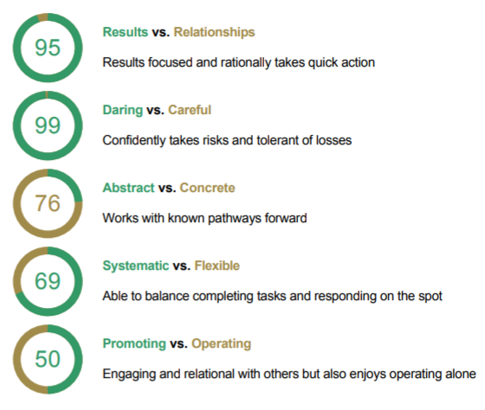
Understanding 5 Core
Work Talents

Slide 23
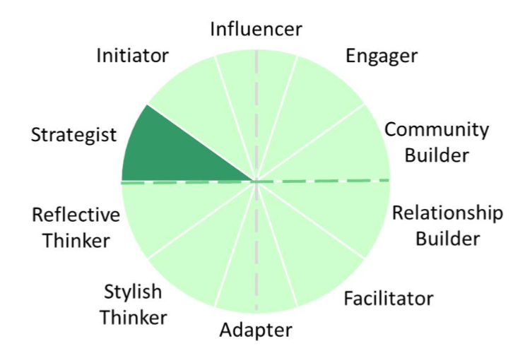
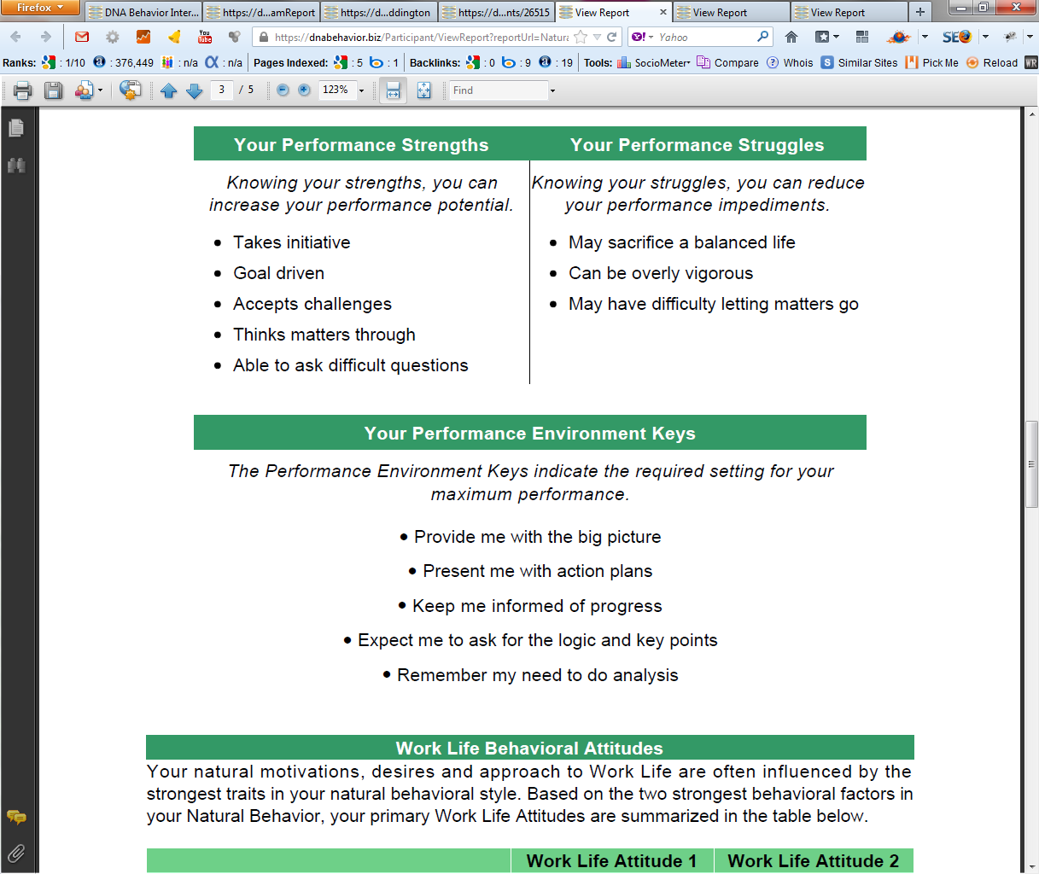
Practical Analysis of the Key Talents
Driving Employee Productivity and People Culture
10 Unique Natural Workplace Styles based on 8 Primary Factors and 24 Sub-factors
Customized DNA Ultimate Performance Guide

Slide 24
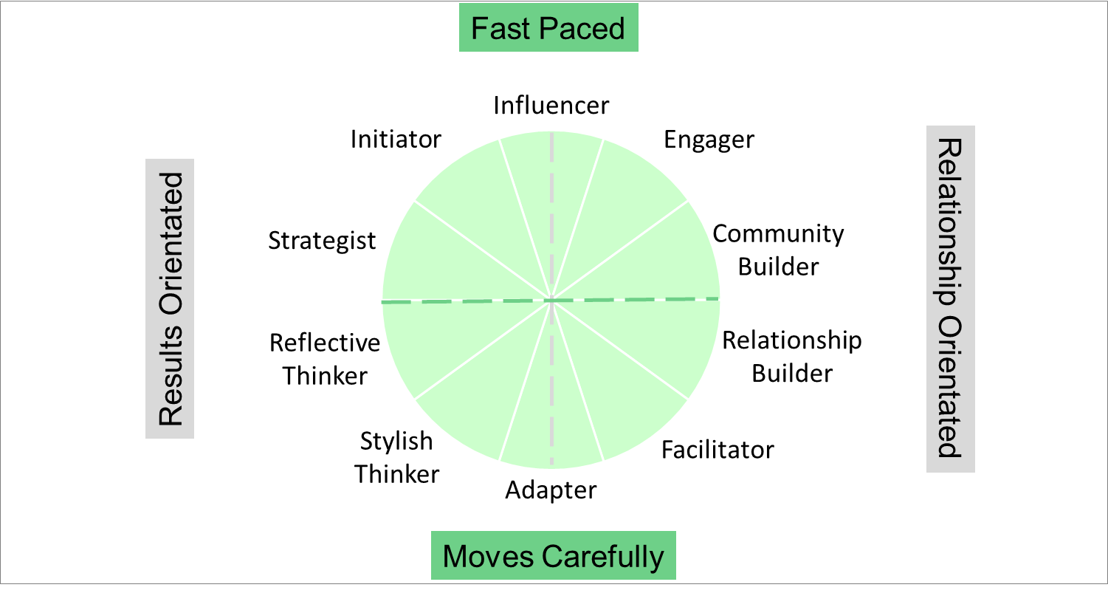
DNAB Natural Behavior Unique Style Matrix
Potential Behaviors Influencing Decision-Making and Culture
Visionary and Determined
Heavy-handed and intimidating
Ambitious, cuts corners, greedy
Takes unnecessary risks
Open and Fun
Impulsive decision-maker
Loose with information
Sudden emotional outbursts
Analytical and Reliable
Resists change
Fails to initiate action
Lacks transparency
Relational and Inclusive
Buries problems
Passive aggressive
Covert sabotaging

Slide 25
A Structured Framework for Managing Talents
Based on 45 Years of Scientific Research and Experience

Slide 26
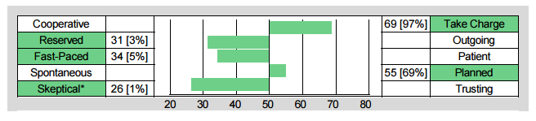
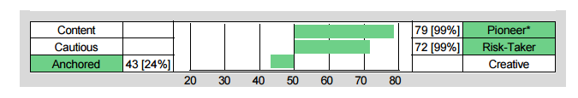
Building Your Own Level of Self-Awareness
Understand Your Strengths and Struggles
Chris Coddington - Strategist
Skeptical Strength:
Questioning and guarded
Skeptical Struggle:
Too doubting and wary
Pioneering Strength:
Goal orientated and ambitious
Pioneering Struggle:
Too driven and success focused

Slide 27
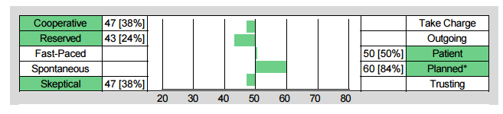
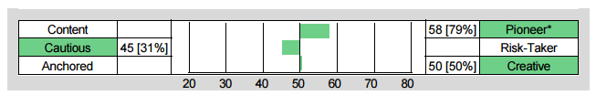
Empowering With Self-Awareness
Coaching a Quiet Leader to Contribute More in Meetings
Joshua Connor – Reflective Thinker
Co-operative + Reserved:
Create a relaxed Environment
Soften Up Language
Provide Time to Think, and then Ask for Comments
Pioneering Planned and Cautious
Keep the meeting structured and focused on goals
Address How Risk Can be Mitigated

Slide 28
Summary of Entrepreneurial Leader Genetics
Drive Takes Over From Creativity as the Business Grows
>1M Turnover
1. Resilience
3. Pioneering
>10m Turnover
1. Resilience
2. Risk Taking
2. Risk Taking
4. Creativity
5. External Charisma
3. Pioneering
4. Creativity
5. External Charisma

Slide 29
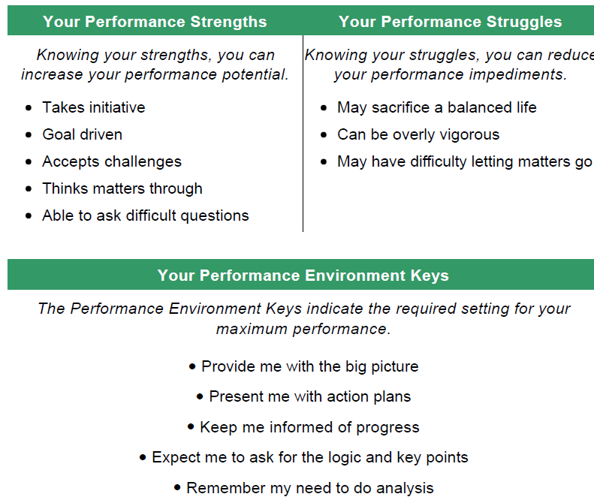
Sharing Vulnerability Within the Team
Chris Coddington Openly Admitting His Strengths and Struggles

Slide 30




Customizing the Workplace Experience
How Do Your Employees and Clients Wish To Be Communicated With?
Fast Paced
Vision
Openness
Options
Verbalize
Bottom Line
Broad Facts
Goal Setting
Discussion
Lifestyle
Graphics
Lifestyle
Results Orientated
Relationship Orientated
Analysis
Feelings
Facts
Feelings
Soft tone
Security
Instructions
Soft Tone
Transparent
Security
Information
Tangible
Stability
Instructions
Moves Carefully

Slide 31
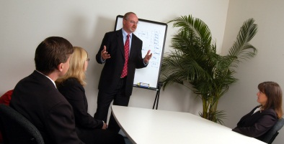
Awesome Leadership Traits Exercise
Why are Your Talents for Leadership the Greatest?
Instructions: Review your top behavioral traits. Spend the next 15-20 minutes preparing a brief presentation on why your talents are the greatest for being a leader.
Why are your traits the greatest for being a leader?
What are the key struggles of your greatest behavioral factor traits?
How do you like to lead, coach or guide others?
What one struggle from another behavioral factor group irritates you the most?

Slide 32

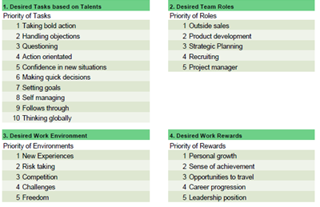
Hire the Right Talent and Retain Them
Getting Round Pegs in Round Holes and Values Alignment

Slide 33
Typical Behavioral Characteristics for Operational Roles
DNA Behavior Factor | Talents - Activity | Operations Manager | Support | Outside Sales | Analyst
Take Charge | Visionary/Decisive | >55 |  | >55
Cooperative | Listens/Collaborates |  | <50 |  | <50
Outgoing | Networks/ Communicates | >50 |  | >55
Reserved | Task Focused/ Researches |  | <55 |  | <50
Patient | Friendly/Supportive | >40 | >50
Fast Paced | Handles Objections/ Rejection |  |  | <45 | <45
Planned | Detailed/ Structured | >45 | >50 |  | >55
Spontaneous | Flexible |  |  | <45
Trust | Receptive | >40 | >45
Skeptical | Asks Questions |  |  | <45 | <50
Pioneer | Goal Driven | >50 |  | >55 | >50
Content | Balanced |  | <50
Risk Taker | Takes Bold Action |  |  | >55
Cautious | Manages Risk | <55 | <50 |  | <50
Creative | Problem Solves
Anchored | Implements/ Executes | <50 | <50 | <50 | <50

Slide 34

Do You Know Who Your Different Teammates Are?
As a Leader You Need to Recognize How To “Know, Engage and Grow” Different Styles For Delivering Customized Experiences

Slide 35

Managing Differences
Using Comparison
Reporting

Slide 36
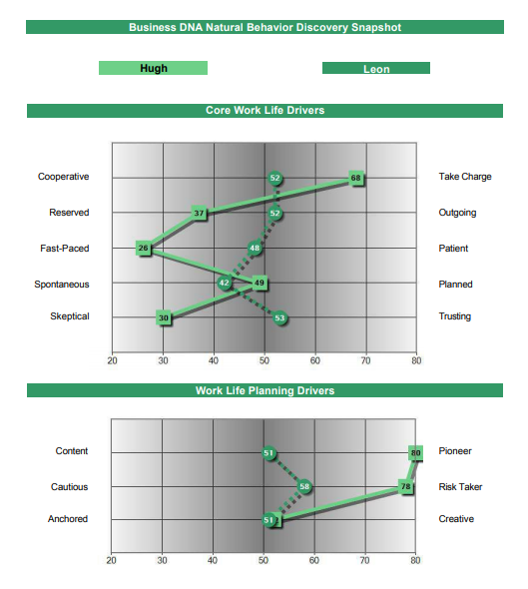
CEO/President Working with Differences
Leadership Counter-Balance for Delivering Team Productivity
Hugh – Initiator -Leads from the Front:
Take Charge - visionary
Pioneer – goal driven
Risk Taker - courageous
Fast-Paced – task focused
Reserved - reflective
Skeptical - discerning
Leon – Initiator - Leads the Team by Connecting:
Take Charge – team guide
Outgoing – connective
Patient - listens
Spontaneous - flexible
Trust – cohesive approach
Risk-Taking – takes chances

Slide 37
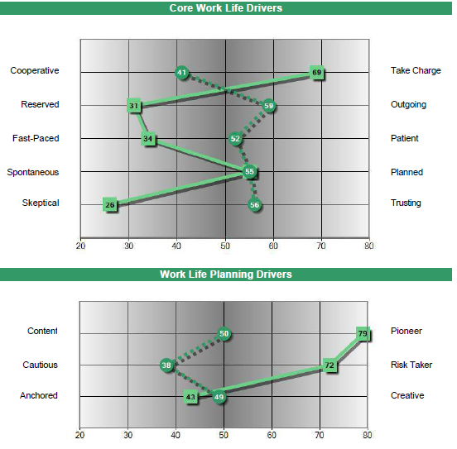
CEO/COO Working with Differences
Adapting to Differences For Maintaining Energy
Strategist
Stylish Thinker
Chris may not provide John with the personal engagement he needs
John could be far more content and cautious than Chris’s pushy goal driven style

Slide 38
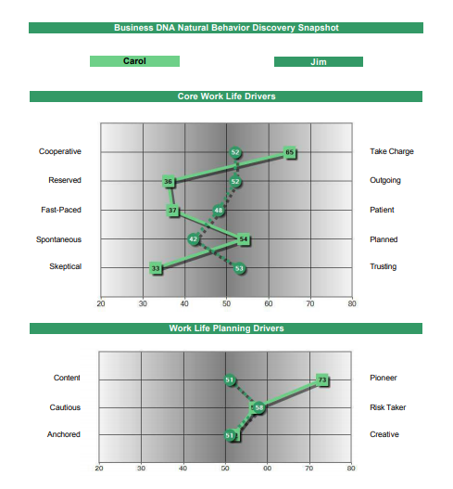
COO Comparison
Dominating vs Guiding the Team
Carol – Initiator - Leads by Micro-Management:
Take Charge - controlling
Pioneer – goal driven
Reserved - withdrawn
Fast-Paced – task focus
Planned - exacting
Skeptical – lacks trust
Jim – Initiator - Leads the Team by Connecting:
Take Charge – team guide
Outgoing – connective
Patient - listens
Spontaneous – flexible
Trust – cohesive approach
Risk-Taking - opportunistic

Slide 39
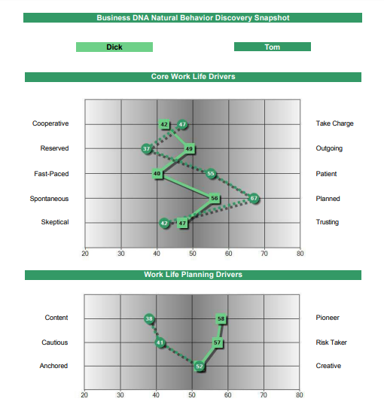
Rogue CEO and CFO Executives
Leadership Going Off the RightPath to Build a “Molotov Cocktail”
Tom – Reflective Thinker Style:
Co-operative – follows directions
Reserved - guarded
Patient – no push back
Structured – implements directions
Creative – designs solution
Dick CEO – Reflective Thinker Style:
Reserved – secretive
Pioneer – cuts corners
Creative – creates confusion
Risk Taking – takes opportunities

Slide 40
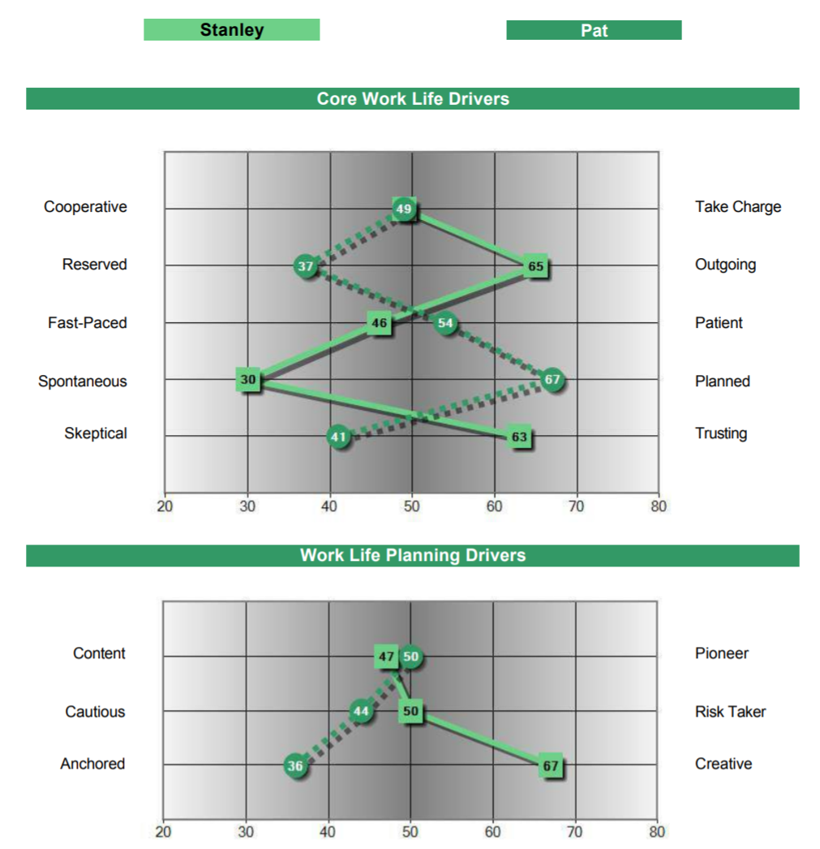
Workplace Adaptability (AQ)
Adaptable and Fixed Styles
Reflective Thinker – Very
Fixed:
Planned
Anchored
Engager – Highly Adaptable:
Spontaneous
Creative

Slide 41
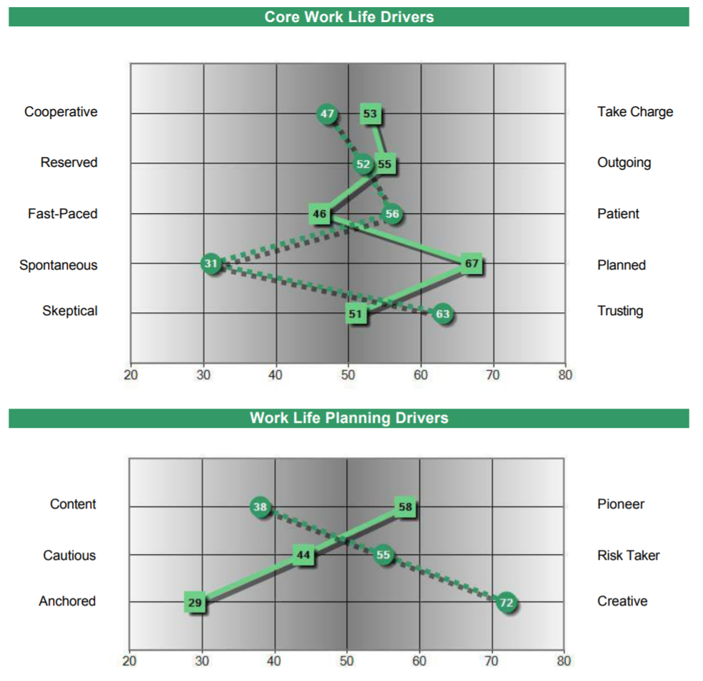
Workplace Adaptability (AQ)
Adaptable and Fixed Profiles
Facilitator – Very Fixed:
Planned
Anchored
Influencer – Highly Adaptable:
Spontaneous
Creative

Slide 42

How Well Are You and Your Team Aligned?
Behavioral Differences Need to be Understood
DNA Behavior presents data analysis, reports and findings to HR, Executive Teams and Leaders to help the teams be more productive

Slide 43
Build a Healthy Team Culture
DNA Team Performance Model
C O M M U N I C A T I O N S
ALIGN
UNDERSTANDING
ACCEPTANCE
RESPECT
TRUST
^{TEAM}
^{SUCCESS}
ALIGN
C O M M I T M E N T
Different Talents
Team Development:
From Diversity to Unity to Success

Slide 44
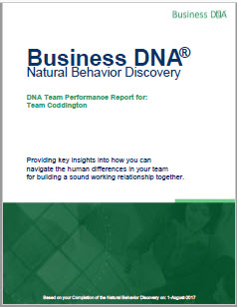
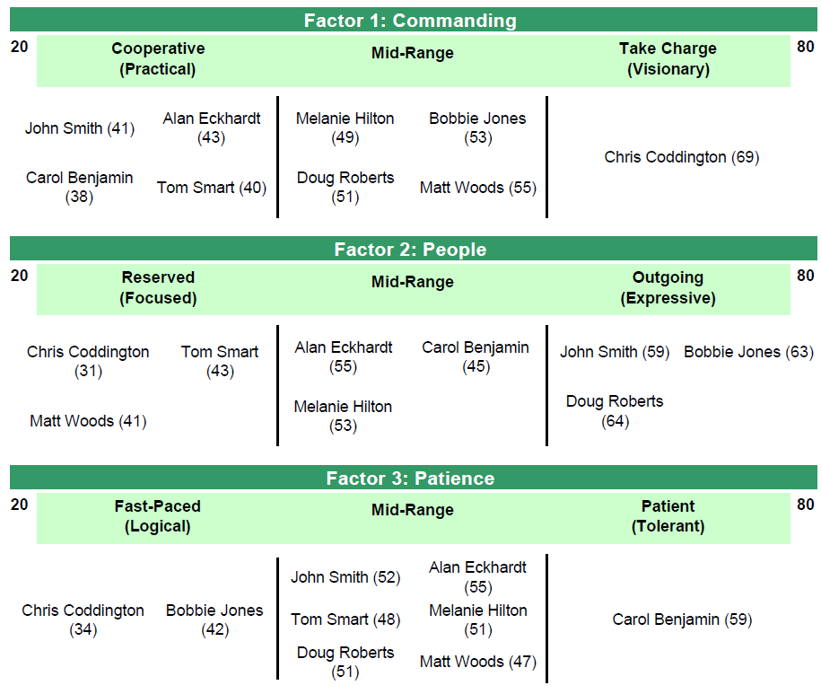
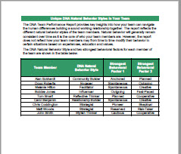
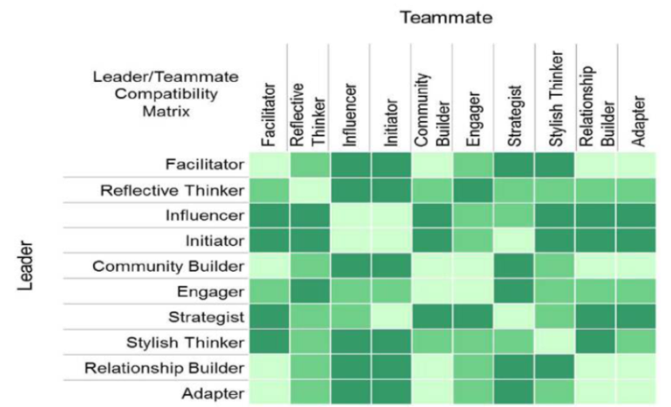

Navigating Team Differences
The DNA Team Report Provides An Objective Analysis of the Differences
Core Work Life Drivers - Natural Behavior Team Report
Natural Behavior Team Report
Leveraging Team Talents for Success
Hiring and Aligning Top Talent
Understanding, Accepting, Respecting Differences for Enhanced Teamwork
Team Compatibility Matrix- Natural Behavior Team Report

Slide 45
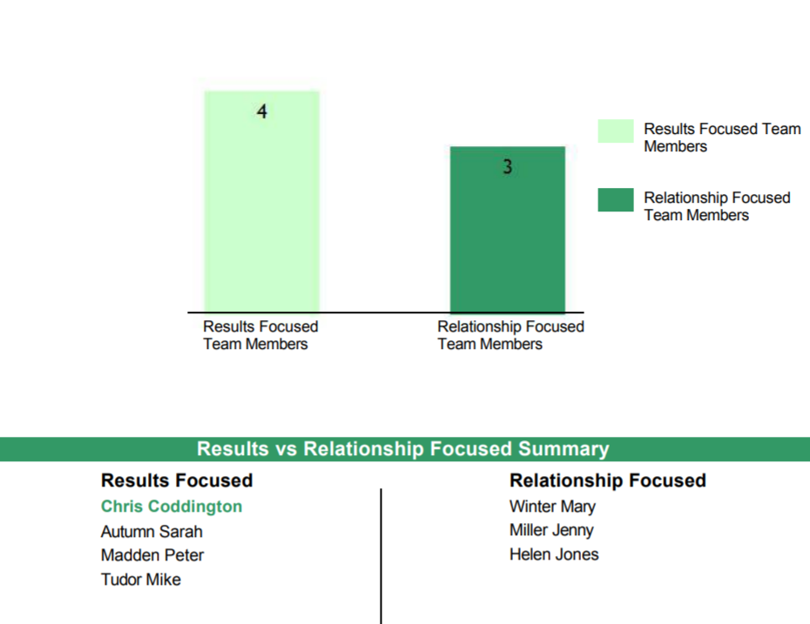
What is the Culture of Your Team?
The Different Team Personalities Will Influence It
The Business DNA Team Report makes understanding team culture easy by providing:
.
Graphical analysis of team differences
.
Summary of Results and Relationship drive
.
Analysis of blended team strengths and struggles
.
How to communicate with each team member

Slide 46
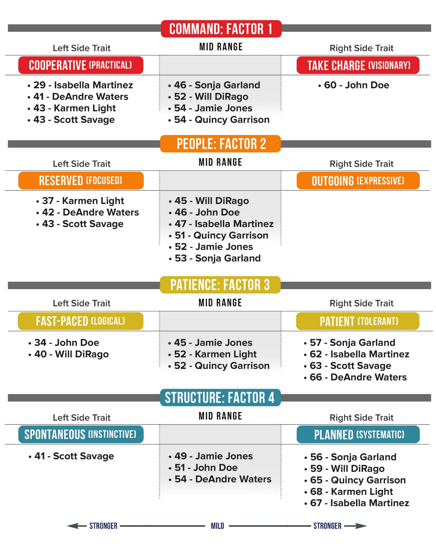
Serious Team Factors

Slide 47
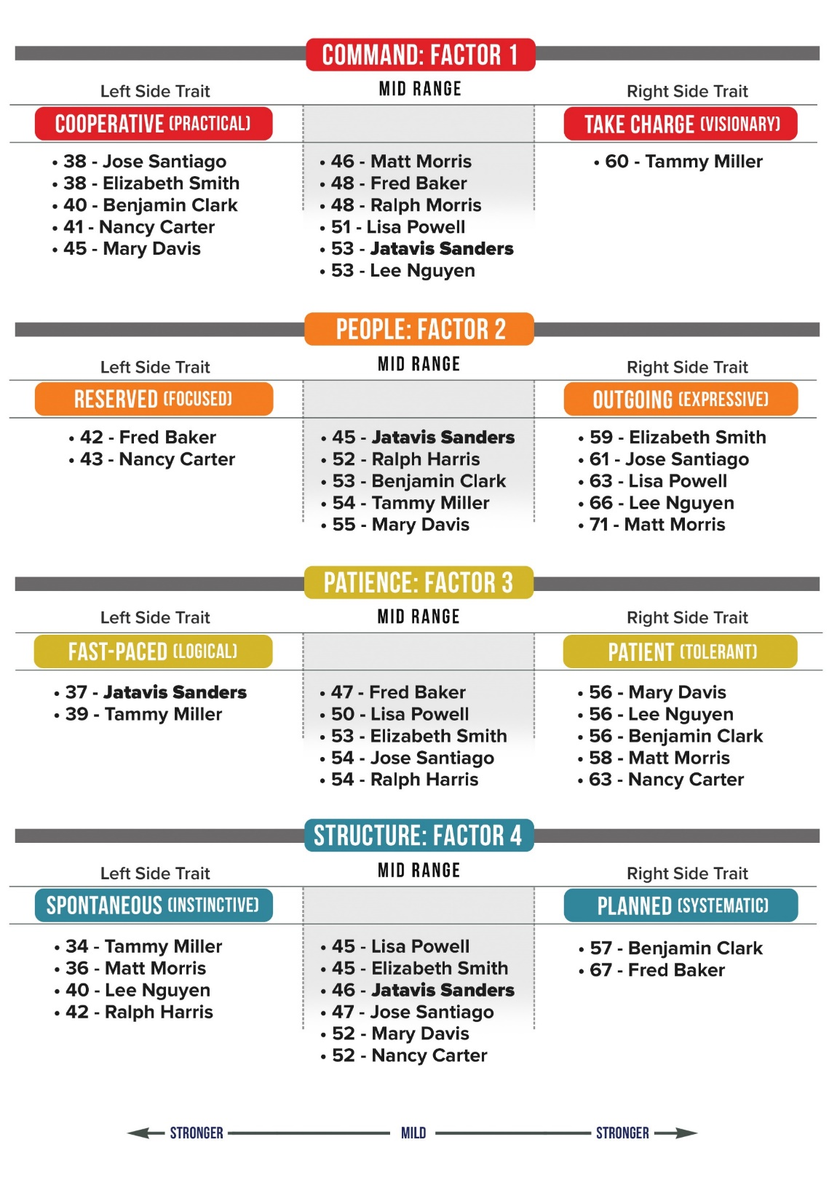
Fun Team Factors

Slide 48
Team Analysis
Based on data collected from Team Members Individual Reports
Strongest Factors:
Fast Paced:
Objective, results driven, rational
Risk Taker:
Venturesome, takes chances, optimistic
Average Unique Style:
Initiator
66%
Average Risk
Tolerance
Notes:
*Leon

Slide 49
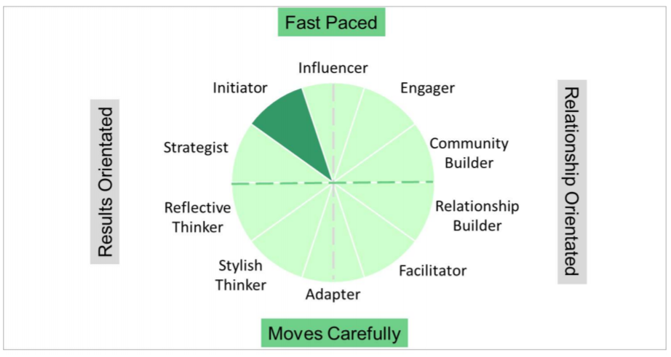
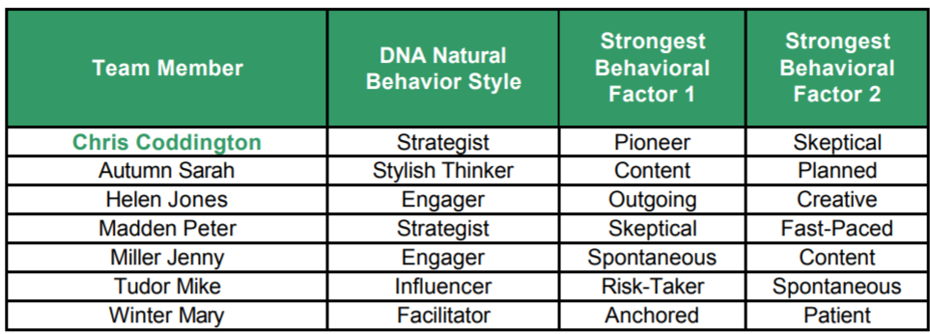
Coddington
Team at a Glance

Slide 50
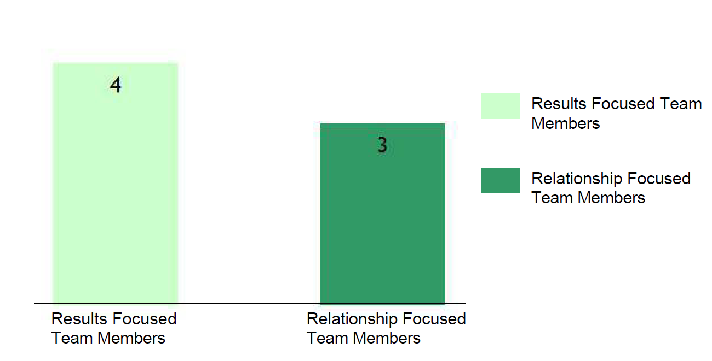
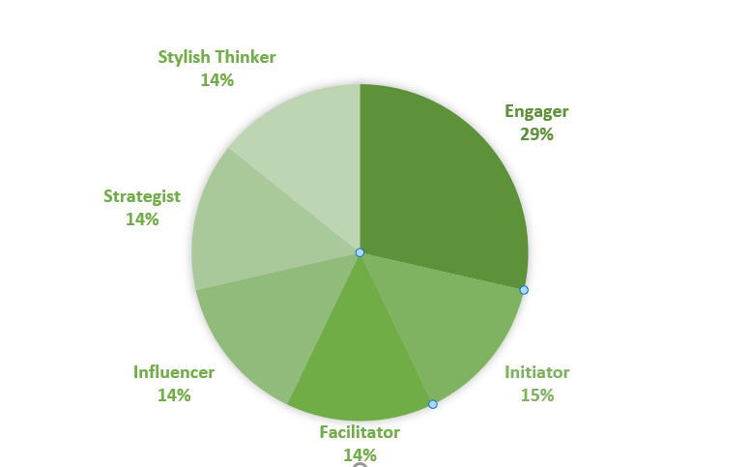
Team at a Glance
How do you see this play out in the group?

Slide 51

Coddington Team
Top Strengths:
Favors logic over feelings
Comfortable making difficult decisions
Prefers to take action
Ventures into new areas
Faces danger comfortably
Top Struggles:
May lake needed patience
May be abrupt or interrupting
May take unnecessary risks
©2019 Technology Association of Georgia

Slide 52
Coddington Team
Factor Relationships
Name | Top Factor | Top Factor 2 | Factor Relationship
Helen Jones | Outgoing | Creative | Likes to be in limelight with ideas
Jenny Miller | Spontaneous | Content | Can lack follow through
Mary Winter | Anchored | Patient | Reluctant to change winning formula
Mike Tudor | Risk Taker | Spontaneous | Takes risks without looking
Peter Madden | Skeptical | Fast Paced | Confronts difficult problems quickly
Sarah Autumn | Content | Planned | Challenged with change
Chris Coddington | Pioneer | Skeptical | Controlling about the goal

Slide 53
Coddington Team
Behavioral Business Risks
Name | Behavioral Risk
Helen Jones | May be too open with information, can make emotional decisions, likely to over spend
Jenny Miller | May be impulsive in decision-making, over look the details and not be sufficiently prepared
Mary Winter | May over rely on proven methods, discounts new ideas, can be too fixed on experiences
Mike Tudor | Can create exposures, may cut corners and not properly see the dangers of decisions
Peter Madden | May get in the way of ideas, resists delegating and not transparent, and may be intimidating
Sarah Autumn | Tends not to change the status quo, may not follow through enough and fail to initiate action
Chris Coddington | May be overly focused on success, too driven and not properly recognize resources needed

Slide 54
Optimized Marketing: Selling to Coddington Team
The Power of Behavioral Insights
Unique Styles | Count | Preferred Meeting Type | Writing Style | Meeting Space Set-up | Meeting Format | Optimal Marketing Spend
Strategist | 2 | Phone | Provide options in bullet points | Boardroom | Make it formal | Mail (or email a book), Gift card to dinner
Engager | 2 | In-person meeting | Use emojis and graphics | Provide screens and show success stories | Make it inspiring | Networking events, Sporting events
Influencer | 1 | Meeting | Present opportunities in bullet points | Boardroom | Make it formal | Steak dinner, Meetings with leaders, Sporting event
Facilitator | 1 | In-person meeting | Start by asking about family or community | Living room setup or at client's home | Make it relaxed | Group education event
Stylish Thinker | 1 | Email | Be specific (use facts) | Tidy, Functional and practical | Make it structured (Provide agenda ahead of time) | Coffee house, Mail (or email) a book, Networking events
Notes:
*Leon
**Time Target: 40-minutes
Comm. Builder: 2
Engager: 2
Influencer: 3
Reflective Thinker: 2
Presentations we cater to the audience:
Many prefer meeting in person, visuals, use cases and specifics, show inspirations.

Slide 55
Leadership Behavior and Money
Behavior and Money Attitudes Impact Every Decision
Behavior
Money Attitudes
Decisions

Slide 56
The Behavioral Finance Proposition
Behavior and Money are Completely Inter-Connected Getting In the Way of Rational Decisions
Spending
Risk
Goals
Behavioral styles drive money (thereby influencing every decision) and the flow of money reflects behavioral styles.

Slide 57
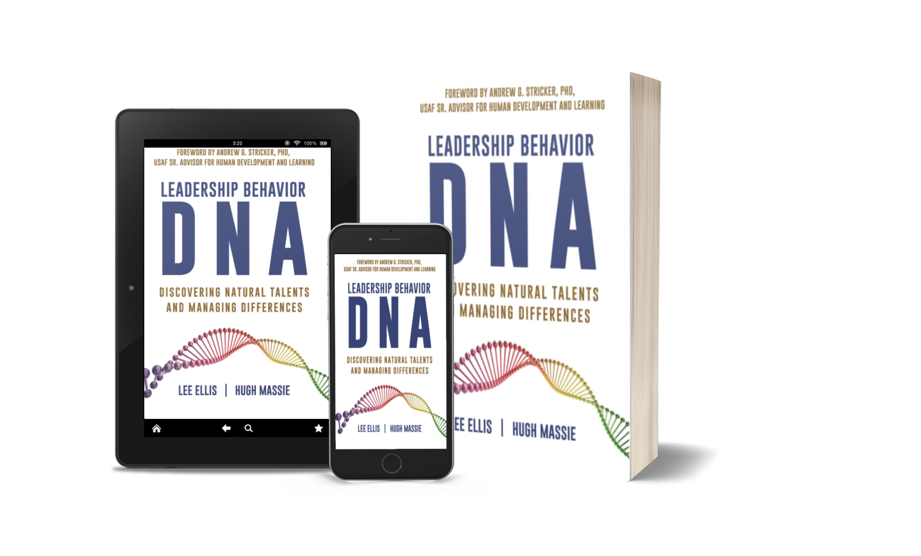


The Fundamentals of DNA Behavior and Leadership
DNA Behavior 8 Factors and 16 Traits
Managing Team Differences and Building Culture
DNA Behavior
Unlocking the Science of Natural Behavior In Yourself and Others
Now available on Amazon.com
dnabehavior.com

Slide 58




Personal Leadership Development
Leadership Development
Team Alignment and Dynamics
Programs available from DNA Behavior
Enterprise Leadership

