Slide 1

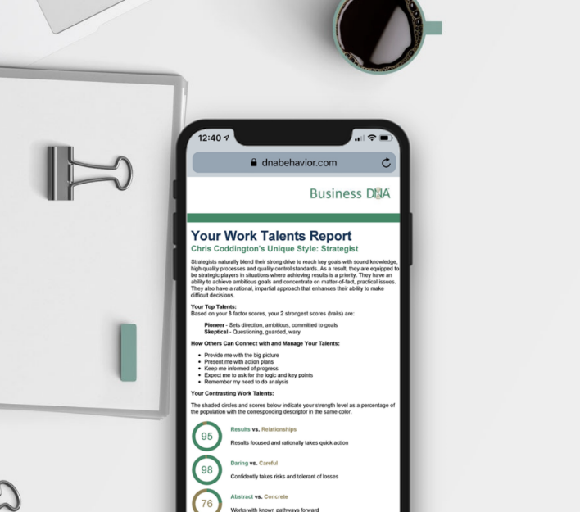




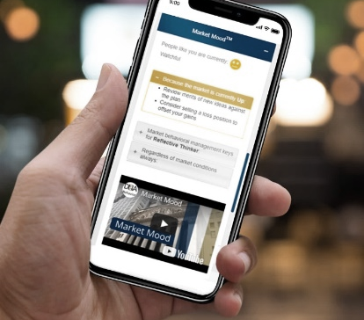

Leverage Financial Personality Insights for Advisor Client Win-Win
Notes:
Primary Title Page
The presenter can change the images but must stick to brand guidelines: Images must encompass people, technology and behavior.
NOTE: Blank template is available in the master slides where the images can be swapped out.

Slide 2
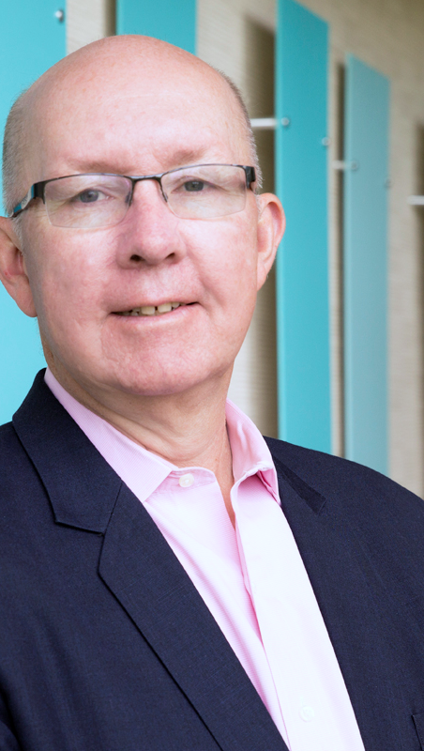

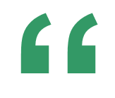
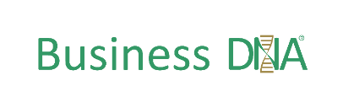
Hugh Massie
Hugh advocates 80% of human performance comes from managing human differences and the emotional aspects of decision-making
Founder and CEO of DNA Behavior International
Reformed Accountant
Behavioral Finance Insights Pioneer
Advisory Culture Strategist
Author of Financial DNA®

Slide 3

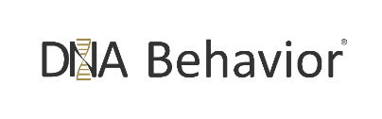
DNA Behavior
We deliver real-time behavioral management solutions through validated behavioral insights to connect, customize and power human performance.
The problem we solve:
Intensified behaviors caused by unmanaged human differences, money attitudes, pressure and emotions derail performance.
2002 Harvard Research shows 87% of business issues are communication related caused by human behavioral differences.
What We
Are as a Business
dnabehavior.com
Notes:
Prob we solve:
Intensified behaviors caused by unmanaged human differences, money attitudes, pressure and emotions derail performance.
Harvard:
87% issues caused by human differences

Slide 4

Do You Know Who Your Different Clients Are?
As an Advisor You Need to Recognize How To “Know, Engage and Grow” Different Styles For Delivering Customized Experiences

Slide 5
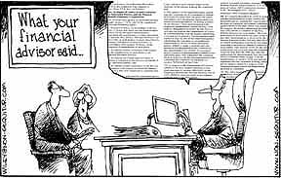
What You Say, Isn’t Necessarily What Your Clients Hear
Re-Framing Communication Assists Strategy Adoption

Slide 6


Who is getting in the way of your life and financial performance?
People React Differently to the Same Life and Market Events Because They Are Different
The Problem for Clients is Themselves
What have been your 5 best and worst financial decisions? What is the pattern?

Slide 7
Your Business:
Portfolio or Behavioral Management?
personality style
emotions
passions
excitement
listening
optimism
fear
reaction
anxiety
past experiences
communication preferences
confidence
speculation
93.6%
of managing wealth is
Behavioral Management
opportunism
Investments

Slide 8



Meeting the Financial Planning Challenge
Financial DNA Closes the “Intention – Action” Gap
Human Emotions
Unique Approach
Rational Processes
One Size Fits All
Intention – Action Gap

Slide 9





Your Financial Personality Brain
Natural Impulses = Primary Driver of Imperfect Decision-Making
95% Natural DNA Behavior (Level 1 – Instinctive, Intuitive Automatic, Hard-wired)
5% Learned Behavior
(Level 2 – Conscious thinking based on experiences, education)
Behavioral + Cognitive Biases (Driven Harder by Emotions)
Imperfect Decision-Making
Reading: Thinking, Fast and Slow Daniel Kahneman
Emotional Stimuli
(Fear, Anxiety, Greed, Excitement)
Triggered by Money and Relationships

Slide 10



The Next Gen Business Model Based on Financial Personality Discovery
Active Client Participation to Boost Engagement
Active Behavioral Management by Advisor
Customized and Compliant Service Experience

Slide 11


How to Build
a Behaviorally Smart
Financial Planning Process

Slide 12







Large Firm Know Your Client Process
Day 1:
Client meets with Concierge
Invited to client portal & completes DNA
Day 2:
Client matched to advisor
Advisor reaches out using DNA insights
Day 5:
Advisor meets with client face to face
Advisor walks client through Goals 360 process
Client is charged $350
Day 10:
Advisor presents client with portfolio
Comparison Reports and Dashboards are used to include all parties
Day 30:
Compliance conducts a suitability analysis
Reviews client’s portfolio, risk, and KYC suitability
Real-time:
Advisor receives a Market Mood alert
Advisor reaches out to client in right way, at right time
Periodic:
Review takes place
DNA is used to conduct meeting in right way
Goals are reviewed

Slide 13
Financial DNA® = Financial Personality
Multi-Dimensional Behavioral Discovery
01
Advisor Client Communication
03
02
Financial
Personality
Risk Profile & Behavioral Biases
Goals &
Spending Patterns

Slide 14

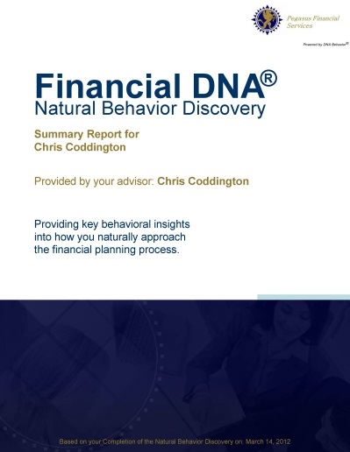

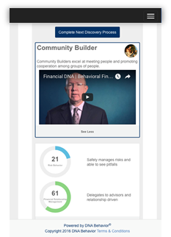
Financial DNA is Quicker & 91% More Reliable Method
FDNA Natural Behavior Discovery (10 to 12 Mins)
Completed by each individual
family member and advisor
To Predict Reactions to Market / Life Events
LEARNED SITUATIONAL BEHAVIOR
NATURAL BEHAVIOR
Automatic
Behavior Biases
Communication Style
Spending Patterns
Learning Style
Risk Taking & Loss Aversion
Decision-Making
Goal Motivations

Slide 15
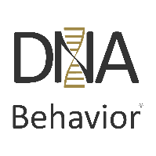
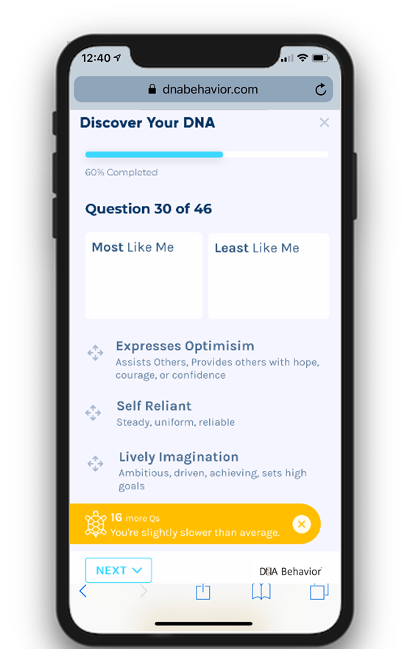
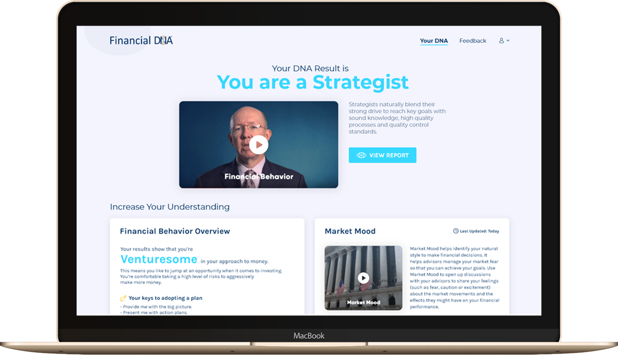

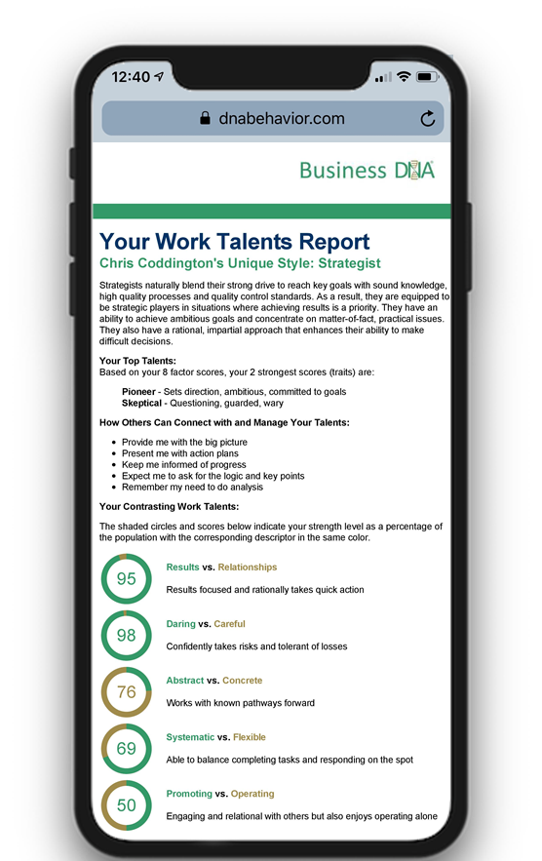

Creating a DNA Experience in Your Service Model
Scalable & Customizable Employee & Client Experiences Across the Business
  DNA analyzes the question answers
  Sends behavioral insights to your firm
  Employee/Client Logs into Firm’s Online Platform
  Employee/Client completes the DNA Natural Behavior Questionnaire
  Answers are stored in Firm’s Databases
  Firm Posts answers to DNA
  Firm receives DNA behavioral insights
  Triggers internal workflow
  Insights available immediately:
  Financial Behavior insights revealed for clients
  Work Talent insights revealed for employees
dnabehavior.com
Notes:
*Ryan*

Slide 16
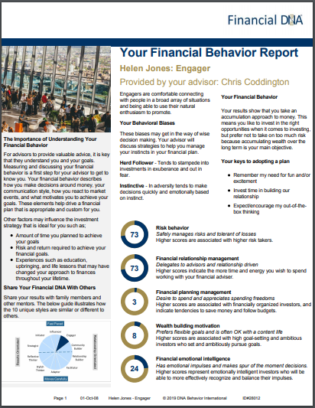

Financial Behavior Report and
Online Dashboard Reporting
Immediate Online Feedback for Clients e.g. Helen Jones (Engager)
DNA Unique Style: Engager
Behavioral Biases:
Herd Follower
Instinctive
Population Scoring:
High Score is >70%
Middle Range Score is between 30% and 70%
Low Score is <30%
Risk behavior
Financial relationship management
Financial planning management
Wealth building motivation
Financial emotional intelligence

Slide 17
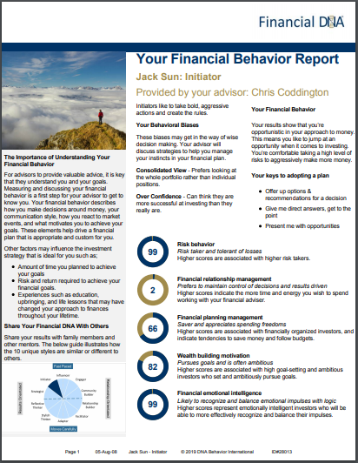

Financial Behavior Report and
Online Dashboard Reporting
Immediate Online Feedback for Clients e.g. Jack Sun (Initiator)
DNA Unique Style: Initiator
Behavioral Biases:
Consolidated View
Over Confidence
Population Scoring:
High Score is >70%
Middle Range Score is between 30% and 70%
Low Score is <30%
DNA Unique Style: Engager
Behavioral Biases:
Herd Follower
Instinctive
Risk behavior
Financial relationship management
Financial planning management
Wealth building motivation
Financial emotional intelligence
Risk behavior
Financial relationship management
Financial planning management
Wealth building motivation
Financial emotional intelligence

Slide 18
Managing Risky “Molotov Cocktail” Clients
High Spending Diminishes Financial Capability
High Portfolio Risk Required to Achieve Goals
High Capital Shortfall To Meet Goal Requirement
(Low Investments/ High Debt)
Financial Capability Problem if client has:
Low Risk Tolerance
Low Goal Drive
High Spending Propensity
High Spending Propensity
(Low Savings Rate)

Slide 19
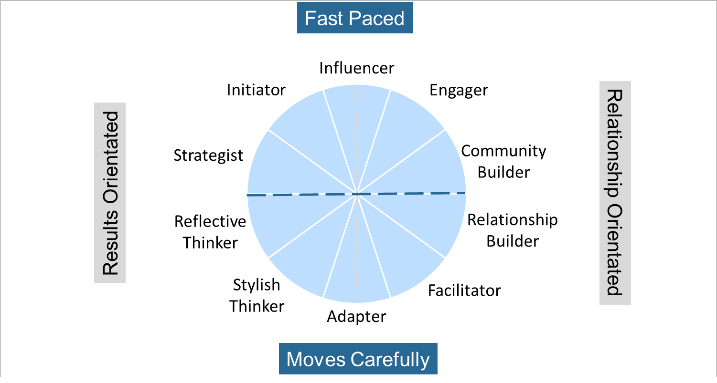
Overall Unique Decision-Making Style Summary
Connected to Natural Behavior
Risk Taker
Strategic Goal Setting
Growth Focused
High Impact
Spender
Lifestyle
Balanced Life
Public Recognition
Saver/Discipline
Information
Fear of Not Enough
Accountability
Cautious/Security
Family Stability Guarantees
Tactical/Local

Slide 20




Customizing the Planning Experience
How Do Your Clients Wish To Be Communicated With?
Fast Paced
Vision
Openness
Options
Verbalize
Bottom Line
Broad Facts
Goal Setting
Discussion
Lifestyle
Graphics
Lifestyle
Results Orientated
Relationship Orientated
Analysis
Feelings
Facts
Feelings
Soft tone
Security
Instructions
Soft Tone
Transparent
Security
Information
Tangible
Stability
Instructions
Moves Carefully

Slide 21
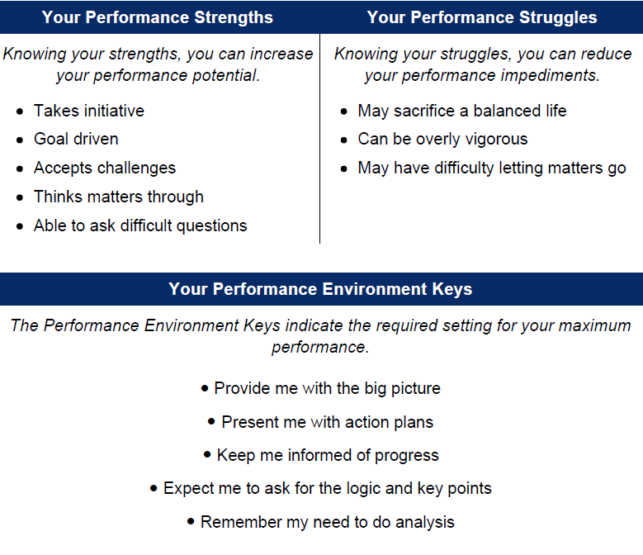
Mutual Sharing Vulnerability With Clients
Chris Coddington (the Advisor) Openly Admitting His Strengths and Struggles

Slide 22





Behaviorally Smart Client to Advisor Matching
Customizable Behaviorally SMART Matching Approach
Initiator
Risk: 80%
Biases: Instinctive,
Overconfidence
Reflective Thinker
Risk: 41%
Biases: Newness bias,
Pattern bias
Facilitator
Risk: 27%
Biases: Benchmark focus,
Risk aversion
Engager
Risk: 32%
Biases: Risk aversion,
Herd follower
Concierge
Provides warm introduction & matches clients to the perfect advisor
Influencer
Risk: 87%
Biases: Overconfidence,
Over trading

Slide 23
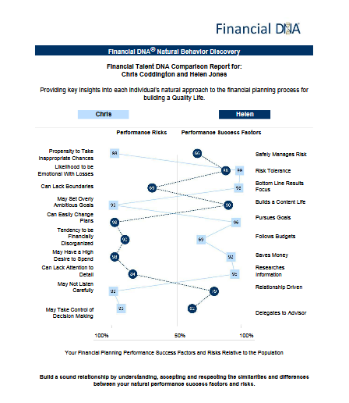
Is Helen Jones an Ideal Client
for Chris Coddington?
Many Behavioral Differences to Navigate:
Chris may not provide Helen with the personal engagement she needs
Helen will be far more content, and lifestyle driven than Chris’s pushy goal driven style

Slide 24
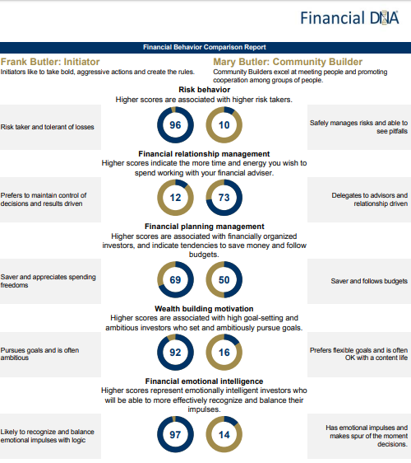
Navigate Couple Differences
Frank and Mary Butler Differences to Navigate
The main concern for Mary is the security of her family.
Frank will control decision-making.
Both are fiscally responsible.
Frank could be very goal driven and seek to take a lot of risks.
Frank will be a rational decision-maker and Mary more emotional

Slide 25


Relationships
Results
Father
Fast Paced
Moves Carefully
Daughter
Son
Son
Mother
The Williams Family

Slide 26
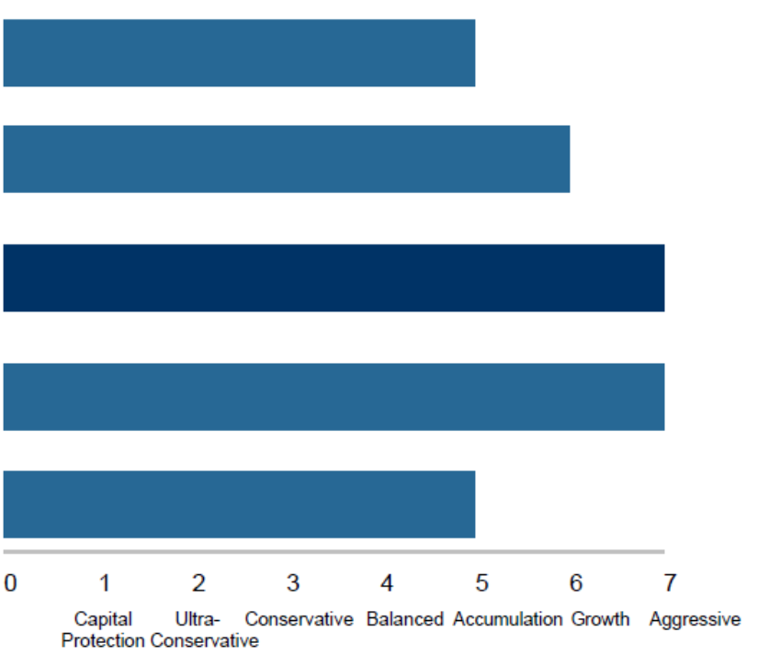
Building the Financial Plan and IPS
Aligning the Risk Profile to Goals, Capacity, and Financial DNA
Your Assessment of the Client’s Current Portfolio Risk Profile Group
Your Assessment of the Client’s Portfolio Risk Need Group to Achieve Goals
Your Assessment of the Client’s Portfolio Risk Group based on Current Financial Risk Capacity
Financial DNA Natural Behavior Portfolio Risk Group (based on Risk Propensity and Tolerance)
Financial DNA Learned Behavior Portfolio Risk Group (From Financial Personality Discovery or Advisor’s Assessment )
Overall Selected Portfolio Risk Profile Group (Selected by Advisor and Client based on discussion of the aggregate of all scores)

Slide 27
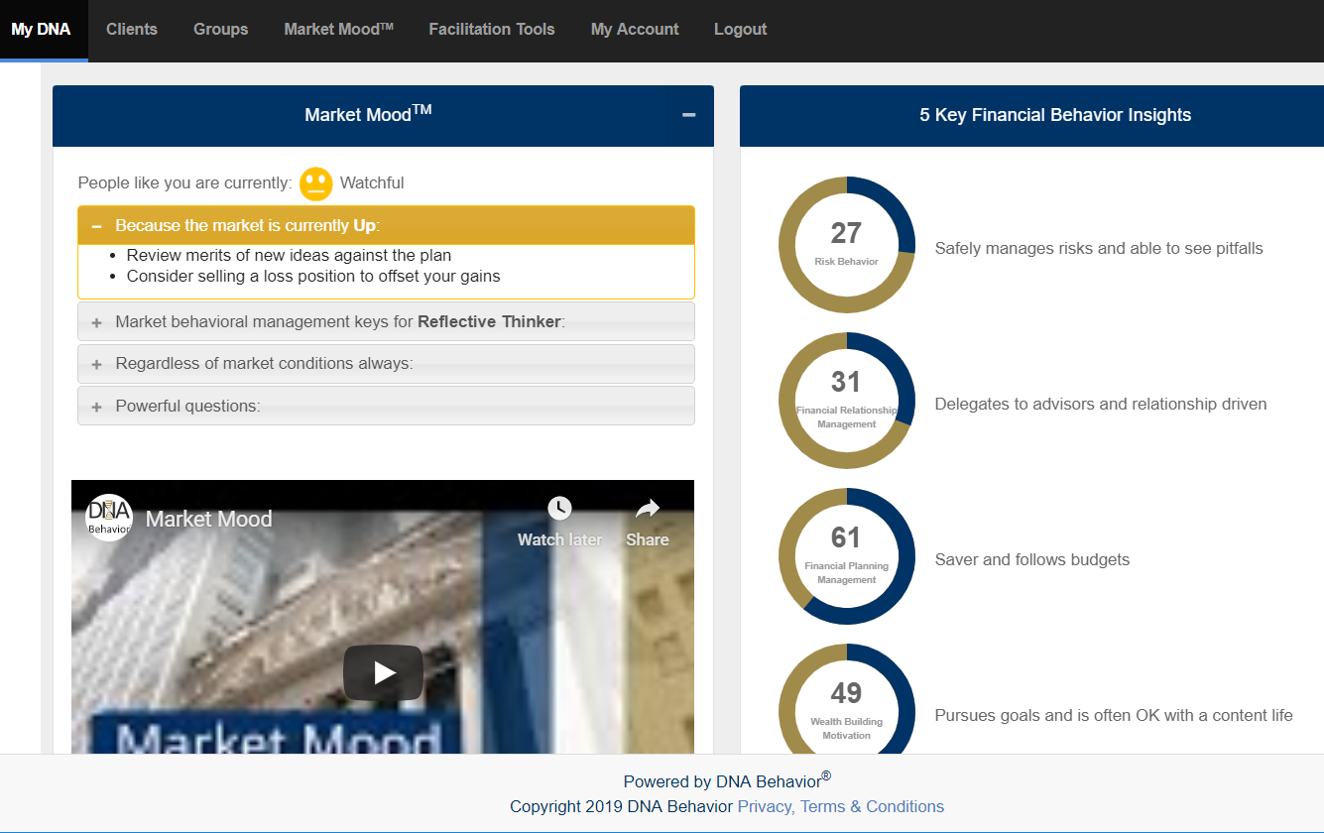
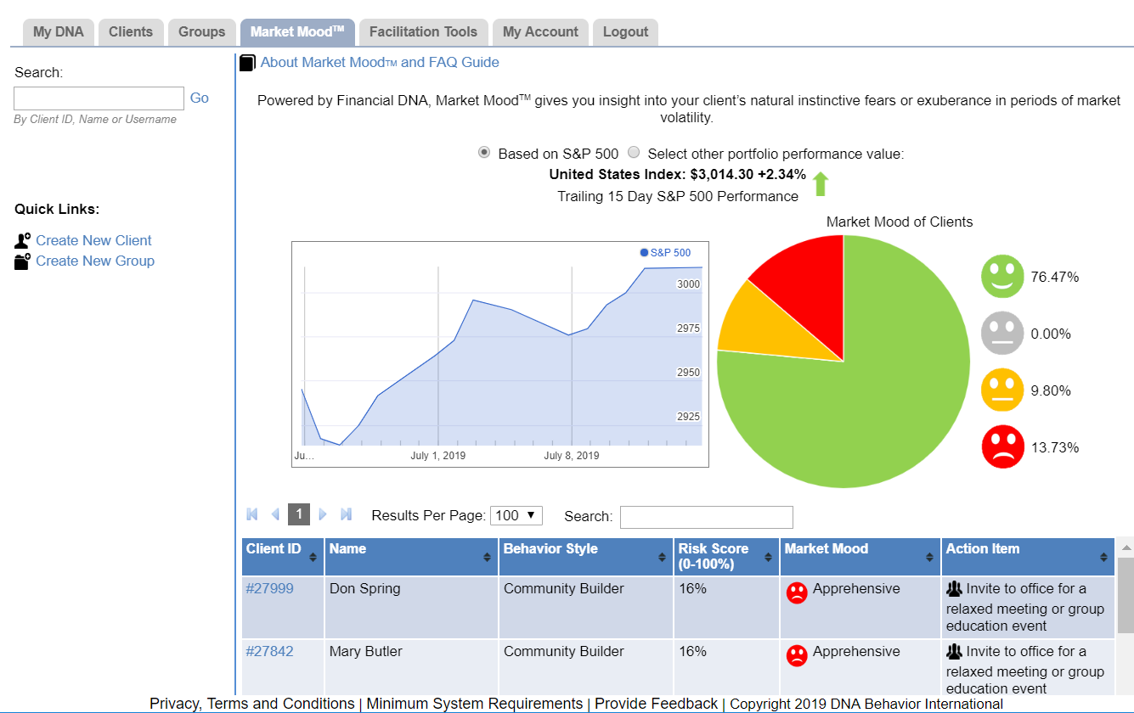
Market Mood
Notes:
Market Mood
S&P 500 or with our API, client portfolios
Risk, Behavioral Biases, CDNA

Slide 28
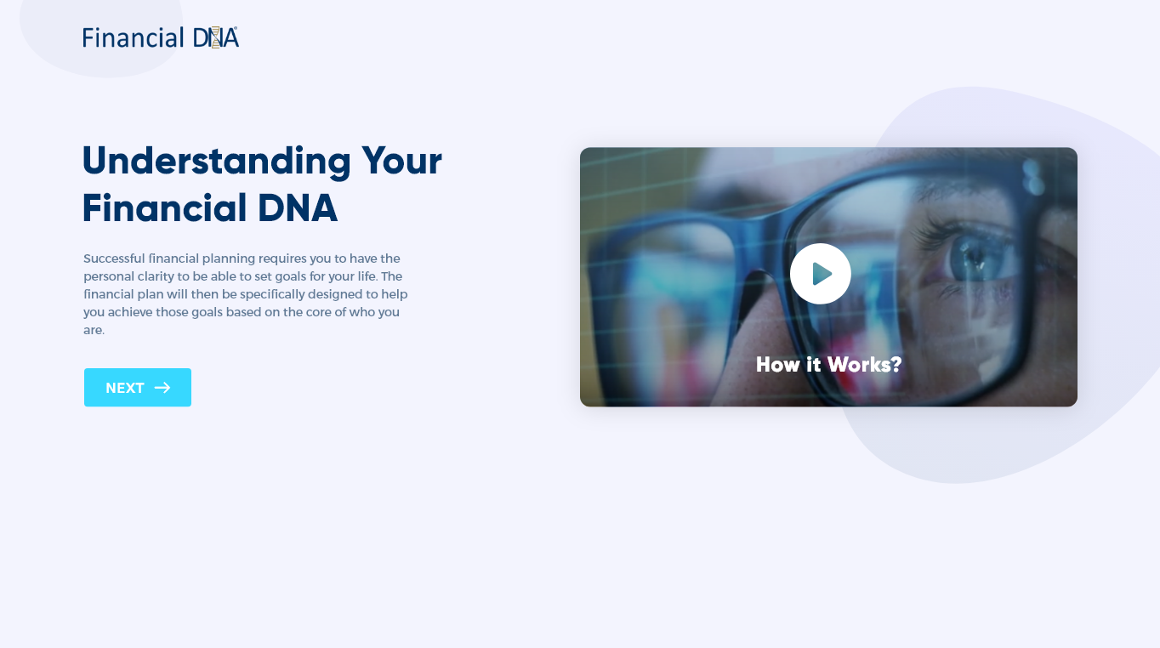
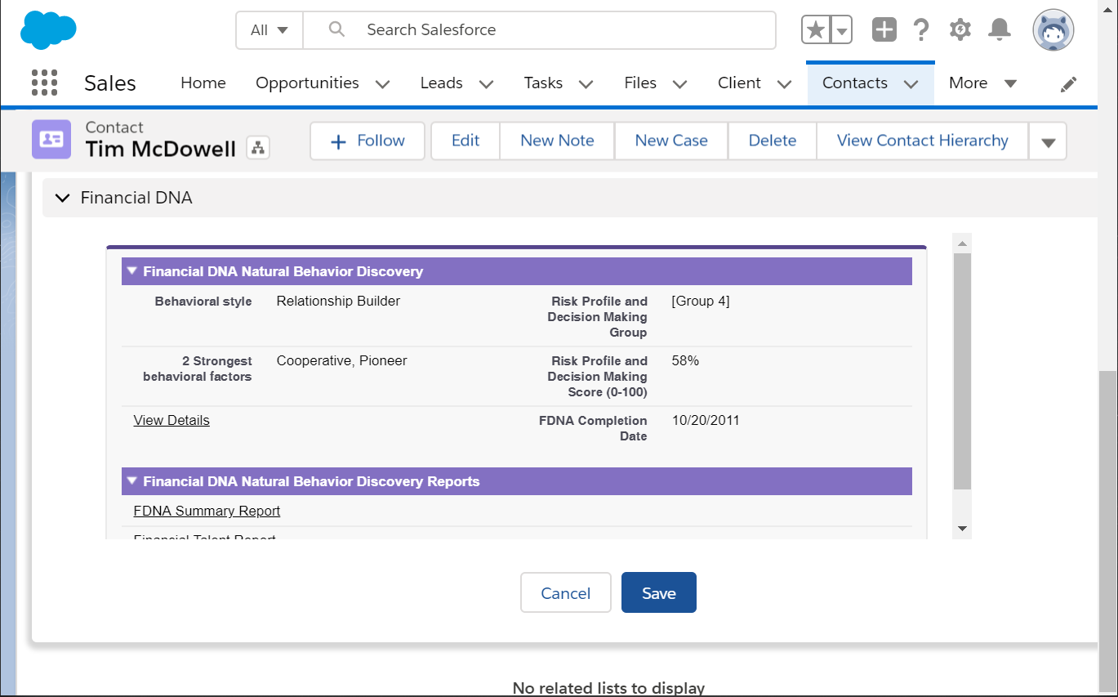
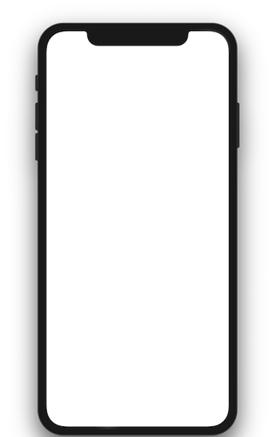
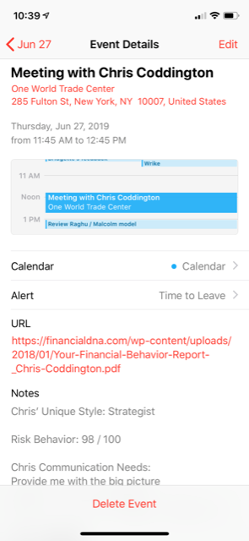
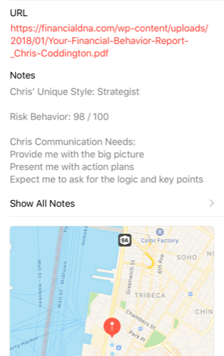
Behaviorally Smart On-Going Client View
Salesforce CRM
Advisor view:
Risk Behavior
Behavioral Biases (Based on Strongest Factors)
Communication Keys
Single Sign on to DNA Record
Client Report Access
Calendar Powered with Behavioral Insights
Compliance Reporting:
Know your client documentation
Reporting archives
Client to advisor mismatches
Individual over dominance in couples
Team reporting
Notes:
*Ryan*
FDNA integration with Salesforce:
Client details on advisor screen
Calendar integration
Suitability user report (clients risk / advisor risk)

Slide 29
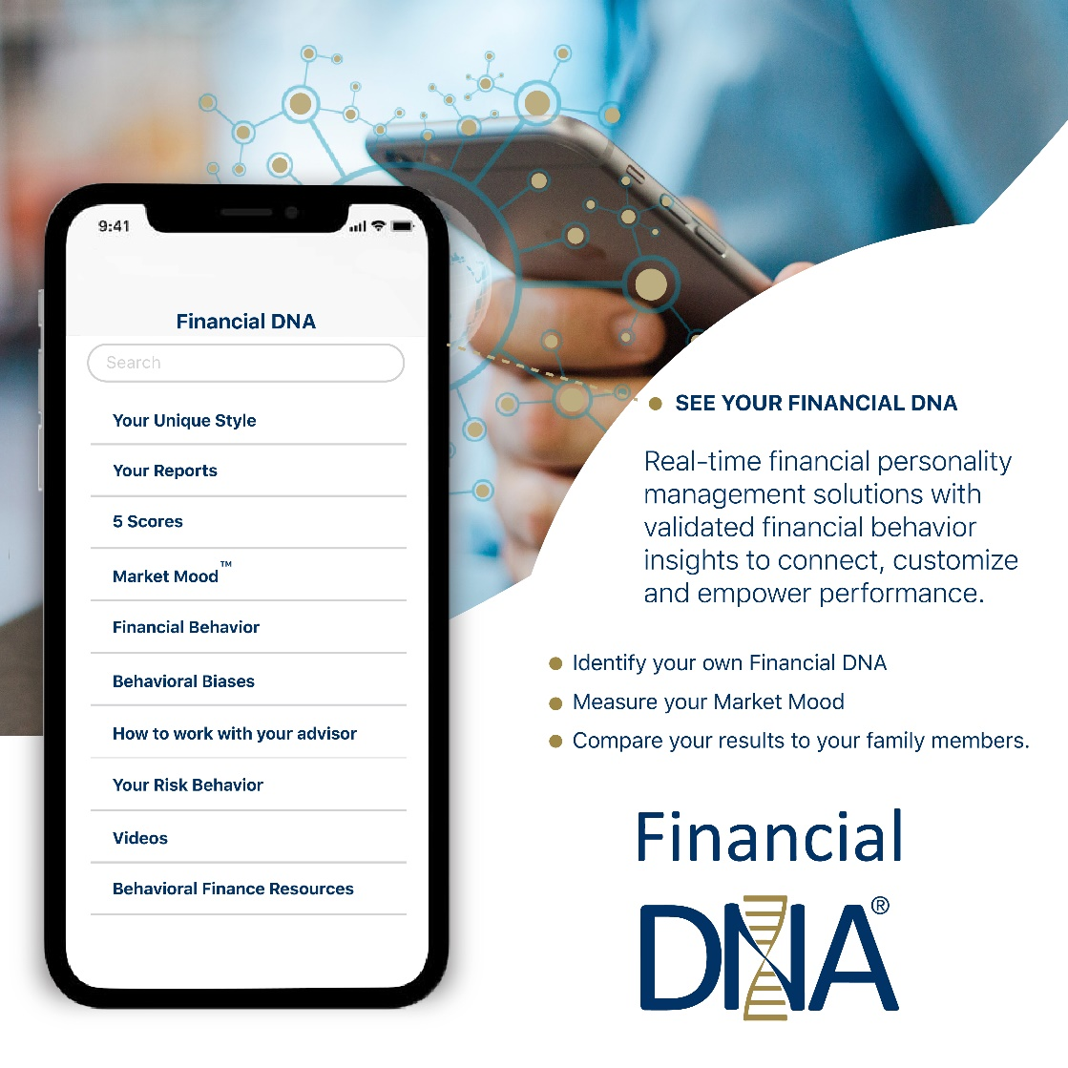
Measurable Benefits for Advisors
Value of Advice: 150 BPS from Behavioral Management
50x Advisor ROI return from referrals, retention and increased share of wallet
Increased Advice Fees
Maintained AUM from Intergenerational Wealth Transfers
Advisor Meeting Efficiencies

Slide 30
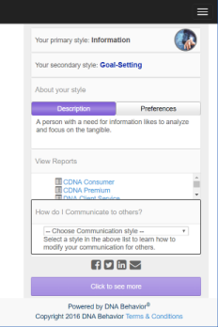
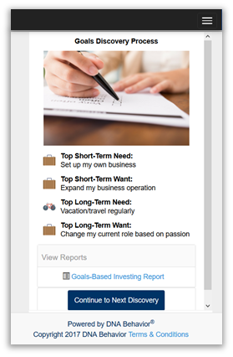
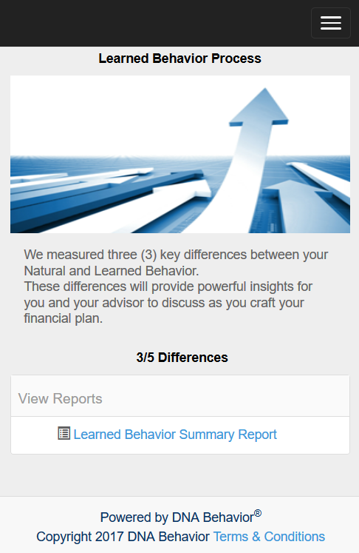
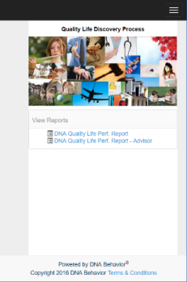
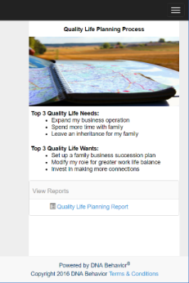
The Family of DNA Discovery Processes
Aligning the Risk Profile to Goals, Capacity, and Financial DNA
Communication | Natural Behavior | Goals-Based Planning
Learned Behavior | Quality Life Discovery | Quality Life Planning

Slide 31

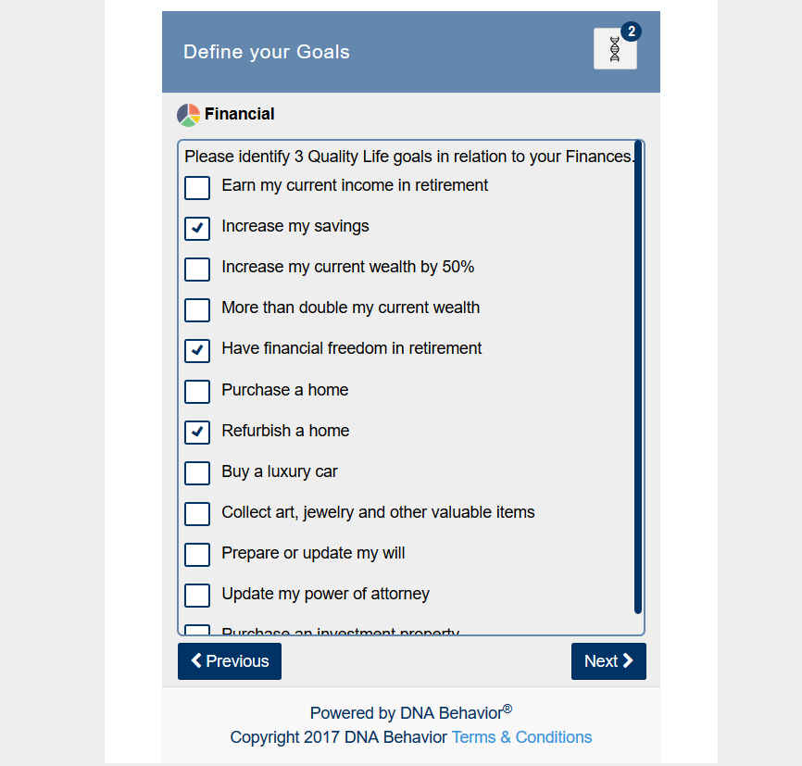
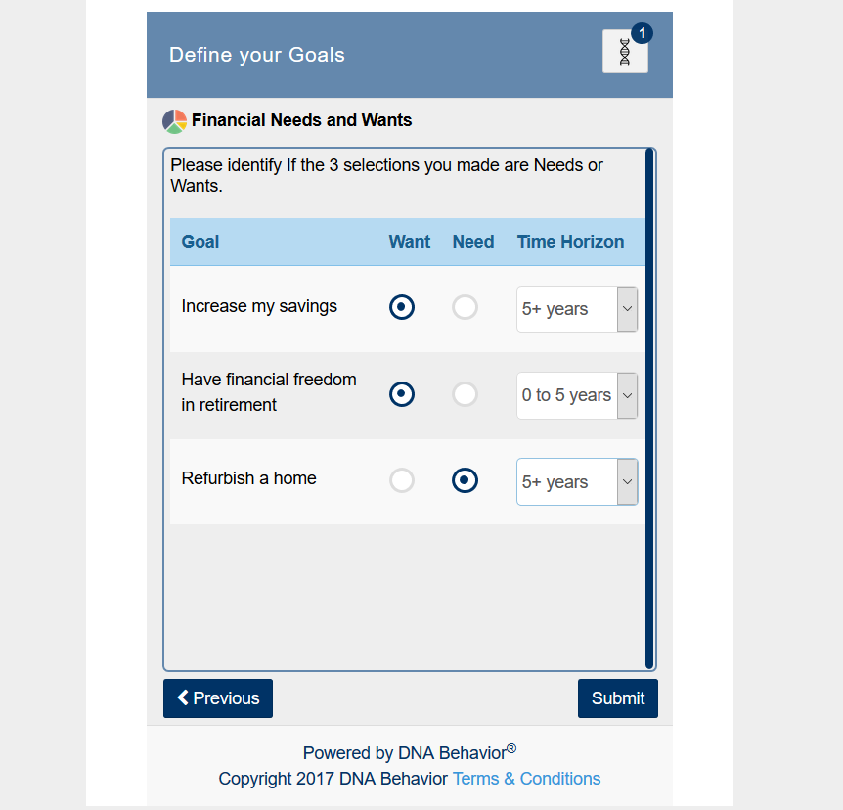





Financial DNA Goals Discovery
The Discovery Process
Career & Business
Recreation
Relationships
Community
Health
Financial
Completed on any device; Results in 10 Mins

Slide 32


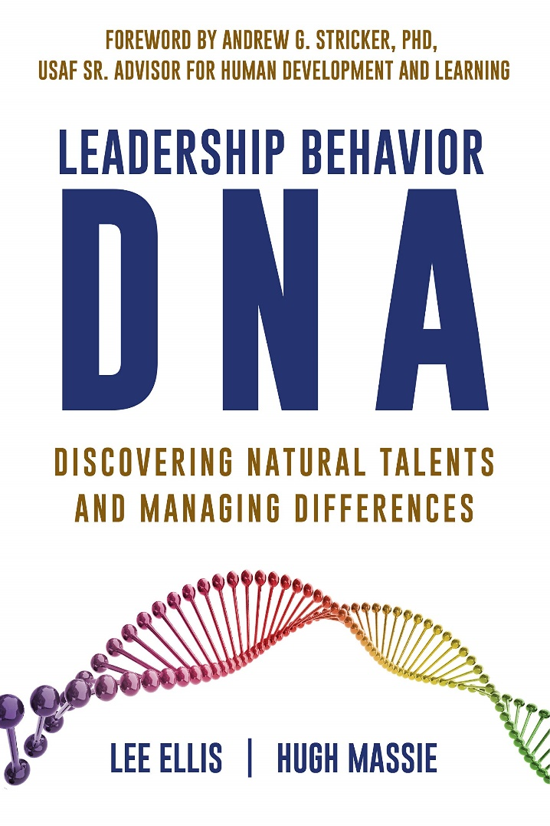
Hugh Massie, along with Lee Ellis literally wrote the book on discovering Natural Talents and Managing Differences.
Now available on Amazon.com
DNA Behavior
Unlocking the Science of Natural Behavior In Yourself and Others
dnabehavior.com

Slide 33
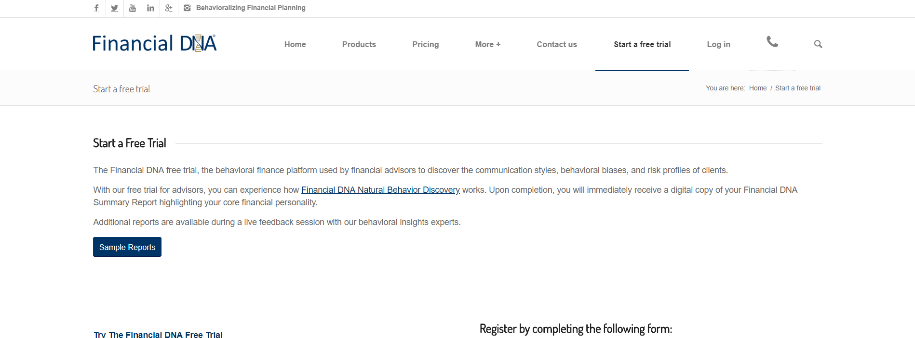
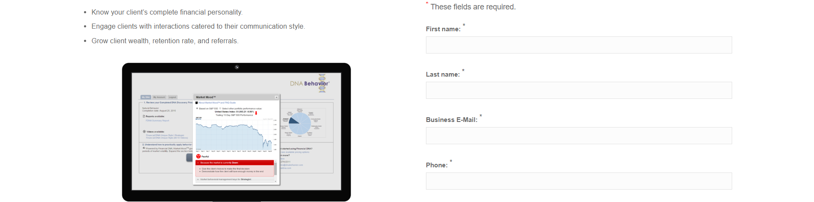
Think Twice Before You Wreck Yourself
Discover Your Financial DNA® -
Financial Personality
www.financialdna.com/start-a-free-trial

