Slide 1

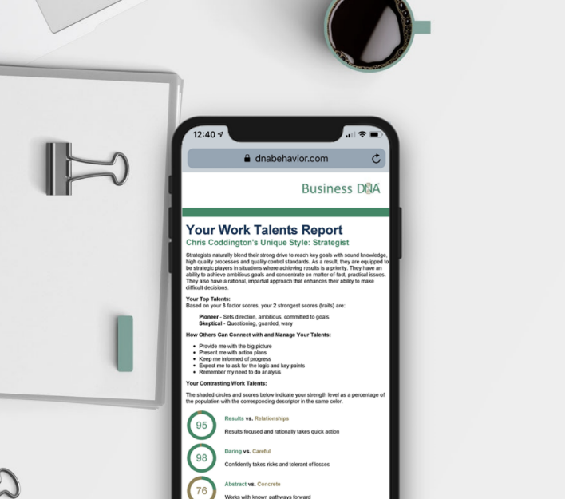




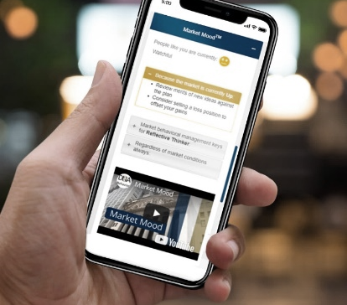

Behaviorally SMART™ Family Continuity
Closing the Relative Gap
Notes:
Primary Title Page
The presenter can change the images but must stick to brand guidelines: Images must encompass people, technology and behavior.
NOTE: Blank template is available in the master slides where the images can be swapped out.

Slide 2

What is the No 1 Hurdle for Families to Cross?
Navigating Behavioral Differences In Every Family Interaction
Money is the elephant in the room.
Is the discussion of money taboo in your family?
What are the money memory stories in your family?
Who feels completely understood in their family unit by parents, siblings, spouse and children?
Whose family has good communication?
Are there blockages to decision-making?

Slide 3
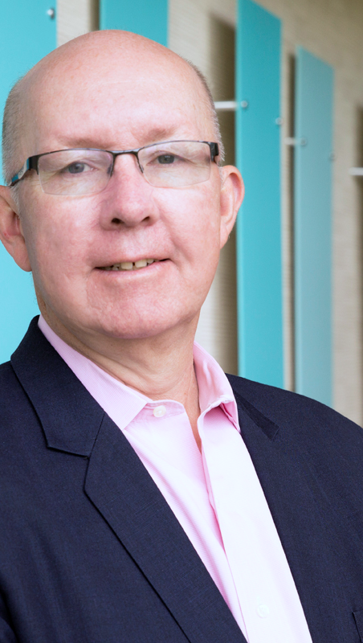
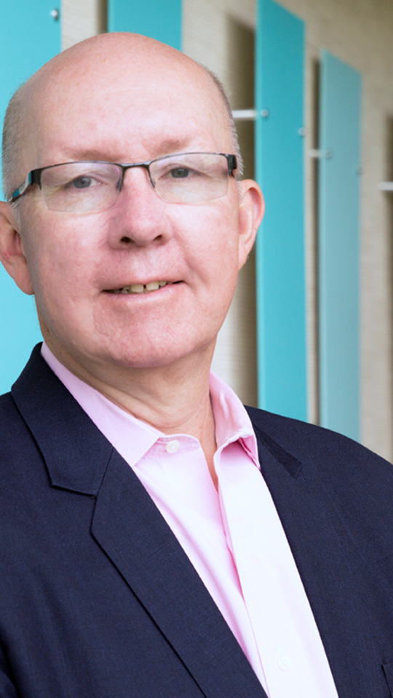
“
Hugh Massie
Hugh advocates 80% of family continuity success comes from managing family member differences and the emotional aspects of decision-making
Chairman and CEO of DNA Behavior International
Reformed Accountant
Behavioral Insights Pioneer
Business Strategist
Wealth Mentor
Author of Leadership Behavior DNA® and Financial DNA®

Slide 4
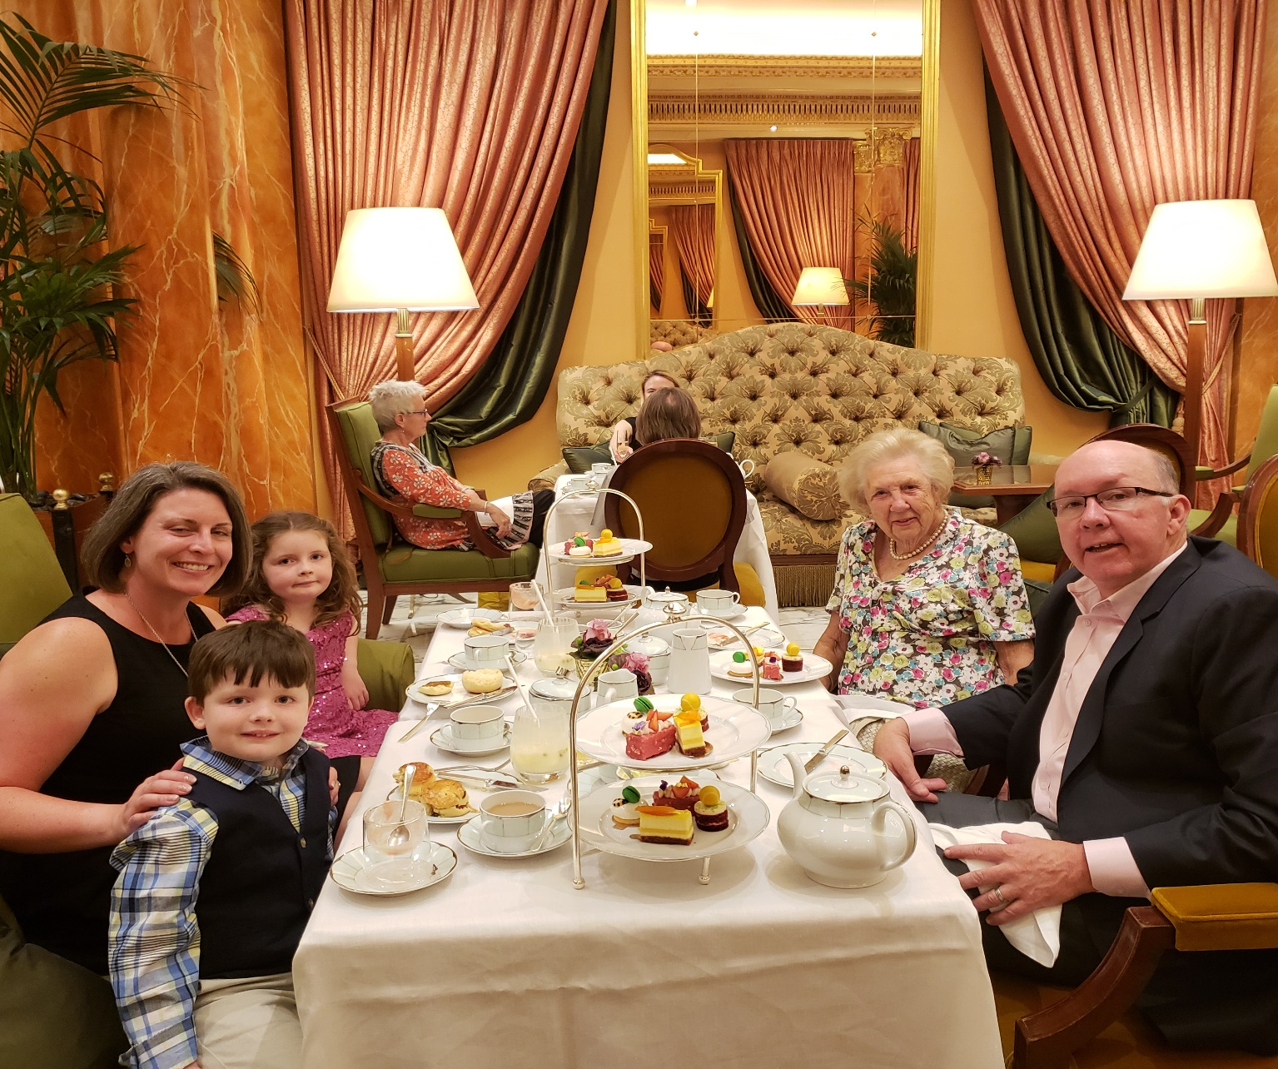
The Massie Family
Awareness Closing the Relative Gap

Slide 5
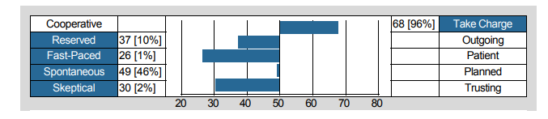
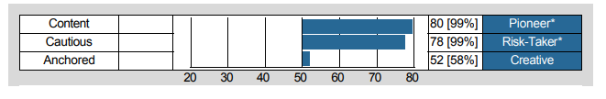
Hugh Massie’s DNA Hard Wiring
Results Driven Pioneer + Opportunist
Focused on Tasks and Results
Daring to Achieve Goals

Slide 6
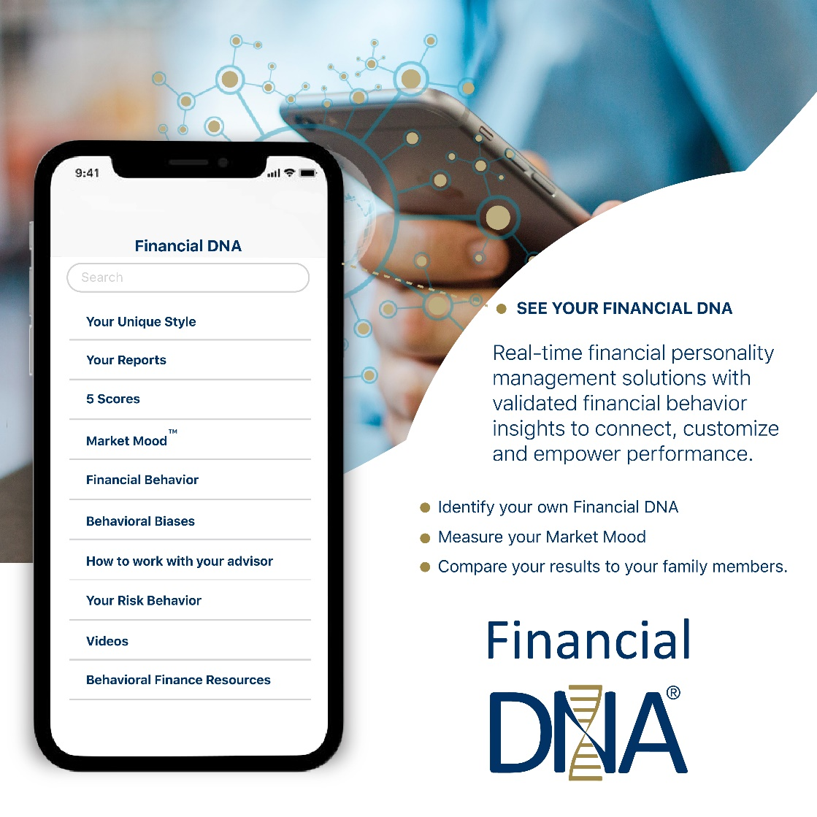

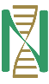
What DNA Behavior is as a Business
Delivering Customized Behavioral Experiences Since 2001
We deliver real-time behavioral management solutions through validated behavioral insights to connect, customize and power human performance.
The problem we solve:
De-railed performance due to intensified behaviors caused by unmanaged human differences, money attitudes, pressure and emotions.

Slide 7

Family Trust Strengthens Trusts Case Study

Slide 8

The Family Differences Proposition
Every family member has a different financial personality – Financial DNA Style.
This manifests itself in many different ways which cause us to perceive the same situation differently and have different expectations.
Therefore, for all people regardless of their age, wealth, culture, position or situation we believe behavior drives family relationships and money can get in the way of family relationships.

Slide 9

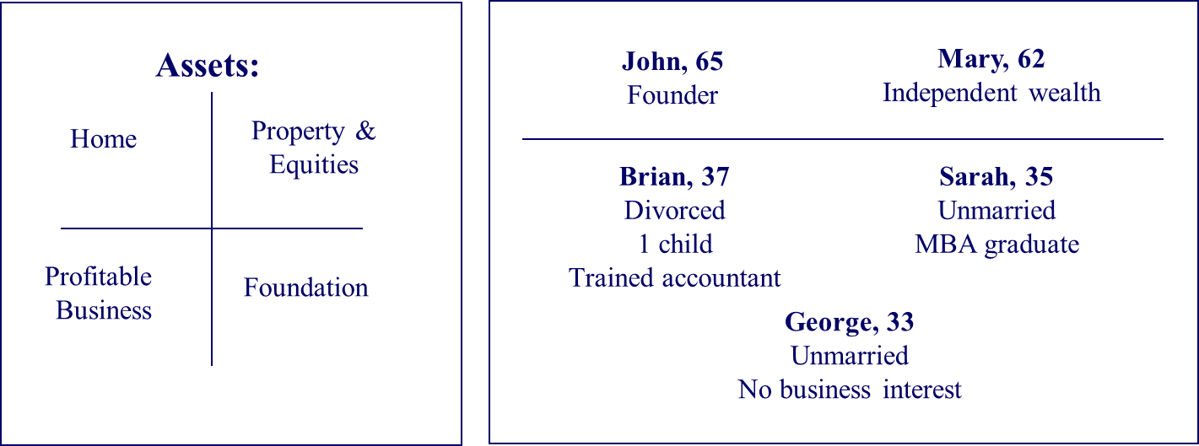
Facts: The Williams Family in Transition
Engaging them in Family Continuity Planning
The Family Status Quo:
Scenario: John wants to retire:
Framework to address transition:
John Williams has a harmonious family life defined by the 4 “E’s”:
Entertainment
Excitement
Entitlement
Expectation
Both parents want to distribute family wealth, possessions and responsibilities equitably.
Communicate their values.
Seek common ground in family unit purpose and mission.
Relationship continuity (the priority)
Values continuity (the priority)
Business continuity
Financial continuity
Philanthropic continuity

Slide 10

John Williams Working With The Advisory Team
Building a “Legal” Will
Wealth Transfer is Private
John is a businessman who in the past has treated the making of a will as a private financial and legal process.
The Traditional Rational Approach
John’s current estate plan reflects his personal wishes for what he believes is the equitable transfer of his financial wealth on passing.
John does not have confidence in how his family will react to his choices and does not have the trust to reveal them.
But John is not aware of the impact his will may have on family members.

Slide 11

John, What Do Your Children Think?
The Ideal: Build a Customized Family Continuity Plan
The Succession Reality
John’s children have to live with his choices and will have their own perceptions of their parents, family life and what their future should be.
Managing their emotions and expectations will be critical.
The Solution – Build a Family Continuity Plan:
Involve and educate family members in the Succession Planning Process in your life-time while recognizing different family emotions.
Family conversations will remove assumptions which are the big threat to Family Continuity

Slide 12
Building a Behaviorally SMART™ Family Continuity Process

Slide 13
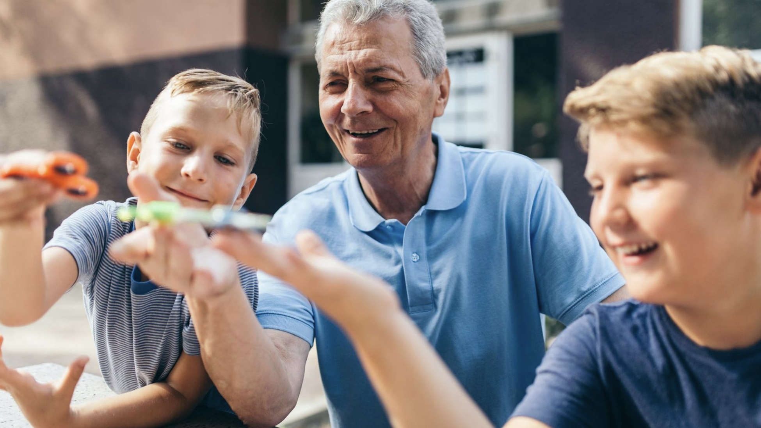
leading the family business
“
What is Family Continuity?
Building sustainable family relationships across
generations for:
living an improved family life
creating a legacy achieved with higher levels of confidence and personal commitment by having a greater understanding of your and those of family members and advisors.
building & preserving wealth

Slide 14

What Issues Get in the Way of Family Continuity? How Do They Get Managed?
Emotional
Lack of Purpose
Financial Mis-Alignment
Shame about wealth
Fear of not being good enough
Different capabilities
Spoiled children without direction
Family missing cohesive bond
Wills, structures and plans not aligned to different family members lives and needs
Lack of communication between generations

Slide 15

The Key Issues to be Addressed by Families
Preparing Heirs: The Independent Williams & Preisser Research Shows:
The transfer of wealth within families is an emotive issue.
60% of transition failures are caused by a breakdown of communication and trust in the family unit
25% of failures in family wealth transfer are caused by inadequately prepared heirs

Slide 16
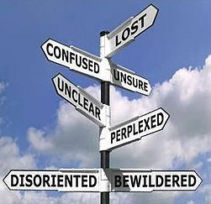
Unmanaged Emotions Destroy Wealth
How Are Your Family Members Managing Their Emotions?

Slide 17

The DNA Family Continuity Model
Starts With Objectively Understanding Differences
C O M M U N I C A T I O N S
ALIGN
UNDERSTANDING
ACCEPTANCE
RESPECT
TRUST
^{Family Continuity}
ALIGN
C O M M I T M E N T
Every Family Member Has a Unique
Financial Personality (Innate Behaviors
and Preferences – “Financial DNA” Style
Family Cohesion:
From Diversity to Unity to Family Continuity

Slide 18




DNA Behavioralizes Life & Money for Family Members
Leverage Natural Behavior Insights Across Your Family
Strong Family Culture
Sound Strategies
Behavioral Insights
(Talents, Communication, Biases, Beliefs, Values, Standards)
Intergenerational Family Continuity

Slide 19
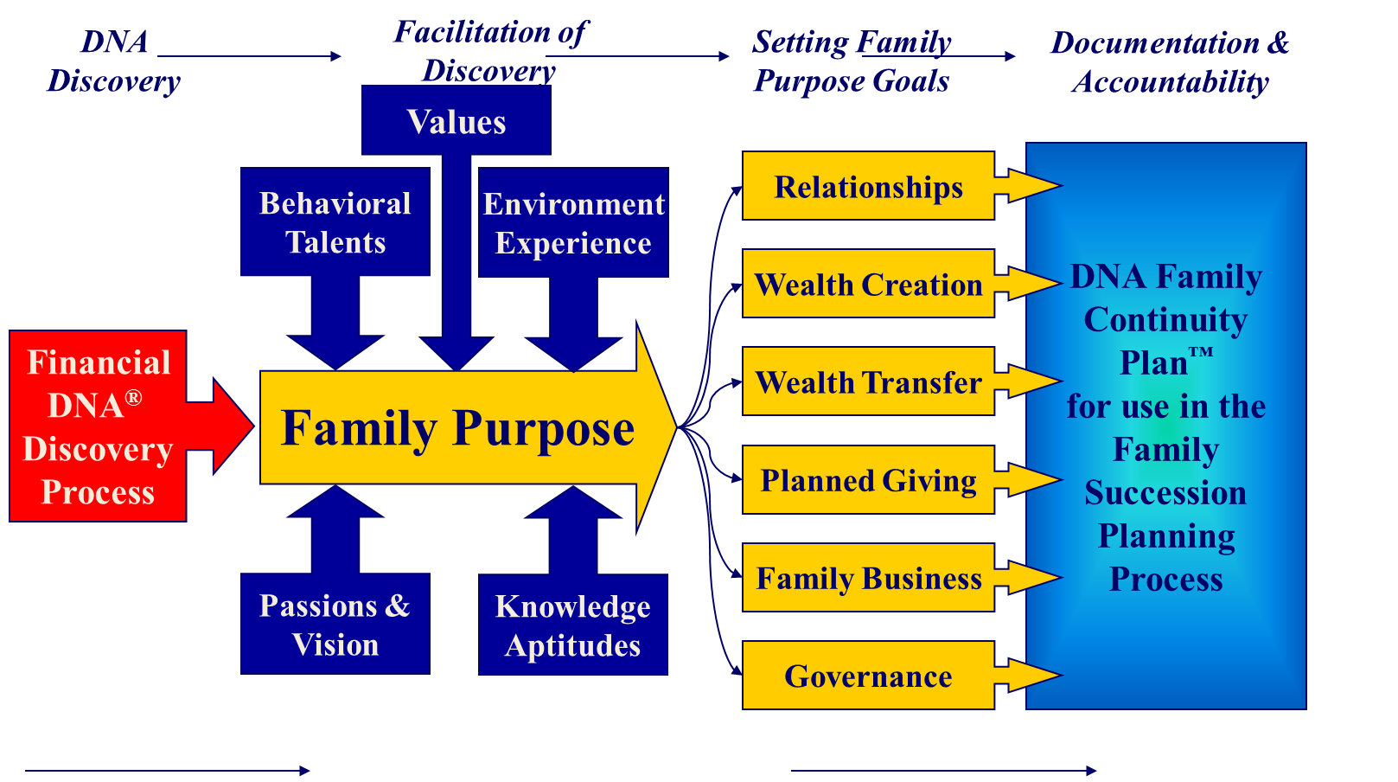
The DNA Continuity Planning Vision

Slide 20
Discovering Each Family Member’s Financial DNA - Financial Personality

Slide 21





Your Financial Personality Brain
The Drivers of Imperfect Decision-Making
95% Natural DNA Behavior (Level 1 – Instinctive, Automatic, Hard-wired)
5% Learned Behavior
(Level 2 – Conscious thinking based on experiences, values)
Cognitive Biases (Driven harder by Emotions)
Imperfect Decision-Making
Reading: Thinking, Fast and Slow Daniel Kahneman
Emotional Stimuli
(Fear, Anxiety, Greed, Excitement)
Triggered by Money and Relationships

Slide 22
Financial DNA® = Financial Personality
Multi-Dimensional Behavioral Discovery
01
Advisor & Family Member Communication
03
02
Financial
Personality
Risk Profile & Behavioral Biases
Goals &
Spending Patterns

Slide 23

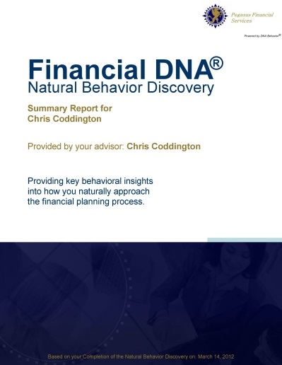

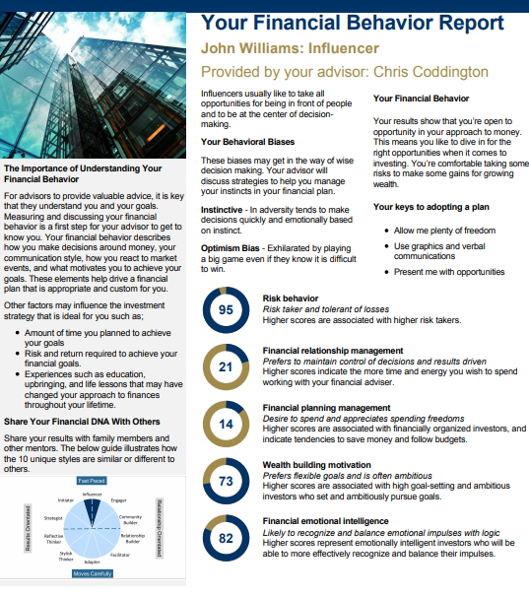
Financial DNA is Quicker & 91% More Reliable Method
FDNA Natural Behavior Discovery (10 to 12 Mins)
Completed by each individual
family member and advisor
To Predict Reactions to Market / Life Events
LEARNED SITUATIONAL BEHAVIOR
NATURAL BEHAVIOR
Automatic
Behavior Biases
Communication Style
Spending Patterns
Learning Style
Risk Taking & Loss Aversion
Decision-Making
Goal Motivations

Slide 24
Financial Behavior Report and
Online Dashboard Reporting
Immediate Online Feedback for Clients e.g. John Williams (Influencer)
DNA Unique Style: Engager
Behavioral Biases:
Herd Follower
Instinctive
Population Scoring:
High Score is >70%
Middle Range Score is between 30% and 70%
Low Score is <30%
DNA Unique Style: Engager
Behavioral Biases:
Herd Follower
Instinctive
High risk behavior
Low financial relationship management
Low financial planning management
High wealth building motivation
High financial emotional intelligence
Risk behavior
Financial relationship management
Financial planning management
Wealth building motivation
Financial emotional intelligence

Slide 25
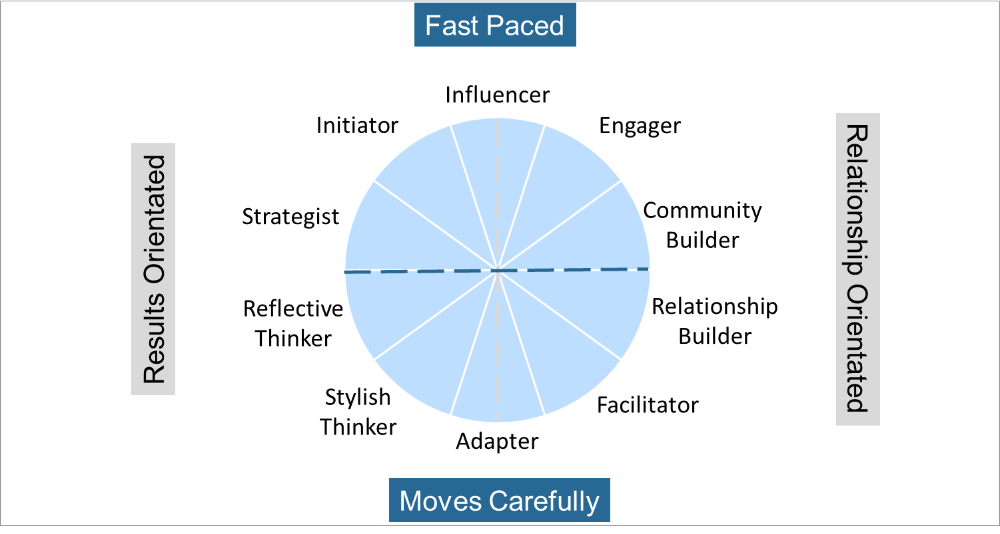
Overall Unique Decision-Making Style Summary
Connected to Natural Behavior
Risk Taker
Strategic Goal Setting
Growth Focused
High Impact
Spender Lifestyle
Balanced Life
Public Recognition
Saver/Discipline
Information
Fear of Not Enough
Accountability
Cautious/Security
Family Stability Guarantees
Tactical/Local

Slide 26
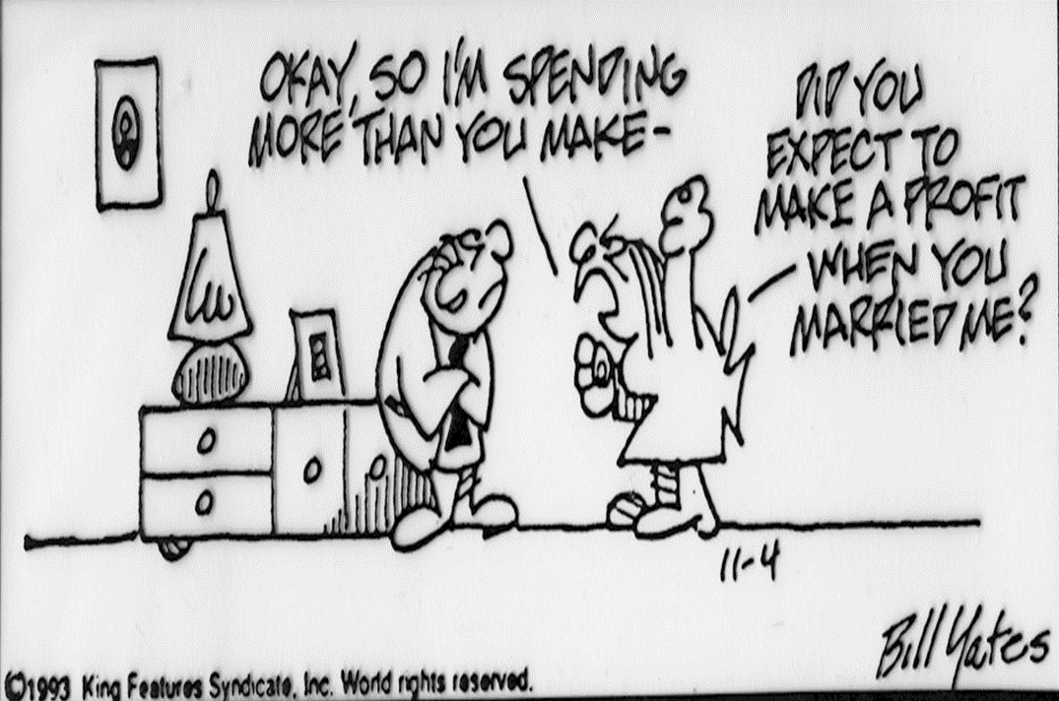
Different Behavioral Styles Drive Lack of Family Continuity
Every Family Member Has Different Expectations and Perceptions to be Managed

Slide 27
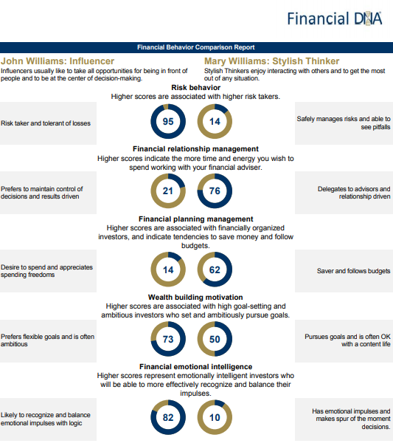
Navigate Couple Differences
John and Mary Williams Differences to Navigate
The main concern for Mary is the security of her family.
John will control decision-making, and Mary will delegate.
Mary is more fiscally responsible.
John could be very wealth creation driven and Mary will have a balanced life desire.
John will be a rational decision-maker and Mary more emotional

Slide 28

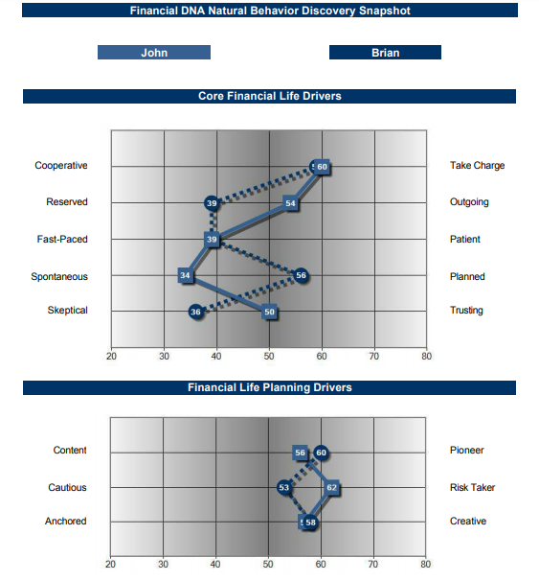
COMPARISON REPORT
John and Brian Williams

Slide 29
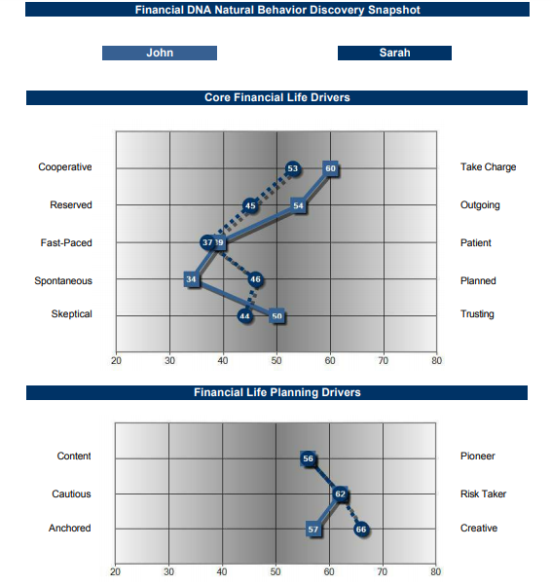
COMPARISON REPORT
John and Sarah Williams

Slide 30
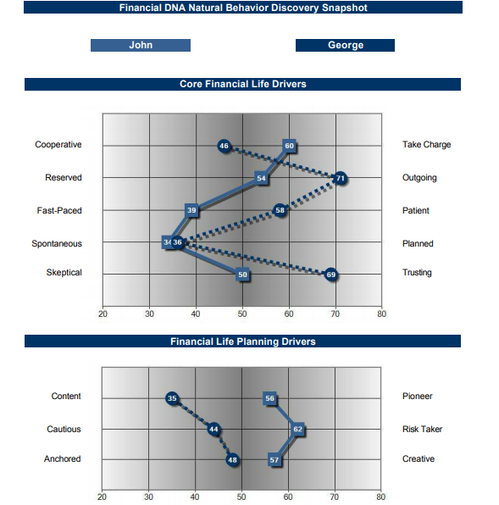
COMPARISON REPORT
John and George Williams

Slide 31
Navigating the Family Meeting to Make Decisions and Build the Continuity Plan

Slide 32
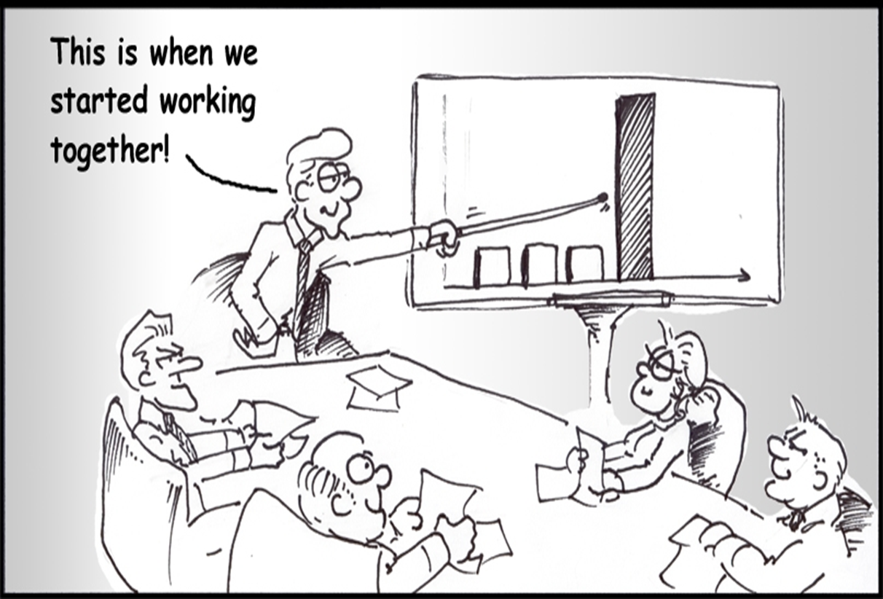
Greater Family Relationships
Lead to Greater Family Wealth

Slide 33
The Family Financial Behavior Proposition
Different Behavior and Money Attitudes Impact the Quality of Every Decision
Behavior
Money Attitudes
Decisions

Slide 34

How an Independent Facilitator Can Guide Your Family?
An Objective and Unbiased Approach
Provide human capital, life, financial and business insights for each family member
Recognize the interplay of passing on wealth, values, virtues and memories
Closing the generational gaps
Succession planning
Mentoring family members
Facilitating family purpose and mission
Family Governance Council and processes
Aligned fee model and manage advisory team biases

Slide 35




Customizing the Family Continuity Experience
How Do Family Members Wish To Be Communicated With?
Fast Paced
Vision
Openness
Option
Verbalize
Bottom Line
Broad Facts
Goal Setting
Discussion
Lifestyle
Graphics
Lifestyle
Results Orientated
Relationship Orientated
Analysis
Feelings
Facts
Feelings
Soft tone
Security
Instructions
Soft Tone
Transparent
Security
Information
Tangible
Stability
Instructions
Moves Carefully

Slide 36
Key Questions for the Family
What are your primary strengths and struggles for helping your family unit build a Quality Life together?
2. Identify the relationship dynamics between you and other family members. How would your strengths and struggles impact each other?
3. Based on your behavioral style, how will you adapt your communication with the other family members?
4. Based on their strengths and struggles, what do you think their decision-making pattern is likely to be?
5. How will your decision-making pattern differ to theirs?

Slide 37
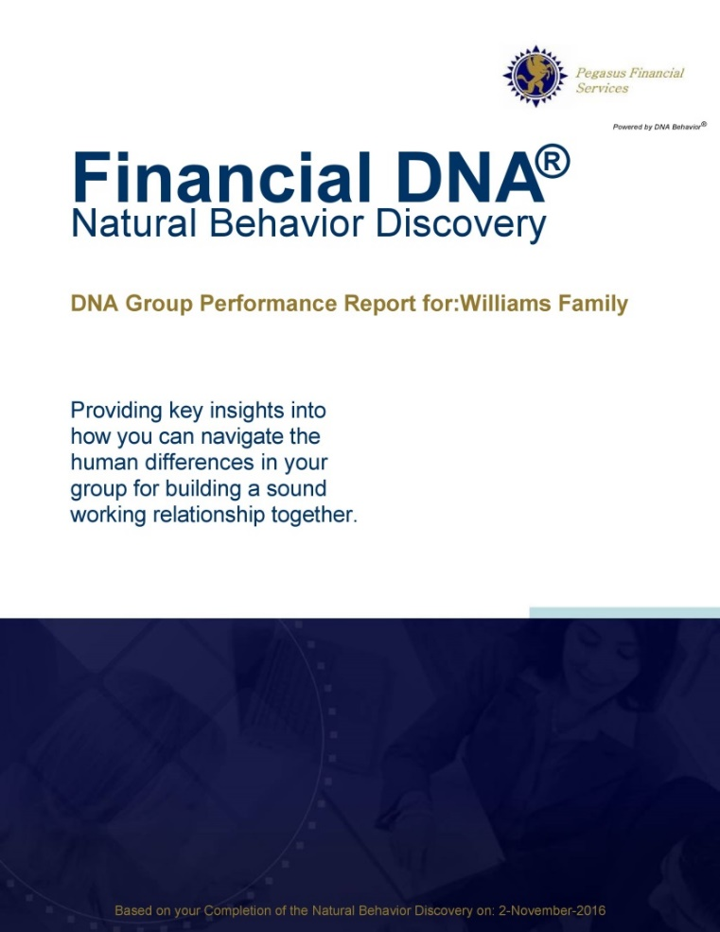
Financial DNA Group Report
Objectively Understanding Family Differences and Aligning the Advisory Team
Every family member participates in FDNA Discovery and is equally involved
The conversation is about “them” and not directly their money
Behavioral strengths and struggles identified for tailoring a sustainable continuity plan
Increases engagement of the wealth inheritors/next generation
Advisory team matching for customizing experiences

Slide 38


Relationships
Results
Father
John
Fast Paced
Moves Carefully
Daughter
Sarah
Son 1
Brian
Son 2 George
Mother
Mary
The Williams Family
Notes:
Measure behavior of each person
10 style groups for plotting: 4 quadrants
Detailed View in the Appendix – give you slides

Slide 39


Relationships
Results
Father
Fast Paced
Moves Carefully
Daughter
Advisor 1
Son 1
Son 2
Mother
The Williams Family + Advisors
Notes:
Measure behavior of each person
10 style groups for plotting: 4 quadrants
Detailed View in the Appendix – give you slides

Slide 40
Resolution: Family Continuity Plan
Wealth Transfer
Assets
Management
Equity split 3 ways
Profitable Business
Control given to Sarah
Equity split 3 ways
Property & Equities
Control given to Brian
Family Foundation
Control given to George
Mother, Mary
Home

Slide 41
Relationships
Results
Fast Paced
Moves Carefully
Elizabeth
Tom
Christina
Kathy
Eric
The Jones Family
Notes:
Measure behavior of each person
10 style groups for plotting: 4 quadrants
Detailed View in the Appendix – give you slides

Slide 42
Relationships
Results
Fast Paced
Moves Carefully
Son 1
Son 2 Wife
Matriarch
Mother
The Coddington Family
Notes:
Measure behavior of each person
10 style groups for plotting: 4 quadrants
Detailed View in the Appendix – give you slides

Slide 43
Relationships
Results
Fast Paced
Moves Carefully
Brother 1
Sister 1
Brother 2 Wife
The Carlisle Family
Notes:
Measure behavior of each person
10 style groups for plotting: 4 quadrants
Detailed View in the Appendix – give you slides

Slide 44
Relationships
Results
Fast Paced
Moves Carefully
Patriarch
Son 1
The Fish Family
Notes:
Measure behavior of each person
10 style groups for plotting: 4 quadrants
Detailed View in the Appendix – give you slides

Slide 45


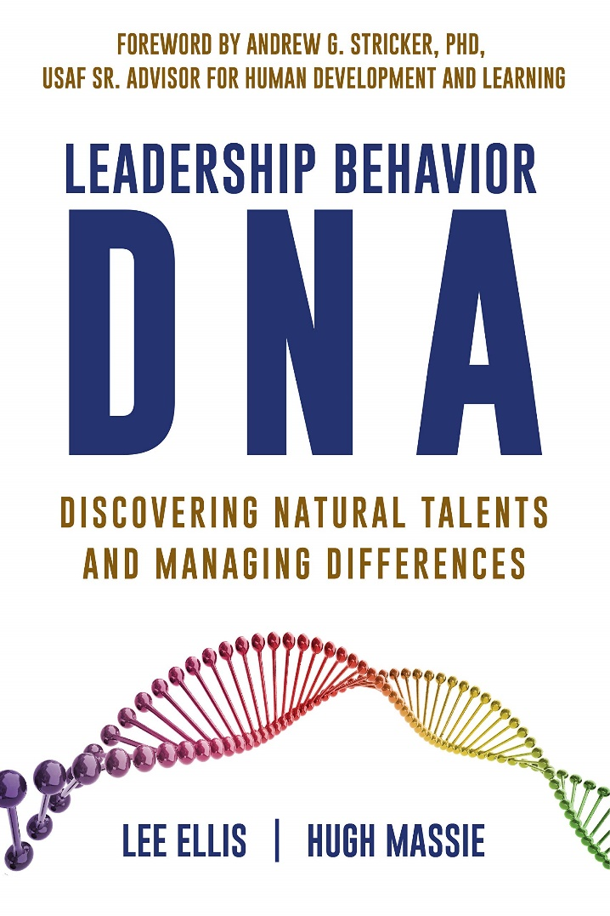
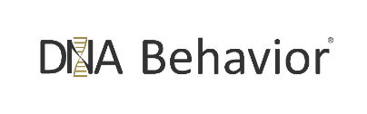
Hugh Massie, along with Lee Ellis literally wrote the book on discovering Natural Talents and Managing Differences.
Now available on Amazon.com
DNA Behavior
Unlocking the Science of Natural Behavior In Yourself and Others
dnabehavior.com

Slide 46
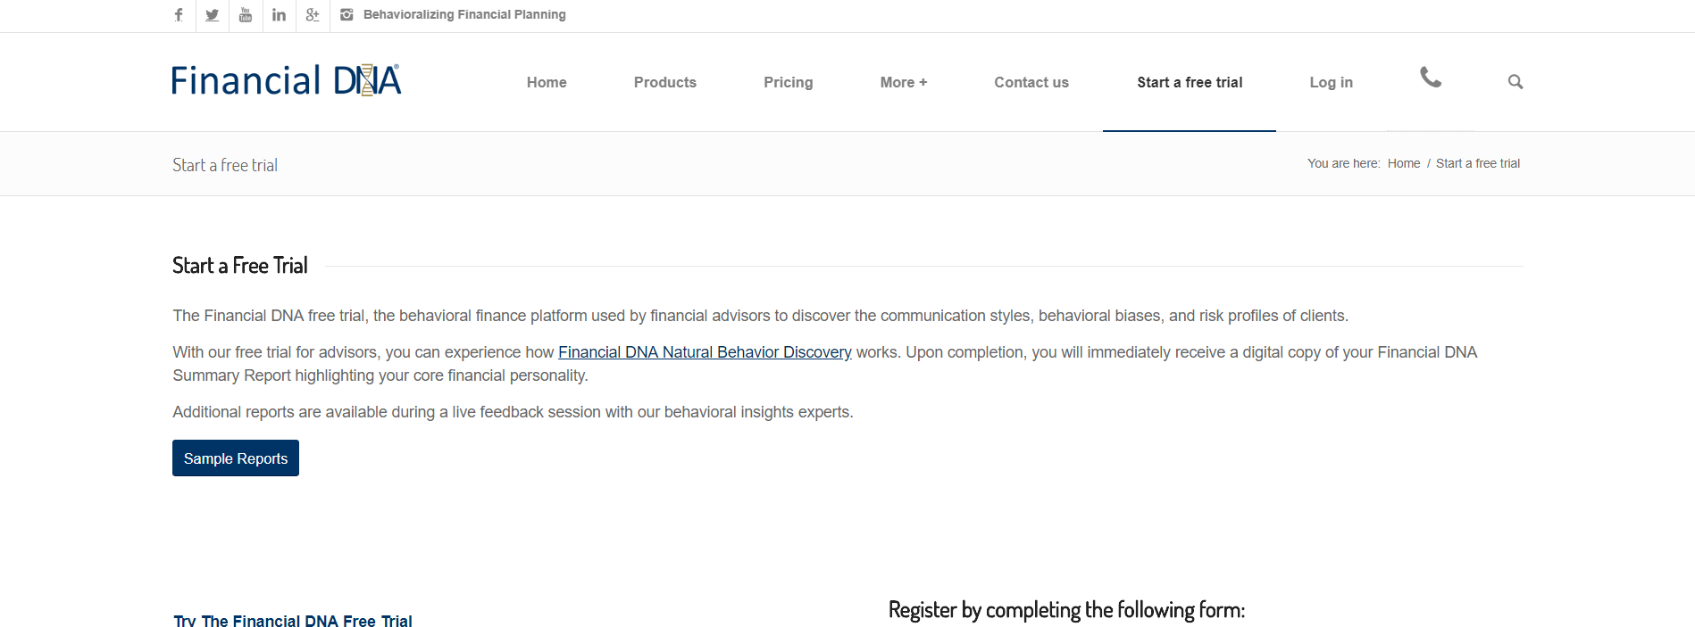
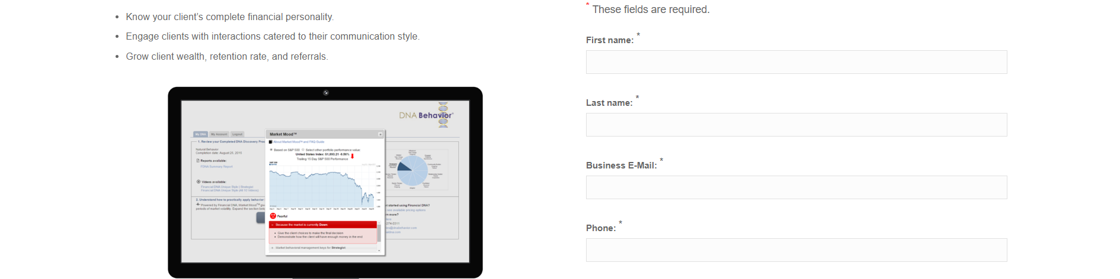
Think Twice Before You Wreck Yourself
Discover Your Financial DNA® -
Financial Personality
www.financialdna.com/start-a-free-trial

Slide 47



Contact Us
For more information about Financial DNA:
Contact:
DNA Behavior
5901 Peachtree Road
Suite 115
Atlanta, GA 30326
1-866-791 8992
inquiries@dnabehavior.com
www.dnabehavior.com
www.financialdna.com
Follow us on LinkedIn:
Financial Personality Insights
and/or Financial DNA on Twitter
Purchase Leadership Behavior DNA on Amazon.com
Read our blogs on the latest trends
and solutions at http://blog.dnabehavior.com/

