Slide 1



Hugh Massie
Hugh advocates 80% of human performance comes from living your identity, managing human differences and recognizing the emotional impulses of decision-making
Reformed Accountant who has become an Identity Trailblazer
Chairman and Founder of DNA Behavior International
The Behavior and Money Insights Company

Slide 2

Behaviorally SMART Business Decisions
Leveraging Financial Behavior Insights for Responsible Decision-Making
Notes:
Case Studies: Digital Advice & Intergenerational Wealth Transfer
Organizational Transformation
Big Data

Slide 3

A Hugh Massie Moment In Business Decision-Making
Understanding People Before Numbers

Slide 4
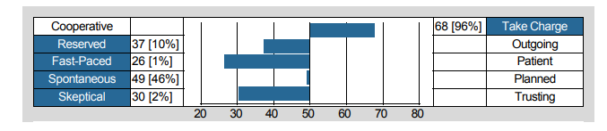
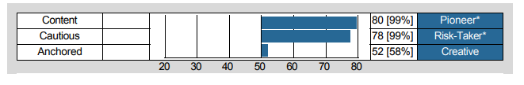
Hugh Massie’s Leadership Behavior DNA Mapping
Identity Trailblazer and Behavioral Finance Insights Pioneer
Reflective on Opportunities
Converts Vision to Reality
Initiates Quick Action
Discerning Approach
Pursues Competitive Goals
Bold Decision-Maker

Slide 5
Hugh Massie’s Financial Behavior Mapping
Identity Trailblazer and Behavioral Finance Insights Pioneer
Takes a Consolidated View
Over Trading Bias
Financially Practical
Optimism Bias
Over Confidence Bias

Slide 6

Leadership Is Critical
Choosing the Wrong People to Lead is the No 1 Risk for Businesses – Warren Buffet, 2021

Slide 7

“Five Table Stakes” Requirements for All Leaders
How Do These Attributes Get Played Out in Responsible Decision-Making When Money Is Involved?
Courage
Confidence
Character
Connection
Collaboration

Slide 8
The 3 Primary Forces Destroying Business Decisions
Behavioral Triggers at the Epicenter of Every Business Decision and Problem
Behavioral Blind-Spots
Mis-Guided Identity
Mis-Understood Differences
Mis-Managed Financial Behavior
Notes:
Differences need to be understood so people feel understood, accepted and respected
Emotions are the devil of returns and relationships
Misguided talents lead to cancers and lack of productivity

Slide 9
Mastering the Energy of Money
Behavior and Money are Completely Inter-Connected Impacting Every Decision and the Flow of Money Reflects Behavioral Styles
Behavioral Biases
Intensified Behavior
Money Attitudes

Slide 10

Leader Decision-Making:
Discovering Your Identity and Financial Behavior Style – Financial DNA®

Slide 11

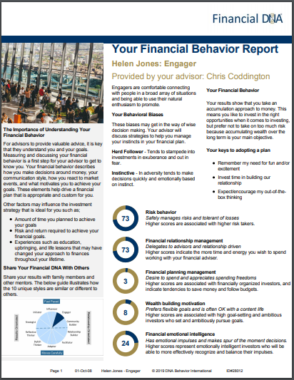

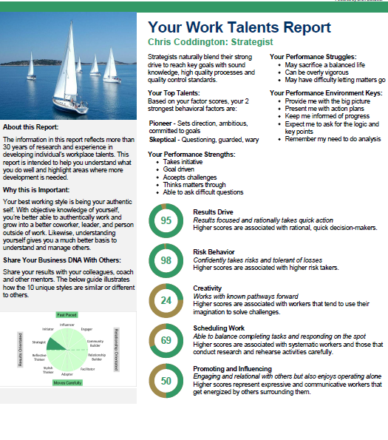

DNA Behavior is Quicker & 91% More Reliable Method
DNA Natural Behavior Discovery (10 to 12 Mins)
Completed by each individual
Universally Applicable Insights
LEARNED SITUATIONAL BEHAVIOR
NATURAL BEHAVIOR
Automatic
Behavior Biases
Communication Style
Talents
Learning Style
Leadership Style
Decision-Making
Risk-Taking

Slide 12
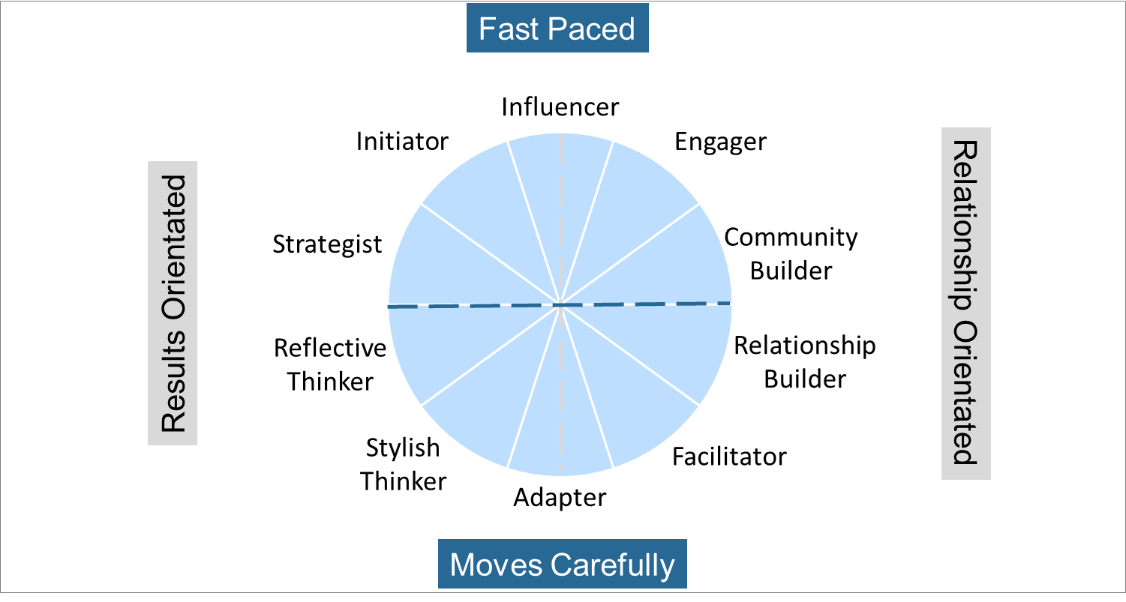
Overall Unique Decision-Making Style Summary
10 Unique Decision-Making Styles Connected to Natural Behavior
Risk Taker
Strategic Goal Setting
Growth Focused
Over Extends
Spender/Low Fiscal Control
Public Recognition
Shiny Object Syndrome
Over Innovates
Saver/Disciplined
Paralysis by Analysis
High Information Need
Fear of Not Enough
Not Intuitive
Cautious/Security
Business Stability
Holds on Too Long
Seeks Guarantees
Tactical/Local

Slide 13
Evaluating Opportunity Risk using Prospect Theory
Are the gains more than 2X++ the risk-adjusted loss potential?
Prospect Theory: Losses valued 2X++ vs gain
Buy
Expand or Invest
Leverage
Sell

Slide 14
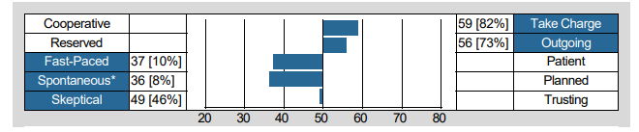
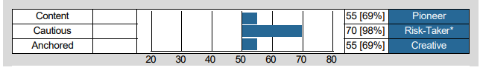
Mike Tudor’s DNA Behavior Mapping –
Expanding A Business Unit
Influencer – Sports Car Innovator
Follows Herd
Over Trades
Over Spends
Instinctive
Risk behavior
Financial relationship management
Financial planning management
Wealth building motivation
Financial emotional intelligence
Risk behavior
Financial relationship management
Financial planning management
Wealth building motivation
Financial emotional intelligence
Over Confidence Bias

Slide 15
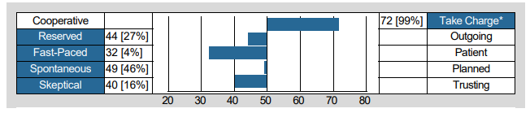
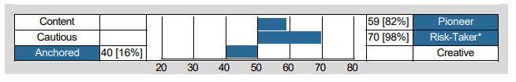
Jack Sun’s DNA Behavior Mapping –
Buying A Business
Initiator – Building Hospitality Experiences
Consolidated View
Over Trades
Risk behavior
Financial relationship management
Financial planning management
Wealth building motivation
Financial emotional intelligence
Risk behavior
Financial relationship management
Financial planning management
Wealth building motivation
Financial emotional intelligence
Optimism Bias
Over Confidence
Benchmark Bias

Slide 16
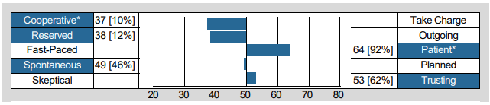

Craig Moon’s DNA Behavior Mapping –
Business Restructure
Relationship Builder – Designer of Innovative Accounting Software
Fear of Regret
Loss Aversion
Risk behavior
Financial relationship management
Financial planning management
Wealth building motivation
Financial emotional intelligence
Risk behavior
Financial relationship management
Financial planning management
Wealth building motivation
Financial emotional intelligence
Risk Averse
Newness Bias

Slide 17

Managing Differences
Financial Behavior Influence on Group Decision-Making

Slide 18
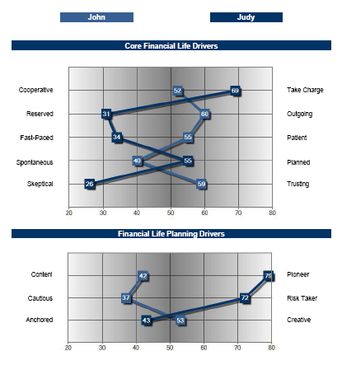
Business Partners Taking On Expansion Capital
Comparison of John Jameson (Community Builder) and Judy Rankin (Strategist)
DNA Unique Style: Engager
Behavioral Biases:
Herd Follower
Instinctive
John:
Stability
Cautious
Relationship driven
Connective
Expansion Fear
Judy:
Goal drive
Risk taker
Results driven
Reflective
Pro Expansion
Risk behavior
Financial relationship management
Financial planning management
Wealth building motivation
Financial emotional intelligence
Risk behavior
Financial relationship management
Financial planning management
Wealth building motivation
Financial emotional intelligence

Slide 19


Relationships
Results
High Business Growth
High Bold Decisions
High Financial
Management
Chris –
Leader
Mike
Helen/
Jenny
Peter
The Coddington Team
Notes:
Measure behavior of each person
10 style groups for plotting: 4 quadrants
Detailed View in the Appendix – give you slides

Slide 20
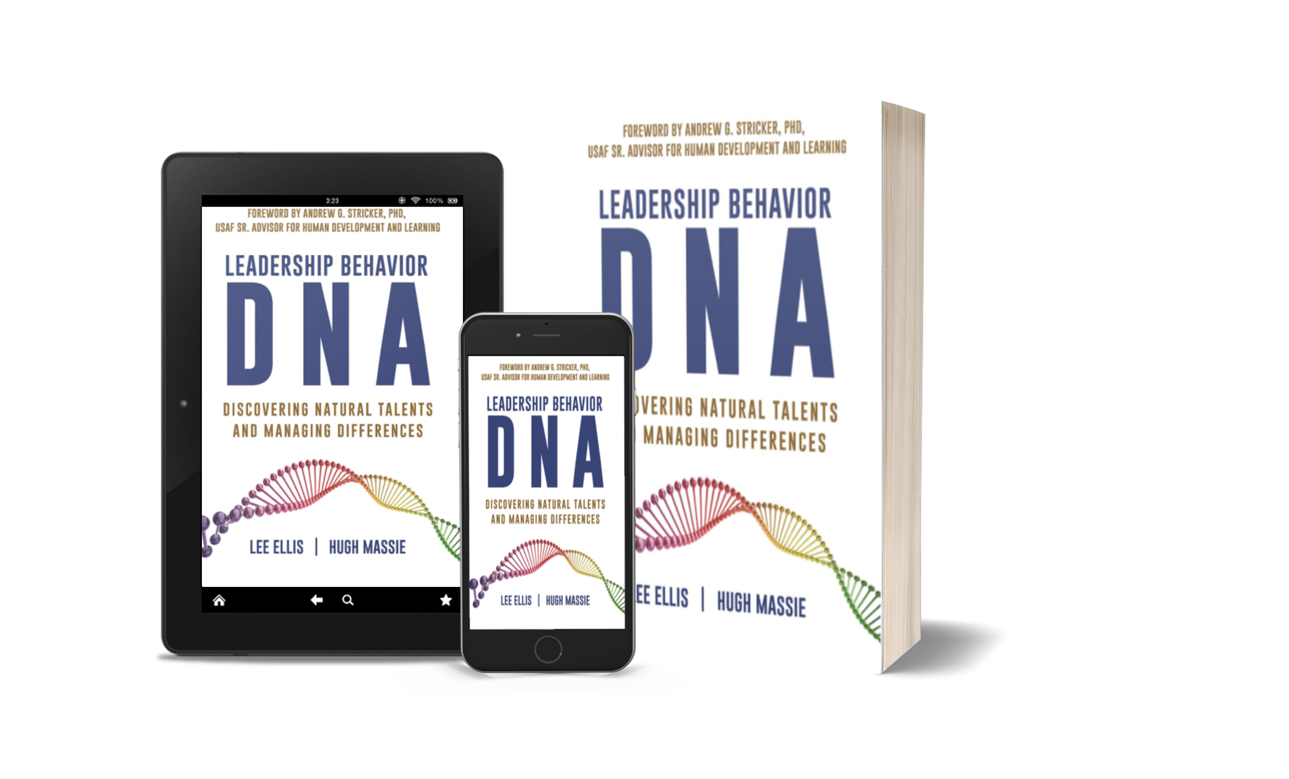


DNA Behavior – Contact Us
3372 Peachtree Rd, Suite 115
Atlanta GA 30326
Tel: 1866 791 8992
Inquiries@dnabehavior.com
www.dnabehavior.com
Now available on Amazon.com
dnabehavior.com

Slide 21
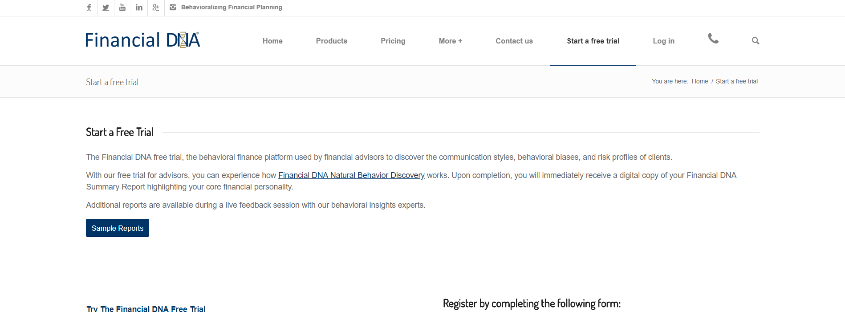
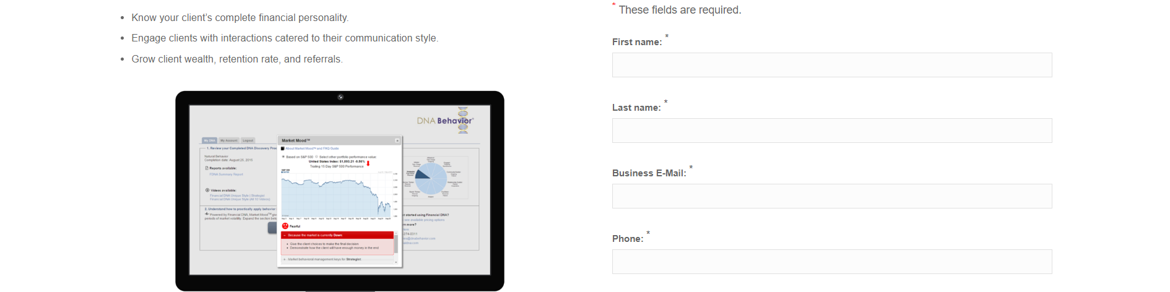
Think Twice Before You Wreck Yourself
Discover Your Financial DNA® -
Financial Personality
www.financialdna.com/start-a-free-trial

