Slide 1
Behaviorally SMART Marketing
Increasing Engagement with Communication DNA Insights

Slide 2
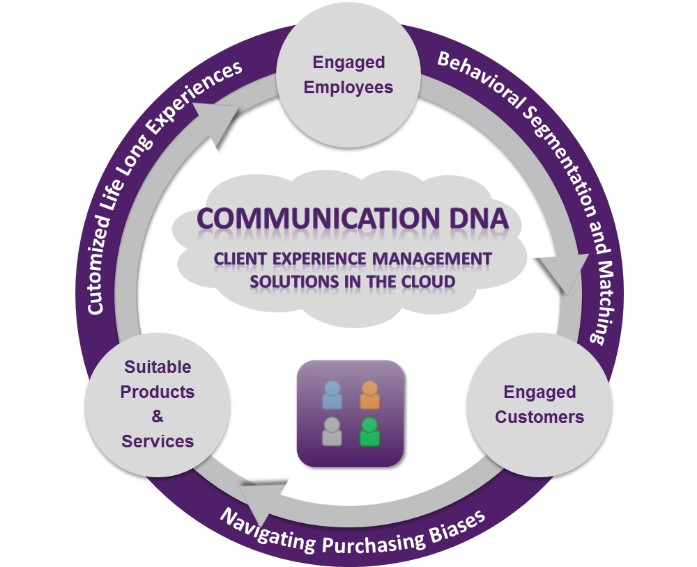
Communication DNA® Delivering Communication Insights
“Behavioralizing” Marketing and Sales
Know, Engage and Grow Every Client using our MarketingTech Platform.
Since 2001, we have been delivering unique communication insights for marketing and sales teams to be Behaviorally SMART™ so they can deliver customized life long experiences to every client and customer.
Behaviorally matching sales teams to clients and solutions is a proven way to build a client-centered business which out-performs.

Slide 3
Today’s Webinar
Objectives
Learn how sound communication helps to close the “Relationship Gap” to build meaningful client and team relationships
Know your Communication DNA Style using the Communication DNA Reports
Understand how to adapt your communication for different people
Learn how to introduce Communication DNA to clients for increasing engagement

Slide 4
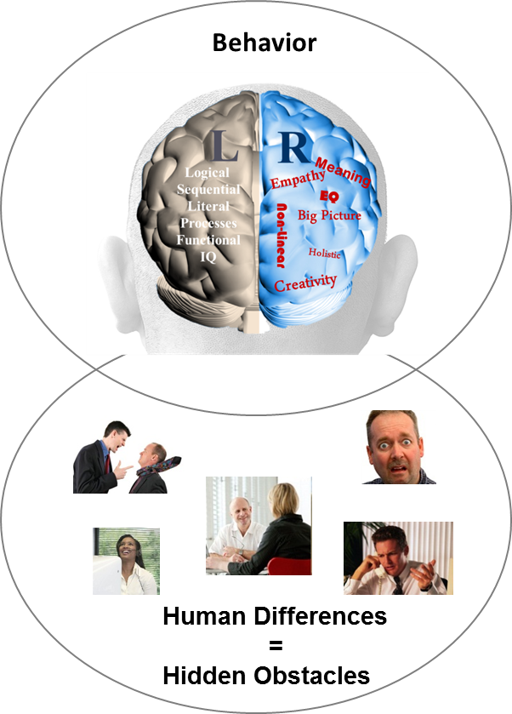
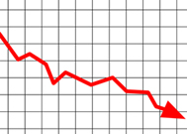
The Need to Reveal and Manage Hidden Communication Gaps
Behavior Causes Engagement Challenges
Sales Conversion
?
Client Engagement
?
Sales Team Productivity
?
Operational Execution
?
87% of
measurable business issues are communication related
Business
Performance
Source: Harvard Business Review 2002

Slide 5
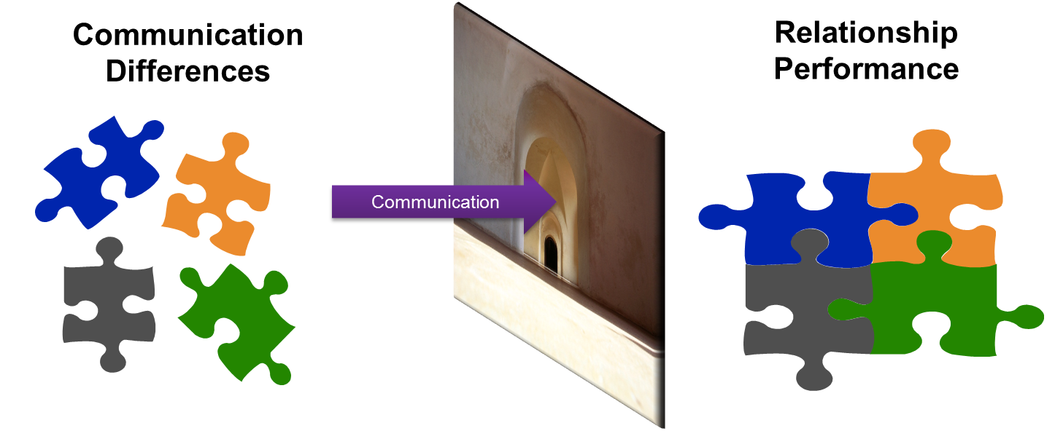
Communication Drives Relationships
Poor Communication
Stress and Discomfort
Misunderstanding
Blockages
Poor Execution
Lack of Trust
Positive Communication
Situations Flow
Clarity
Decisions Get Made
Tasks Get Completed
Engagement

Slide 6
The New Behavioral Economy Opportunity
Re-Framing Communication of Offerings to Remove Biases
Knowing Product Preferences Based on Quantitative Persona Models
Reframing Offering Message to Different Communication and Learning Styles
Highly Customized Life-Long Experiences (Offerings)
The opportunity is to reframe how the same solution is presented to people with different communication and learning styles.

Slide 7
Using Communication to Unlock Revenue Growth
The Power of Matching Sales Teams, Clients, Solutions
Tailored Communication and Solutions Matched to Client DNA Style Drives Confident Long Term Decision-Making
Hiring Advisory or Sales Teams Matched to Client DNA Style Drives Higher Engagement

Slide 8
The Vision (for Sales):
A Client Centered Business Built on Behavioral Matching
Sales Team With Lack of Behavioral Insight
Behavioral Discovery to Know, Engage and Grow Employees and Customers
Matching Employees and Clients for 4 in 4 Engagement
Goal Setting: Provide Discussion and Opportunities
?
?
?
Life Style: Provide Fun, Openness and Graphics
?
Stability: Provide Security, Feelings and Instructions
Default Styles =1 in 4 Engagement
Information: Provide Analysis, Research and Details
23% Revenue Uplift
Source: Gallup Organization 2009 and DNA Behavior Research 2001-2014

Slide 9
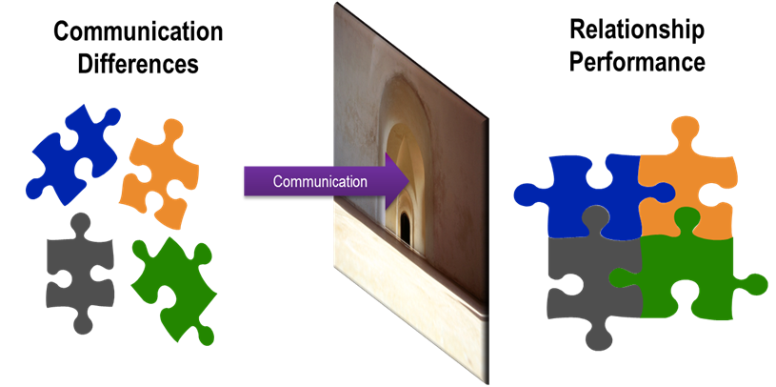
The Vision (for Wealth Conversations):
People Have Different Comfort Levels
Which type of wealth management conversations are you comfortable with?
Goals Business Transfer Life Balance Inheritance Personal/ Family Relationships Planned Giving Investment Portfolio Retirement Planning

Slide 10
DNA Engagement Programs Enhance Life-Long Client Relationships
Client Engagement Development
Organizational Change Management
Service Delivery Execution
Sales Training
Solution Matching
Behavioral Marketing
Employee and Team Engagement
Leadership Messaging
Communication DNA Discovery Systems, Training, Tools

Slide 11
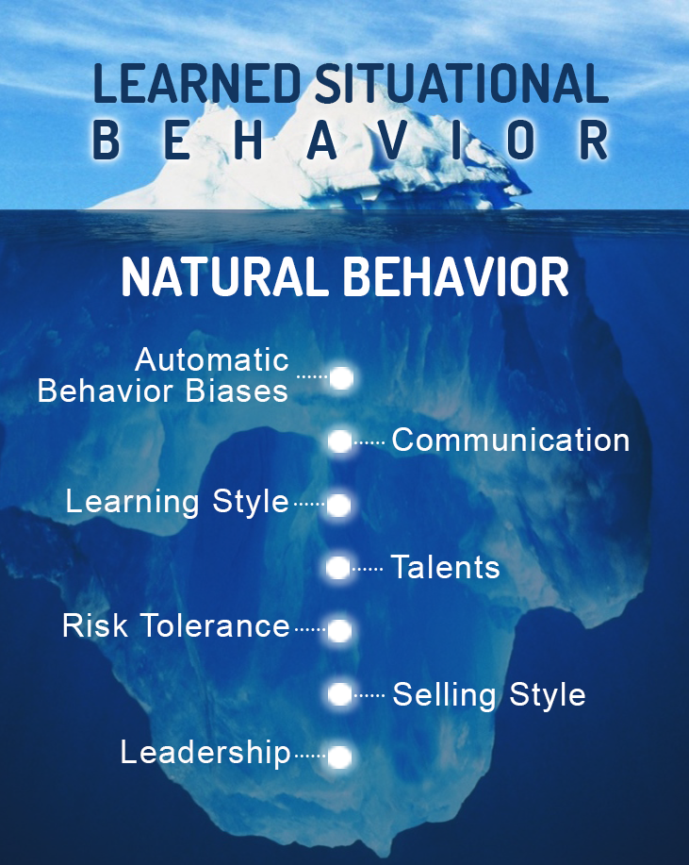
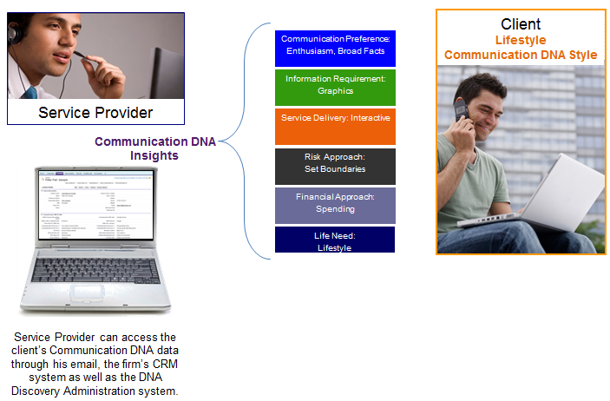
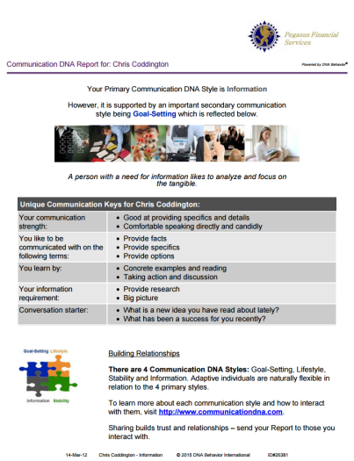
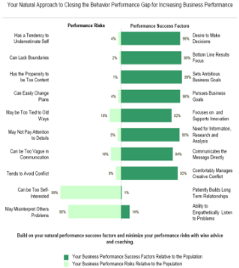
Quicker and 91% More Reliable Method
To Predict Reactions to Business / Life Events
CDNA – 12 Questions (2 to 5 Mins)
BDNA – 46 Questions (10 to 12 Mins)

Slide 12

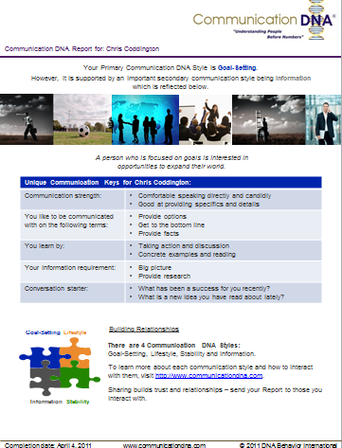
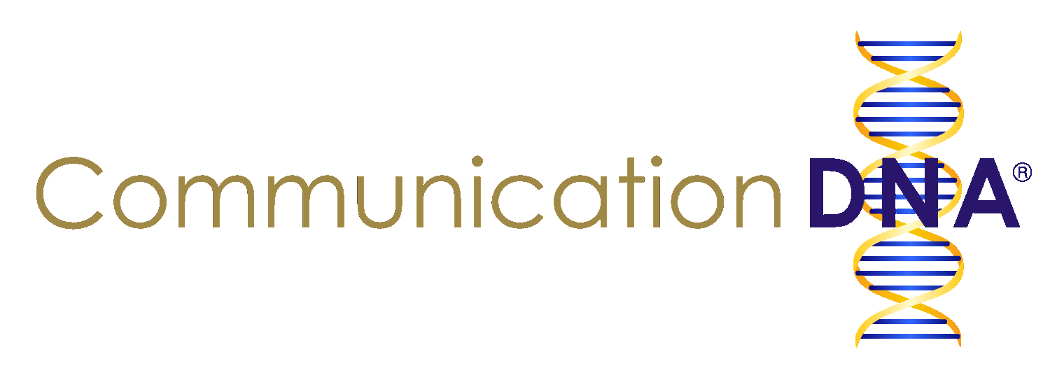
Communication DNA Discovery
Engagement Insights
Communication DNA Discovery uncovers the natural preferences for how sales people and clients wish to be communicated with by others. It takes 2 to 5 minutes to complete.
This enables:
Differences to be understood;
Communication with a person on their terms;
Relationships to be developed based on trust.
Communication DNA Insights Include:
Natural communication style
Preferences when communicating with others
Life needs
Information requirement
Communication DNA Report

Slide 13
Summary of 4 Primary Communication DNA Styles
Insights on How to Adapt
Communication Keys for Behaviorally Smart Conversations
Communication Style | Strengths | Struggles | What They Want
Goal-Setting (Allow Them to Discuss It) | Speaks Directly and Candidly | Could Be Too Forceful, Abrupt, Interrupting | Provide Options, Get to Bottom Line, Present Opportunities
Lifestyle (Allow Them to See It) | Open and Engaging | May Be Too Transparent and Uninhibited | Openly Express Views, Verbalize Provide Broad Facts
Stability (Allow Them to Feel It) | Shows Empathy and Warmth | May Compromise Too Much and Be Too Diplomatic | Keep it Relaxed, Speak Softly, Share Your Feelings
Information (Allow Them to Read It) | Provides Specifics and Details | May Be Too Serious, Modest, Not Interactive | Provide Facts, Provide Specifics, Demonstrate Transparency

Slide 14






Behavioral Discovery
Leads to Higher Engagement
Our unique online behavioral discovery methodology leads to a more reliable prediction of an employee or client’s communication and learning style:
Reduces decision-making bias by re-framing of the same concept or message on their unique terms
Increased decision-making comfort from a higher level of personal alignment to the solution
Client feels higher level of connection by directly participating
Engaged Team
Engaged Clients
Behavior Drives Relationship Performance

Slide 15
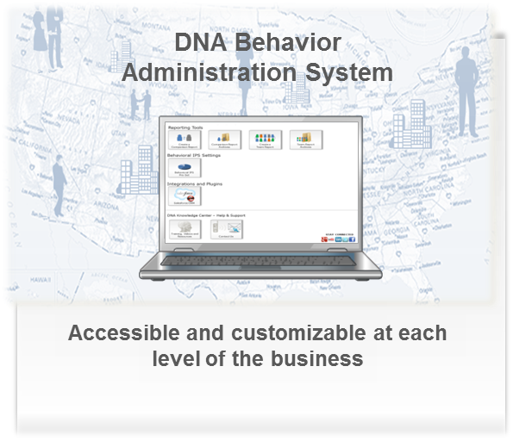
Technology Transforms the Client Experience
Segment & Match Clients to Employees
Based on their communication style to customize sales, marketing and service activities
Solution Matching
Tailor Your Workflows
With specific guidelines based on their communication style & specific needs
Provide Customized Experiences
Based on their communication style & specific needs to make the offering more appealing
Match your client to the right solutions to speed up sales conversion
Customized Messaging
Send personalized
communications to increase connectivity of the message
Powerful Strength based Discovery Questions
Based on their communication style to unlock the interaction
Increased Revenues by Over 23% Per Year Through Creating Higher Levels of Sustainable Employee and Client Engagement

Slide 16
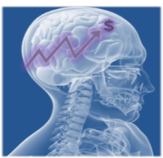

DNA Behavioral Marketing
More Than Traditional Marketing Approaches
“Left Brain” Persona Approach
Traditional Economics methodology using Quantitative Data Scraping Analysis to identify what the client has and does based on patterns of activities: Transaction Analysis Spending Patterns Income Demographics
“Right Brain” Personality approach
Psychograhic Methodology using Quantitative Behavioral Analysis based on Communication DNA Discovery to tailor the Solution and Relationship: Client, Employee and Solution Matching Emotional Engagement Customize Information Presentation to Different Communication and Learning Styles
DNA Marketing Automation program
23% revenue uplift Client Segmentation Targeted Resonance Marketing Personalized Solutions Client Service Relationship, Loyalty and Referrals
Source: Gallup Organization 2009 and DNA Behavior Research 2001-2015

Slide 17
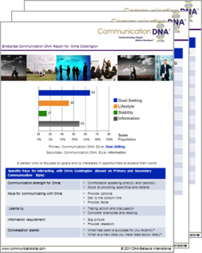
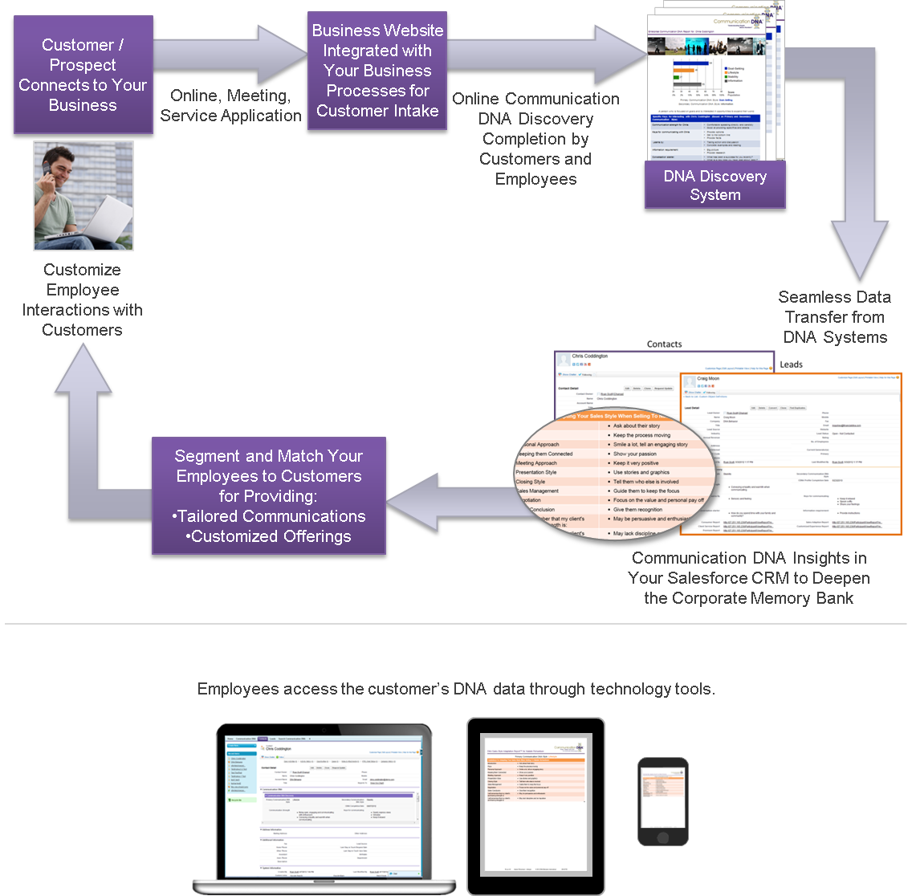
Communication DNA Process
How it Works

Slide 18
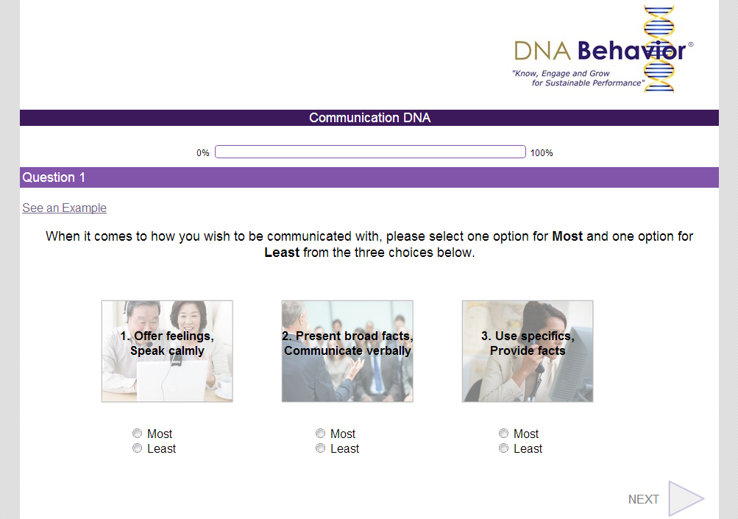
12 Question Communication DNA Discovery Process (2 to 5 Mins)

Slide 19
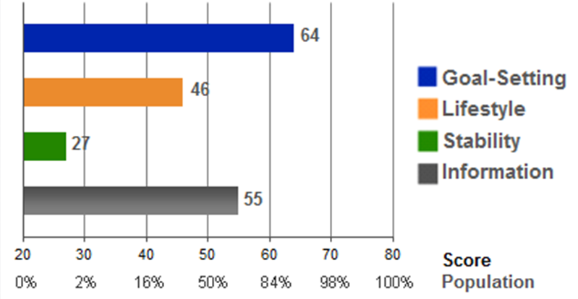
Communication Style Determining the Communication Style
Communication DNA for: Chris Coddington
Primary Communication DNA Style: Goal-Setting
Secondary Communication DNA Style: Information

Slide 20
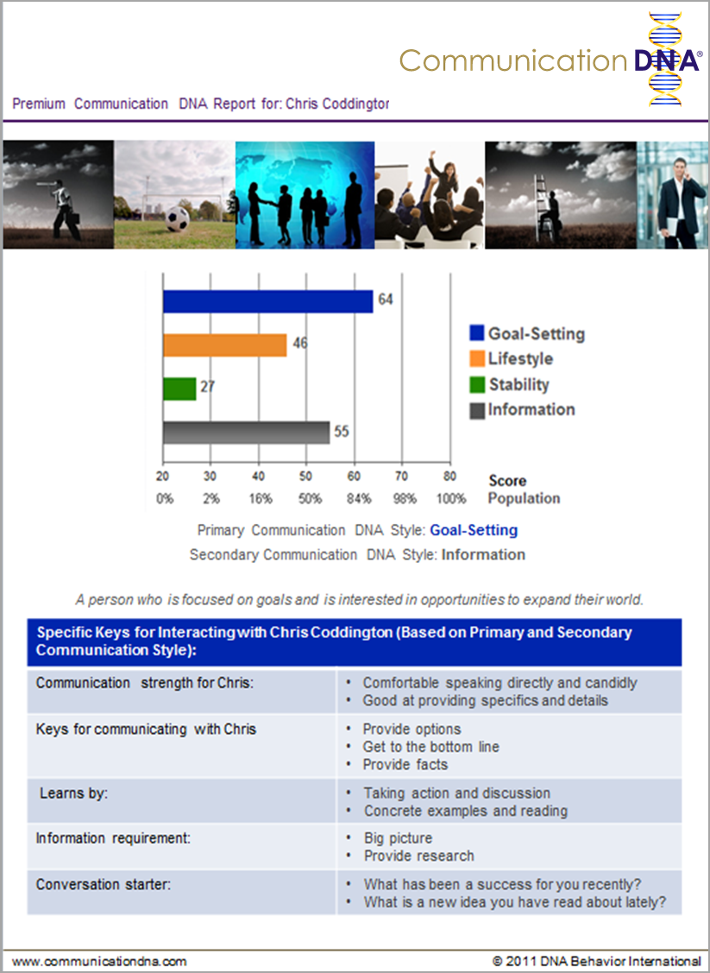
Communication DNA® Report For a Goal Setting Client
Premium Report
only (shows scores)
Primary Style: Goal-Setting as it is the highest score and over 55
Secondary Style: Information as it is the only additional score over 50
Insights combine Goal-Setting and Information

Slide 21


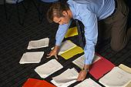

Communication Strengths of 4 Primary Styles
Fast Paced
Goal-Setting
Lifestyle
Communication Strengths: Speaks directly and candidly
Direct – WHAT?
What has been a success for your recently?
Communication Strengths: Open and engaging
Enthusiasm – WHO?
Who have you connected with lately?
Results Orientated
Relationship Orientated
Communication Strengths: Provides specifics and details
Logical – WHY?
What is a new idea you have read about lately?
Communication Strengths: Shows empathy and warmth
Serving – HOW?
How do you spend
time with your family and community?
Information
Stability
Moves Carefully
Notes:
21
Each of the right side traits on the graph (Directing, Engaging, Harmonious, and Methodical) share certain characteristics with those traits that are adjacent to them, i.e., Directing and Engaging. The left side traits are in small text and, as shown, have a statistical relationship to certain right side traits. Thus, Directing people typically will score in the Objective range, Engaging in the Spontaneous range, etc. The blended profiles which are an exception to this rule, Stylish Innovator (engaging/methodical) and Administrator (harmonious/directing) are somewhat rare.

Slide 22


Communication Struggles of 4 Primary Styles
Goal-Setting
Fast Paced
Lifestyle
Communication Struggles: Could be too forceful, abrupt and interrupting
Learn when to soften up
What will you do to draw people out in a
more friendly way?
Communication Struggles: May be too transparent and uninhibited
Learn to allow others to talk
Who could you involve more in conversations?
Results Orientated
Relationship Orientated
Communication Struggles: May be too serious, modest, and not interactive enough
Learn when to be more flexible
What will you do to show more enthusiasm in discussions ?
Communication Struggles: May compromise too much and be too diplomatic
Learn to speak up more
How can you get to the bottom line more quickly in discussions?
Information
Moves Carefully
Stability
Notes:
22
Each of the right side traits on the graph (Directing, Engaging, Harmonious, and Methodical) share certain characteristics with those traits that are adjacent to them, i.e., Directing and Engaging. The left side traits are in small text and, as shown, have a statistical relationship to certain right side traits. Thus, Directing people typically will score in the Objective range, Engaging in the Spontaneous range, etc. The blended profiles which are an exception to this rule, Stylish Innovator (engaging/methodical) and Administrator (harmonious/directing) are somewhat rare.

Slide 23
Communication Keys and Learning Styles
Employees and Clients
Goal-Setting
Provide Quick Fixes
Lifestyle
Present them options, opportunities, get to bottom line
Learns by discussion
Allow them to discuss it
Openly express your views, verbalize, provide broad facts
Intuitive learner
Allow them to see it
Left Brain Orientated
Right Brain Orientated
Provide them facts, details, transparency
Learns if tangible
Allow them to read it
Keep it relaxed, soft, feelings based
Sensory learner
Allow them to feel it
Information
Stability
Provide Procedures
Notes:
23
Each of the right side traits on the graph (Directing, Engaging, Harmonious, and Methodical) share certain characteristics with those traits that are adjacent to them, i.e., Directing and Engaging. The left side traits are in small text and, as shown, have a statistical relationship to certain right side traits. Thus, Directing people typically will score in the Objective range, Engaging in the Spontaneous range, etc. The blended profiles which are an exception to this rule, Stylish Innovator (engaging/methodical) and Administrator (harmonious/directing) are somewhat rare.

Slide 24
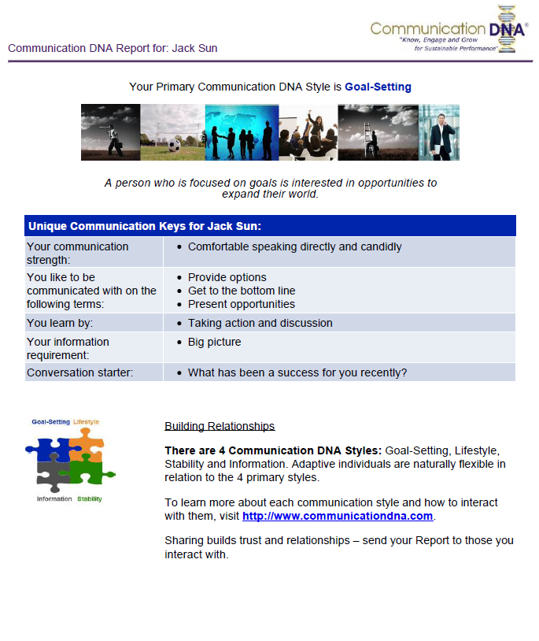
Meeting Tips For Interacting
With a Goal Setting Client
No long stories, keep to the point
Keep meeting agenda short and focused
Prioritize objectives around their goals
Start with the big picture, not too much detail on one part of it
Lay out the options so a decision can be made
Provide bullet points
Clearly outline risk/reward from best and worst case scenario
Ask for their thoughts on recommendations
Ask how involved they want you in the planning process
Recognize them with referrals to other influencers

Slide 25

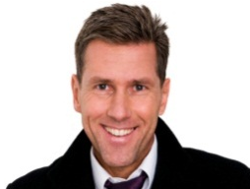
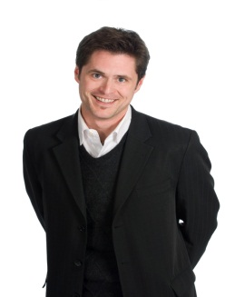


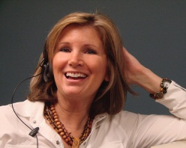
How would the Coddington Team
Communicate with Frank?
Like Frank, Chris focuses on goals and the big picture when communicating.
When communicating with Frank, Chris should:
Focus on returns
Offer options
John is enthusiastic and loves to socialize and network. He often finds pleasure in small talk and “catching up”.
When communicating with Frank, John should:
More quickly get to the bottom line
Minimize the enthusiasm
Chris (Leader)
Goal-Setting
John
Lifestyle
Minimal Adapting Needed
Substantial
Adapting Needed
Laura requires detailed information when making a decision and tends to provide the same amount of details that she requires to others.
When communicating with Frank: Laura should
Note the important points
Avoid unnecessary details
Frank (Client)
Goal-Setting
Sarah generally looks to connect on an emotional level, communicating in a relaxed and calm tone.
When communicating with Frank, Sarah should:
Be more direct
Address and review goals
Laura
Information
Sarah
Stability

Slide 26

How would the Coddington Team
Communicate with Craig?
Chris communicates directly. He has a tendency to be fast-paced and blunt when communicating with others.
When communicating with Craig, Chris should:
Soften the tone of communication
Follow up regularly to ensure he is comfortable
John is enthusiastic and conveys excitement when communicating with others.
When communicating with Craig, John should:
Make meetings more relaxed
Speak more calmly
Chris (Leader)
Goal-Setting
John
Lifestyle
Substantial Adapting Needed
Minimal Adapting Needed
Craig (Client) Stability Need
Laura’s communication is structured. She tends to focus on facts and research.
When communicating with Craig, Laura should:
Lighten up the meeting
Allow him to share his feelings about the facts
Like Craig, Sarah is interested in the feelings and emotions of others. She values relationships and building connections.
When communicating with Craig: Sarah should
Offer her feelings
Express her emotions
Laura
Information
Sarah
Stability

Slide 27
DNA Matrix
for Adapting Communication
Communication DNA Style | Goal-Setting | Lifestyle | Stability | Information
When working with Goal-Setting Communication DNA Styles | Minimal modification required: Present goals Focus returns Offer options | Some modification required: Move more quickly to the bottom line Minimize enthusiasm Recognize they may not enjoy small talk | Significant modification required: Be more direct Keep conversations formal Recognize they may come across as cold | Some modification required: Avoid unnecessary details Present the big picture Recognize they may be put off by too much detail too soon
When working with Lifestyle Communication DNA Styles | Some modification required: Provide graphics Explain how bottom line will impact lifestyle Recognize they may be bored with formal meetings | Minimal modification required: Invite to social events Set boundaries to keep focused Engage in small talk | Some modification required: Be more energetic Express emotion and allow them to express views Recognize they may focus on possibilities not certainties | Significant modification required: Be more interactive Avoid jumping into facts and research too soon Recognize they may lose focus if the lifestyle benefit is not clear
When working with Stability Communication DNA Styles | Significant modification required: Soften the tone Follow up regularly to ensure they are comfortable Recognize they may feel pressured if not given enough time and warmth | Some modification required: Speak more calmly Create a relaxed environment Recognize they may not enjoy impersonal environments | Minimal modification required: Offer feelings Express emotions and ask that they share theirs Provide instructions | Some modification required: Lighten up meetings Ask how they feel about the facts Recognize they may want a guarantee of security
When working with Information Communication DNA Styles | Some modification required: Have research available Demonstrate how risks are minimized Recognize they may need to retreat and think to make decisions | Significant modification required: Concentrate on being reliable Focus on being structured Recognize they may get irritated by imprecise communication | Some modification required: Provide action steps Focus more on facts than feelings Recognize they may appear to be unexpressive | Minimal modification required: Offer detailed research Ask if more information is needed Stay focused on the practical

Slide 28
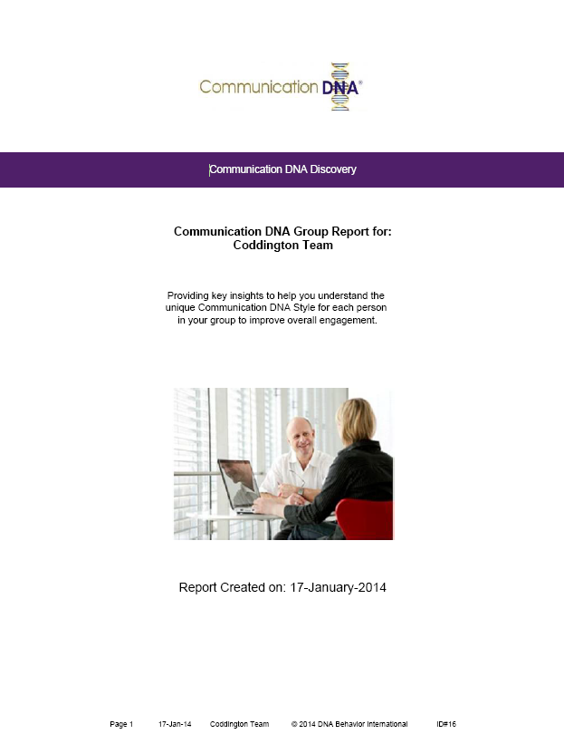
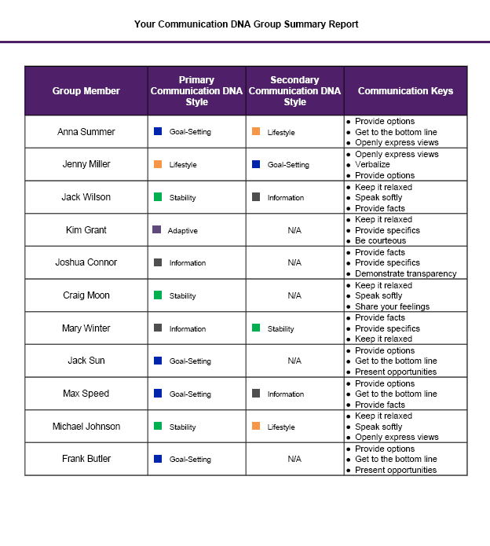
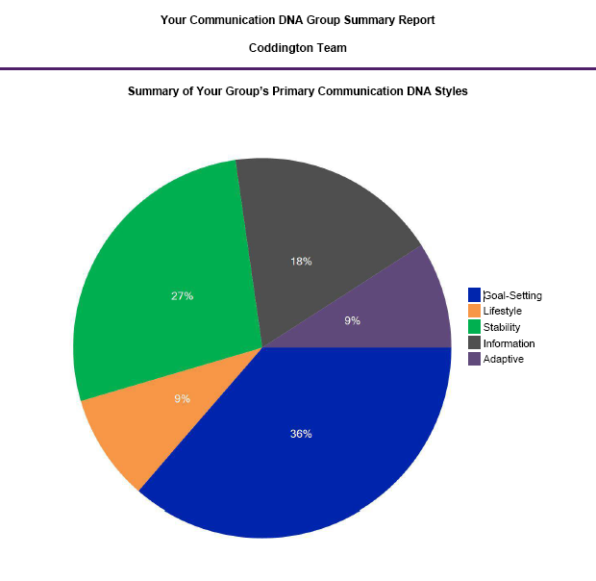
Communication DNA
Group Report

Slide 29
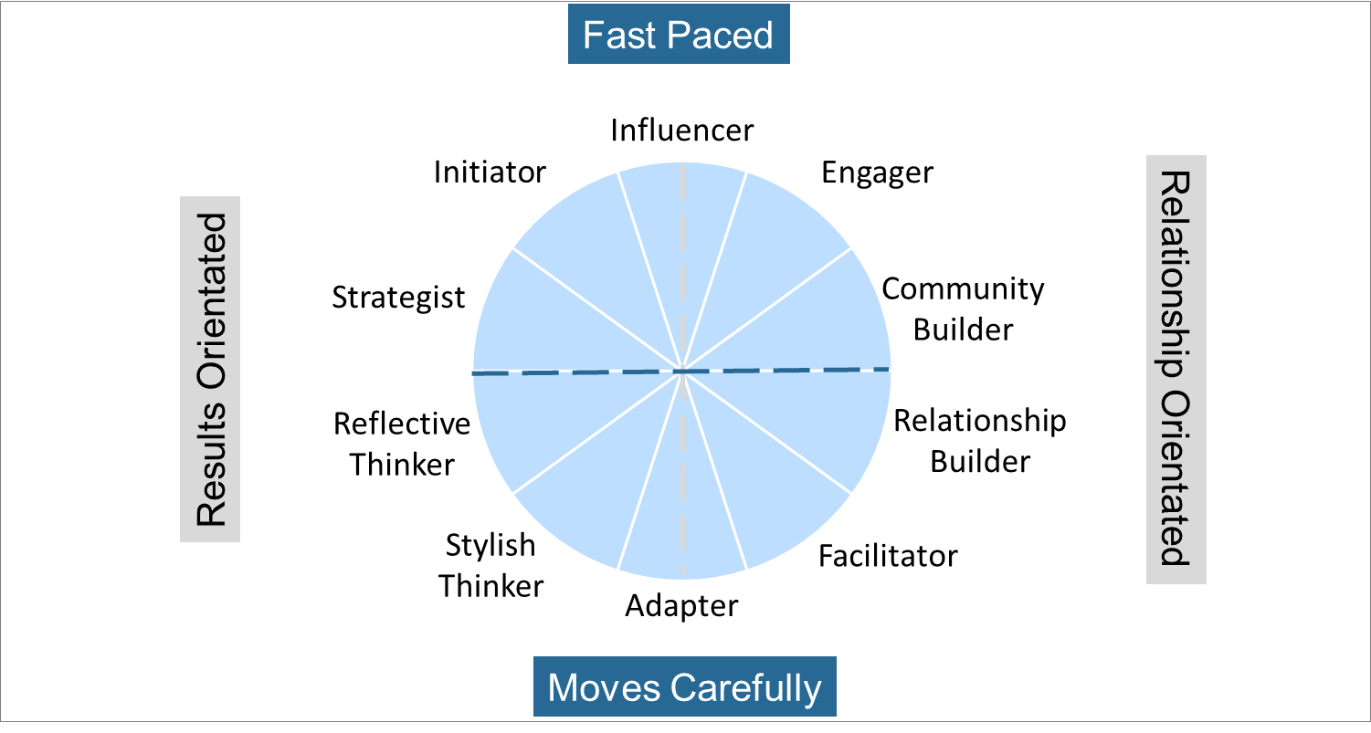
Communication DNA Style Connected
to Natural Behavior
Goal Setting
Lifestyle
Information
Stability

Slide 30


Behavioral Technology Transforms Your Firm
DNA Client Engagement and Talent Management
Systems
Matching Employees to Clients and Solutions Offered
Grow Engaged Clients and Employees
$
DNA Discovery Processes
DNA Training
Employees
DNA Knowledge Center
DNA Technology Systems
Clients
Communication Drives Business Relationship Performance

Slide 31
DNA Behavior Discovery Systems
The Science Behind the DNA Behavior Discovery Systems
Powerful and Unique Client Centered Behavioral Solutions Delivered in 123+ Countries and 11 Languages
Forced Choice Assessment Measuring 64 Behavioral Traits
60+ Man Years of Development Investment Since 2001
Independent Validation by Team with 100+ Years of Experience

Slide 32
Questions?
Contact Us
More information about Communication DNA:
Contact:
inquiries@dnabehavior.com
www.communicationdna.com
Complete your trial: https://dnabehavior.biz/Account/RegisterByGroup/CDNA%20Tripp%20Rockwell/22
The Blog: http://blog.dnabehavior.com/
Our Podcast: http://behaviorallysmartmoney.libsyn.com/

