Slide 1
Behaviorally SMART Team Performance
Part 4: Stage Summaries, Leadership 360, and Communication

Slide 2

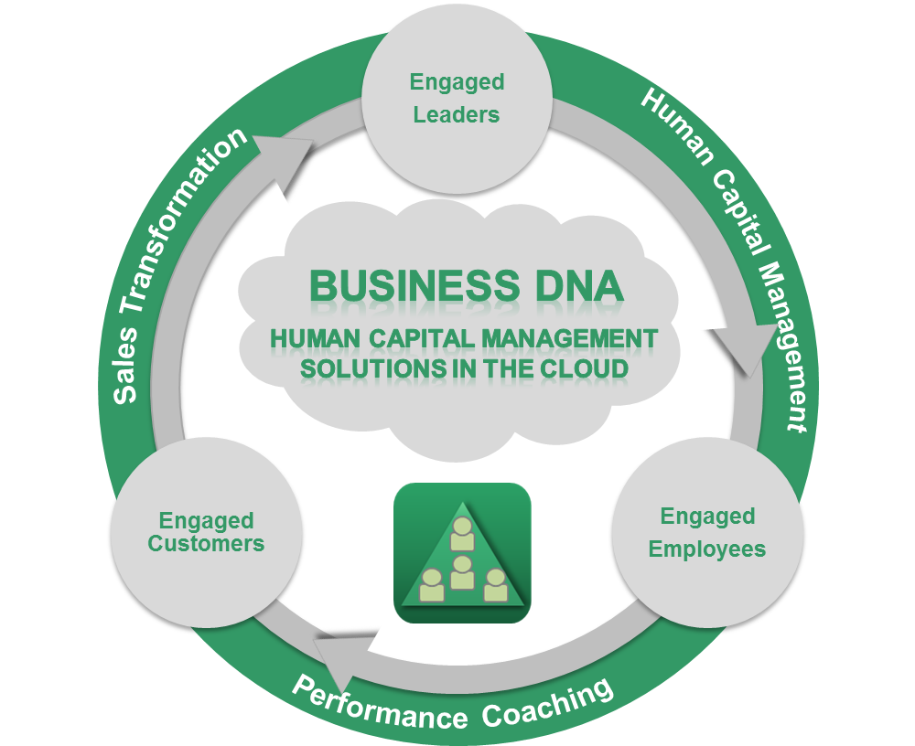
Behavioral Intelligence Platform
Managing Human Capital

Slide 3
Today’s Webinar
Objectives - Series 4 of 4
Through behavioral discovery understand, develop and productively use human capital for transforming personal and team performance
Understand that Behavior, Communication and Learning style is hard-wired but can be “influenced”
Start with Self-Awareness and understanding why natural behavior matters in the workplace
Summary of Team Development Stages: Forming, Storming, Norming, and Performing.
Leadership 360 – team review for leadership development
Understand how to adapt your communication for different people.

Slide 4
Closing the Behavior Performance Gap for Teams
+70%
Team Productivity Gains*
+70%
Team Productivity Gains*
Team Growth Drivers:
Operational Competence
Team Results
Team Leadership
Team Communication
Customer Engagement
Supplier Engagement
Team Growth Drivers:
Operational Competence
Team Results
Team Leadership
Team Communication
Customer Engagement
Supplier Engagement
Team Sustainability Drivers:
Team Trust
Team Values
Team Sustainability Drivers:
Team Trust
Team Values
*2009 Gallup Research

Slide 5
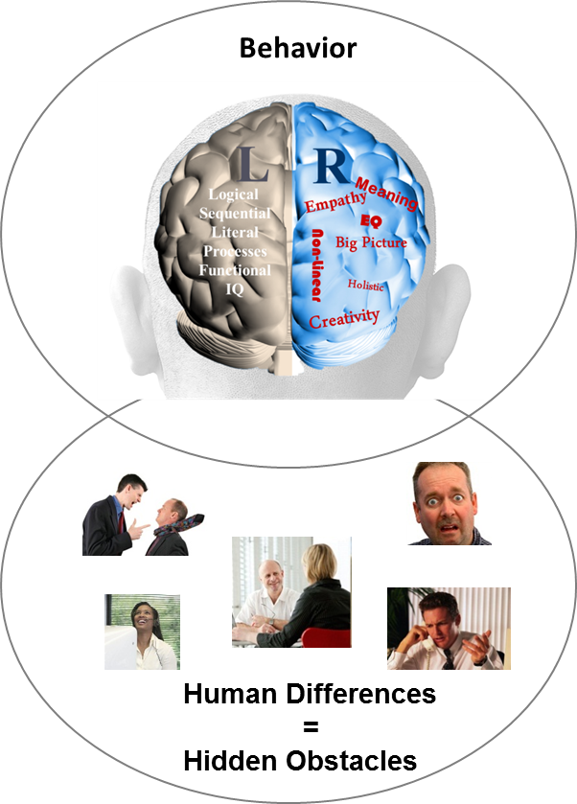
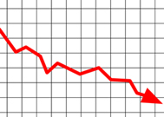
Behavior Causes Business Performance Challenges
87% of
measurable business issues are communication related
Sales Conversion
?
Client Engagement
?
Employee Retention & Productivity
?
Operational Execution
?
Business
Performance
Source: Harvard Business Review 2002

Slide 6
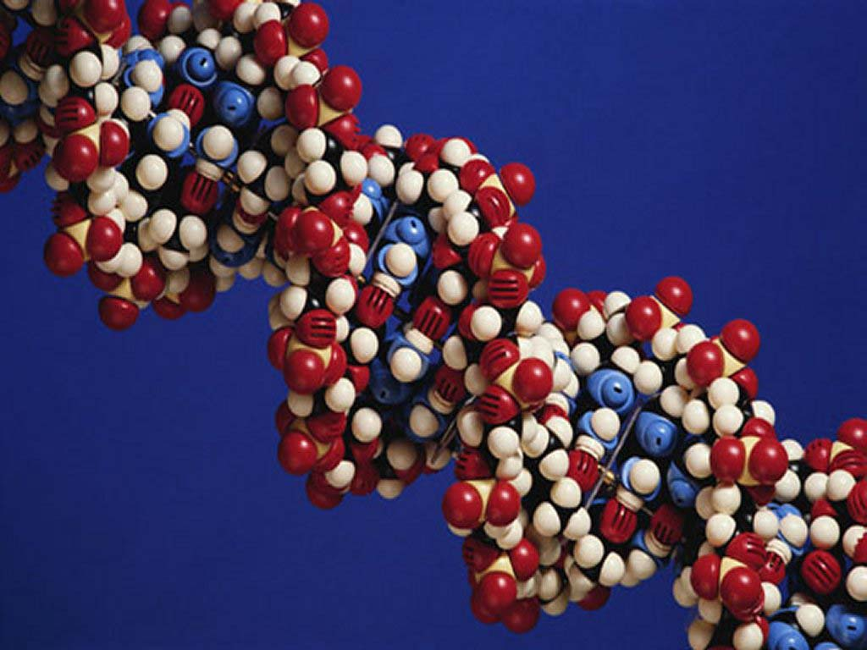
DNA Behavioral Style
What Is Your Natural Behavioral Style ?
Each person has a unique natural behavioral style
The natural behavioral style along with personal environment (history, experiences), values, and education shapes our overall personality
This impacts every business, career, financial and life decision that we make
Every person has the desire to be understood on a deeper level

Slide 7
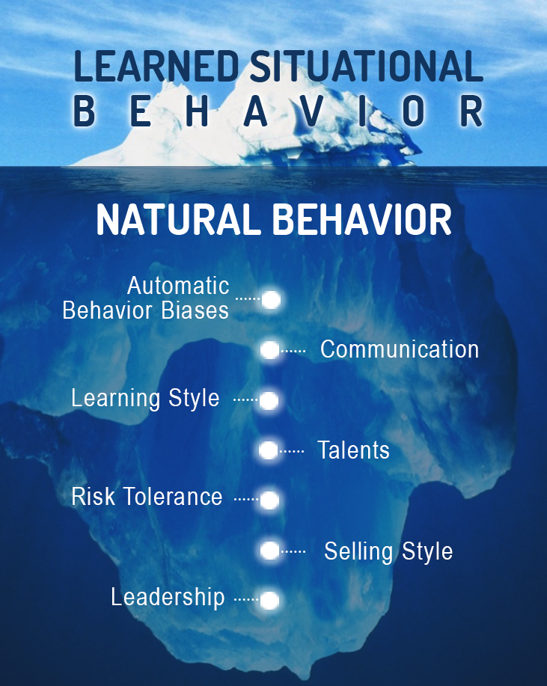
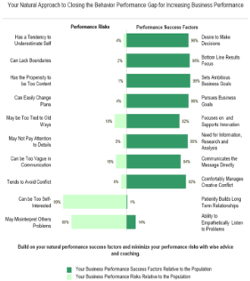
Predict Employee & Customer Reaction to Life, Business Events
A Quicker and More Reliable Method
Observations
Do Not Get
Below the
Surface
Business DNA
Natural Talent Discovery and Performance Measurement
(10 to 12 mins)

Slide 8
Communication Solution
A Behaviorally Smart Business Built on Matching
Team With Lack of Behavioral Insight
Behavioral Discovery to Know, Engage and Grow Employees and Clients
Matching Employees and Clients for 4 in 4 Engagement
Goal Setting: Provide Discussion and Opportunities
?
?
?
Life Style: Provide Fun, Openness and Graphics
?
Stability: Provide Security, Feelings and Instructions
Default Styles =1 in 4 Engagement
Information: Provide Analysis, Research and Details
23% Revenue Uplift
Source: Gallup Organization 2009 and DNA Behavior Research 2001-2014
8

Slide 9
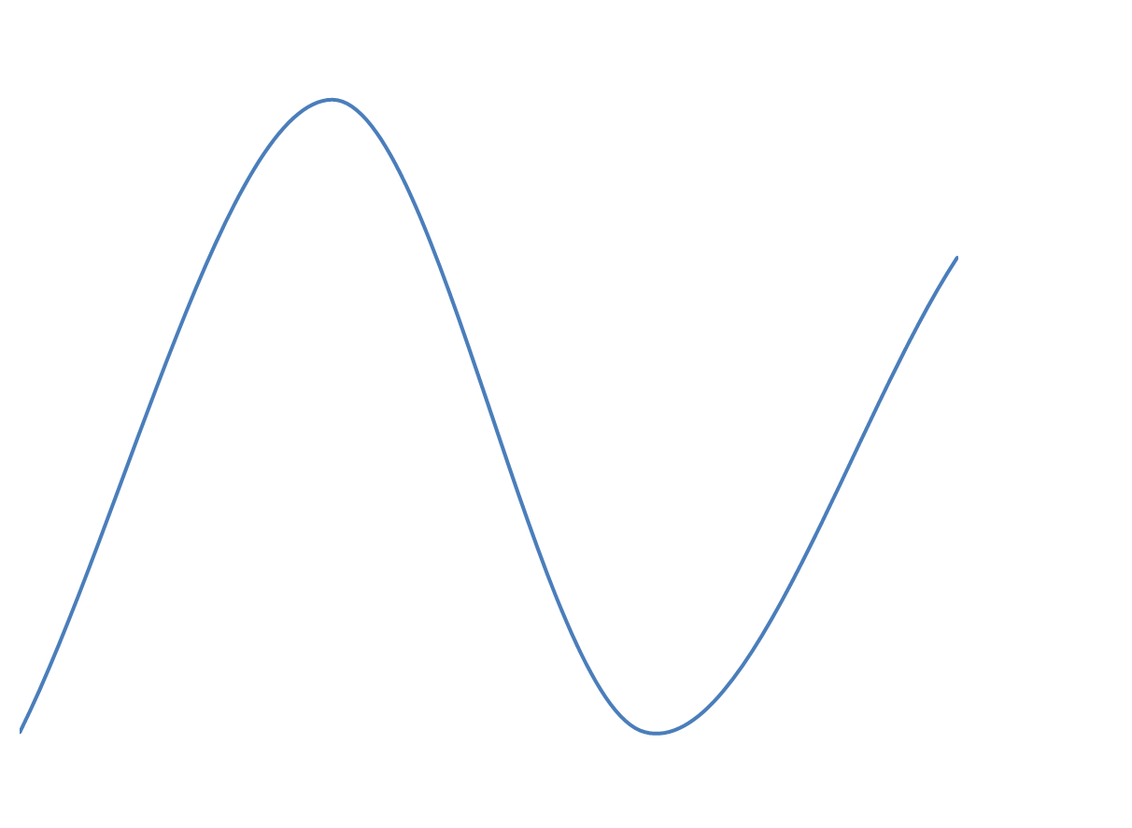
Behavioral Centered Approach
To Performance
Skills
Knowledge
Experiences
Environments
Learned/ Modified Behavior
Traditional Tool Starting Point
Confidence
Personal Performance Potential
Natural DNA
Behavior – Unique Natural Talents
Instinctive Normal
“Go To”
Personal Performance Impediments
Skills
Knowledge
Experiences
Environments
Our Unique Starting Point
Low Self Belief
Learned/ Modified Behavior

Slide 10
Discovering Your Performance Attributes
LEVEL C
Education, Training, Experience
LEADER- SHIP SKILLS
WORK SKILLS
COMPETENCIES
LEVEL B
RELATIONSHIPS
RESULTS
Business DNA Natural Behavior
NATURAL BEHAVIORAL TALENTS
Heredity and Environment
LEVEL A
CHARACTER and INTEGRITY
Trustworthy * Authentic * Emotionally Stable * Passion, Values, Purpose Driven

Slide 11
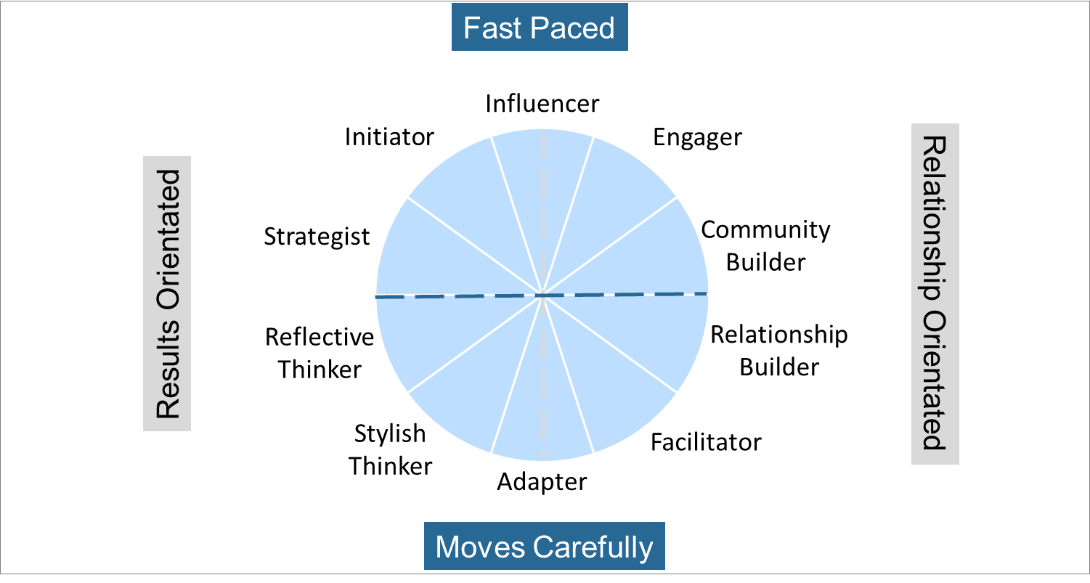
Summary of Natural DNA Behavior – 10 Unique Styles

Slide 12
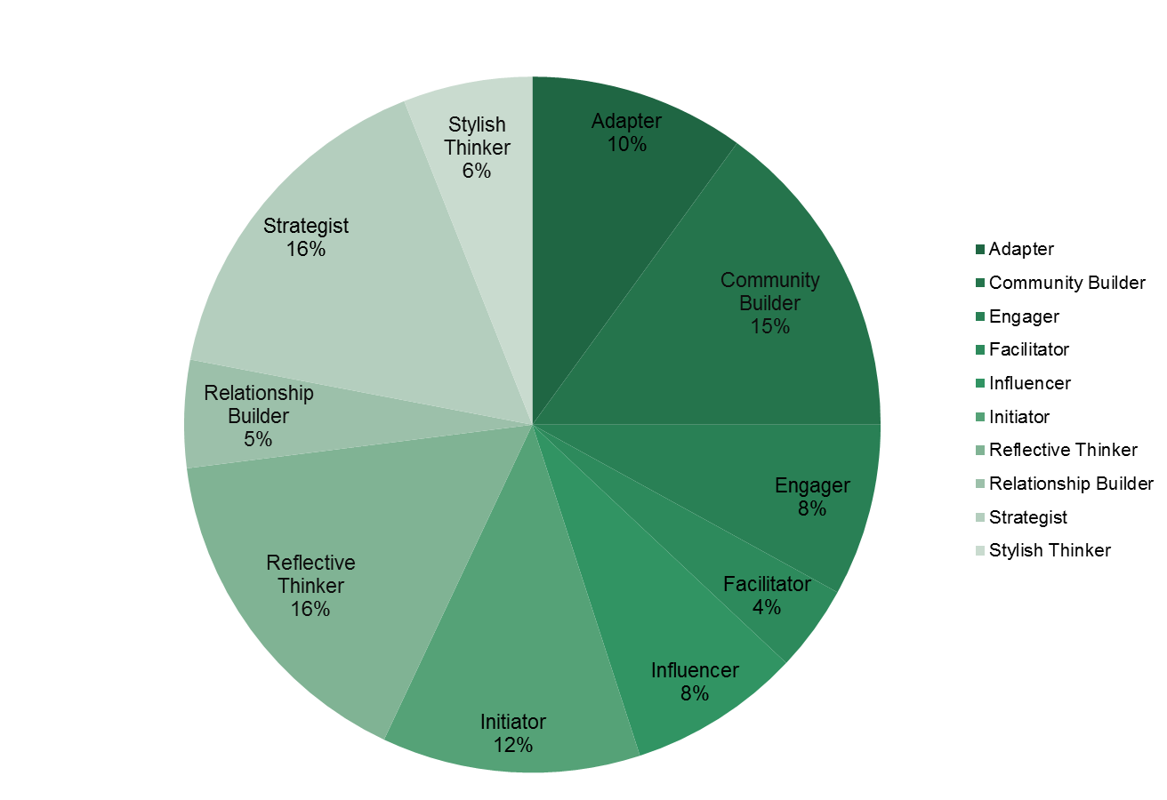
General Population Distribution
DNA Natural Behavior Styles

Slide 13
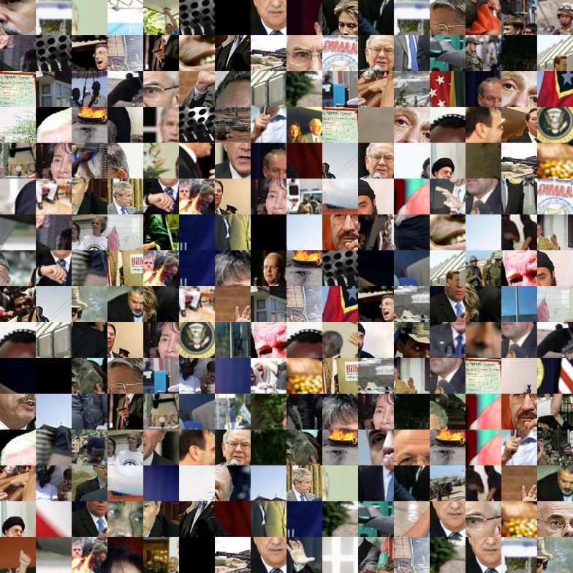
Do You Know Who You Are Working With?
Notes:
13

Slide 14
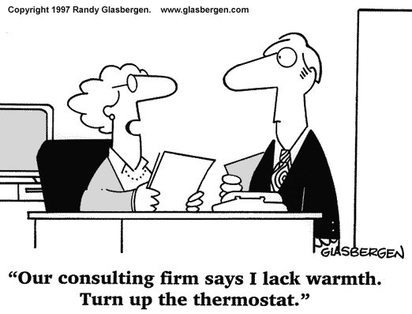
Building Sound Relationships
To build sound relationships you need to:
Know how to adapt your communication to meet the other person’s terms. Empathetically demonstrate your understanding of them when communicating.
Be aware of how your strengths and struggles can impact the other person. Be prepared to adapt your style.
Transparency builds trust. Be able to openly share of yourself to build trust: “knowing me-knowing you”. Openly admit your strengths and struggles.
Honest appraisal and feedback

Slide 15
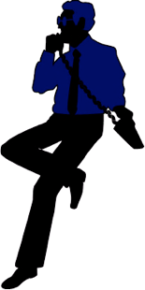
DNA Team Performance Model
TRUST
D
I
F
F
E
R
E
N
T
C O M M U N I C A T I O N S
T
A
L
E
N
T
S
UNITY
ALIGN
Team Success
UNDERSTANDING
ACCEPTANCE
RESPECT
TRUST
ALIGN
C O M M I T M E N T
UNITY
TRUST
Team Development:
From Diversity to Unity to Success

Slide 16
Summary of Natural DNA Behavior – 10 Unique Styles
Goal Setting
Lifestyle
Information
Stability

Slide 17
Four common advisor team structures
Developed by Bruce Tuchman
Four common advisor team structures
Developed by Bruce Tuchman
Performing
Norming
Storming
Forming
Source: https://www.mindtools.com/pages/article/newLDR_86.htm
Notes:
Forming, Storming, Norming, or Performing.
If you’re forming, you’re likely a younger team, still in your growth phase. You’re beginning to hire, you’re bringing on a new associate, or you’re purchasing a new book of business.
If you’re storming, you’ve got your team members in place, but it’s a grind. Either you’re not communicating well as a group, your team can’t seem to grasp the vision you have for your business, or there’s downright insubordination.
If you’re norming, there’s a sense of peace about you, no major conflicts, everyone pulls their weight. Awesome.
Performing though, is the real sweet spot, and only about 10% of teams actually get there. Performing teams are composed of people who not only pull their weight but actively contribute to the vision you have for your business and take pride in doing so. They bring a sense of energy into work with them every day, and the clients can FEEL it. Sounds pretty good, doesn’t it? So why do so few teams get there, and what can you do about it?
There is no one-size-fits-all answer to this question, but I can talk to you a little bit about how some of these issues can be addressed.

Slide 18
Teams in the forming stage
Resist the urge to hire someone just because they have a pulse and the basic skills you need to fill the position
Run a comparison report to ensure that your candidate balances out your strengths and weaknesses
Ask the selling advisor to take both assessments If you’re looking to purchase a book of business,
Notes:
If you’re currently a forming team, this is actually kind of awesome because it enables you to construct your team thoughtfully from the ground up. The number one mistake a team will make in the forming stage would be to hire someone with a pulse because they had the basic skills to fill a position. One great capability within Business DNA is the Team Report function – one each member of your team takes the assessment, we can take a look at your team’s combined strengths and weaknesses, and make sure you bring someone on who balances you out – regardless of the position you’re trying to fill. Another way to look at this would be, if you’re looking at purchasing a book of business, how could you use insights you glean from their DNA to anticipate where during the transaction the seller might experience stress, and then customize your communication accordingly?

Slide 19
TEAMS IN THE STORMING STAGE
Teams storm when individual behaviors, biases, decision making styles, and communication styles are out of sync.
Your team’s Natural Behavior is triggered by this environmental stress, and it’s demonstrated in an unhealthy way
If you can sense the tension, it’s likely that your clients can too
Start with the Team Report as a means to get all of the issues out on the table in a safe setting
Notes:
If you’re currently storming, I’m sorry to hear that, but don’t worry, these issues can be untangled. We just need to take the engine apart, clean it, and put it back together. Teams begin to storm when individual behaviours, biases, decision making styles, and communication styles are out of sync. There’s a case study at your place setting that I’d encourage you to take a look at to understand why these issues exist, and how they can be resolved with a little give and take. All human beings have a desire to be understood on a deeper level, and when we’re not, and we feel our boundaries are being violated, resentment sets in – on both sides. If you feel your team is currently storming, it’s likely that you work within a larger team. I would warn you against hiring new people until you’re able to identify where the crack is in your foundation, and fix it. The danger within a storming team is that if you can sense the tension, it’s likely that your clients are feeling it too. Much of this work is self-awareness. Just getting these issues out in the open, in a safe setting, can be the key to alleviating some of this pain.

Slide 20
TEAMS IN THE NORMING STAGE
Communicate the vision you have for your business, and ask for their help to turn your vision into tangible goals
Regularly ask for their input, and listen while they give it to you
Incentivize your team members in a way that is meaningful to them
Notes:
If you’re norming, that’s great! And some would say, Kaitlyn, I’m fine with norming, I don’t want to fix what isn’t broken, and I get that. I will warn you that James Butler will do a number on you later about The Cost of Comfort. But there is a huge opportunity here, and the difference is made by getting your team’s buy-in.
Have you communicated the goals you have for your business to your team, so that they can feel a sense of ownership over your cause? Do you have an incentive piece in place? Let me clarify: I’m not talking just about bonuses and raises. DNA Behaviour is able to prioritize rewards that are most appealing to each team member. Many times it’s continuing education, public acknowledgement, and inclusion in business building conversations that gets team members excited. So I would encourage you, if you think your team is comfortably norming, to start looking at ways you can better your best and really find your competitive advantage.

Slide 21
Teams in the performing stage
Performing teams have equal balance of results-oriented and relationship-oriented individuals.
They represent a host of skills that can solve to any need your clients might have.
PROTECT YOUR CULTURE
Notes:
Performing teams have an equal balance of results-oriented and relationship-oriented people. For that reason, their combined team profile is usually ‘Adapter.’ My advice to performing teams would be to protect your culture. Before making a new hire, have me run a theoretical team report for you to make sure that their behavioural biases are not going to swing you from your power position as a performing team, to one that starts to suffer from behavioural mismatching.
I have a cool story for you. Donna, our Receptionist, took the DNA assessments and when she was done, she couldn’t stop talking about it. I asked her what about the experience got her so excited, and she said “I’m a Community Builder. My job isn’t just to answer the phone or greet people or support the mailroom. Yes, I do those things, but by doing them, I build a sense of community. THAT’S my unique ability.” Those of you who know Donna, know that she’s happy all the time, but I swear her smile got BRIGHTER. DNA isn’t meant to just put a spotlight on what you LACK – it’s meant to show you where you SHINE.

Slide 22
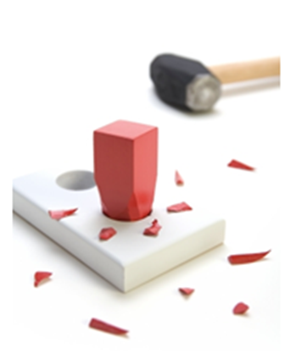
Hiring Performance Challenges
Hiring “Round Pegs in Round Holes” – Matching talent to the role
Building a recruitment process that leads to ongoing employee engagement
Notes:
Now lets start taking you on the path to DNA Advisor Performance. I will start walking you through the methodology using the case study of Chris Coddington, which is laid out in my Financial DNA book.
The issue I have seen for most advisors and clients is seeing through the clutter and confusion to choose between the many options that exist.
Choosing what is an opportunity goes back to your life purpose…..Your life purpose is at the core of your decision making matrix for building a quality life and your business. Getting in touch with your life purpose will help you align your natural talents, passions and values to what you do every day. Everything else is a distraction and an energy drain. When you get to understand this you will really feel it.
Having a concrete written plan based on your life purpose will help you focus on the opportunities and minimize these distractions. This is what we help you create using behavioral insights as the starting point.

Slide 23
DNA Hiring Performance Process
1. Build a Positive Hiring Culture based on a defined belief system and clear processes
2. Identify
the Role knowing the talents required based on current team member behavioral styles and activities to be performed
3. Create Role Benchmark by reviewing the behaviors for the role based on successful performers
4. Match Talent to the Role by having the candidate complete their Natural Behavior Discovery before first interview
5. Match to Manager by comparing the strengths and struggles of the Manager and Candidate
6. Conduct Behavioral Interview using powerful questions based on the strongest behavioral factors

Slide 24
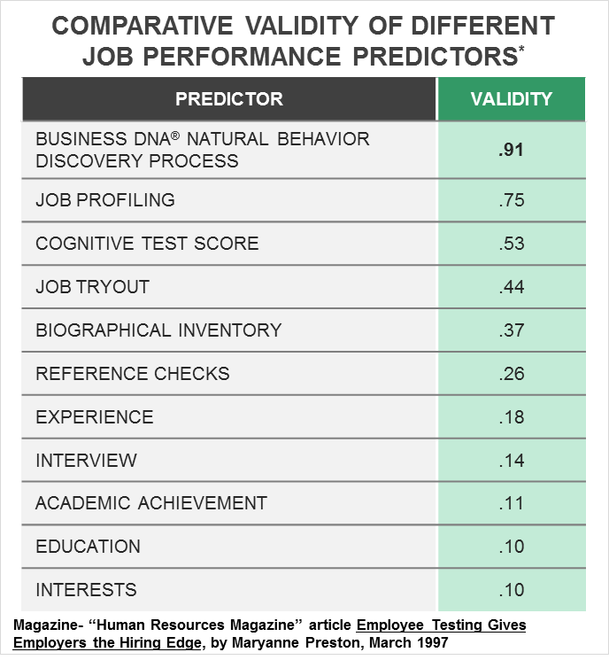
Business DNA as the Foundation of a
Robust Behavioral Hiring Process
Aptitude and Personality Assessments
Increase accuracy of a successful hire to 53%
Job Profiling
75% Accurate
Interview process alone
only 14% accurate
Studies by John Hunter, Ph.D., Michigan State University

Slide 25
Behavioral Awareness
Strengths, Struggles and Mid-Range
Objective behavioral awareness is a critical starting point to your workplace performance transformation. Playing to your strengths consistently will maximize your potential. Although, strengths over-played can become blind-spots.
Strengths - Behaviors that come naturally and which should be used. Note: Strengths over used can become a struggle.
Struggles – Behaviors that can be managed with
greater awareness of your natural behaviors. Struggles not managed can become a weakness.
Mid-Range Scores - Tend to be more flexible in these factors. Easier to move left or right.

Slide 26
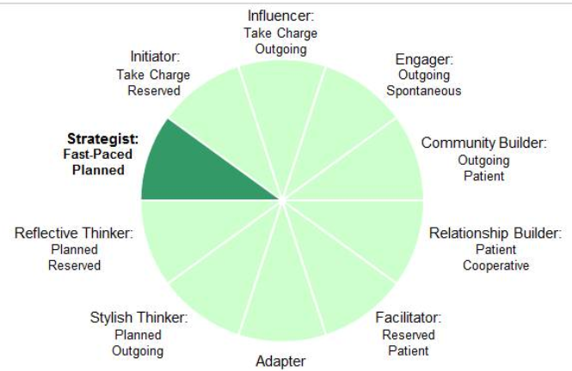
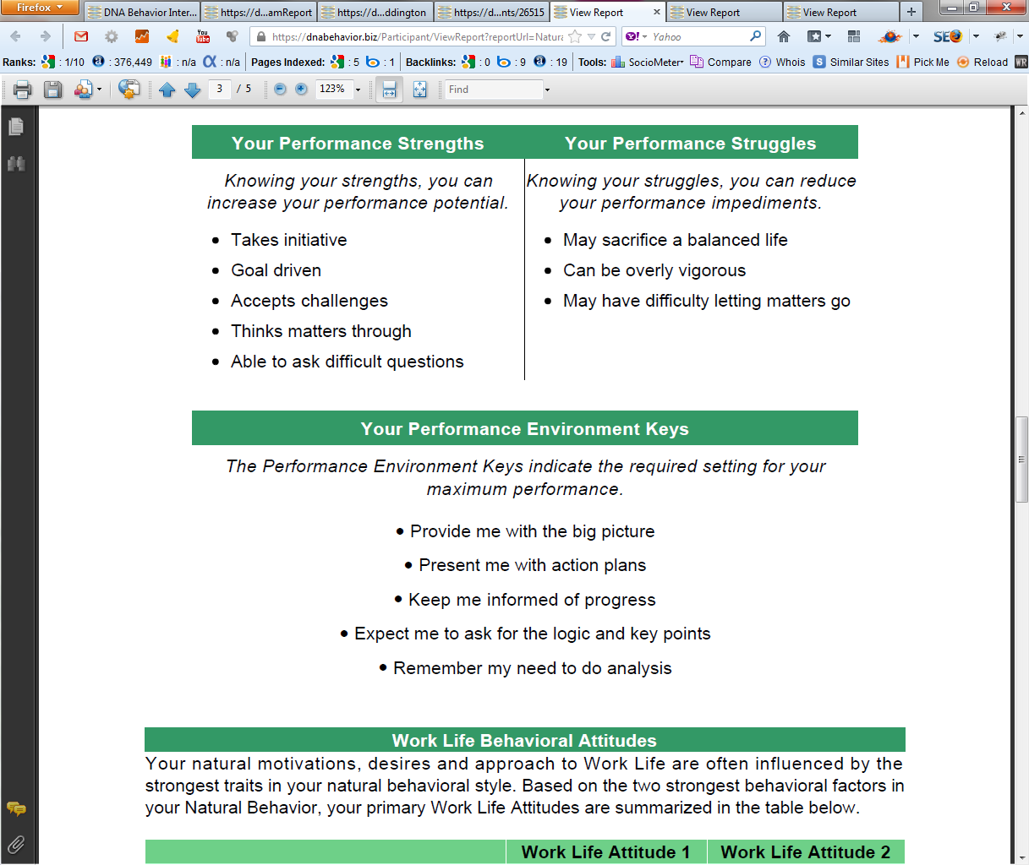
Practical Analysis of the Key Talents that Drive Performance
10 Unique Natural Workplace Styles based on 8 Primary Factors and 24 Sub-factors
Customized DNA Ultimate Performance Guide

Slide 27
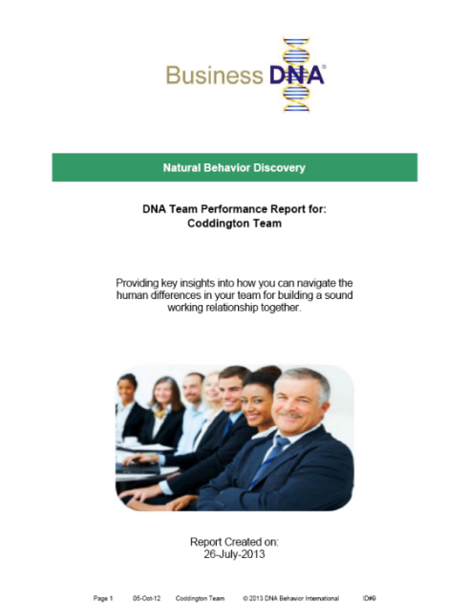
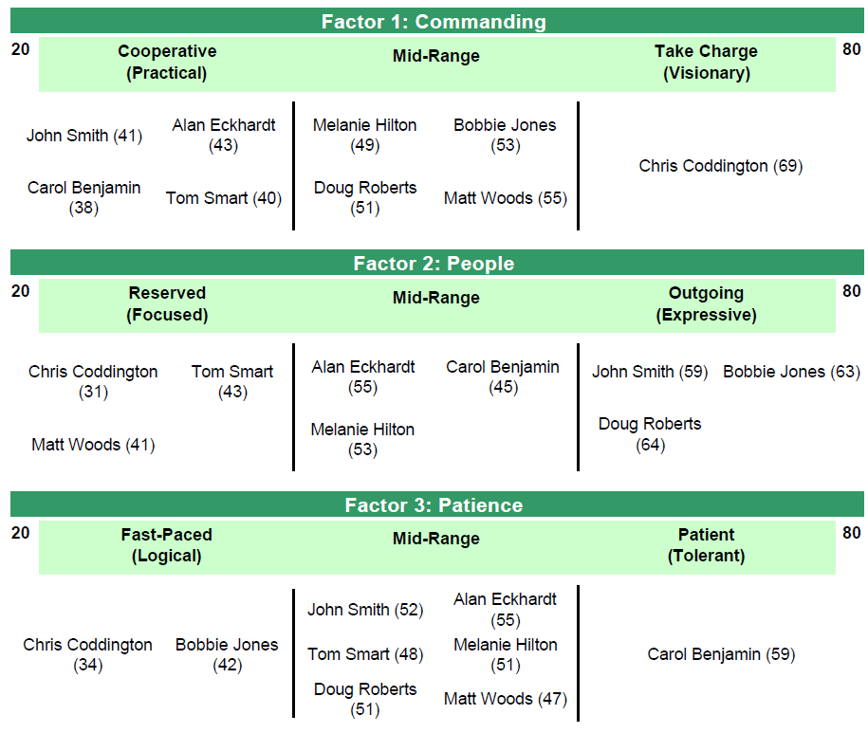
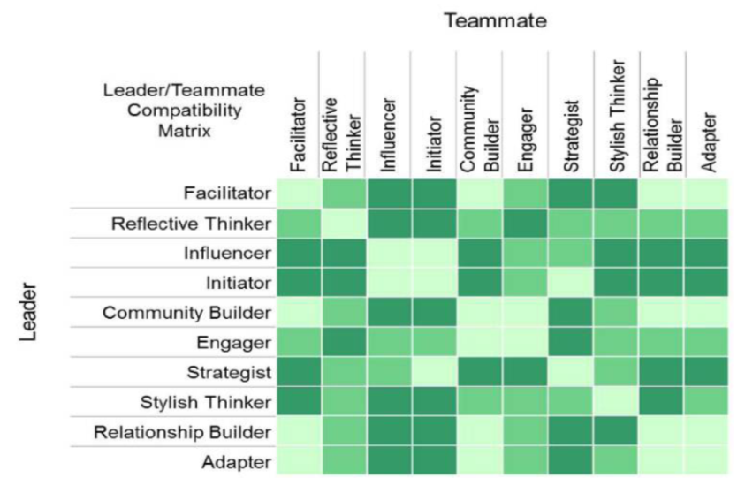

Review Your Business DNA Team Report
Core Work Life Drivers
Leveraging Team Talents for Success
Hiring and Aligning Top Talent
Understanding, Accepting, Respecting Differences for Enhanced Team Work
Team Compatibility Matrix

Slide 28
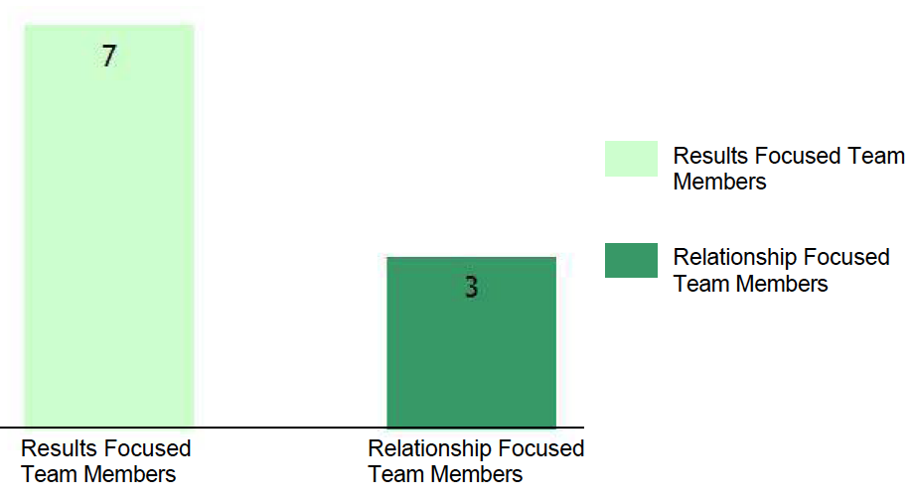
Summary of the Team’s Natural Behavior
Results Focused vs. Relationship Focused
The graph shows the number and percentage of individuals in the team that are
Results Focused and Relationship Focused. Overall, this will indicate the team's natural
tendency towards building relationships and motivations to getting results.
A Results Focused team will be more task oriented, while a Relationship Focused team will be more human engagement oriented.

Slide 29
Summary of the Team’s Natural Behavior
The 10 Unique Styles
Based on the scores of the team members, the blended DNA Natural Behavior Style for the team is Adapter.

Slide 30
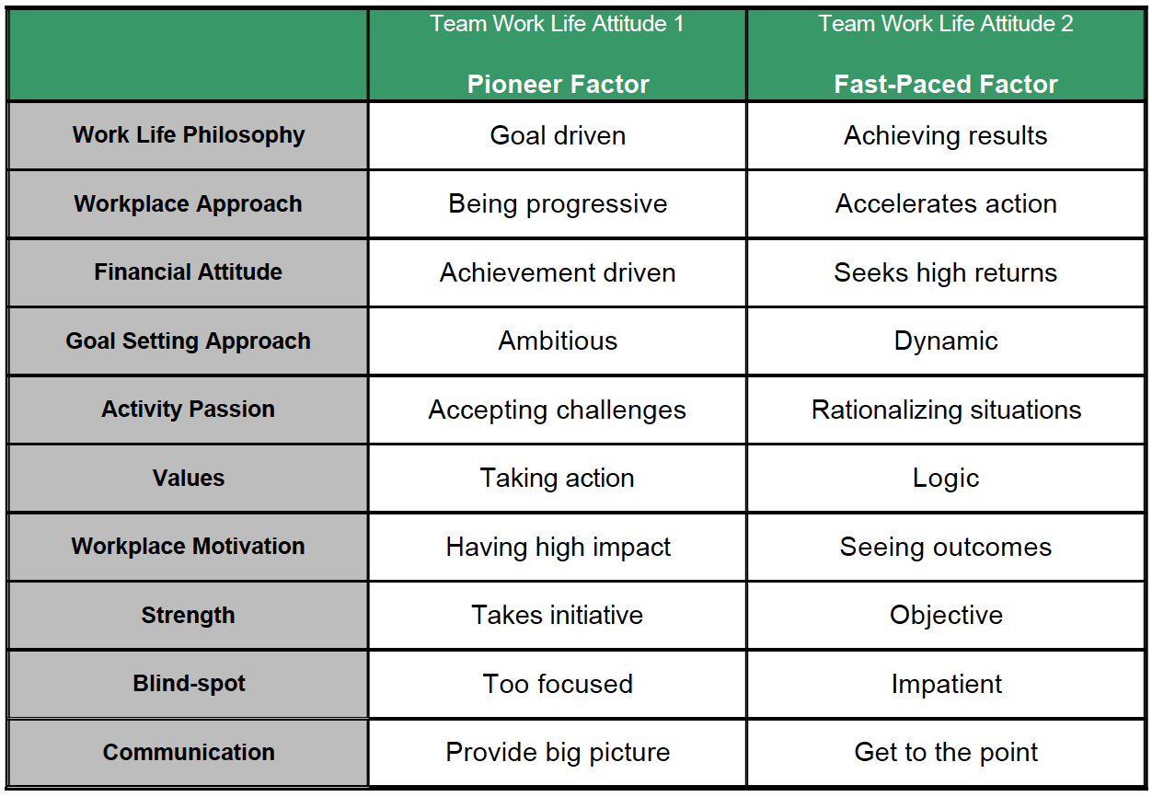
Summary of the Team’s Natural Behavior
Overall Work Life Behavioral Attitudes
The team's overall natural motivations, desires and approach to Work Life are reflective of the two strongest behavioral factors calculated by averaging each individual team member's factor scores.

Slide 31
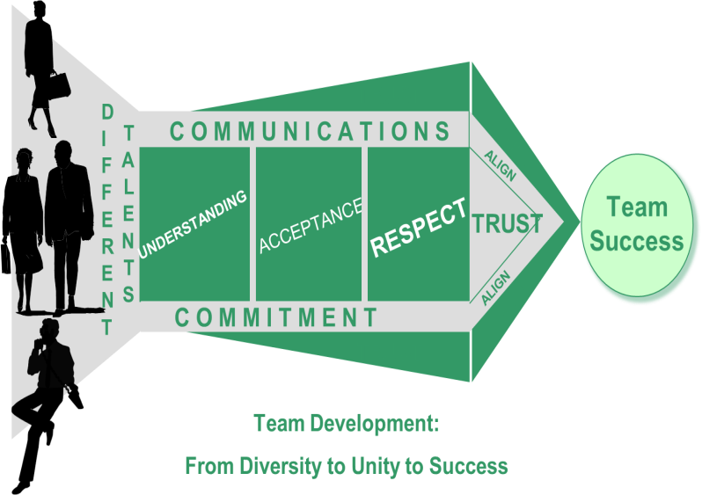
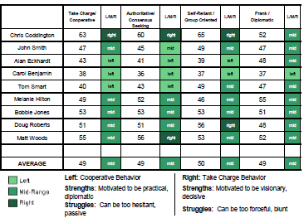
Identifying Team Differences for
Building a Productive Team
The Business DNA Team Report makes understanding team dynamics easy by:
Identifying the different talents of team members
Providing graphical analysis of team differences
Summary of Results and Relationship drive differences
Identifies strengths and struggles of team members for role matching
Summary of how to communicate with each team members

Slide 32
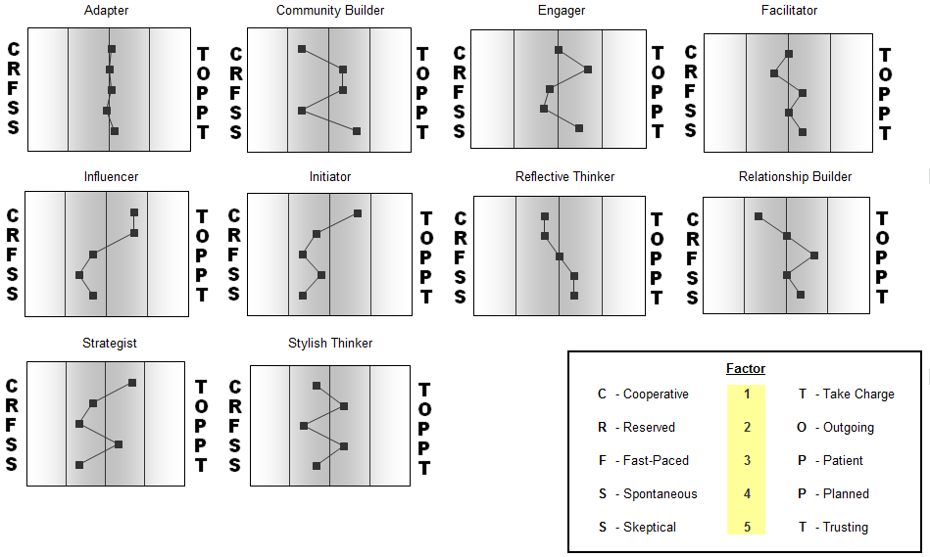
Natural Behavior Styles
10 DNA Natural Behavior Styles

Slide 33
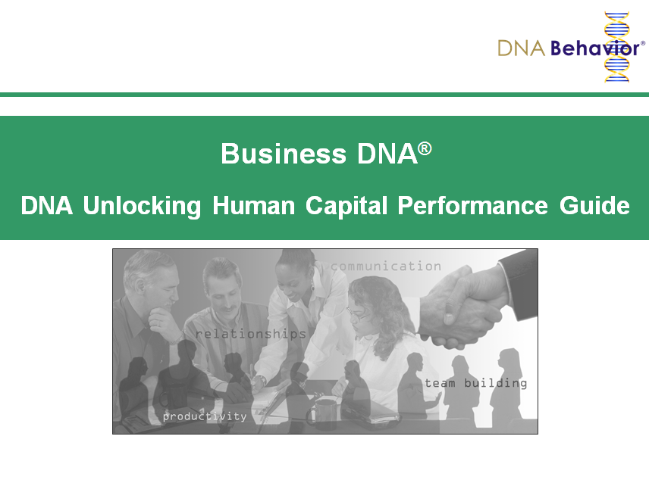
Quick Snapshot
Get a Quick Snapshot of Yourself and Others

Slide 34
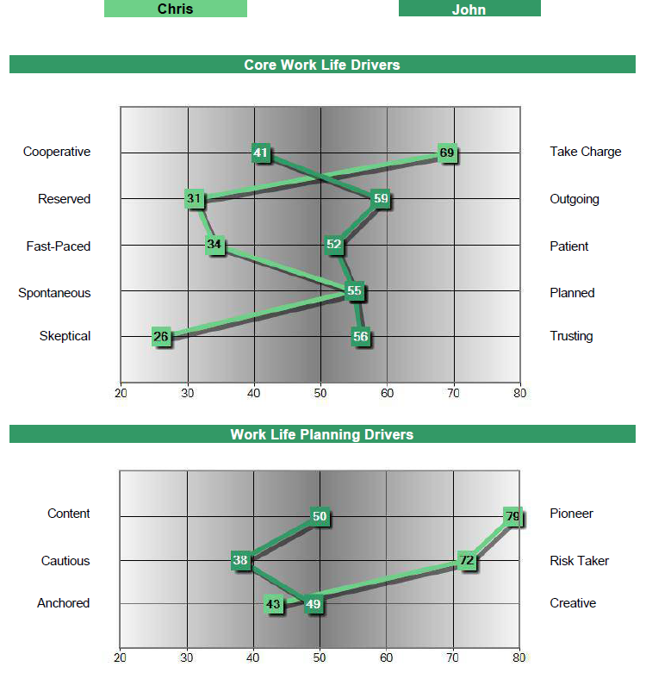
Chris Coddington & John Smith Comparison Graph
Strategist
Stylish Thinker
Many Behavioral Differences to Navigate:
Chris may not provide John with the personal engagement he needs
John could be far more content and cautious than Chris’s pushy goal driven style

Slide 35
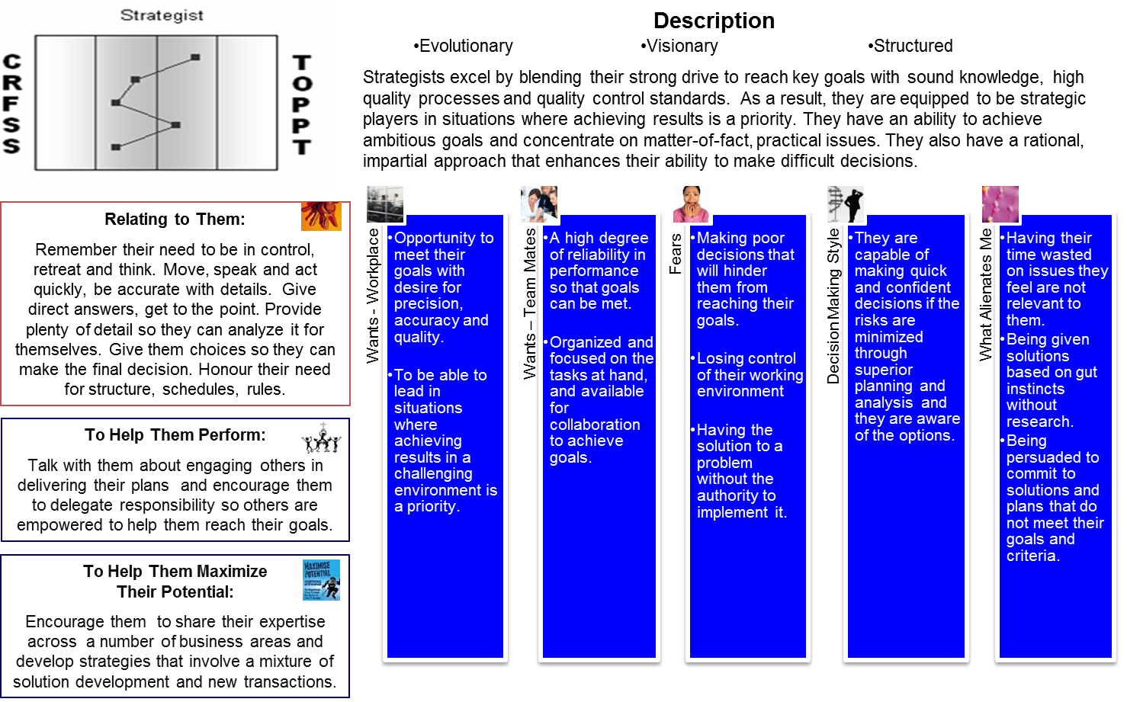
Strategist
Human Capital Performance Guide for a Strategist

Slide 36
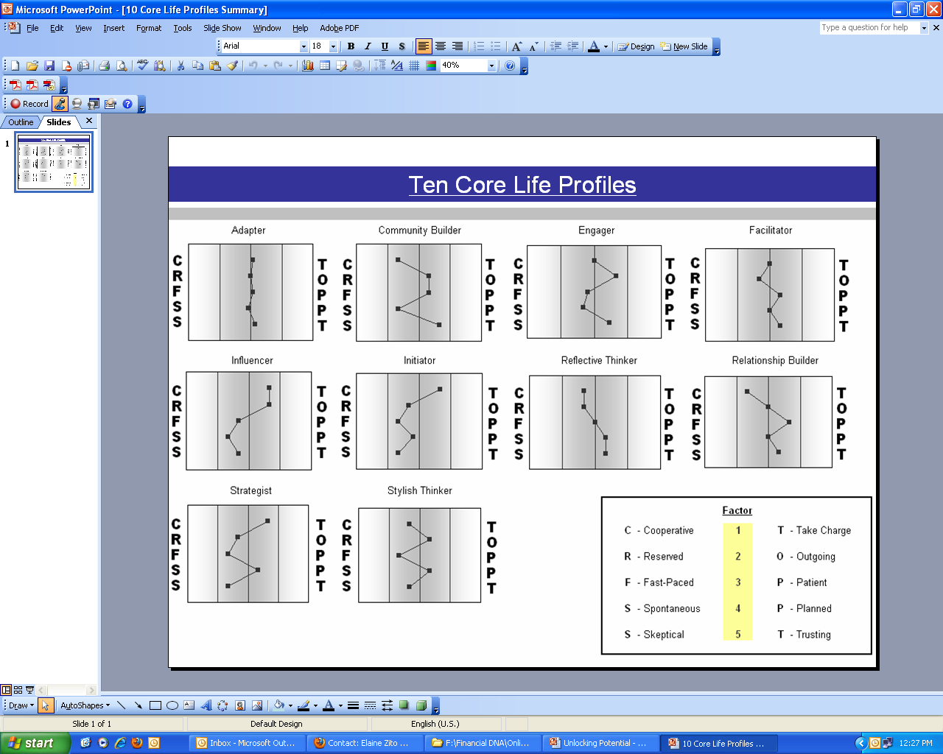








Adapter
Human Capital Performance Guide for an Adapter
Description
Compliant | Respectful | Courteous
Adapters are unique in that they have the unusual ability to adapt to the needs of their environment, and display whatever behaviors are necessary for success. They are very versatile and will generally partner and team well with others. They can generally perform well many tasks relating to achieving their goals and managing their performance, and they operate most effectively when they have very clearly defined expectations and boundaries.
Performance Environment:
Create a relaxed environment. Do not mistake their lack of response for inattention. Use written policies and procedures. Present specifics – facts, figures, data. Look for ways to minimize the risks.
  Reliable products with a balance between security and results.
  Profession-alism and
  to-the-point approach.
  They prefer a balanced and serious approach.
  Being given advice that leads them to commit to products out of line with their goals.
  Rational and focused on the facts at hand. They are likely to be guided by their Mentor in areas they know little about, but will do their homework to ensure they are making the right decision.
  Being given the run-around or being offered products that are obviously not related to their needs.
To Challenge Them:
Encourage them to articulate firm boundaries regarding their investment preferences.
Decision-Making Style
Wants – Products
Fears
What Alienates Me
Wants – Mentor
To Maximize Their Potential:
Encourage them to set clear goals and priorities.

Slide 37
Adapters
Understanding Adapters
If a true Adapter the person will be highly flexible
If an individual is going through a personal crisis in the lives, their psychological state is often changed and in some cases their style resembles an Adapter– survival mode. It’s always good when an Adapter style comes up to have a second conversation with the person to ensure they are not under significant personal challenges that may distort the outcome. If they are, offer them an opportunity in six months time to redo the Business DNA Natural Behavior Discovery.

Slide 38



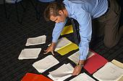

Build the New Team Culture
Leadership and Advisory Team Change Management
Evolve the leadership to coaches, and advisory teams from hunters and portfolio design to holistic planning and relationship managers
Overview:
1. Talent review to identify performance strengths and struggles
2. Assess fit to the role, team(s) and clients
3. Leader as coach model to emotionally engage managers and advisors
4. Advisor development to manage biases and be a behavioral coach

Slide 39
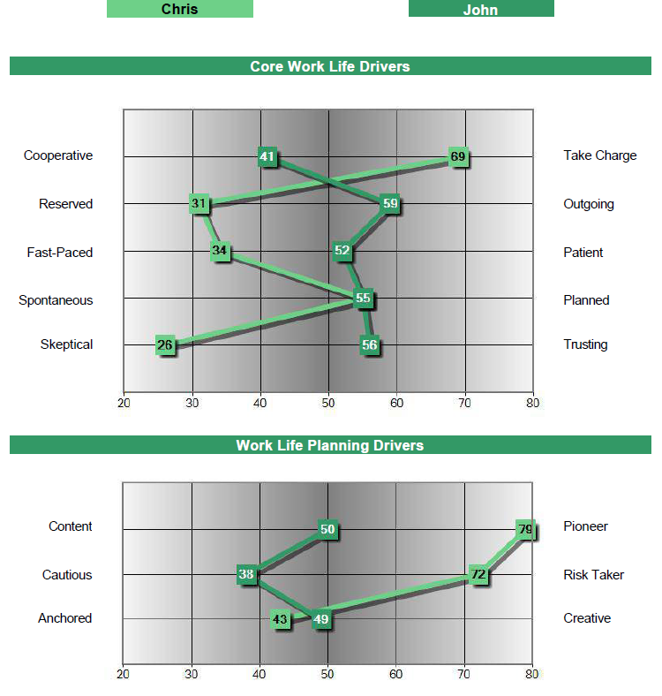
Hiring and Team Productivity Process
Hiring Fit to Role and Team Culture
Strategist
Stylish Thinker
Identify and navigate
behavioral differences:
Chris is a “hunter”, aggressive portfolio manager, highly goal driven
John is more a “farmer”, holistic in approach and relational

Slide 40
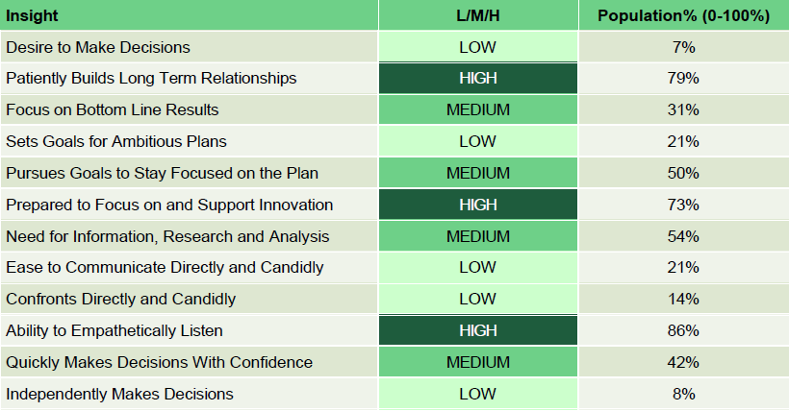
DNA Individual Workplace Insights
Business Decision-Making and Operating Style
Understand Each Person’s Natural Decision Making Preferences To Maximize Empowerment

Slide 41
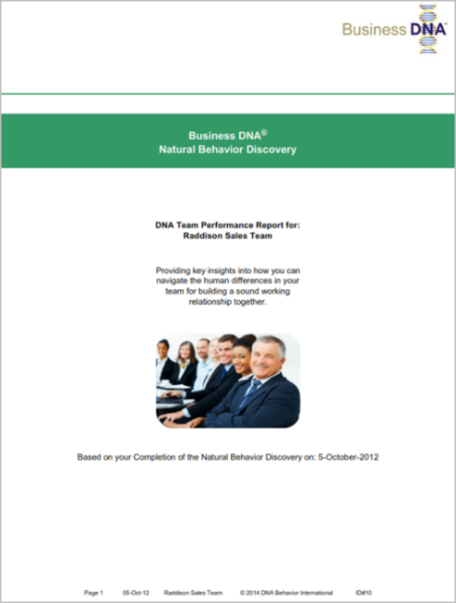
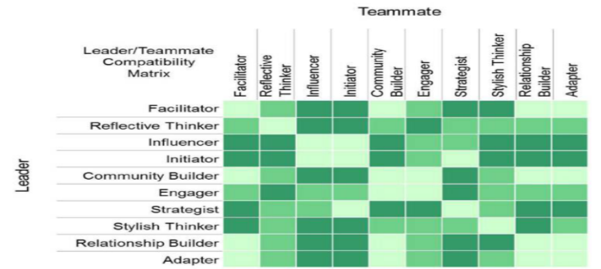
Business DNA Team Report
Review and Navigation of Team Differences
Natural Behavior Team Report
Core Work Life Drivers - Natural Behavior Team Report
What strengths and struggles does the team have?
How would you leverage the different team talents for success?
What talent/positions would you add or remove from the team?
Team Compatibility Matrix- Natural Behavior Team Report
41

Slide 42
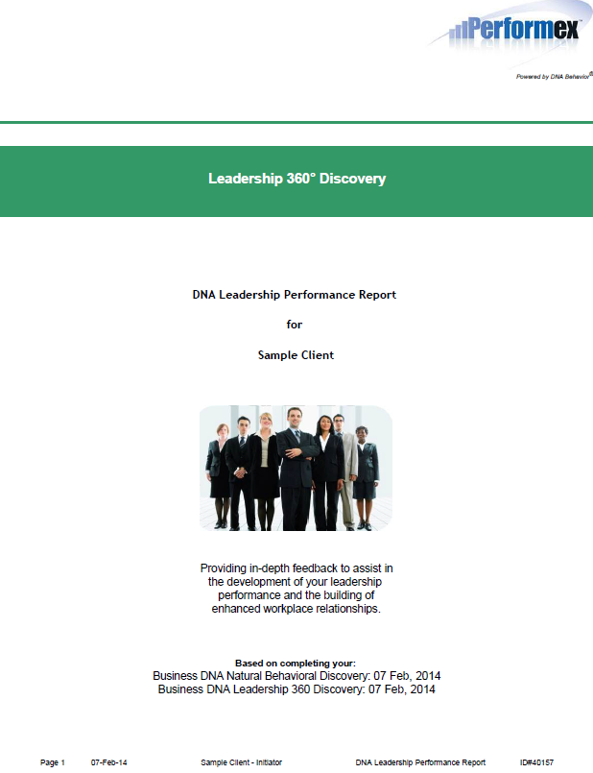
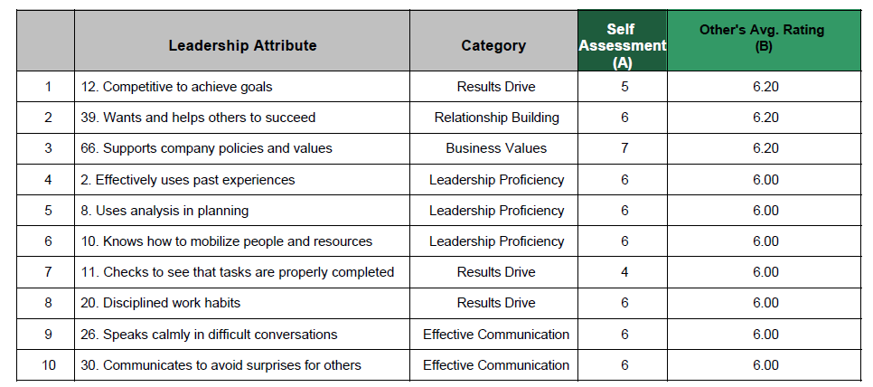
DNA Leadership Performance Report
The Leadership 360° Discovery Process provides in-depth feedback to assist in the development of your leadership performance and the building of workplace relationships. This process takes 15 to 30 minutes to complete 75 individual items across 7 key areas related to leadership.
The DNA Leadership Performance Report highlights your top 10 leadership strengths and struggles, uncovering 75 items relating to your leadership performance in 7 distinct areas:
Leadership Proficiency
Results Drive
Effective Communication
Relationship Building
Leader EQ
Trust
Business Values

Slide 43
Key Features
Business DNA Leadership 360 Process
Point in time objective measurement of sustainable performance (SPI) which promotes year on year comparisons.
Integration of actual Leadership Performance Measurement and how the person should be performing based on their Natural DNA Behavior.
Insights on how the Leader needs to adapt their behavior to improve performance.
Provide a summary of the top 10 Leadership Strengths and Leadership Struggles.
Written feedback of the raters is captured in process and the report.
Dashboard summarizing the average scores for each rating item for each category of rater. (e.g. manager, peer, customers, direct report and other stakeholders)
All rating data and written feedback is 100% anonymous to the leader, raters and DNA Behavior.

Slide 44
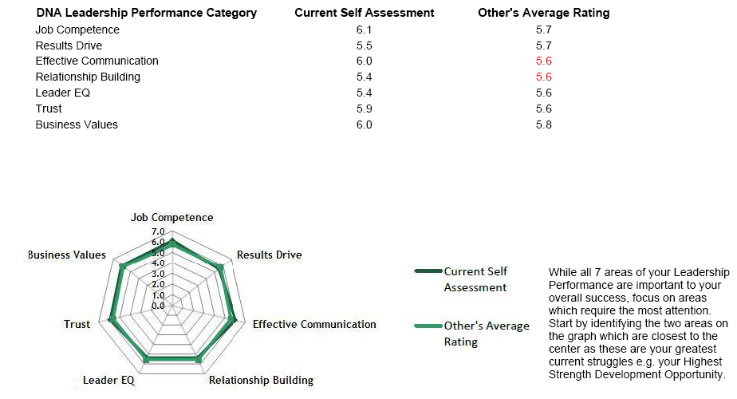
Snapshot Analysis
Your Leadership Performance Balance

Slide 45
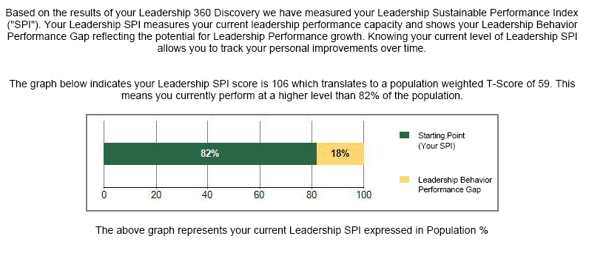
Your Leadership
Sustainable Performance Index

Slide 46
Leadership Performance Planning
The objective is to score a maximum of “7” in each of the 7 leadership areas
The report identifies your top 10 strengths (Section 2A) and struggle (Section 2B) areas
Your success in improving performance in the performance struggle areas will be influenced by how you manage your natural behavior (Section C)
Your Leadership Performance Struggles are items where you scored lowest in how others perceive your performance. Focus on:
  Self perception opportunities where the difference between what you think and others think is “2” or more
  Strengths development gaps where the difference between 7 and what others think is “2” or more
  However, gaps of “1” or more are worthy of discussion

Slide 47
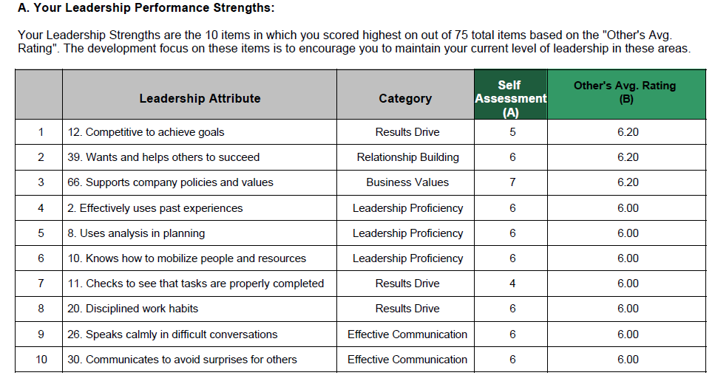
Leadership Performance Planning

Slide 48
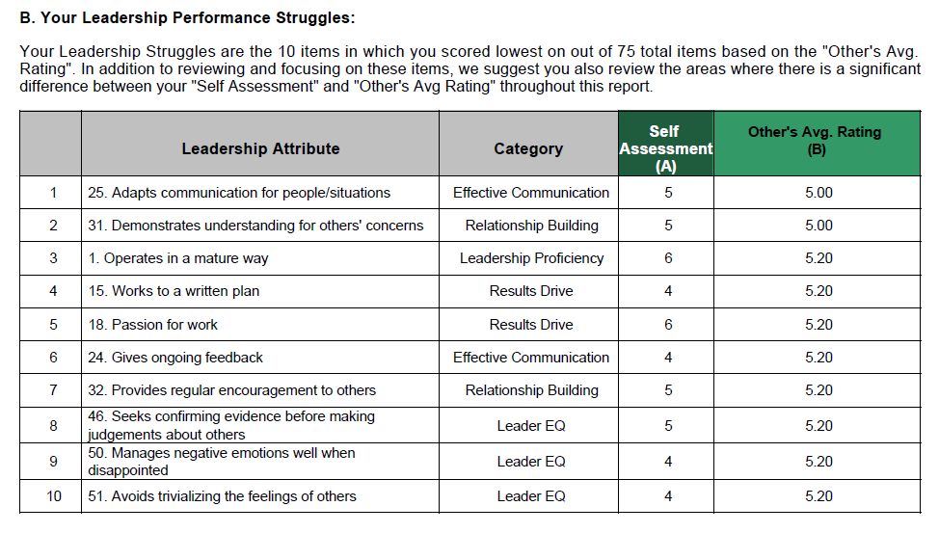
Leadership Performance Planning

Slide 49
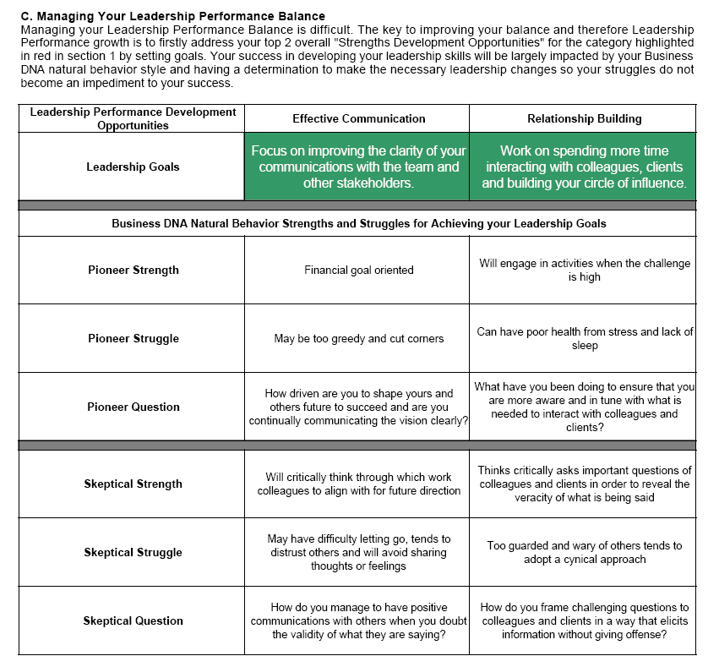
Leadership Performance Planning

Slide 50

Measuring Sustainable Leadership Performance
  Measuring a person’s current sustainable performance capacity and their areas of strength and struggles is a necessary starting place for building their Performance Plan for transformation.
  Personal and business performance progress can be monitored through measuring the “DNA Sustainable Performance Index”.
  The behavioral outputs from our Business DNA Discovery Systems provide the data for measuring the DNA Sustainable Performance Index.
Notes:
50
The focus of DNA Performance is to provide transformation for achieving optimal personal and business performance through behavioral insight to allow you to live a Quality Life and build higher revenues and profits.
Now it will help if I explain how I got to talking to you today:
Sydney 1999 – discover passion – aha moment
2000 - commence reinventing my business to wealth mentoring – charging a retainer fee
Wealth mentoring – central point for dealing with life and money issues – inter connection – trusted advisor - independent
Analyzed and observed importance of behavior – had theories about instinctive behavior on decisions - in May 2001 – had a life changing meeting with an experienced behavioral specialist who told me this was true – started building Financial DNA
2002 – held seminars to draw in clients
2004 - fully went into teaching other advisors – practically this mean’t helping them with personal and business transformation – a key issue to implementation is getting the business model right - we had been building tools for the business market on a parallel basis – deploy those for advisors as part of a structured program

Slide 51



DNA Leadership Sustainable Performance Model
Behavioral Discovery for Leadership Performance
To Identify:
Performance Potential
Behavioral Strengths
and Clarity which Drive Performance
Performance Pathway
Emotional Engagement of Others
Confidence
Wisdom
To Identify:
Performance Impediments
Measurement of Leadership Sustainable Performance Index
Behavioral Struggles
and Blind Spots which De-rail Performance
Foundation for DNA Leadership Performance Plan

Slide 52
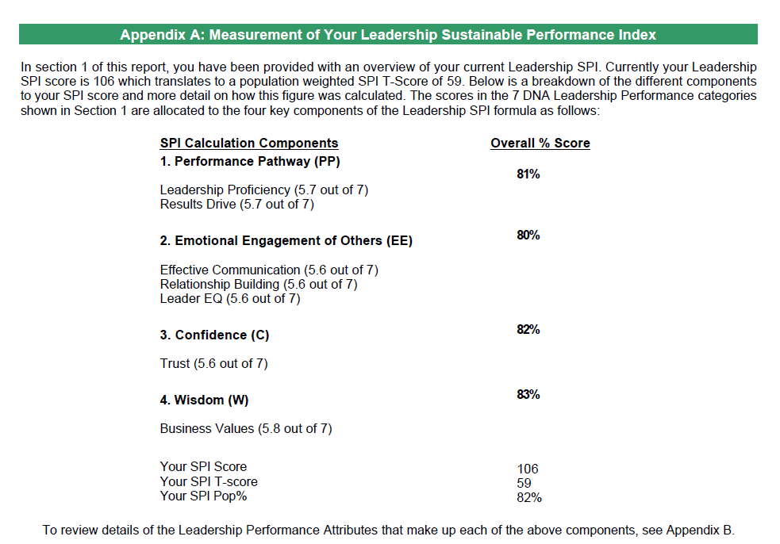
Measurement of Your Leadership
Sustainable Performance Index

Slide 53
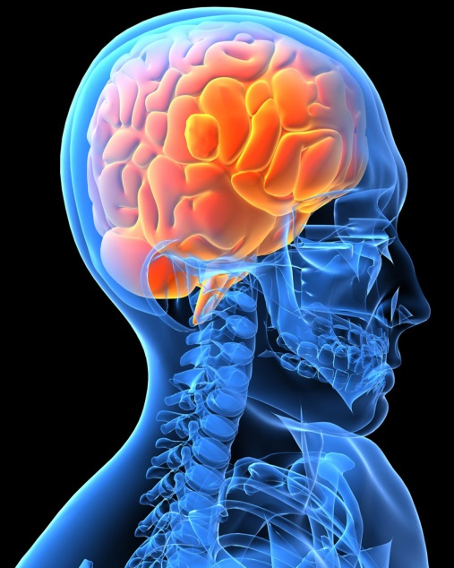

Communication
The DNA Behavior Solution
$
Communication DNA® is used to discover a person’s unique communication and learning style for the real time customization of sales, marketing and service activities to improve employee and client engagement for enhancing Relationship Performance.

Slide 54
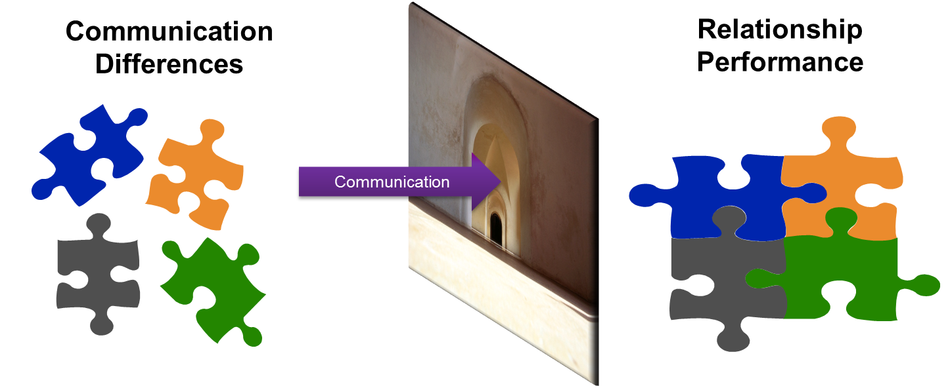
Communication
Drives Relationships
Poor Communication
Stress and Discomfort
Misunderstanding
Blockages
Poor Execution
Lack of Trust
Positive Communication
Situations Flow
Clarity
Decisions Get Made
Tasks Get Completed
Engagement

Slide 55
The Vision:
A Client Centered Business Built on Behavioral Matching
Team With Lack of Behavioral Insight
Behavioral Discovery to Know, Engage and Grow Every Employee and Client
Matching Employees and Clients for 4 in 4 Engagement
Goal Setting: Provide Discussion and Opportunities
?
Life Style: Provide Fun, Openness and Graphics
?
?
?
Stability: Provide Security, Feelings and Instructions
Information: Provide Analysis, Research and Details
Default Styles =1 in 4 Engagement
23% Revenue Uplift
Source: Gallup Organization 2009 and DNA Behavior Research 2001-2014

Slide 56
DNA Matrix
For Adapting Communication
Communication DNA Style | Goal-Setting | Lifestyle | Stability | Information
When working with Goal-Setting Communication DNA Styles | Minimal modification required: Present goals Focus returns Offer options | Some modification required: Move more quickly to the bottom line Minimize enthusiasm Recognize they may not enjoy small talk | Significant modification required: Be more direct Keep conversations formal Recognize they may come across as cold | Some modification required: Avoid unnecessary details Present the big picture Recognize they may be put off by too much detail too soon
When working with Lifestyle Communication DNA Styles | Some modification required: Provide graphics Explain how bottom line will impact lifestyle Recognize they may be bored with formal meetings | Minimal modification required: Invite to social events Set boundaries to keep focused Engage in small talk | Some modification required: Be more energetic Express emotion and allow them to express views Recognize they may focus on possibilities not certainties | Significant modification required: Be more interactive Avoid jumping into facts and research too soon Recognize they may lose focus if the lifestyle benefit is not clear
When working with Stability Communication DNA Styles | Significant modification required: Soften the tone Follow up regularly to ensure they are comfortable Recognize they may feel pressured if not given enough time and warmth | Some modification required: Speak more calmly Create a relaxed environment Recognize they may not enjoy impersonal environments | Minimal modification required: Offer feelings Express emotions and ask that they share theirs Provide instructions | Some modification required: Lighten up meetings Ask how they feel about the facts Recognize they may want a guarantee of security
When working with Information Communication DNA Styles | Some modification required: Have research available Demonstrate how risks are minimized Recognize they may need to retreat and think to make decisions | Significant modification required: Concentrate on being reliable Focus on being structured Recognize they may get irritated by imprecise communication | Some modification required: Provide action steps Focus more on facts than feelings Recognize they may appear to be unexpressive | Minimal modification required: Offer detailed research Ask if more information is needed Stay focused on the practical
56

Slide 57
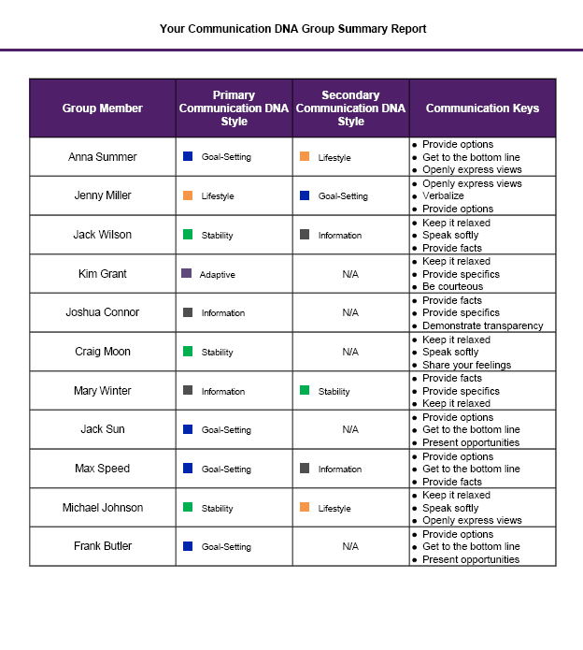
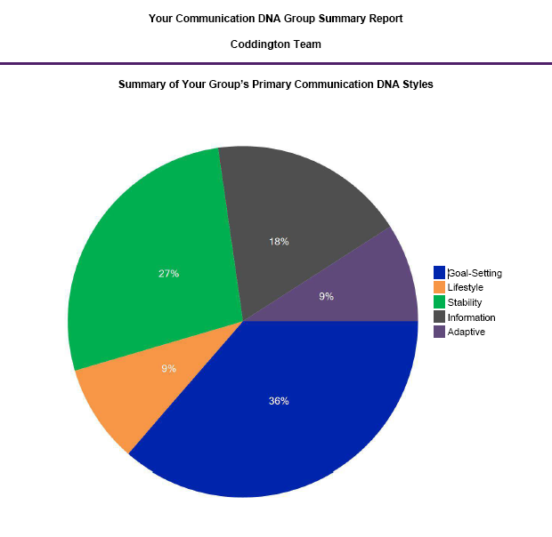
Communication DNA
Group Report
57

Slide 58
Meeting Meeting Preparation
Use of Communication DNA in Meeting Preparation
Simple two step process:
Review the clients Communication DNA Premium Report
  Look at the graph for strength of the scores
  Review their communication keys & learning style
  If you are struggling for a communication starter, one is provided
Review the DNA Unlocking Relationship Guide for the Meeting Tips (which are the same as the Customized Meeting Guide Report):
  Select the primary style of the client and review communication keys
  Think about the structure, style, and content of the meeting
  Tailor your style to suit the keys of each client
  Identify what questions would be appropriate for this client
  If you are meeting a couple, remember to address both equally (noting the decision maker / influencer can often be the quiet one)
58

Slide 59
First Break All the Rules
Build Up Your Teammates - Key Points:
Capitalize on differences (diversity) to build strong teams
By nature, differences divide
We need each other:
  Shared/complementary talents
  Teams need trust
  Trust leads to unity
Understand self
Understand others, and
  Accept
  Respect & Appreciate
  Align
  Trust
Seek to Meet Their Communication Style
Bottom line = Teamwork
Great managers offer this advice:
Focus on each person’s strengths and manage around their weaknesses… Help each person become more of who they already are. This radical insight is fueled by one simple insight: Each person is different.
What the world’s greatest managers do differently.
By Marcus Buckingham and Curt Coffman, 1999 by Simon & Schuster

Slide 60
The 6 Pillars of DNA Team Performance
1.Leader Review
For the Leader to Understand their Natural Leadership Talents to Build a Healthy Team and Identify the Team Issues for Increasing Revenues
2.Team Member Review
For Each Individual Team Member to Understand their Natural Talents for Performing their Role in the Team
3.Team Meeting
A Team Meeting to Align the Team for Greater Productivity to Achieve Team Goals
4. Team Relationships
Each Team Member to Learn How to Adapt their Communication to Engage and Interact With Others in the Team
5. Leader Coaching
For the Leader to Lead from the Front and Coach Each Team Member Based on their Unique Talents
6.Team Monitoring
Quarterly Team Reviews to Monitor Team Performance and Health
Notes:
60

Slide 61
ACCEPTANCE, UNITY & DIVERSITY
Necessary Ingredients of a Healthy Team
Same
Mission
Commitment
Corporate Values
Opportunity/Loyalty
Policies/Discipline
Different
Talents
Motivations
Ideas/Interests
Needs
Styles

Slide 62
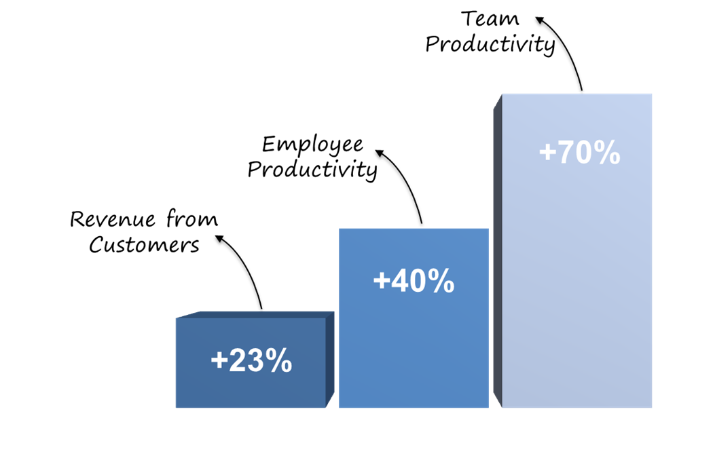
Team Performance
Benefits
Some Indicators of Employee Engagement:
Turn up on time and are reliable
Feel understood by their manager
Want to work for their manager
Follow the company plan
Ask questions when they need help
A Proven Methodology
Our experience and independent research shows this approach leads to improved employee productivity by up to 40% and team productivity by 70% and sustainable revenue growth by more than 23% a year.

Slide 63

Now is the time to capitalize on your strengths as a team
Notes:
As the industry becomes more complex, now is the time to capitalize on your strengths as a team and build a solid foundation for growth.

Slide 64
Examples of applied team performance
Once the behavioral awareness is developed in the team, we have specialized programs in the following areas:
Succession planning
Assimilating new leaders and team members
Scaling back office to support growth
Change management
Establishing goals and priorities

Slide 65
Behavioral Products
Resource Tour and Monthly Features
http://www.businessdna.com/products/
Blog: http://blog.dnabehavior.com/
Case Studies: http://www.businessdna.com/benefits/#2
Our focus here at DNA Behavior in 2017 is to identify the natural instinctive behavioral talents that are very stable over time. Most other tools focus on the other components of personality that are dynamic in different circumstances.
The natural behavior provides a reliable predictor of how a person will consistently perform over the longer term using their talents, make decisions with the least stress, respond to different life and work factors that change, and where they will “go to” under pressure.
Notes:
Make reference to:
Whitepapers and book
30 days trial – register on website

Slide 66
Business DNA® for Behavioral Insights
Using a Validated Psychometric Platform
A Tailor Made Suit for Every Client
Since 2001, we have been providing business services worldwide with a single cloud-based “HRTech” platform which delivers practical and scalable behavioral intelligence solutions to “Know, Engage and Grow” every manager, employee and client online for the building of a client-centered business which delivers high performance.

Slide 67
The Science
DNA Systems
Powerful and Unique Client Centered Behavioral Solutions Delivered in 123+ Countries and 11 Languages
Forced Choice Assessment Measuring 64 Behavioral Traits
60+ Man Years of Development Investment Since 2001
Independent Validation by Team with 100+ Years of Experience

Slide 68

Featured
Featured
The Behaviorally SMART Webinar Series
September’s Featured Webinar Series:
Becoming a Business DNA Performance Advisor
Thursday, September 28th @ 1 PM
https://register.gotowebinar.com/register/50470167765908226
Transforming the Business Consultant role - Becoming a Business DNA Performance Advisor
What is getting in the way of client-centered success? Unchecked behavioral responses driving decision making.
We will guide you on how to identify hiring process, team performance, and leadership development risks triggered by behavior (both yours and your client’s):
  Solve 87% of business issues, which are hidden as they are people related
  Improve employee productivity by up to 40% and team productivity by up to 70%
  Identify the 5% of employees who are potentially rogue, costing 5% of revenue losses per year
Notes:
Make reference to:
Whitepapers and book
30 days trial – register on website

Slide 69
Questions?
Contact Us
Questions?
Contact Us
For more information about DNA Behavior
Contact:
DNA Behavior International
5901-A Peachtree Dunwoody Rd, Suite 375
Atlanta, GA 30328
(866) 791-8992
Leon.morales@dnabehavior.com
http://www.businessdna.com/discovery-trial/
Read our Blog: http://blog.dnabehavior.com/
Please follow our groups:
- LinkedIn at Financial Personality Insights
- Twitter @FinancialDNA
  - Podcast: Leadership & Team Performance
  https://itunes.apple.com/us/podcast/behaviorally-smart-money-11-leadership-team-development/id1228688190?i=1000391087093&mt=2
Notes:
Make reference to:
Whitepapers and book
30 days trial – register on website

